Slide 1
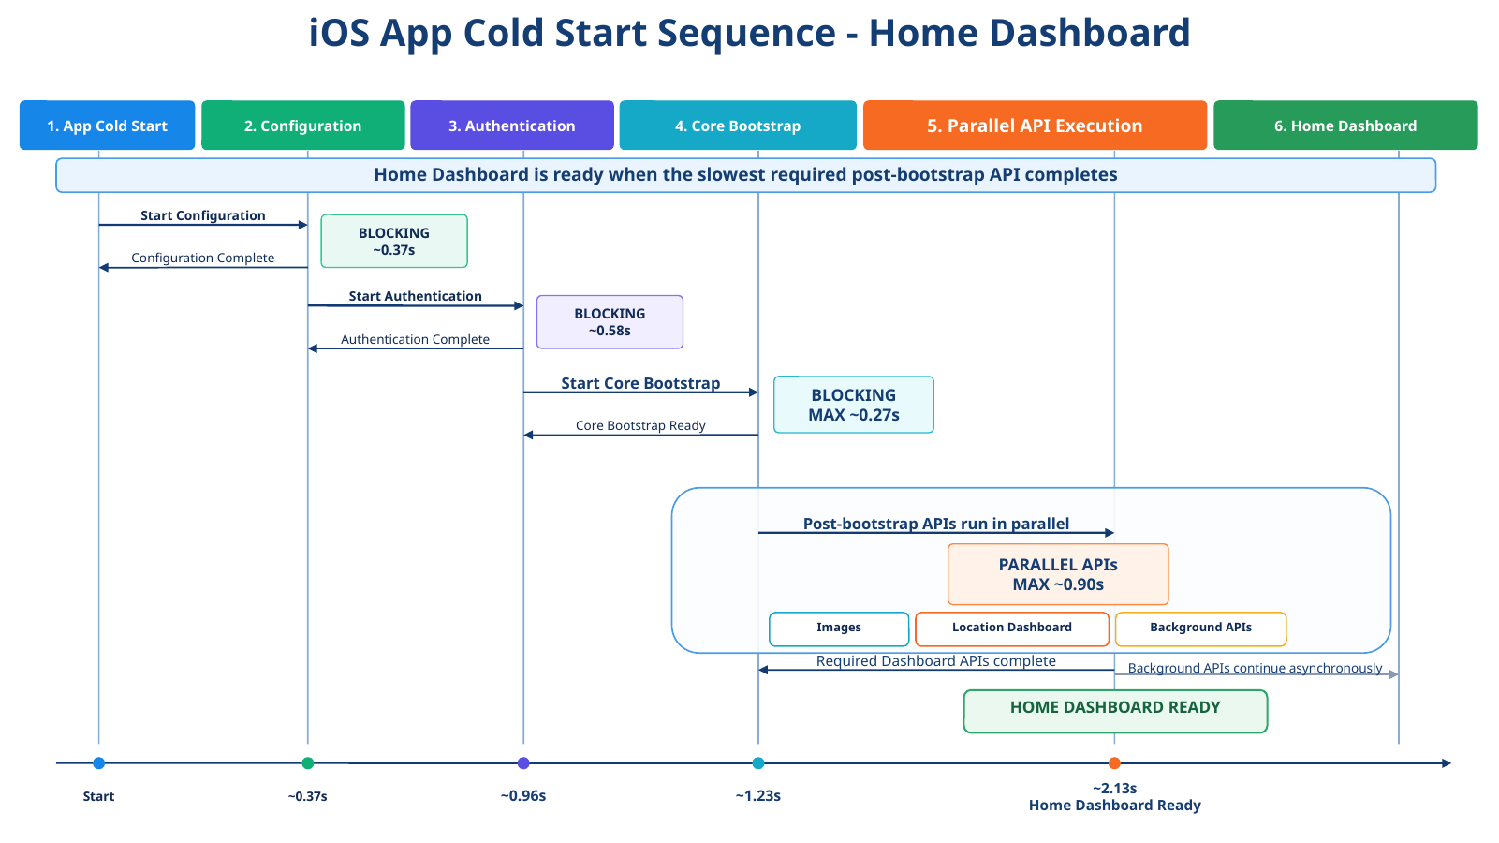
User Profiles
PubNub

Slide 2
