Slide 1
MARWADI UNIVERSITY
Department of CSE AI ML DS | Programming with Python | Course Code 01AP0303
PYTHON LEARNING HUB
A GUI-Based Python Learning Platform — Project Review Presentation
1
2
3
4
5
6
7
Fundamentals
Control Flow
Data
Structures
Files &
Exceptions
OOP
Database
APIs &
Automation
Student Name : Lakshmi Venkata Padmavathi Viswanadham , Pathuri Sindhura
Enrollment No : 92500122005, 92500116009
Faculty Guide : Prof. Mukthar sama
Academic Year : 2025-26

Slide 2
01 · THE CHALLENGE
Problem Statement & Objectives
OBJECTIVES
THE PROBLEM
1
Cover all 7 core Python areas in one GUI-based platform
Beginner Python learners lack a single, structured application that combines detailed theory, runnable examples, auto-graded quizzes, hands-on mini-apps, and visible progress tracking — forcing them to piece learning together from disconnected sources with no reliable way to measure real progress.
2
Pair every topic with theory, a code example, and a video link
3
Auto-grade quizzes per module and record every attempt
TARGET LEARNER
A first- or second-year engineering student, new to Python and structured programming, with basic computer literacy but little to no prior coding experience.
Track topic- and module-level progress persistently
4
5
Reward verified learning with auto-generated certificates
Marwadi University | Programming with Python | 01AP0303
2

Slide 3
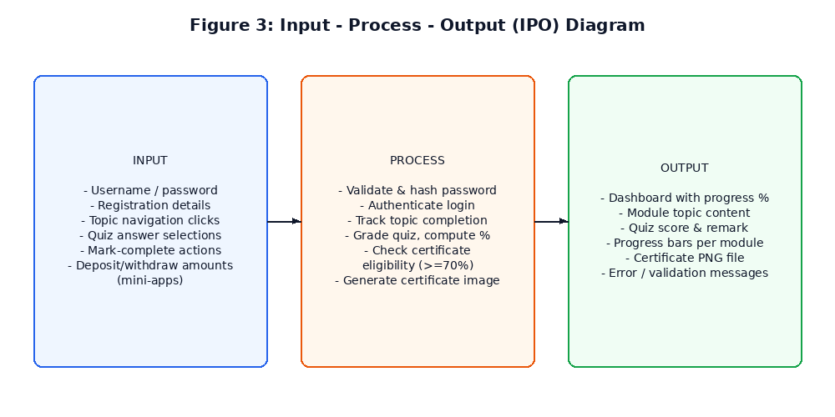
02 · ANALYSIS & DESIGN
Requirement Analysis & Proposed Solution
KEY FUNCTIONAL REQUIREMENTS
Secure registration & login (hashed passwords)
7 modules with theory, code, quiz, and mini-app
Auto-graded quizzes with persistent score history
Certificate issuance on verified completion (8 total: 7 module + 1 final)
Role-based access — dedicated Admin dashboard for all students
Input → Process → Output analysis of the platform
KEY NON-FUNCTIONAL REQUIREMENTS
Usable offline (core app needs no internet)
Reliable persistence via local SQLite database
Modular, maintainable file/package structure
Marwadi University | Programming with Python | 01AP0303
3

Slide 4
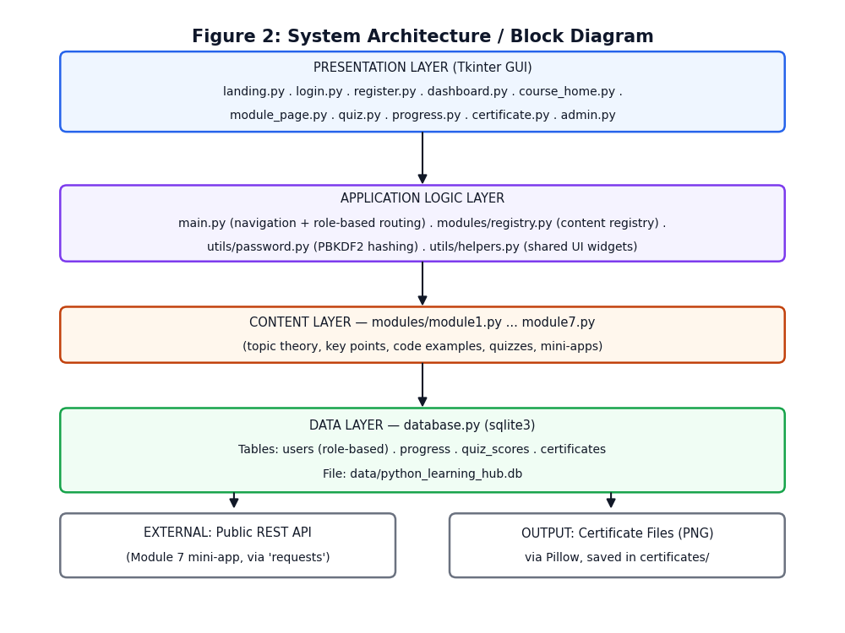
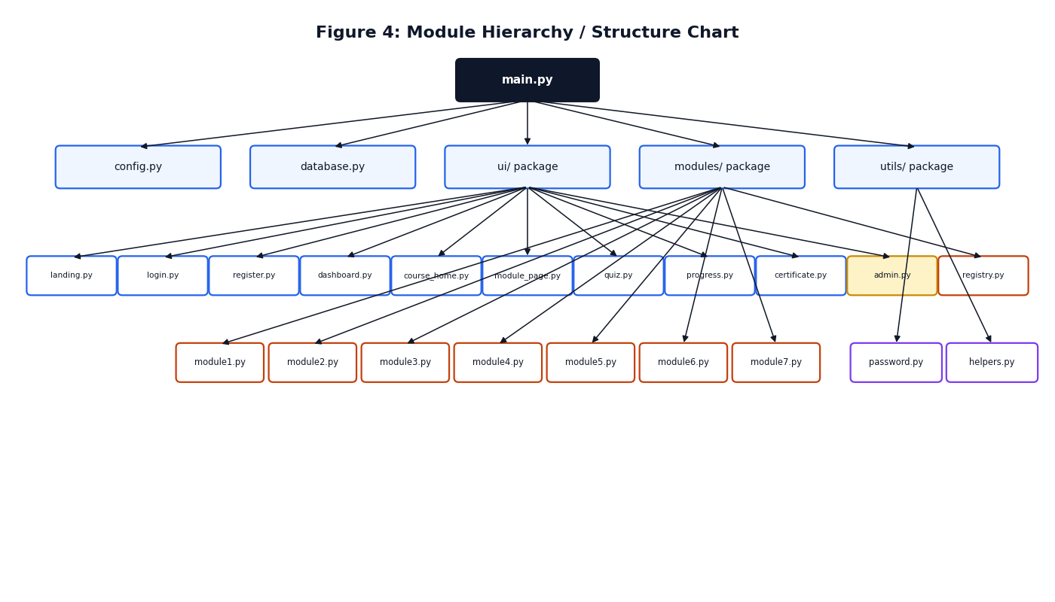
03 · SYSTEM DESIGN
Architecture & Module Structure
SYSTEM ARCHITECTURE
MODULE / FILE STRUCTURE
main.py coordinates config, database, and the ui/, modules/, utils/ packages
Marwadi University | Programming with Python | 01AP0303
4

Slide 5
04 · FOUNDATIONS
Python Concepts, Tools & Libraries
Control Flow
& Functions
Data
Structures
File & Exception
Handling
if/elif/else, loops, and reusable functions drive every screen's logic.
Lists, dicts, sets & tuples model module content and mini-app data.
Safe file I/O and try/except protect every risky operation.
Object-Oriented
Programming
Database
Connectivity
APIs
& JSON
Encapsulation, inheritance & polymorphism power the OOP mini-app.
Parameterised SQLite queries store users, progress, and scores.
A real REST GET request and JSON parsing in the Module 7 mini-app.
TOOLS & LIBRARIES
Python 3.12
Tkinter
SQLite 3
Pillow
requests
Pandas
Matplotlib
Marwadi University | Programming with Python | 01AP0303
5

Slide 6
05 · IMPLEMENTATION
Major Modules & Selected Code Logic
1
Python Fundamentals
SAMPLE LOGIC — CERTIFICATE ELIGIBILITY (ui/certificate.py)
10 topics
2
Control Flow & Functions
def is_module_eligible(user_id, module_id):
module = get_module(module_id)
completed = get_completed_topic_ids(
user_id, module_id)
all_done = len(completed) >= len(
module["topics"])
best = get_best_quiz_score(
user_id, module_id)
passed = bool(best and best[1] and
percent(best[0], best[1]) >= 70)
return all_done and passed
15 topics
3
Data Structures
13 topics
4
File & Exception Handling
12 topics
5
Object-Oriented Programming
13 topics
6
Database Connectivity
13 topics
7
API, Automation & Reporting
Result: a certificate unlocks only when every topic is complete AND the best quiz score is at least 70%.
13 topics
89 topics · 70 quiz questions · 7 mini-apps · 8 certificates — all working end to end
Marwadi University | Programming with Python | 01AP0303
6

Slide 7
06 · VERIFICATION
Testing & Error Handling
6 / 6
ID | Feature | Condition | Result
TC-01 | Registration (normal) | Valid data, matching passwords | ✓ Pass
TC-02 | Registration (boundary) | Password exactly 6 chars | ✓ Pass
TC-03 | Login (invalid) | Wrong password | ✓ Pass
TC-04 | Quiz scoring | Best-score tracking across attempts | ✓ Pass
TC-05 | Certificate issuance | Topics complete + quiz ≥70% | ✓ Pass
TC-06 | Final certificate gating | All 7 modules passed + final quiz ≥70% | ✓ Pass
TEST CASES PASSED
ERROR HANDLING APPROACH
Every database and file operation wrapped in try/except with specific exception types
Registration & login show clear, specific messages (e.g. “Incorrect password”) instead of raw errors
Duplicate certificate claims and invalid quiz submissions are rejected safely
Marwadi University | Programming with Python | 01AP0303
7

Slide 8
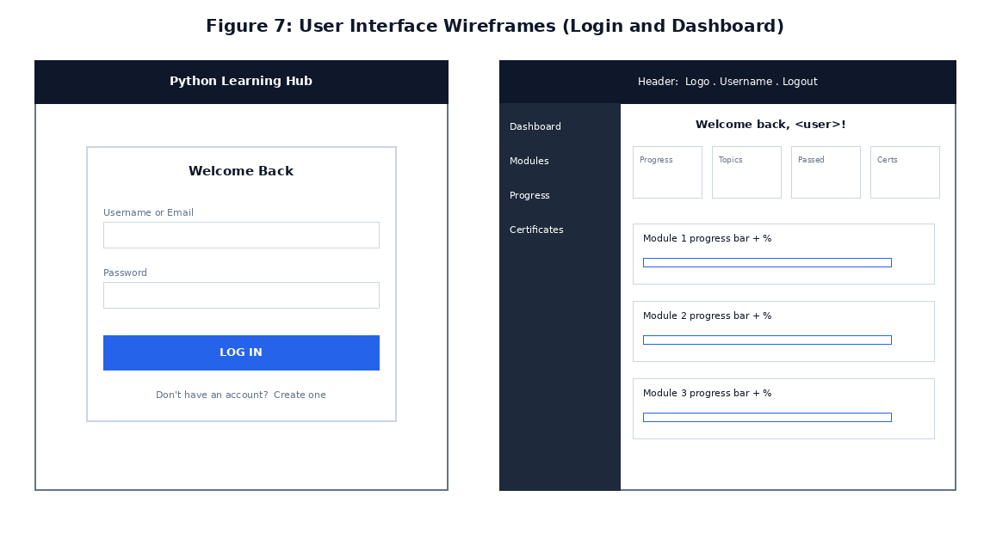
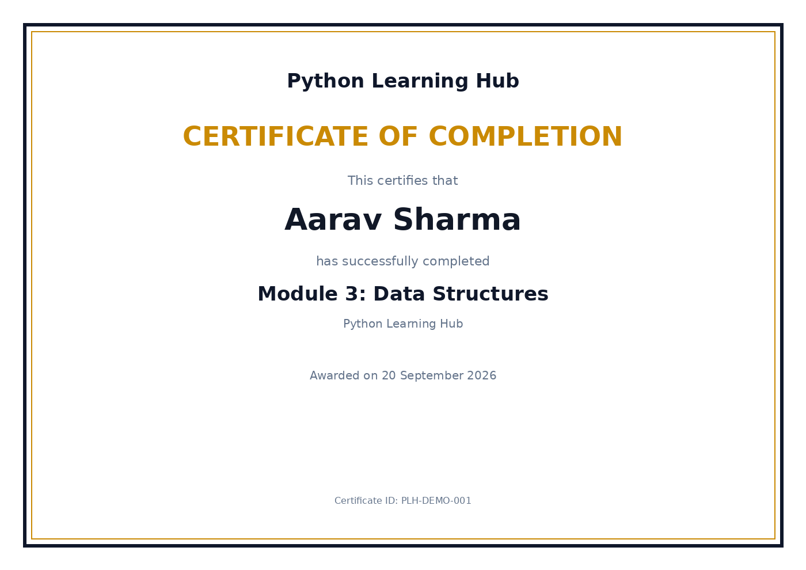
07 · LIVE DEMONSTRATION
Final Outputs & Demonstration
USER INTERFACE (Login & Dashboard)
SAMPLE OUTPUT — AUTO-GENERATED CERTIFICATE
LIVE DEMO
Run: python main.py — demo login: student / Student@123
Marwadi University | Programming with Python | 01AP0303
8

Slide 9
08 · WRAPPING UP
Conclusion, Limitations & Future Scope
Python Learning Hub successfully unifies structured theory, runnable code, auto-graded assessment, mini-applications, progress tracking, and verified certification within one Tkinter application — while itself demonstrating every concept it teaches.
LIMITATIONS
FUTURE SCOPE
Module 7 mini-app needs internet + 'requests'
In-app content management for instructors
Single-user desktop app, not multi-device
Migrate to a client-server database (multi-user)
No in-app content editor for instructors
Leaderboard & peer-comparison view
Standalone executable via PyInstaller
Marwadi University | Programming with Python | 01AP0303
9

Slide 10
09 · ACKNOWLEDGEMENTS
Learning Sources & References
Python Software Foundation - Python 3, tkinter, sqlite3 & hashlib official documentation
Pillow (PIL Fork) Documentation - certificate image generation
Requests: HTTP for Humans - REST API integration (Module 7)
Official Joke API - public REST endpoint used in the live API mini-app
Marwadi University Project Report Preparation Guideline, Course 01AP0303
AI-assisted development: Anthropic Claude supported architecture brainstorming, boilerplate UI code, and report drafting; all code was reviewed, tested, and understood by the student.
Thank You
Questions & Viva
Marwadi University | Programming with Python | 01AP0303
10

