Slide 1
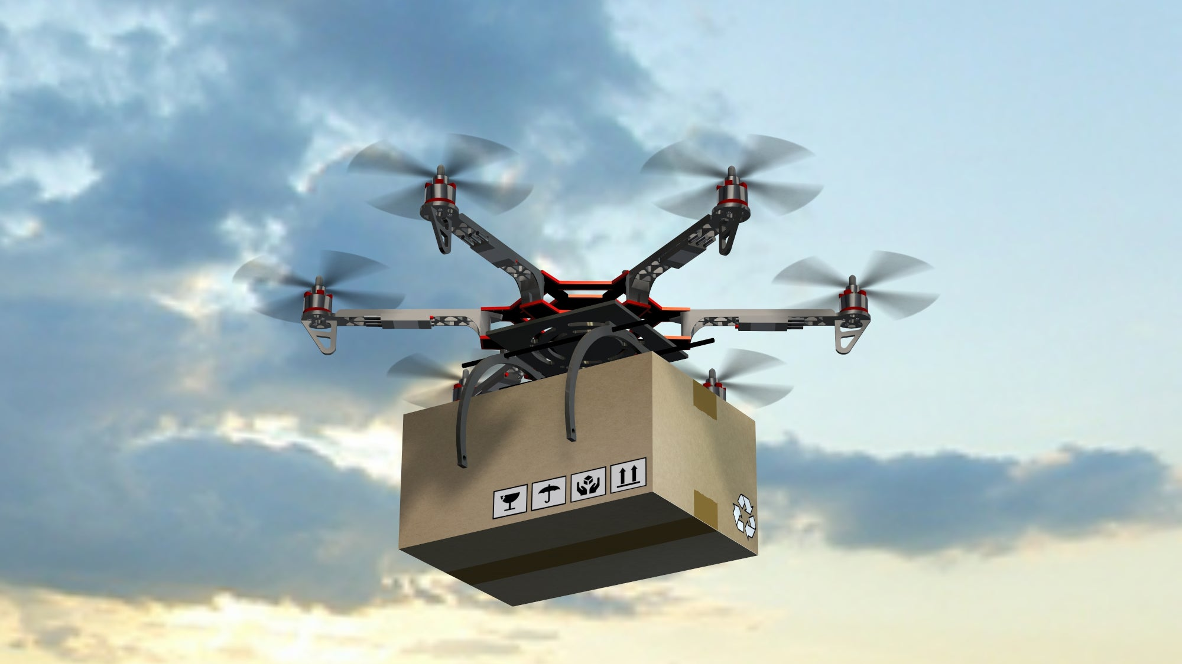
PEAS Framework in Artificial Intelligence
Case Study: Modern Autonomous Delivery Drones
Lakshvir Singh · PRN: 25UAM038 · CSE (AI & ML)
Introduction to Artificial Intelligence

Slide 2

FOUNDATION
What is an Intelligent Agent?
An intelligent agent is anything that perceives its environment through sensors, processes that information, and takes actions through actuators to achieve its goals efficiently.
Environment
Sensors
Provides context and stimuli for the agent.
Perceive environmental inputs and pass data onward.
Agent
Actuators
Processes perceptions and decides on actions.
Execute actions that affect the environment.
The agent continuously loops through this cycle — sensing, deciding, and acting — to navigate its world and accomplish its objectives.

Slide 3
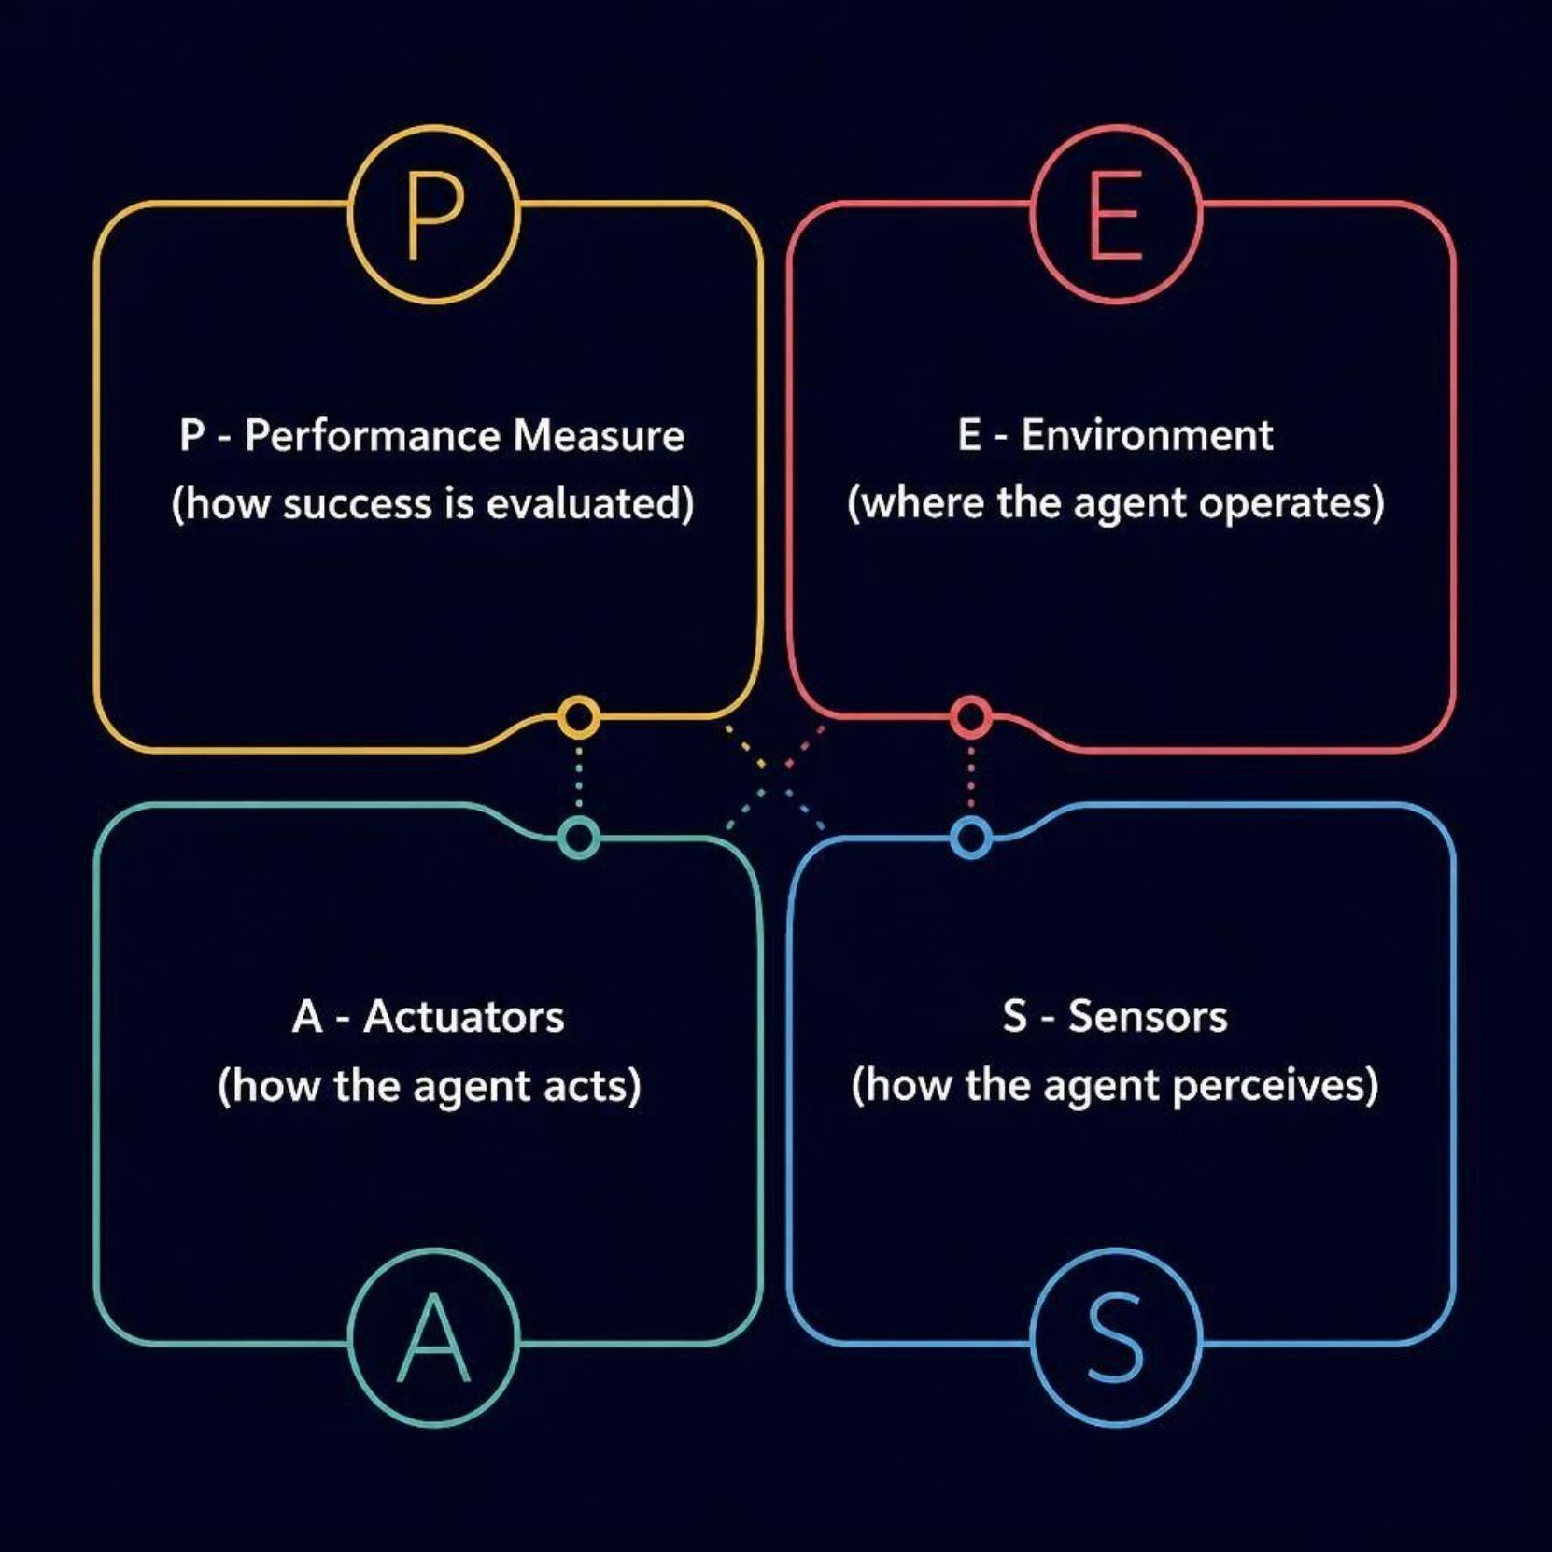
CORE CONCEPT
What is PEAS?
PEAS is a structured framework used to fully describe the task environment of an intelligent agent. It breaks down an AI system into four essential components.
P — Performance Measure
E — Environment
How the agent's success is evaluated
The world in which the agent operates
A — Actuators
S — Sensors
Mechanisms the agent uses to act
How the agent perceives its surroundings

Slide 4
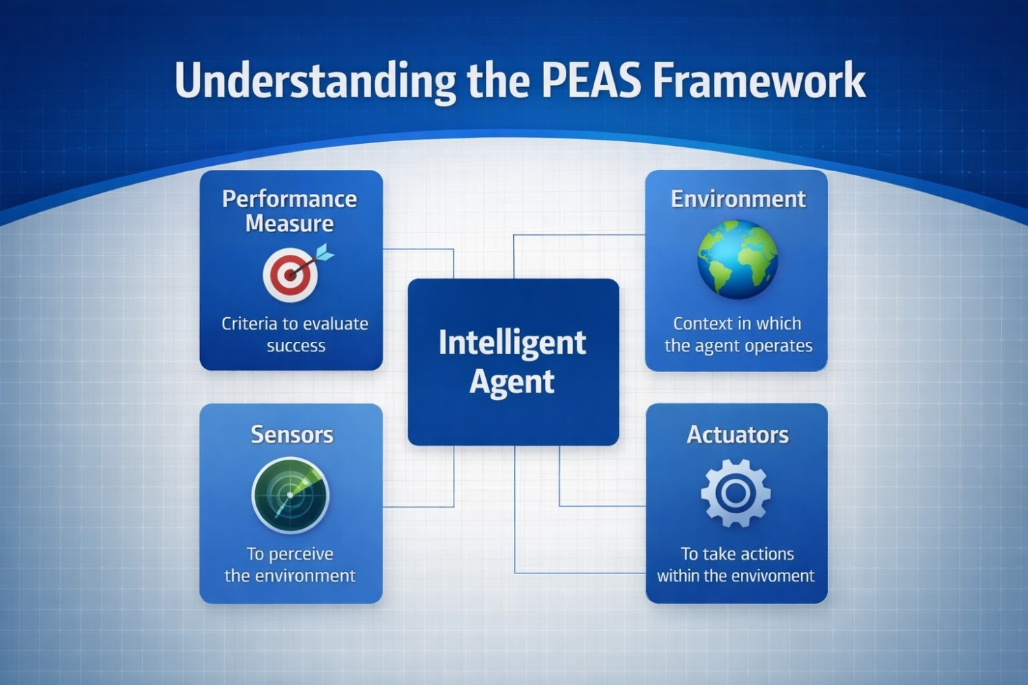
WHY PEAS MATTERS
Why PEAS Makes AI Design Systematic
Defines the Goal
Clarifies what the agent is trying to achieve and how success is measured.
Identifies the Environment
Specifies where and under what conditions the agent will operate.
Guides Sensor Selection
Determines what the agent needs to perceive to make good decisions.
Guides Actuator Design
Defines how the agent will physically interact with and change its environment.

Slide 5
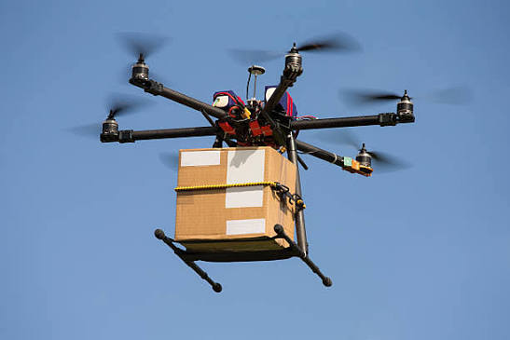
CASE STUDY
Modern Autonomous Delivery Drones
Delivery drones use AI, computer vision, and sensor fusion to transport packages from distribution centers directly to customers — navigating complex real-world environments with minimal human intervention.
📦 Package Transport
From warehouse to doorstep
🧠 AI Navigation
Real-time route planning
🚧 Obstacle Avoidance
Dynamic environment sensing
⚡ Energy Balance
Safety, speed & battery trade-offs

Slide 6

P — PERFORMANCE
Performance Measures of a Delivery Drone
A drone's success is evaluated across multiple dimensions — all must be optimized together.
Safe Delivery
Accuracy
Collision avoidance and safe landing
Deliver to the correct GPS location
Speed
Efficiency
Minimize delivery time
Optimize battery consumption
Package Integrity
Reliability
Keep contents safe and undamaged
Consistent operation under varied conditions
Good Performance = Safe + Accurate + Fast + Energy Efficient

Slide 7
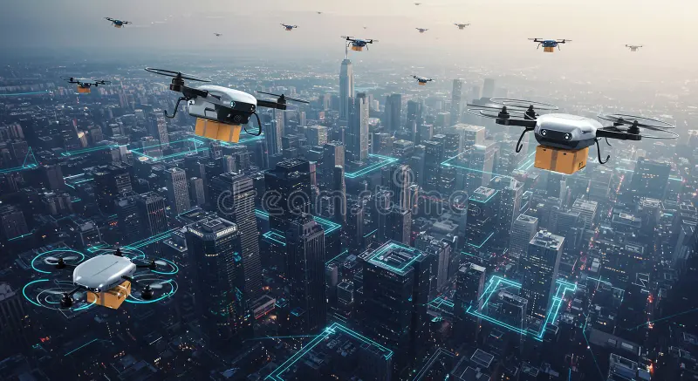
E — ENVIRONMENT
Environment of a Delivery Drone
Delivery drones operate in a dynamic, partially observable environment — conditions can change mid-flight, and the drone cannot perceive everything at once.
Physical Structures
Dynamic Obstacles
Buildings, houses, trees, power lines
Roads, vehicles, pedestrians, animals
Airspace
External Conditions
Other drones, aircraft, no-fly zones
Weather, GPS signal quality, lighting

Slide 8
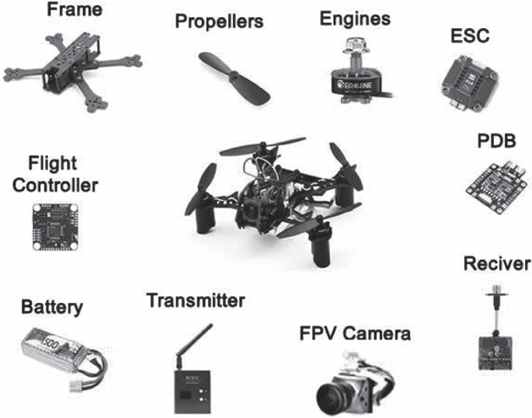
A — ACTUATORS
Actuators of a Delivery Drone
Actuators are the physical mechanisms that allow the drone to act on its environment — converting AI decisions into real-world movement and operations.
Propeller Motors
Control thrust, altitude, and movement
Flight Control System
Manages direction, stability, and orientation
Package Release
Securely drops the package at destination
Landing Mechanism
Supports controlled touchdown
Communication System
Sends status updates and alerts to base

Slide 9
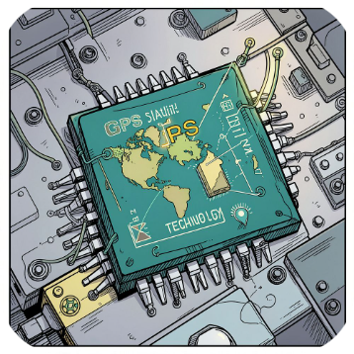

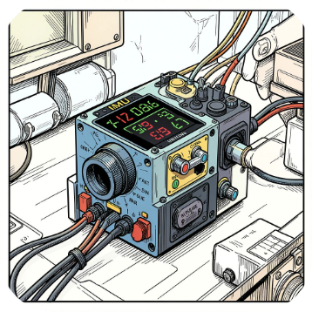
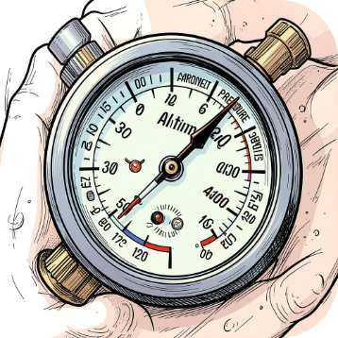
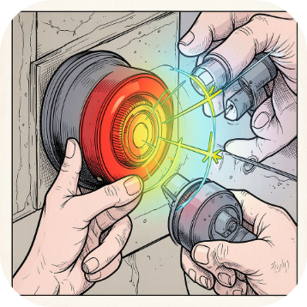
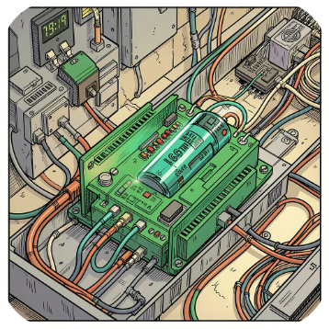
S — SENSORS
Sensors of a Delivery Drone
Sensors give the drone its situational awareness — enabling it to perceive position, obstacles, altitude, and system health in real time.
GPS
Cameras
IMU
Altimeter
Position tracking and global navigation
Visual perception and obstacle detection
Orientation, acceleration, and movement
Measures altitude above ground level
Proximity Sensors
Battery Sensors
Detect nearby objects and obstacles
Monitor charge level and battery health

Slide 10

SUMMARY
Complete PEAS Summary
PEAS Component | Modern Delivery Drone
Performance | Safe delivery, accuracy, speed, battery efficiency, package integrity
Environment | Buildings, roads, people, weather, obstacles, airspace, GPS conditions
Actuators | Propeller motors, flight controls, package release, landing mechanism, comms
Sensors | GPS, cameras, IMU, altimeter, proximity sensors, battery sensors
Sense
Process
Deliver
Act
The drone continuously repeats this loop during flight — sensing, processing, acting, and adapting in real time.
"PEAS helps us understand what an intelligent agent should achieve, where it operates, how it acts, and how it perceives."
References: Russell & Norvig, "Artificial Intelligence: A Modern Approach" (4th Ed.) · FAA UAS Guidelines · IEEE Robotics & Automation Society
Lakshvir Singh · PRN: 25UAM038 · CSE (AI & ML)

