Slide 1
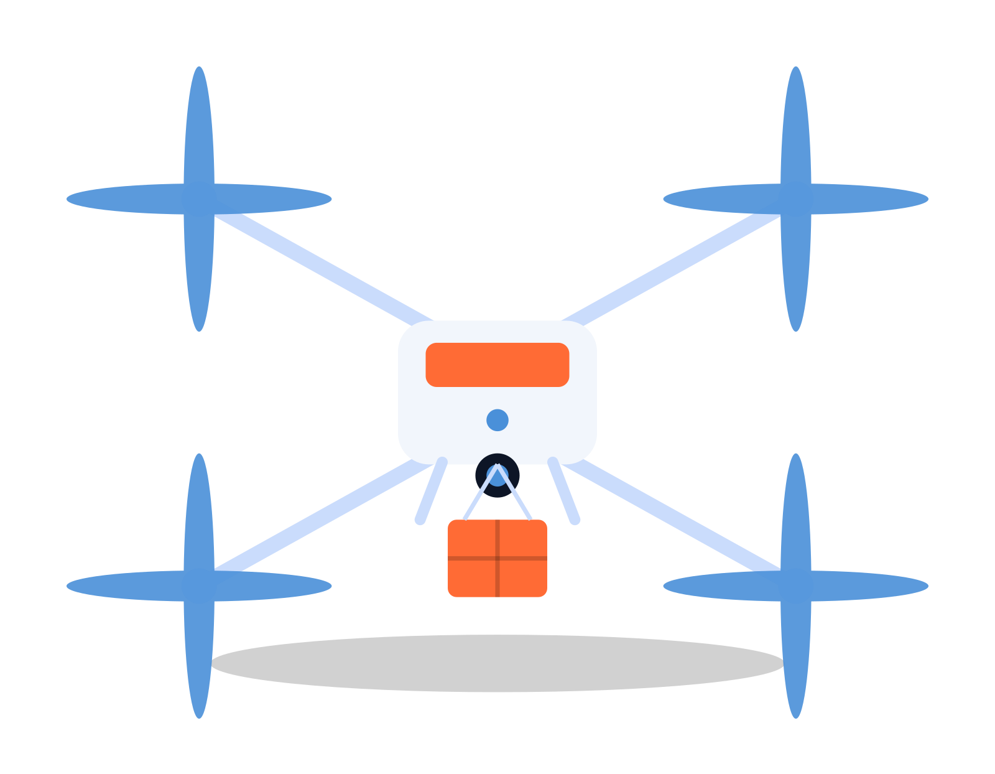
A FRAMEWORK FOR INTELLIGENT AGENTS
The PEAS Framework in AI
Performance measure • Environment • Actuators • Sensors
Explained through a real-world intelligent agent: the modern autonomous delivery drone.
Artificial Intelligence · Intelligent Agents

Slide 2




INTELLIGENT AGENTS
What is PEAS?
Before we can build a rational agent, we must describe its task environment. PEAS is the standard checklist AI designers use to do that — for every agent, ask what it should achieve, where it operates, how it acts, and how it perceives.
P — Performance Measure
The criteria used to judge success
E — Environment
The world the agent operates within
A — Actuators
RUNNING EXAMPLE
The mechanisms the agent acts through
The Modern Delivery Drone
S — Sensors
An autonomous quadcopter that picks up a package and flies it to a customer's doorstep — no human pilot required.
The inputs the agent perceives the world with
02

Slide 3




P
PEAS · DRONE EXAMPLE
The performance measure defines success for an agent — the objective an intelligent system is designed to optimize. A well-designed agent should never be told directly how to act; instead it is evaluated against this measure.
For the delivery drone:
Performance Measure
On-time delivery
Percentage of packages delivered within the promised time window.
How do we know the agent is doing a good job?
Energy efficiency
Battery usage minimized per trip to maximize range and reduce cost.
Safety of flight
Avoiding collisions with people, buildings, and other aircraft.
Delivery accuracy
Package placed intact at the correct address, undamaged.
03

Slide 4



E
PEAS · DRONE EXAMPLE
The environment is everything the agent perceives and acts upon — often partially observable, dynamic, and unpredictable. Understanding it shapes every design decision that follows.
For the delivery drone:
Environment
Open urban airspace
Streets, rooftops, trees, and power lines share the same low-altitude airspace.
What is the world the agent must operate in?
Weather conditions
Wind gusts, rain, and low visibility constantly change flight conditions.
No-fly zones & traffic
Restricted airspace, other drones, and birds must be tracked and avoided.
Dynamic obstacles
Pedestrians, vehicles, and pets move unpredictably near landing sites.
04

Slide 5


A
PEAS · DRONE EXAMPLE
Actuators are the mechanisms through which an agent executes actions and produces effects in its environment — turning a decision into physical motion.
For the delivery drone:
Actuators
Rotor motors
Four (or more) motors spin propellers to control lift, pitch, and yaw.
How does the agent act upon its environment?
Flight control surfaces
Adjusts motor speed differentials to steer, ascend, and hover precisely.
Package release mechanism
A winch or claw lowers and releases the parcel at the destination.
Landing gear
Extends and retracts for safe takeoff and touchdown.
05

Slide 6



S
PEAS · DRONE EXAMPLE
Sensors are the agent's inputs — the raw percepts it receives from the environment, which it must interpret to decide on rational actions.
For the delivery drone:
Sensors
GPS & IMU
Tracks precise location, altitude, orientation, and speed in real time.
How does the agent perceive its environment?
Cameras
Visual feed for landing-site recognition and visual obstacle detection.
LiDAR & ultrasonic sensors
Detect nearby obstacles like wires, branches, and walls at close range.
Barometer & wind sensors
Measure altitude changes and wind conditions to stabilize flight.
06

Slide 7
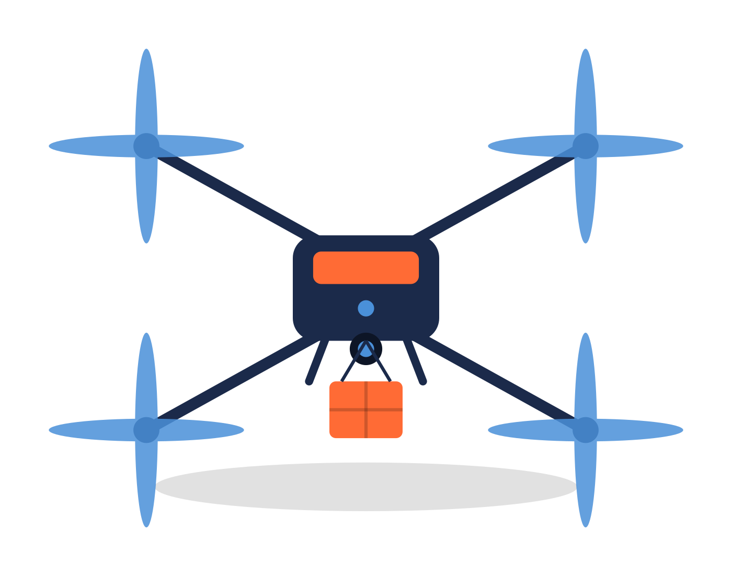
PUTTING IT ALL TOGETHER
PEAS Summary: The Delivery Drone Agent
A single, complete task-environment description for an autonomous delivery drone agent.
P
E
A
S
Performance Measure
Environment
Actuators
Sensors
Fast, safe, energy-efficient, damage-free deliveries
Urban airspace, weather, no-fly zones, moving obstacles
Rotor motors, flight controls, package-release winch
GPS/IMU, cameras, LiDAR, barometer, wind sensors
Agent type: Goal-based, reflex-augmented, partially observable, multi-agent environment
07

Slide 8
WHY PEAS MATTERS
A Better Design Starts With a Better Definition
PEAS forces designers to precisely scope an agent's goals before writing a single line of behavior.
It reveals environment properties (observability, dynamics, number of agents) that determine which AI techniques will work.
It applies to every intelligent agent — from a delivery drone to a self-driving car or a chess program.
“An agent is rational if it does the right thing — as defined by the performance measure.”
08

