Slide 1
JOB RECOMMENDATION SYSTEM
ABOUT THE CODE

Slide 2
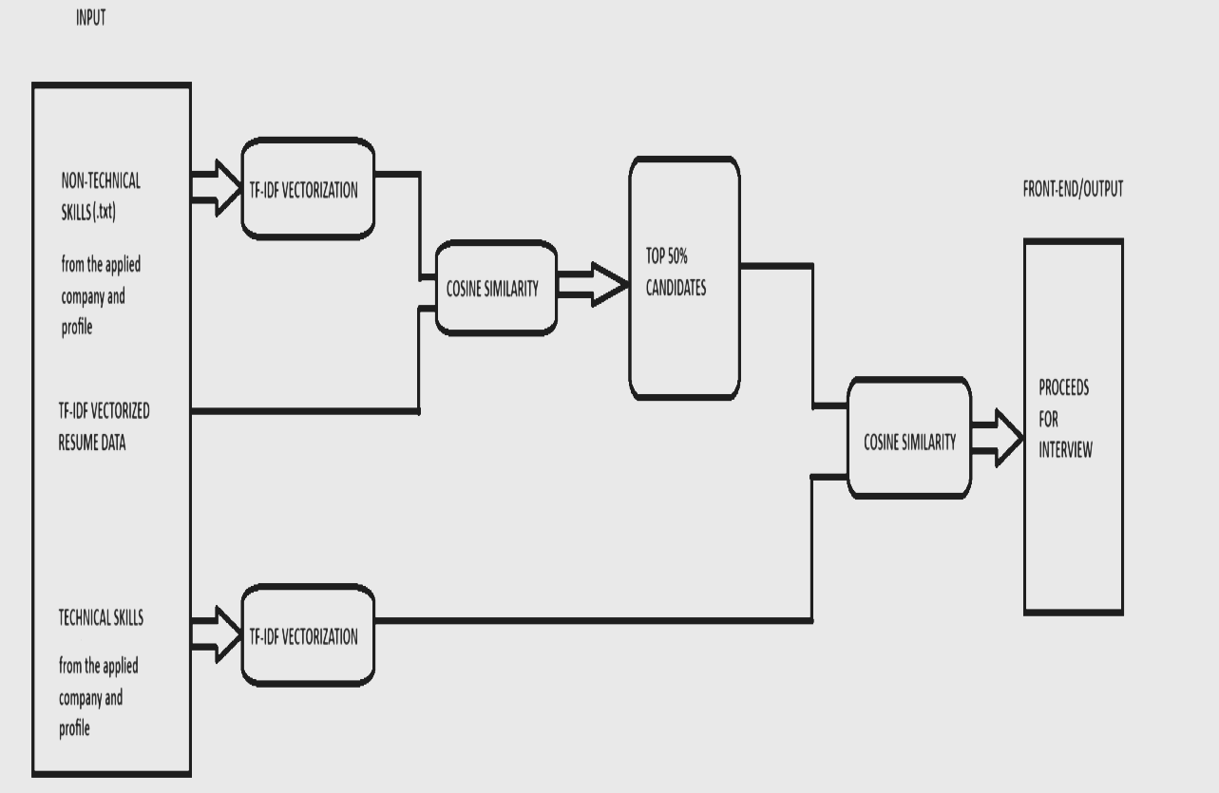
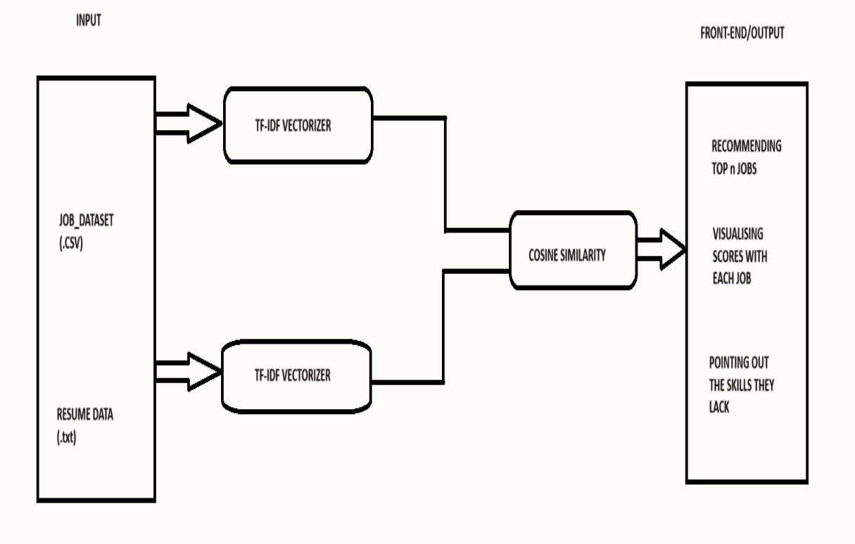
ARCHITECTURE
CANDIDATE
RECOMMENDATION
ARCHITECTURE
JOB RECOMMENDATION
ARCHITECTURE

Slide 3
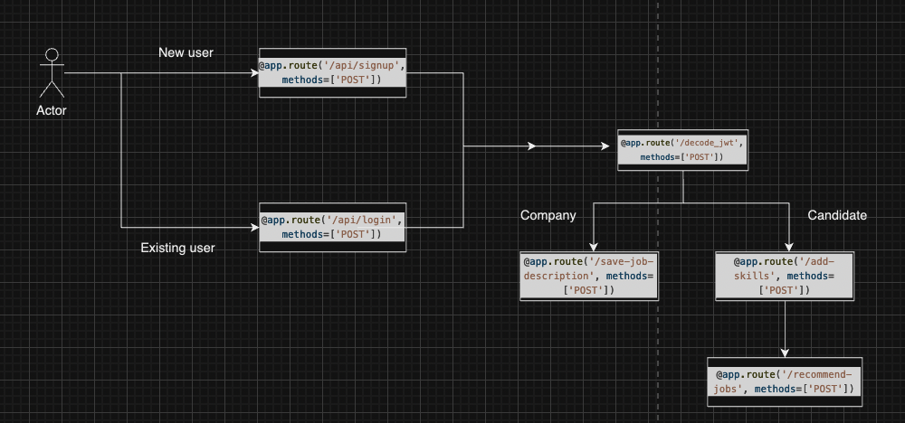
FRONTEND & ITS TECHSTACK
The frontend works on a simple create-react-app boiler plate code. Code written in JSX.
To implement the multi page site, have used the Route class in react-router-dom package.
The above flow shows the broad flow in the site.

Slide 4
FRONTEND …..
Web Framework:
Flask is chosen for building the web server due to the Proof of concept using python, specifically a .ipynb script.
MongoDB Integration:
Flask-PyMongo simplifies the integration of Flask with MongoDB, enabling seamless database operations.
We push new companies and candidates in their corresponding collections, also do note, that we have taken a pre existing database from kaggle and other resources.
JWT Authentication:
Flask provides a straightforward way to implement user authentication using JWT tokens, used to maintain and segregate user sessions. This prevents a user simply modifying the url to switch as a different user, in this case it is not so sensitive, but is a good practice to maintain JWT tokens when implementing login/signup functionality.
Job Recommendation Integration:
We have created a function named as similar_jobs which works to recommend jobs, provides a document of 10 jobs. We then return this to the client side to be presented.
Description to the above is given in a different section.

Slide 5
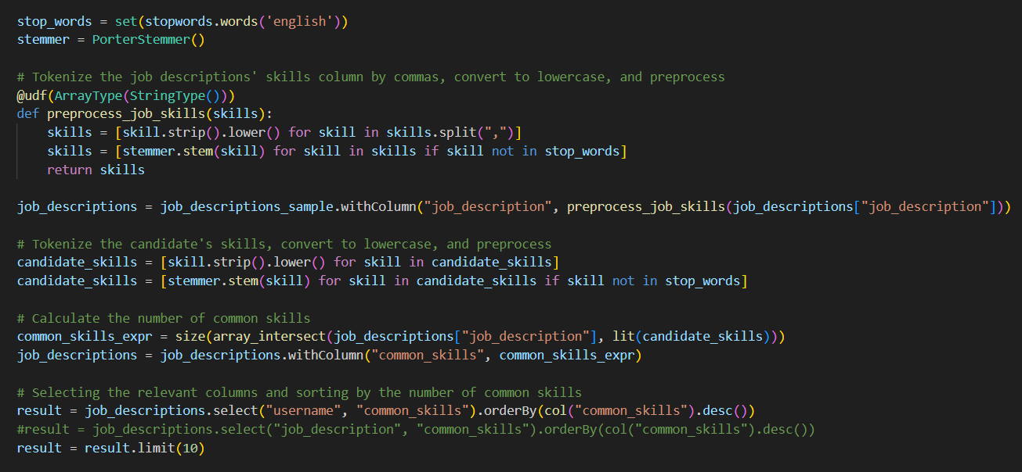
BACKEND & ITS TECHSTACK
DATA PRE-PROCESSING-
Stop words and Porter Stemmer from NLTK : Dimensionality Reduction of data

Slide 6
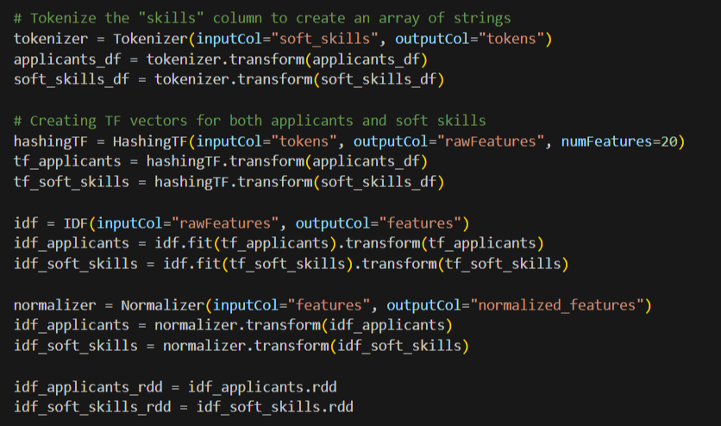
BACKEND….
CALCULATING SIMILARITY -
TF-IDF - Tokenizing words and storing only the relevant ones

Slide 7
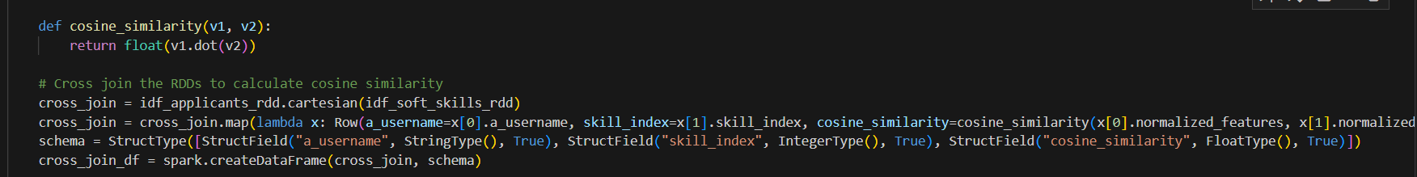
BACKEND….
Cosine-similarity - To find similarity between two words (after vectorizing them - TF-IDF)
DATASET
More than 1 million rows
23 columns for detailed information
Job Dataset -> imported from kaggle

Slide 8
WHY PYSPARK?...
Performance: Spark runs 100 times faster in- memory, and 10 times faster on disk. If Spark runs on YARN with other resources demanding services, there could be major degradation
Fault tolerance: Spark uses Resilient Distributed Datasets (RDDs), which are fault- tolerant collections of elements that can be operated on in parallel
Data processing: Sparks performs batch, real-time, and graph processing of data. It reads data from the cluster, performs its operation on the data, and then writes it back to the cluster
Machine learning: Spark has a built-in machine learning library that can be used for classification, and regression. It can also build machine-learning pipelines with hyperparameter tuning
SQL : PySpark provides powerful SQL capabilities through its DataFrame API, allowing users to leverage SQL queries directly on distributed datasets, enabling efficient data manipulation and analysis within the Spark ecosystem.

Slide 9
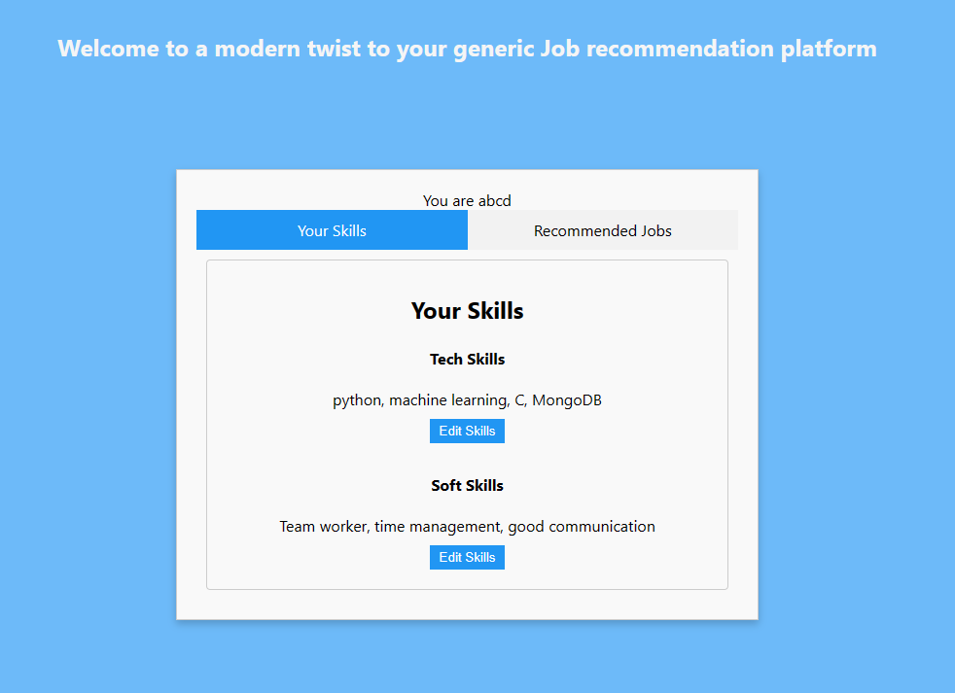
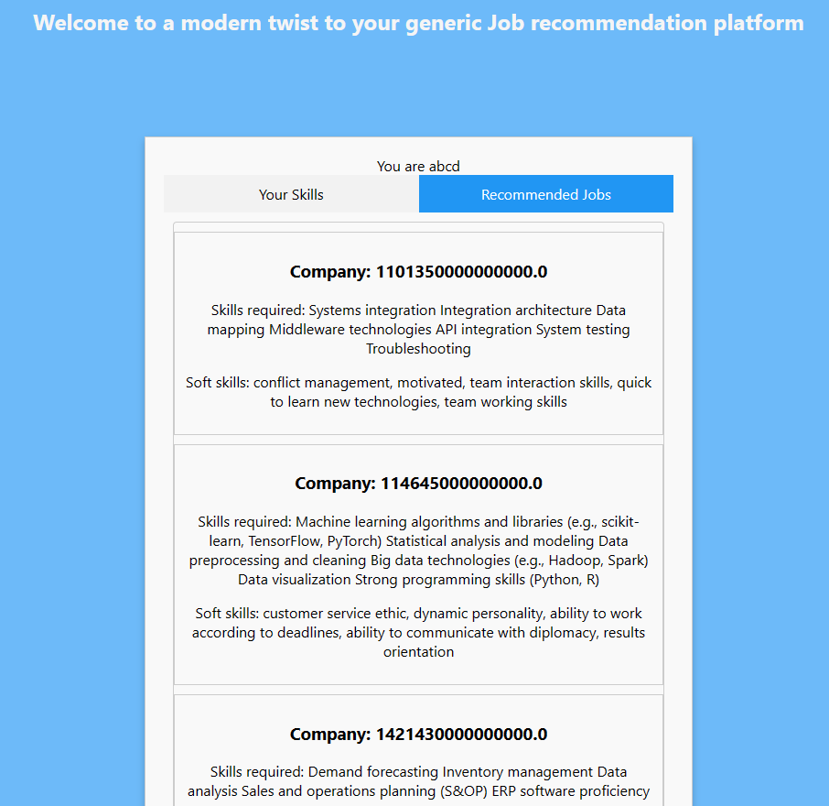
RESULTS
INPUT taken from
candidate - abcd
OUTPUT showing suitable
Jobs for candidate - abcd

Slide 10
THANKYOU

