Slide 1
SOCIAL SIM
A SOCIAL MEDIA SIMULATOR

Slide 2
How did it start?
One day I was listening to news about social media accounts being used to manipulate election results in America. So I thought whether recommendation algorithms can be used directly to manipulate the results.

Slide 3
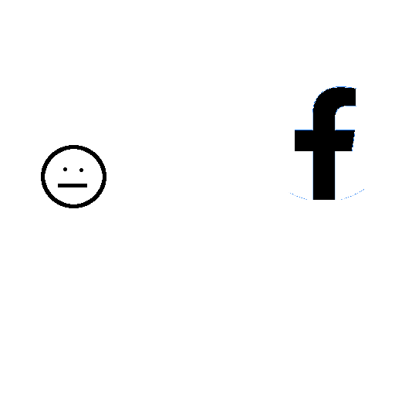
Come on, give me your software
NO

Slide 4
Computational perspective
The problem with probing such an issue is that I could not get just access the software used by social media apps.
So I decided to simulate a small scale version of a social media network.

Slide 5
What is it
Suppose a social media platform like twitter. This framework is able to simulate a simplified version of that using virtual agents. The parts that it simulates are posting, recommendation algorithms and viewer engagement.

Slide 6
Structure of the simulation
It uses a group of independent agents, which represent people on a social network to run the simulation.
Each agent has a state which is an opinion value between -1 and 1. It is used to represent any abstract opinion, such as likeness towards a product or support for a sports team.

Slide 7
Recommendation Algorithms
The agents create posts in the simulation which are recommended to other agents using a recommendation algorithm. The recommendation algorithm is modular so that any type of recommendation algorithm can be used.

Slide 8
What is the purpose of this?
I made this because I wanted to find out what effects recommendation algorithms can have on large scale opinion. But this can be used for simulation of all kinds of scenarios and testing different algorithms.

Slide 9
Working of the Simulation
It works in discrete steps.
Each step the state of all agents evolves according to some preset rules.
The state of an agents consists of

Slide 10

BUT WHAT IS THE ANSWER? DID YOU FIND OUT?

Slide 11
So what is the answer?
Do algorithms affect the large scale opinion of people?
The current answer that I have found out is that..

Slide 12
I don’t know

Slide 13
Reasons for not knowing
There are multiple reasons for the uncertainty in my result.
One is that the simulation platform that I have made is still not very polished. The algorithms have certain problems that have not been solved yet.

Slide 14
But not all hope is lost
The simulation program is still capable of simulating a lot of scenarios.
This capability can be used by researchers or algorithm developers to test out ideas without testing in a real social media app.

Slide 15
SERVER
RECOMMENDATION ALGORITHM

Slide 16
I used this testing framework to test multiple different types of recommendation algorithms.

Slide 17
SERVER

