Slide 1
CampusFlow
Smart Campus Companion & Service Request Management System
Name: LAKSHYA JAIN
Registration No.: CL20260703011709337
Batch: TECFJ 01
Program:— Java Full-Stack
Frontend Stack: React + Vite, JSX, CSS Variables
Backend Stack: Java + Spring Boot REST APIs
Database: MongoDB (Spring Data Repositories)
1. Student Workspace
Empowers students with role-specific views for enrolled courses, upcoming assignments, campus timetable, notices, and direct service request submission with live status tracking (#Pending, #Resolved, #Declined).
2. Faculty Workspace
Dedicated portal for instructors to oversee teaching schedules, department notices, university events, assignments distribution, and report infrastructure/IT concerns seamlessly.
3. Administrator Control Panel
Central command console enabling administration to triage and update campus service requests, monitor operational pulse, and oversee registered student and faculty user accounts.

Slide 2
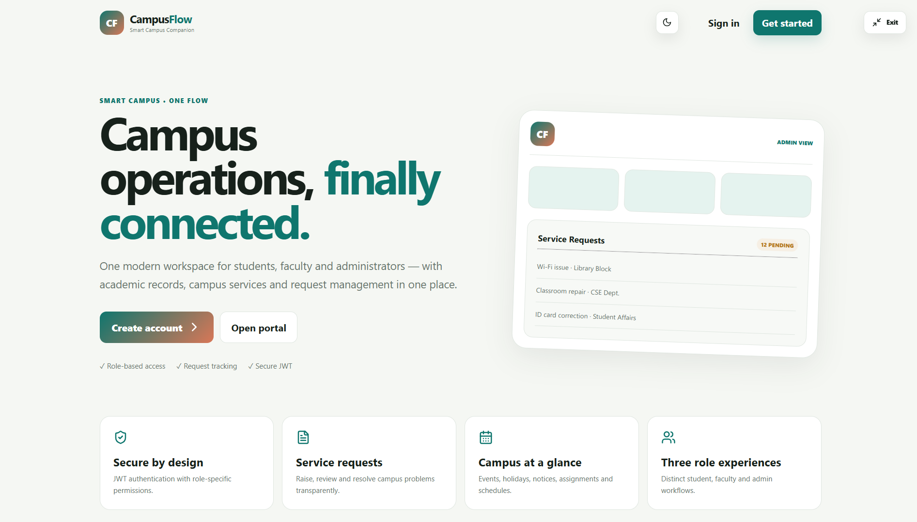
Landing Page — CampusFlow Main Portal & Entry

Slide 3
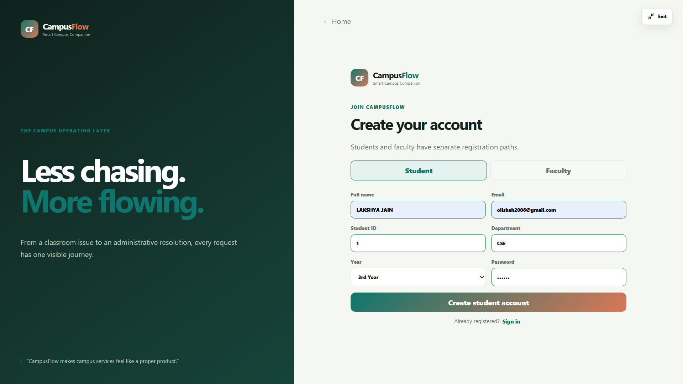
Authentication — Student Registration Portal

Slide 4
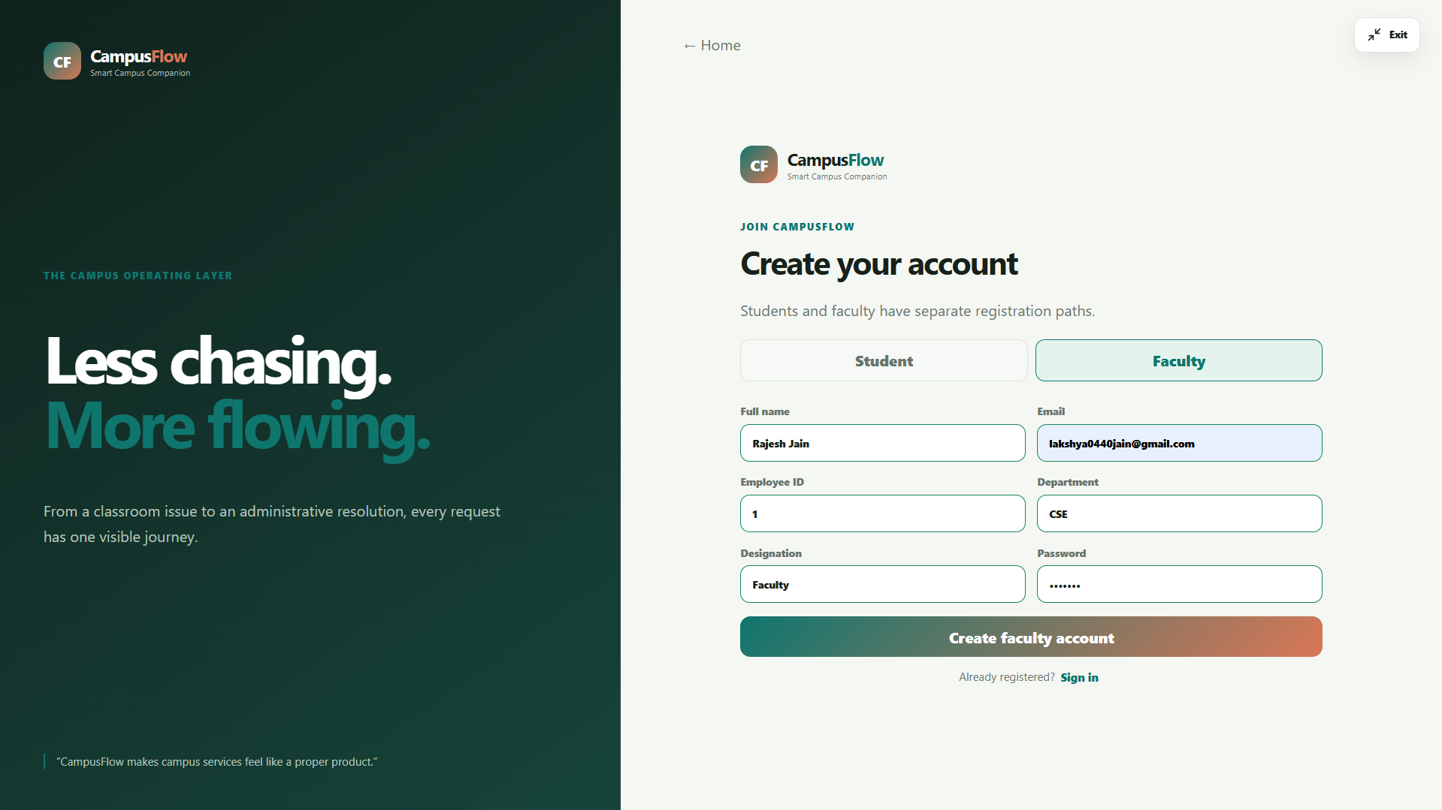
Authentication — Faculty Registration Portal

Slide 5
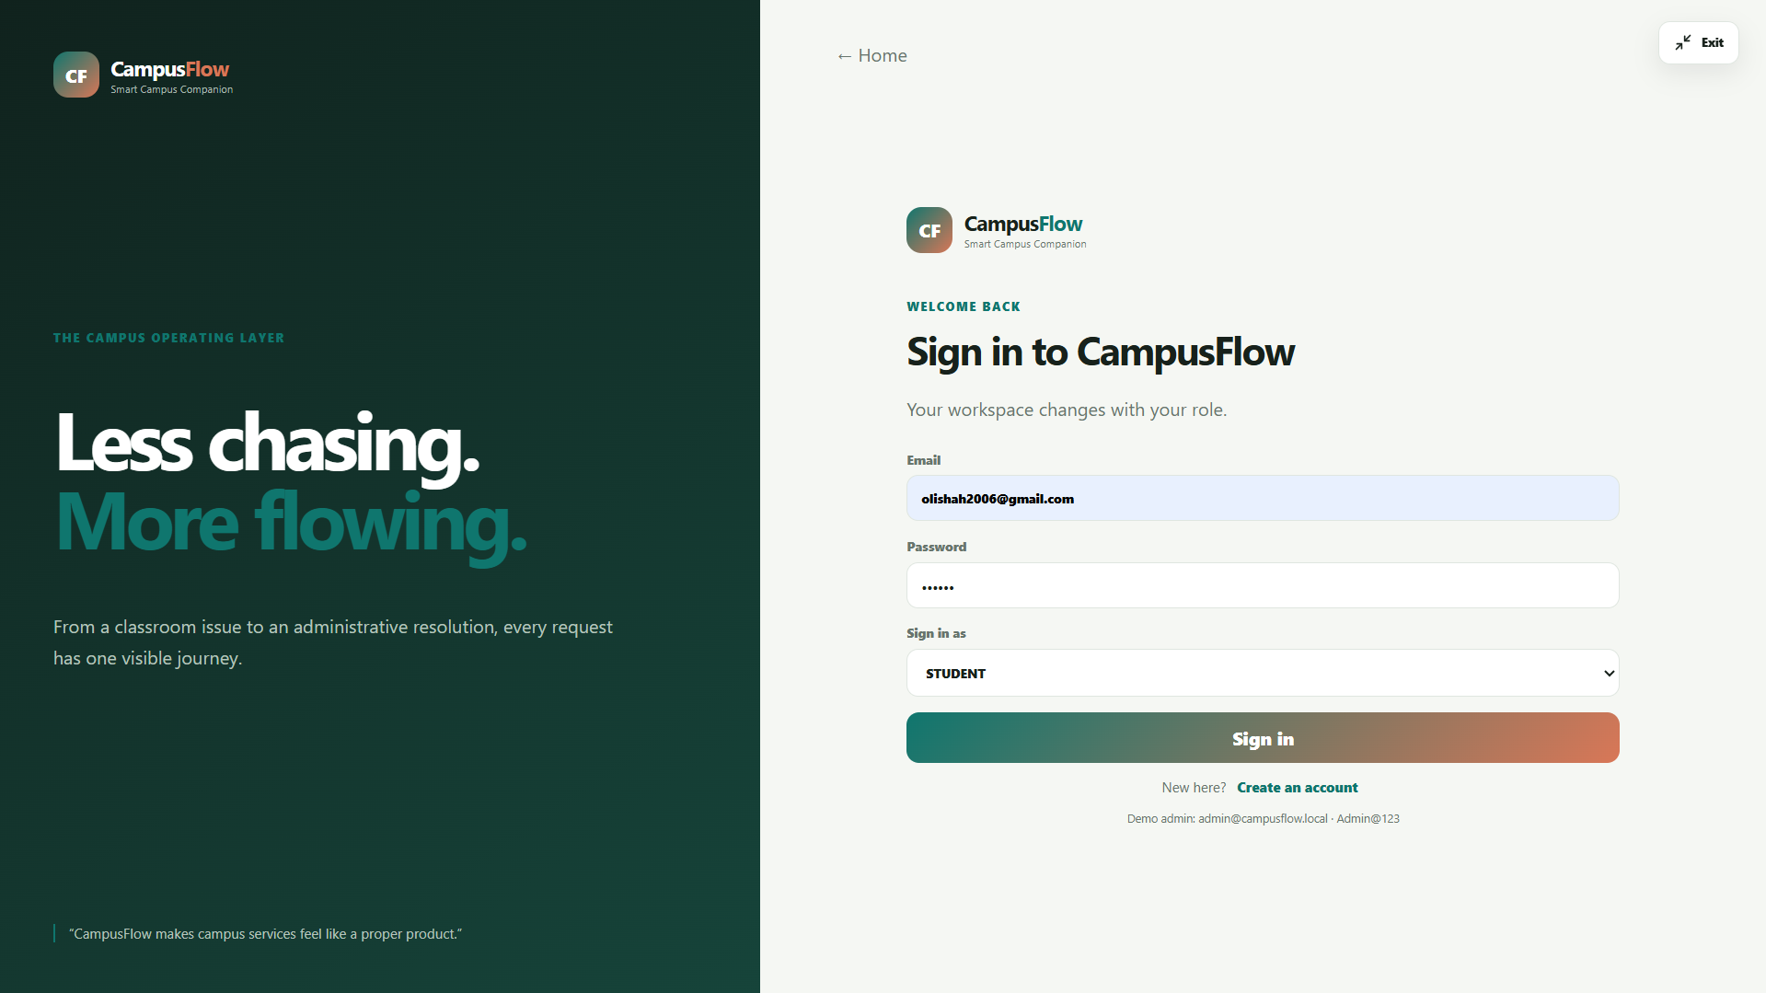
Authentication — Role-Based Secure Login

Slide 6
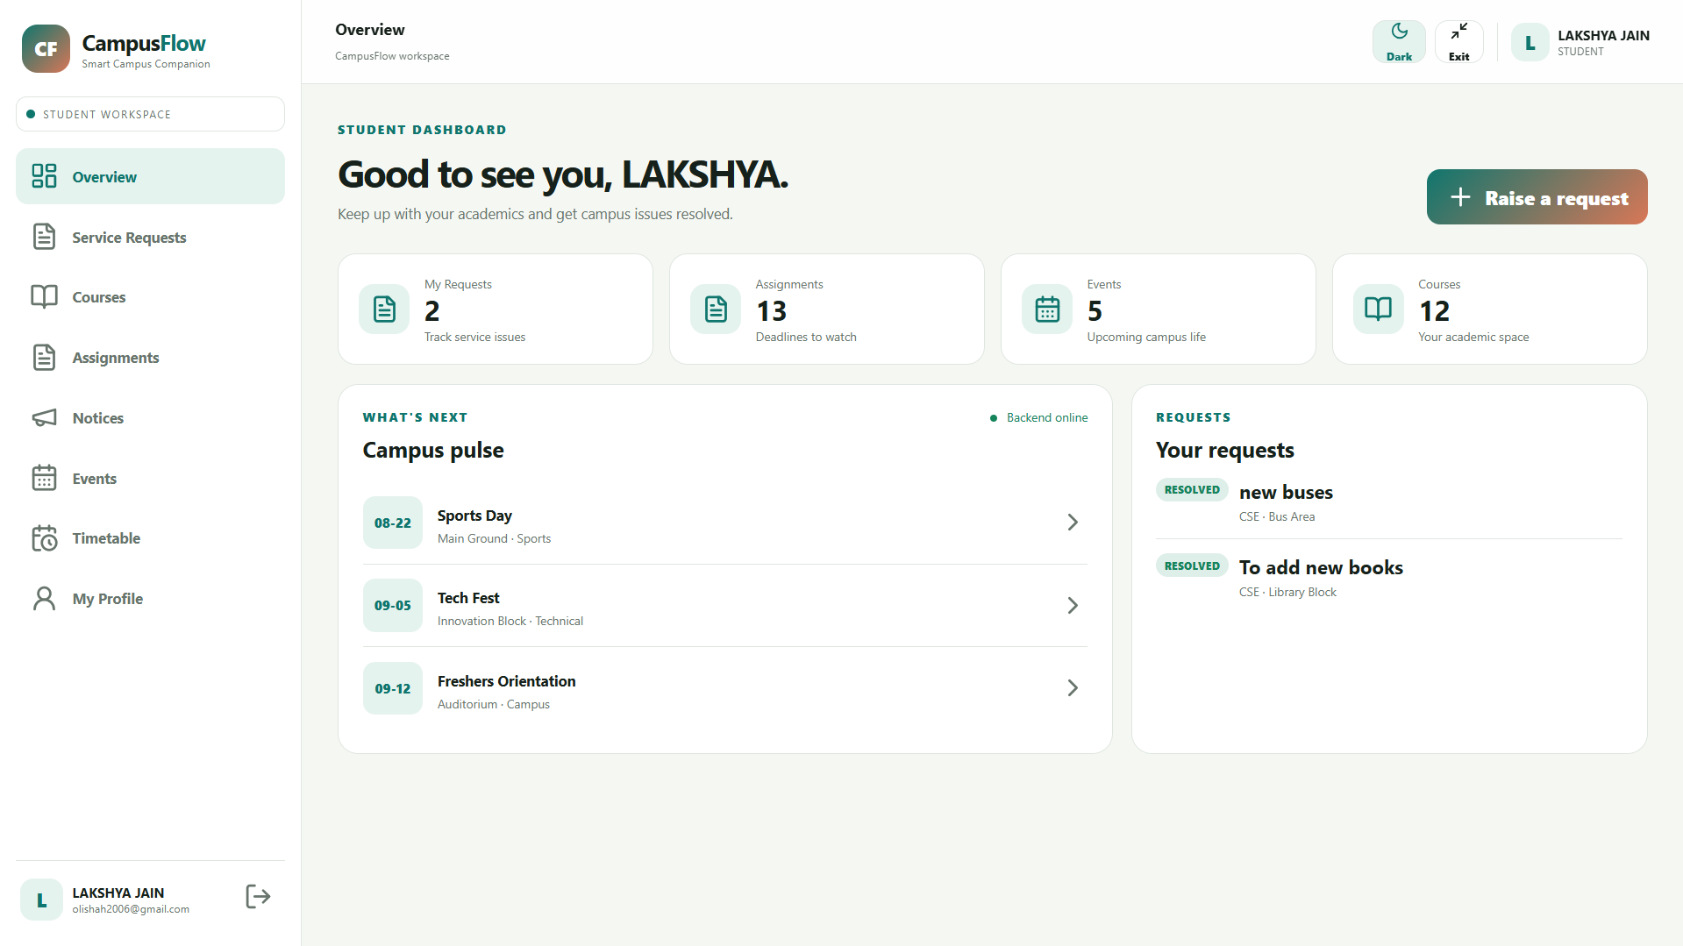
Student Workspace — Overview & Campus Pulse

Slide 7
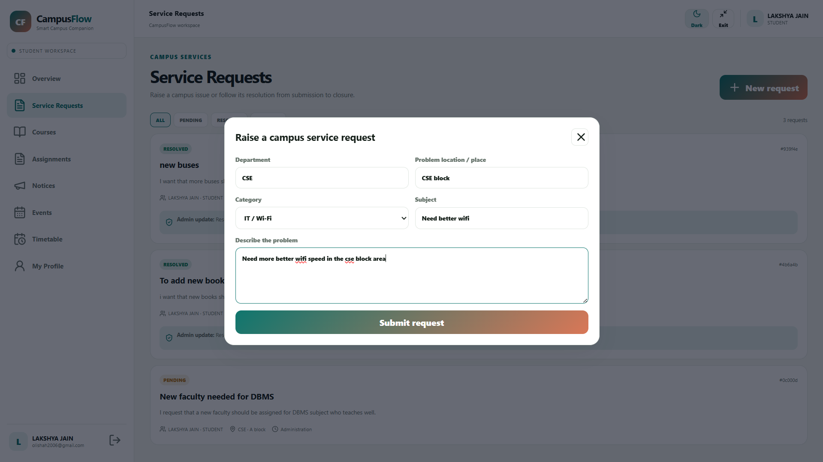
Service Requests — Submit New Issue Modal

Slide 8
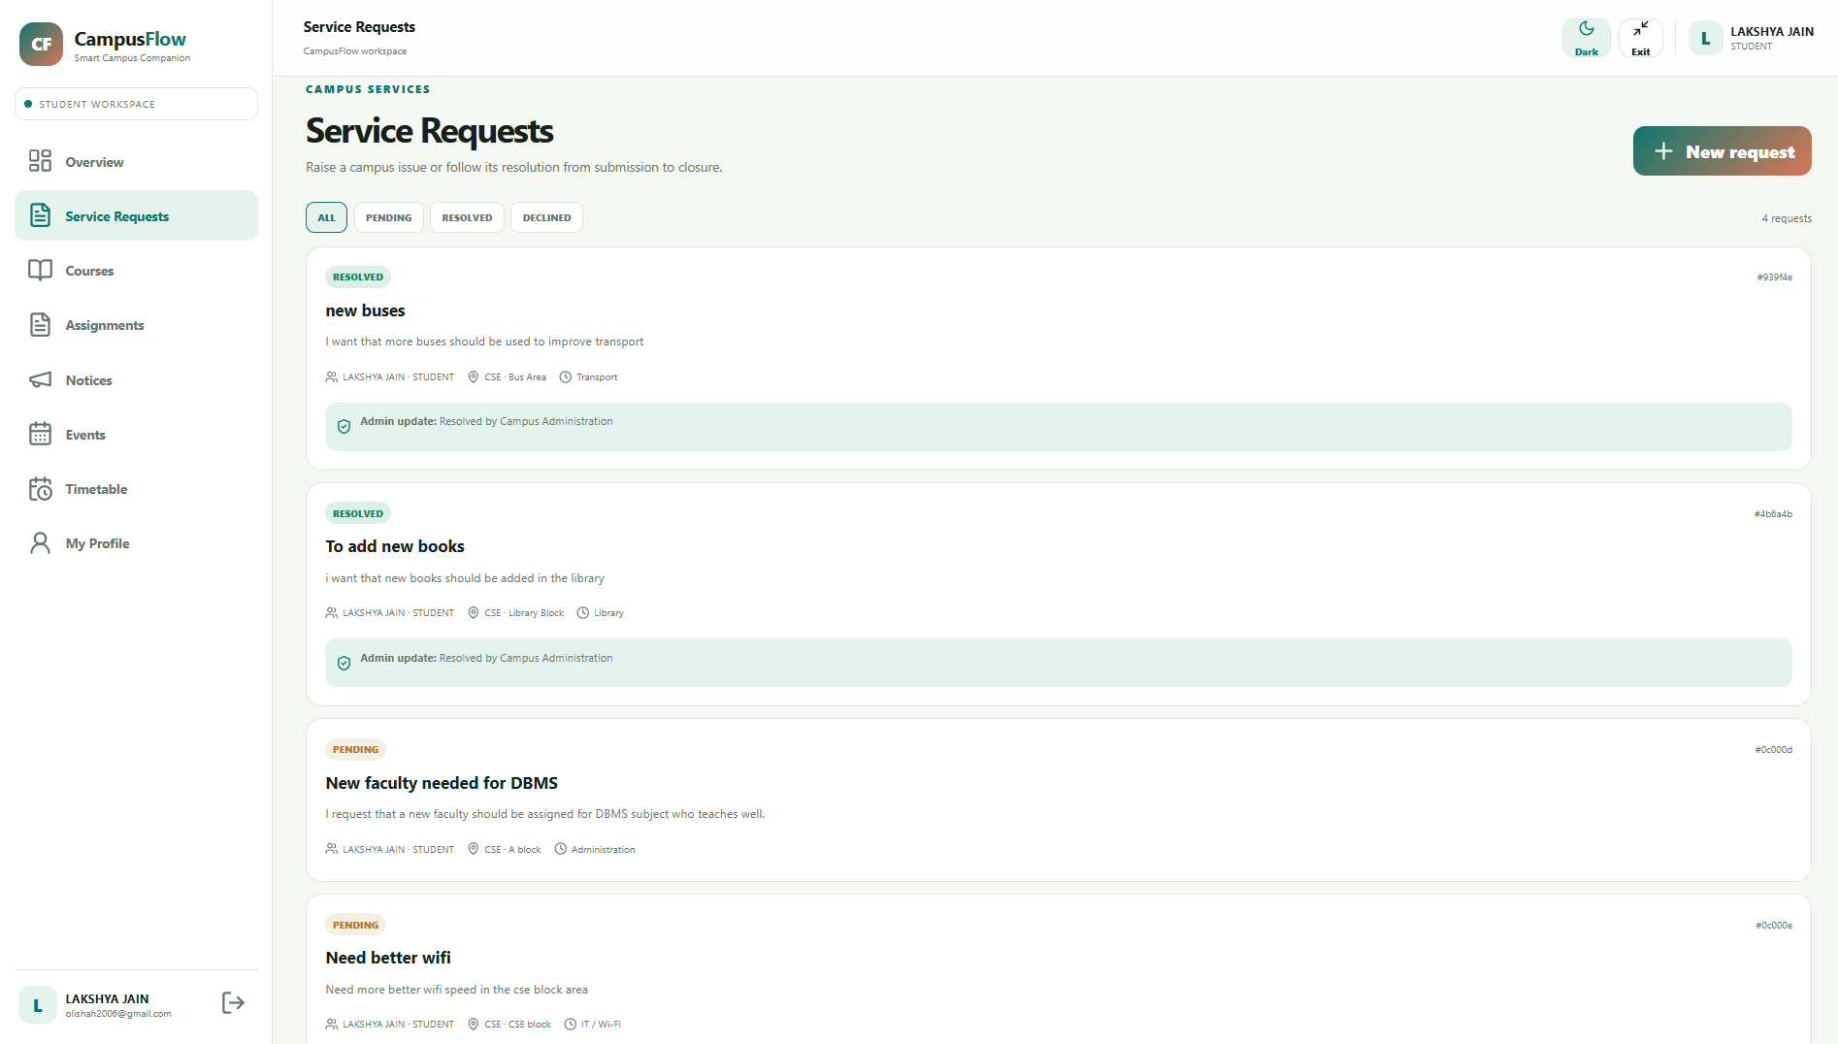
Service Requests — Real-time Issue Status Tracking

Slide 9
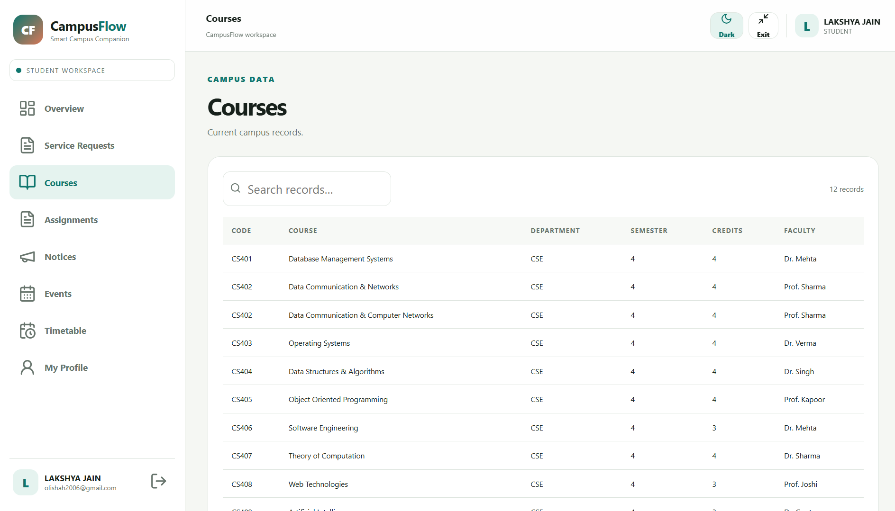
Academic Records — Enrolled Courses Listing

Slide 10
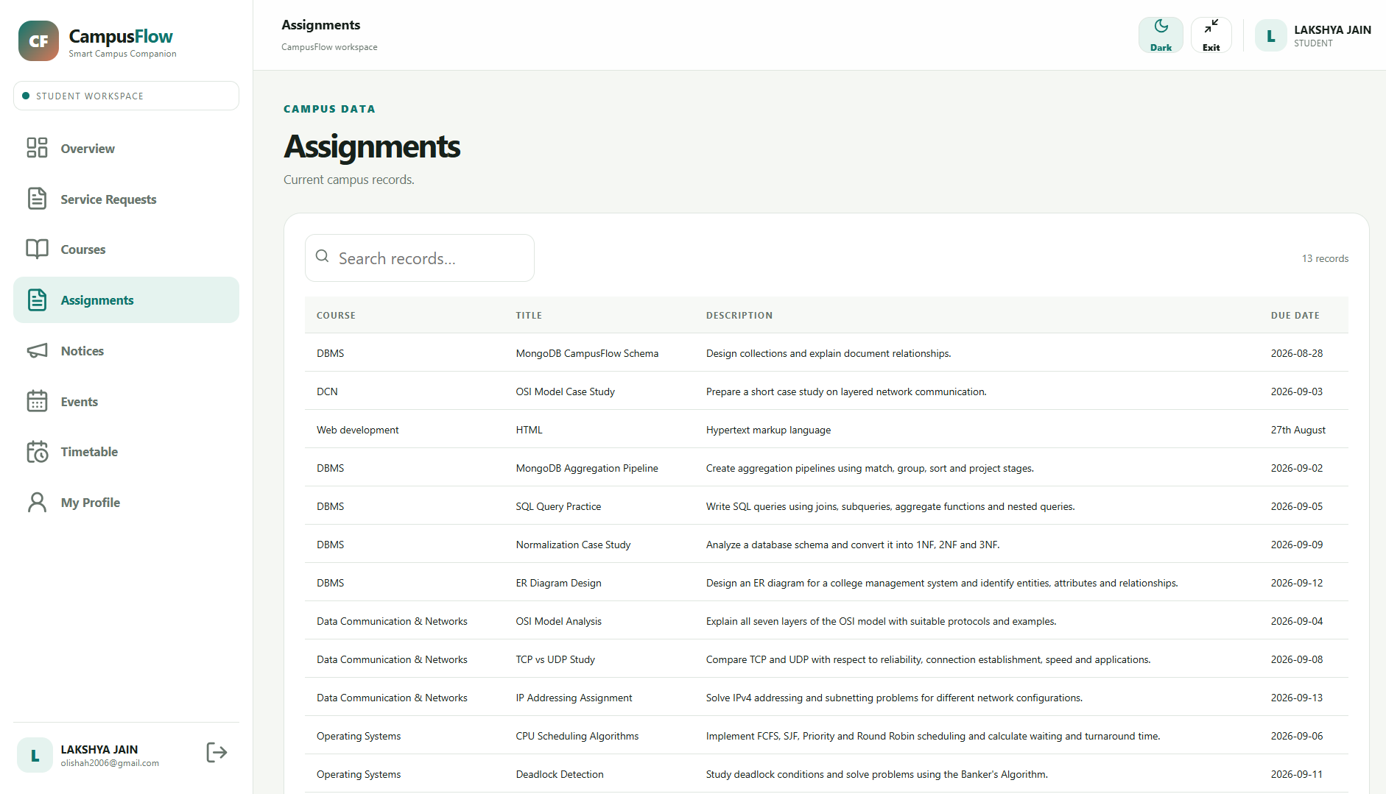
Academic Records — Course Assignments & Deadlines

Slide 11
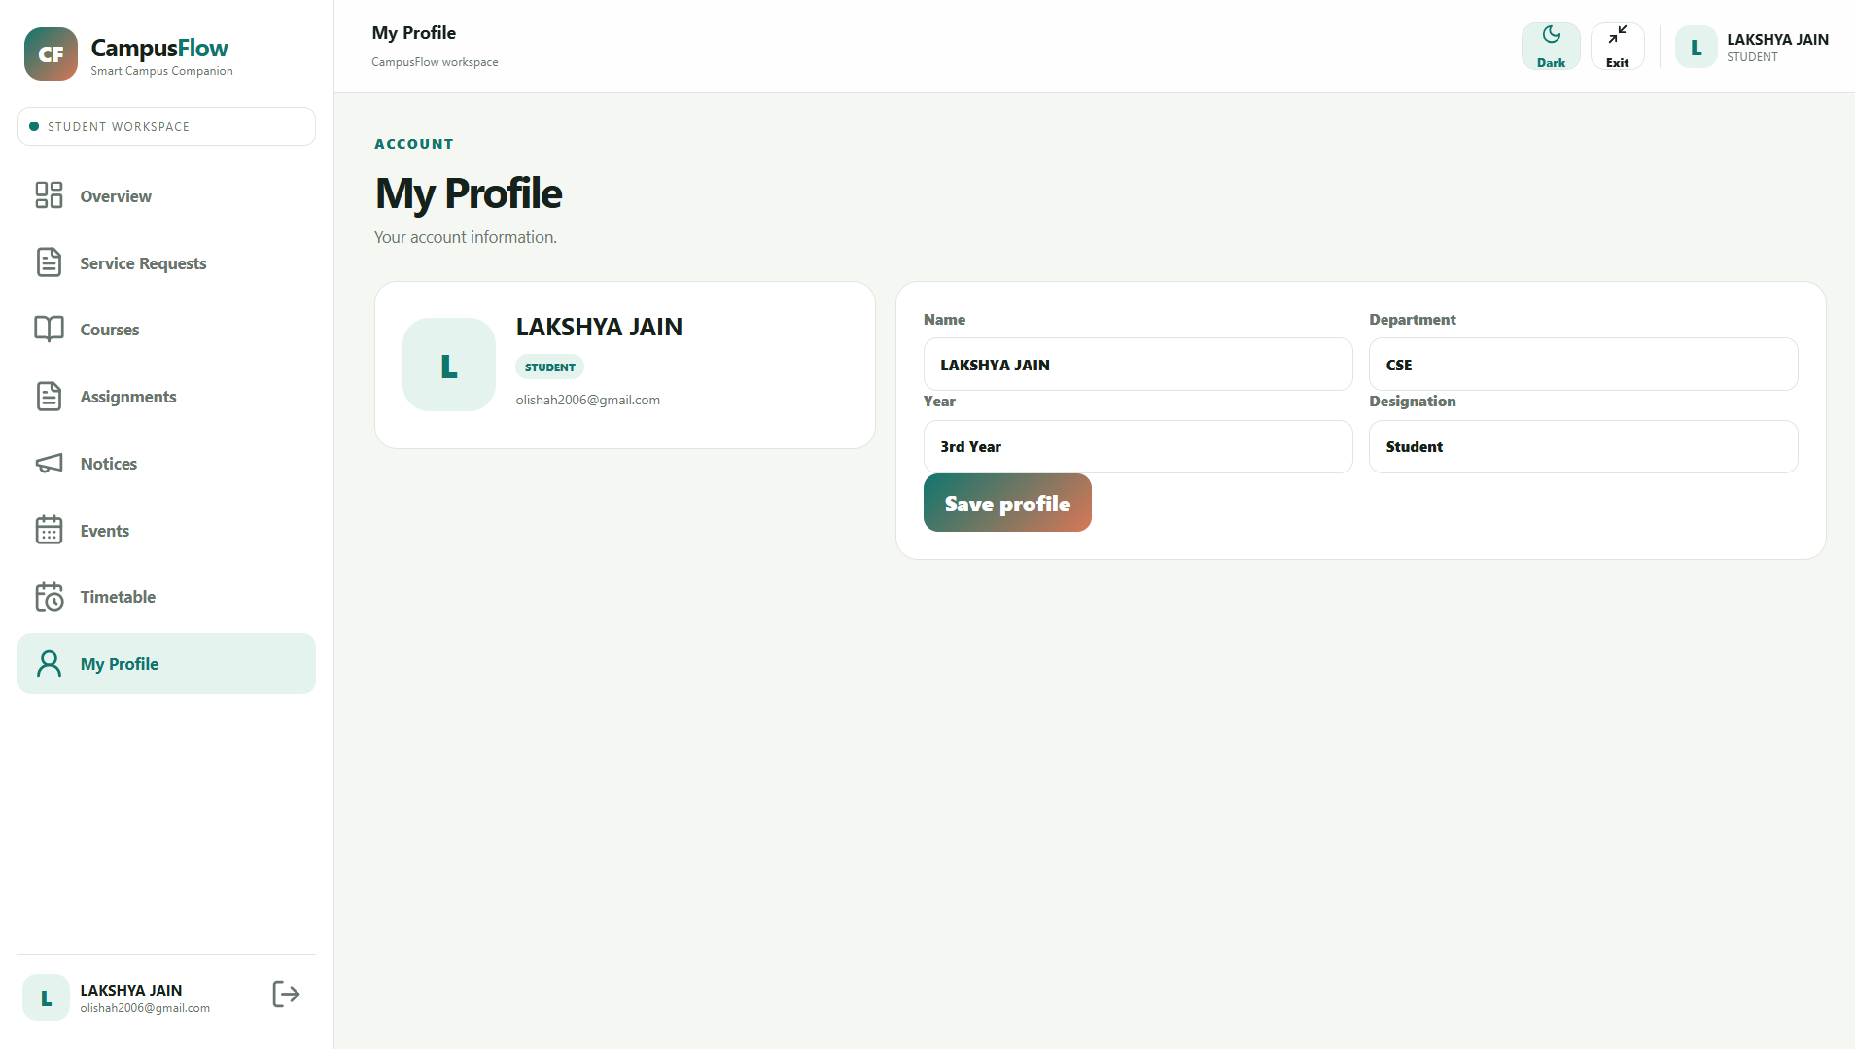
Account Management — Student Profile Settings

Slide 12
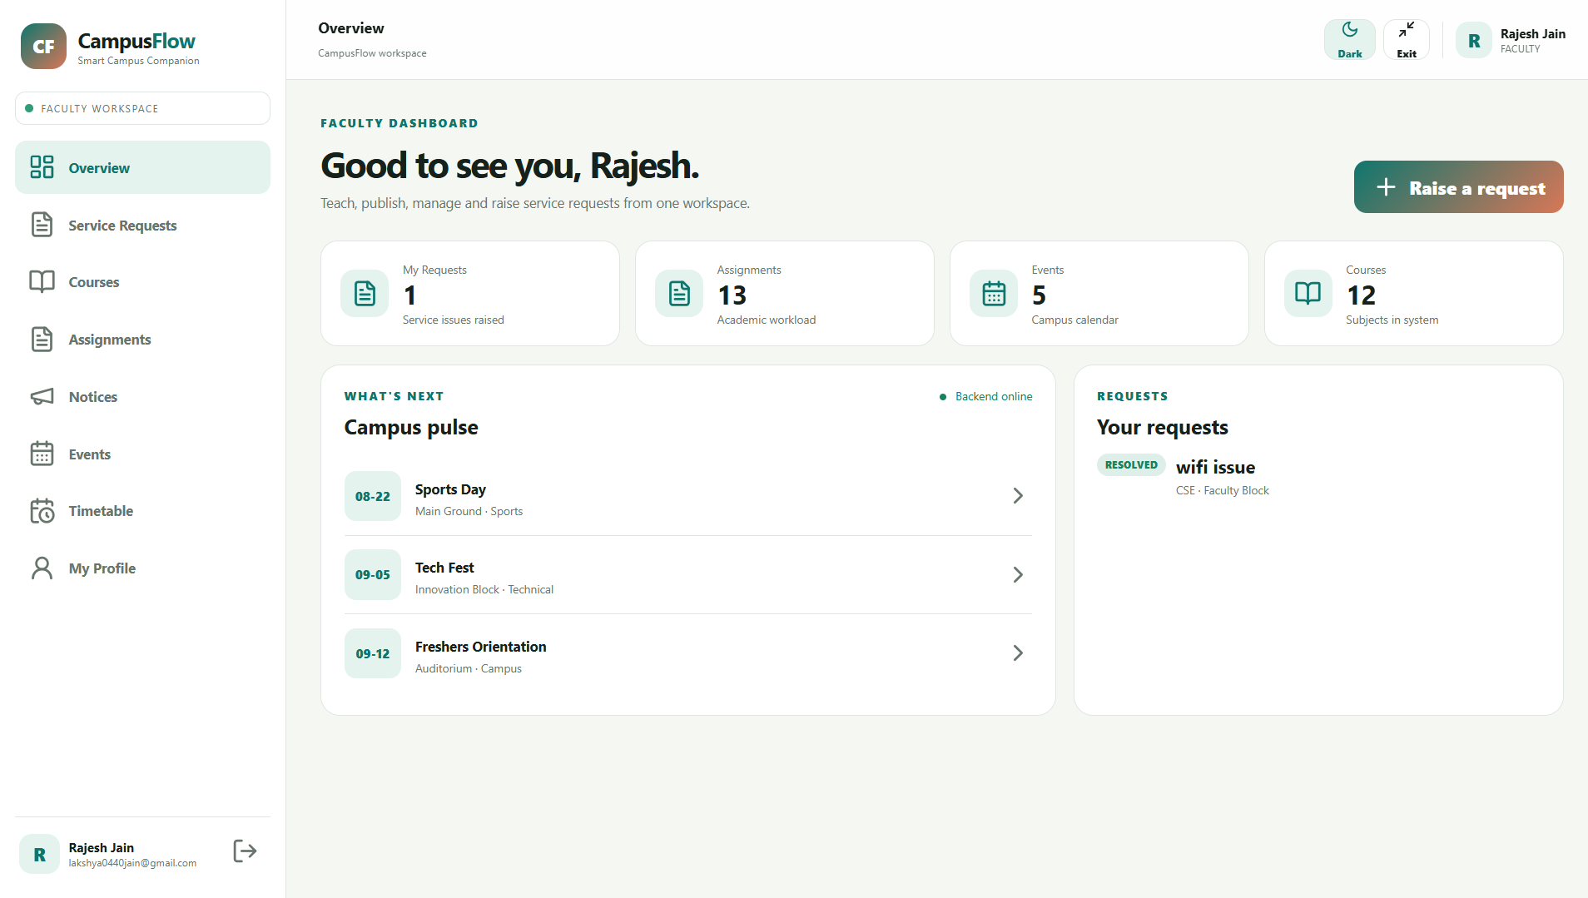
Faculty Workspace — Overview & Faculty Pulse

Slide 13
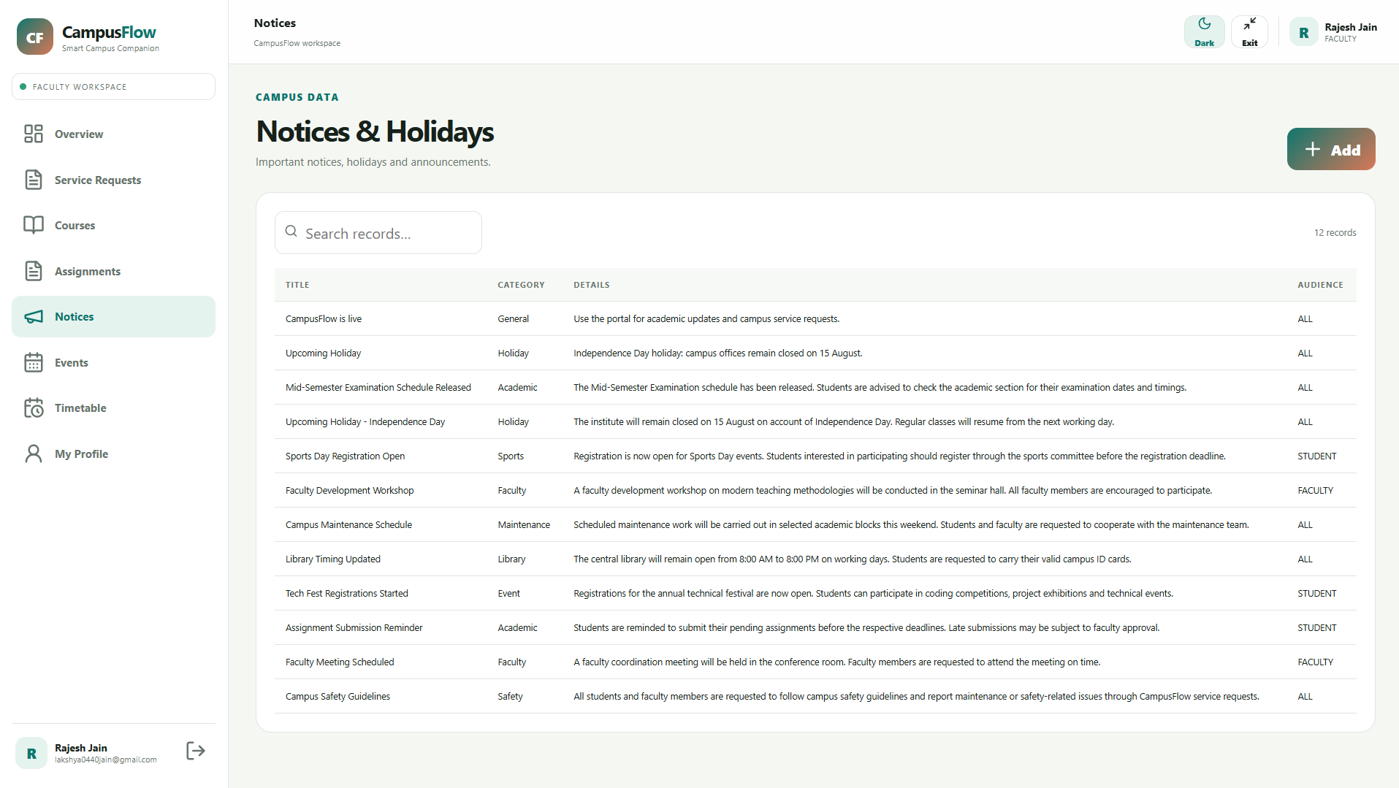
Campus Data — Notices & Holiday Announcements

Slide 14
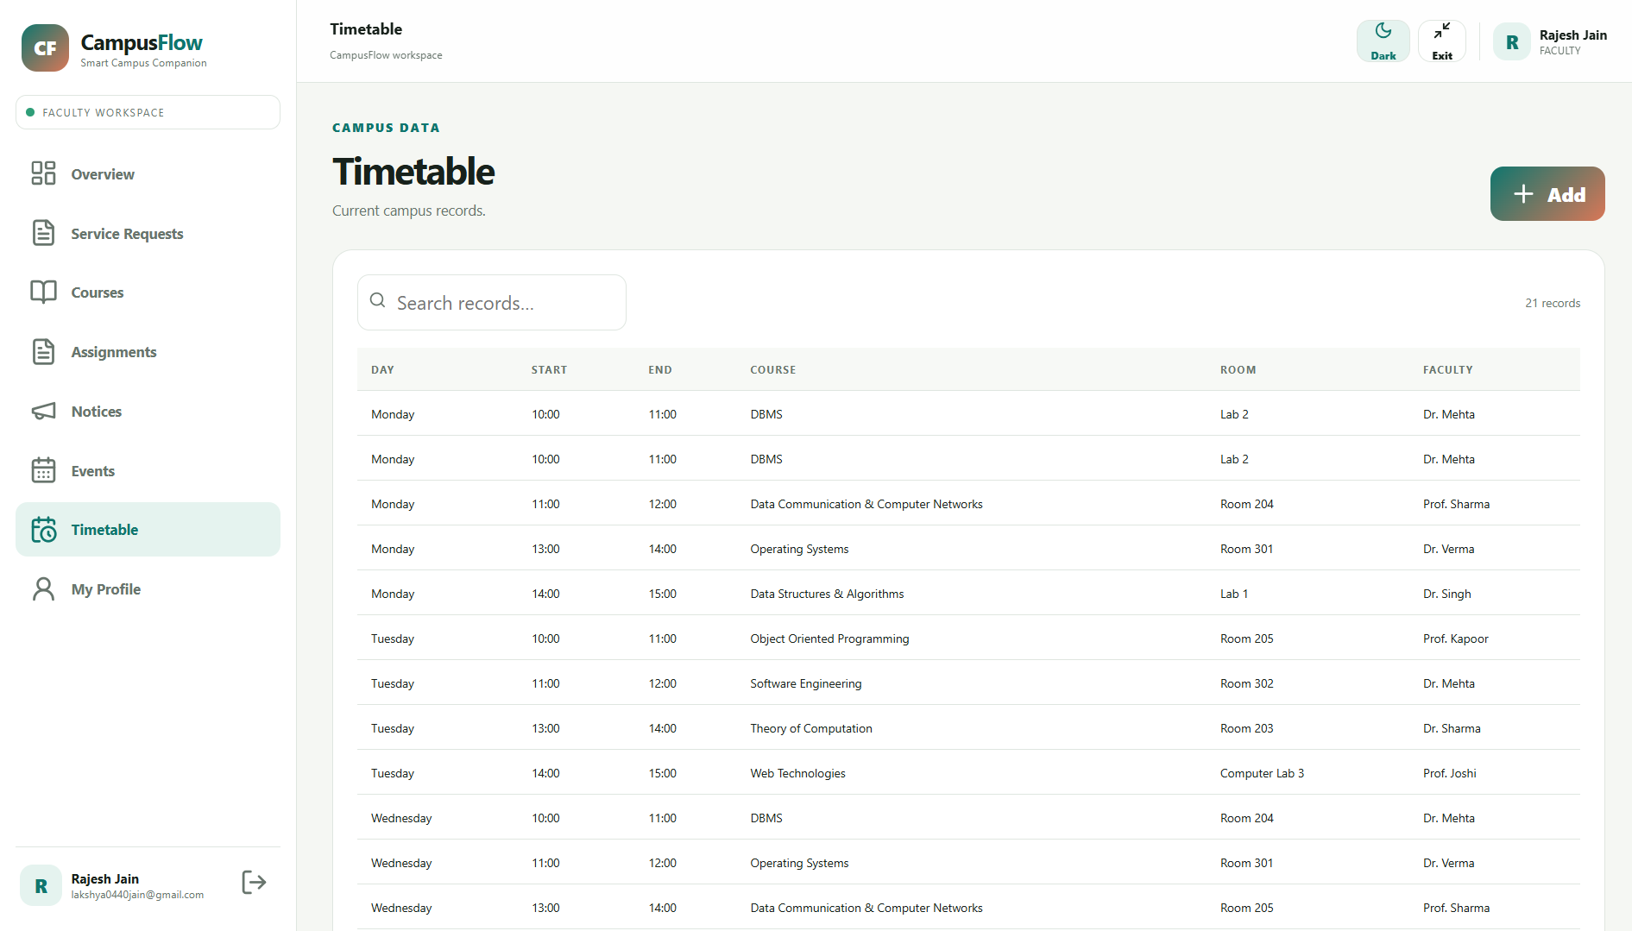
Campus Data — Master Timetable Schedule

Slide 15
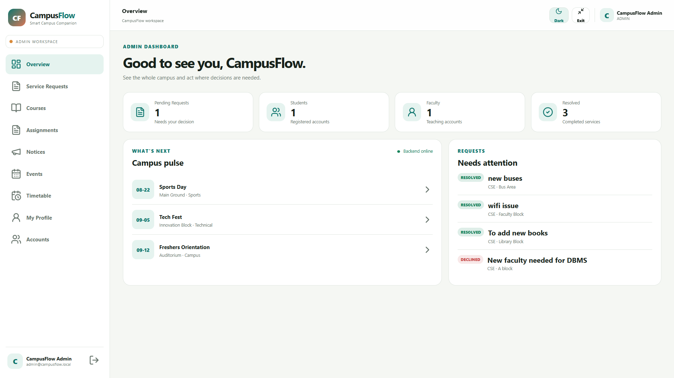
Admin Workspace — System Overview & Analytics

Slide 16
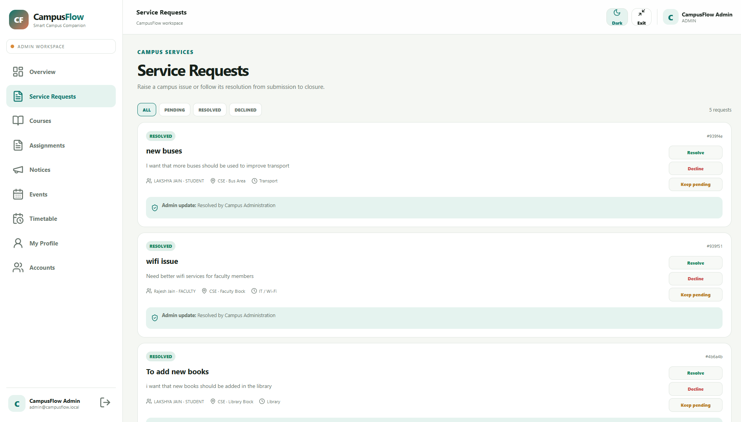
Admin Control — All Campus Service Requests Queue

Slide 17
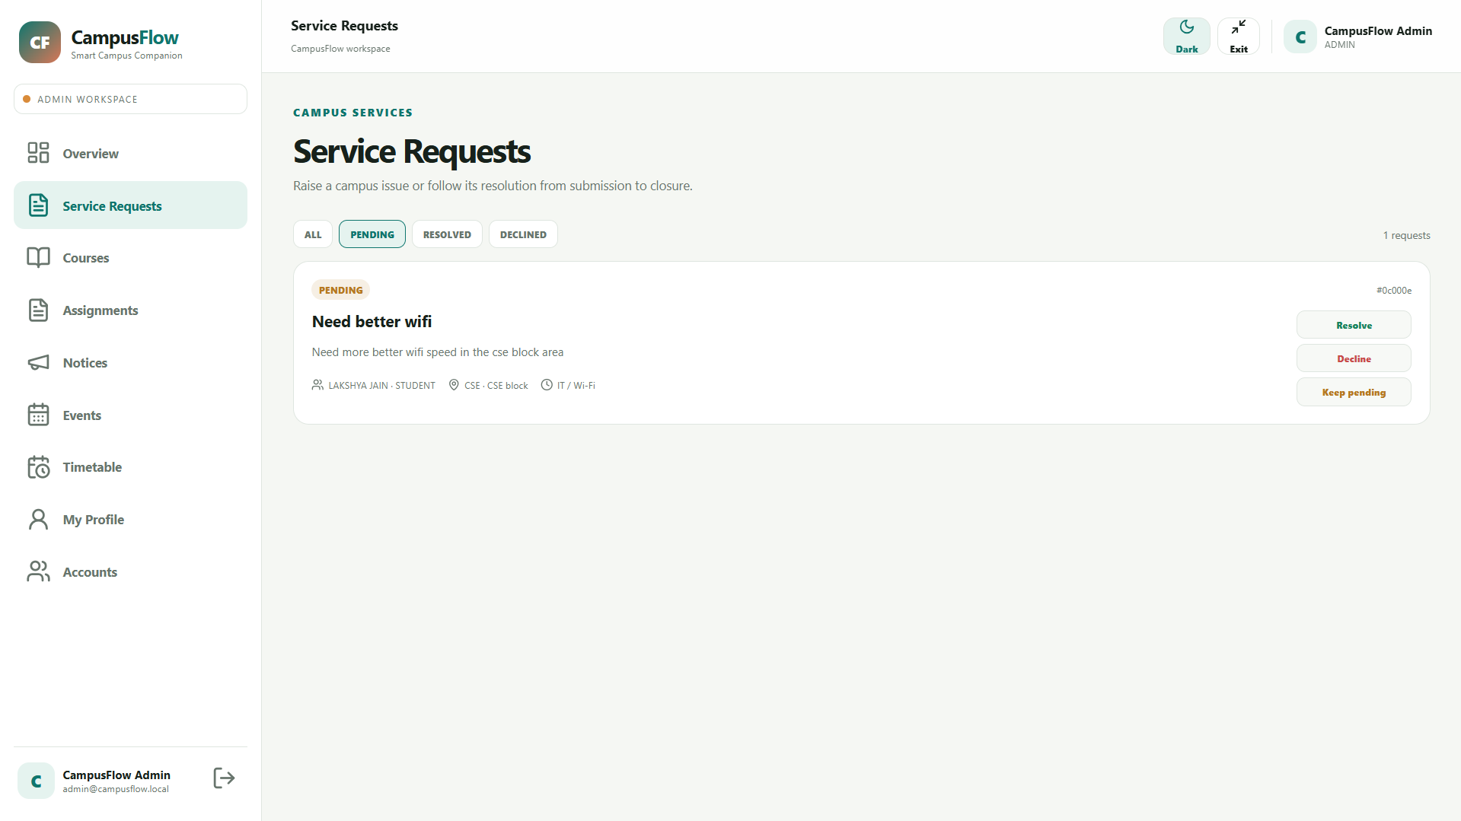
Admin Control — Pending Requests Action Queue

Slide 18
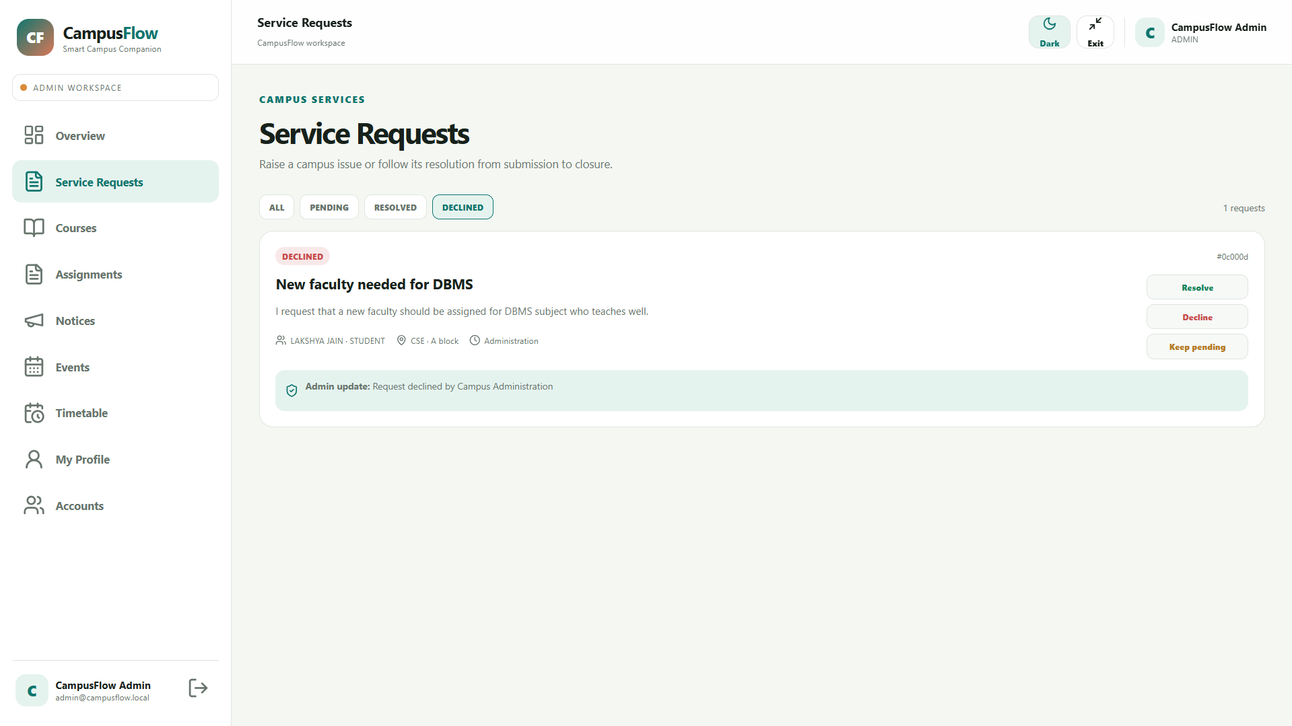
Admin Control — Declined Request Status View

Slide 19
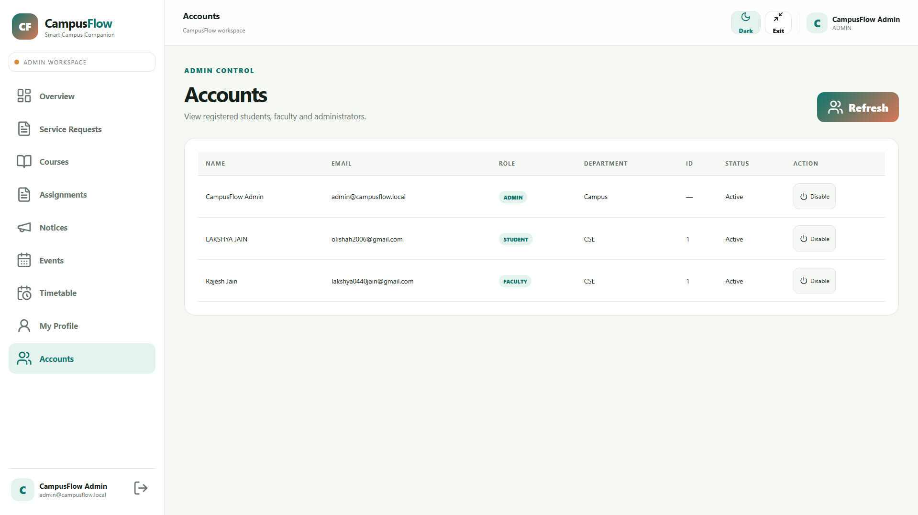
Admin Control — Registered User Accounts Management

Slide 20
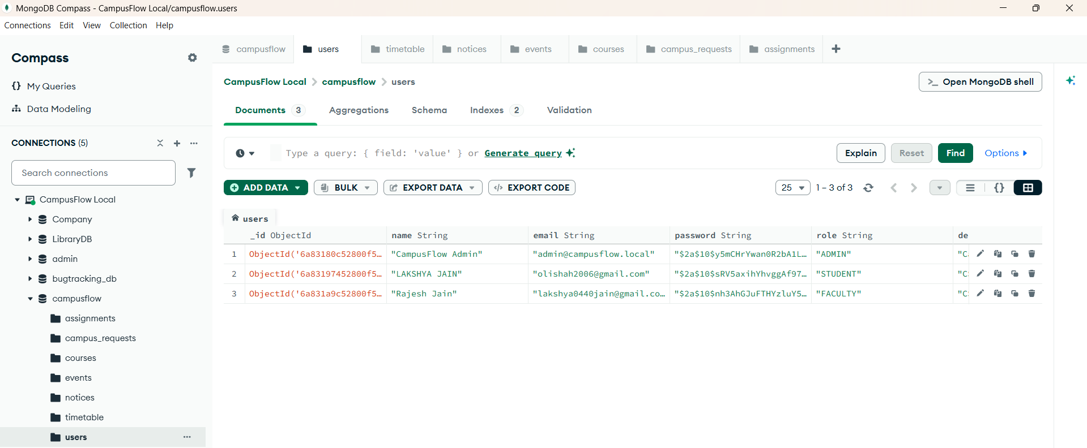
Database Layer — MongoDB Compass Users Collection

Slide 21
-----THE END-----
THANK YOU!

