Slide 1

RecoverFlow
Evidence-led recovery for disputed receivables
Hackathon demo | India MSME credit operations
Notes:
Original abstract visual generated for this deck. Product claims and demo figures come from repository README, .codex/prompt.md, and scripts/demo_hero.py. Synthetic demo; no live customer messages or payments.

Slide 2
Problem statement
A partial payment plus a dispute creates two different balances.
A blunt reminder for the full outstanding amount can demand money the customer has specifically disputed.
For a credit selling MSME, staff must reconcile the invoice, purchase order, receipt and customer reply before they can ask for the amount actually owed.
Target user: Indian retailers and distributors selling on credit. Market need remains a pilot hypothesis.
02
Notes:
Source: .codex/prompt.md sections 1 and 8.
Target customer is a pitch hypothesis, not a measured market size.

Slide 3
The recoverable balance
₹90,000
outstanding after partial payment
₹30,000
₹60,000
disputed and on hold
undisputed and eligible for a draft
Invoice ₹2,40,000 − received ₹1,50,000 = outstanding ₹90,000
03
Notes:
Synthetic hero case, verified by scripts/seed_hero_case.py and successful local scripts/demo_hero.py run on 2026-10-24. The disputed ₹30,000 is a delivery shortfall in customer evidence.

Slide 4
Complete workflow
01
Intake
CSV/PDF/image upload. Staff confirms extracted invoice and receipt.
02
Investigate
Match invoice, PO, payment and messages. Link each claim to a source.
03
Decide
Server rules split the balance and bound the next action.
04
Approve
Staff edits or approves the exact draft version for the sandbox.
05
Verify
Only a matched SIMULATED payment updates the ledger and case state.
04
Notes:
Sources: README.md; scripts/demo_hero.py; frontend/app.js; app/services/receivables.py; app/services/negotiation.py.
Customer-facing sends and payments remain simulator/sandbox.

Slide 5
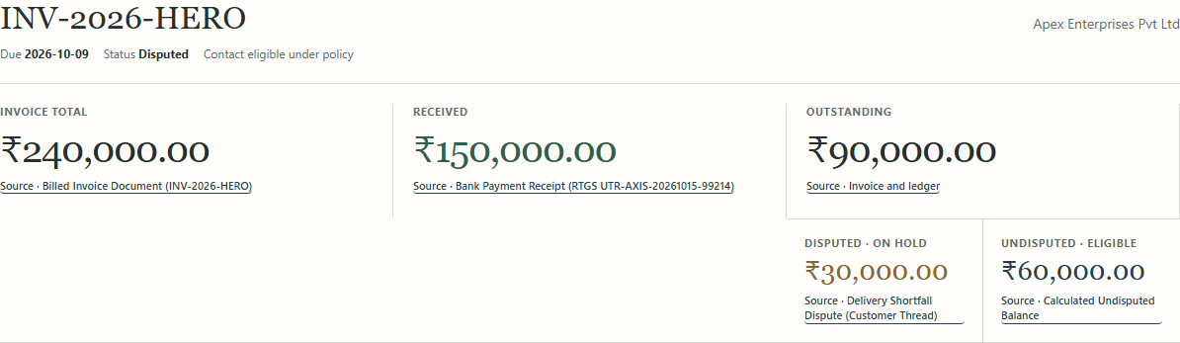
The case file makes the split visible
Each figure has a source control. The ₹30,000 dispute stays on hold while the ₹60,000 request can advance.
05
Notes:
Screenshot captured from local seeded app at 127.0.0.1:8012 on 2026-10-24. Synthetic data. Source: frontend/app.js case view; scripts/seed_hero_case.py.

Slide 6
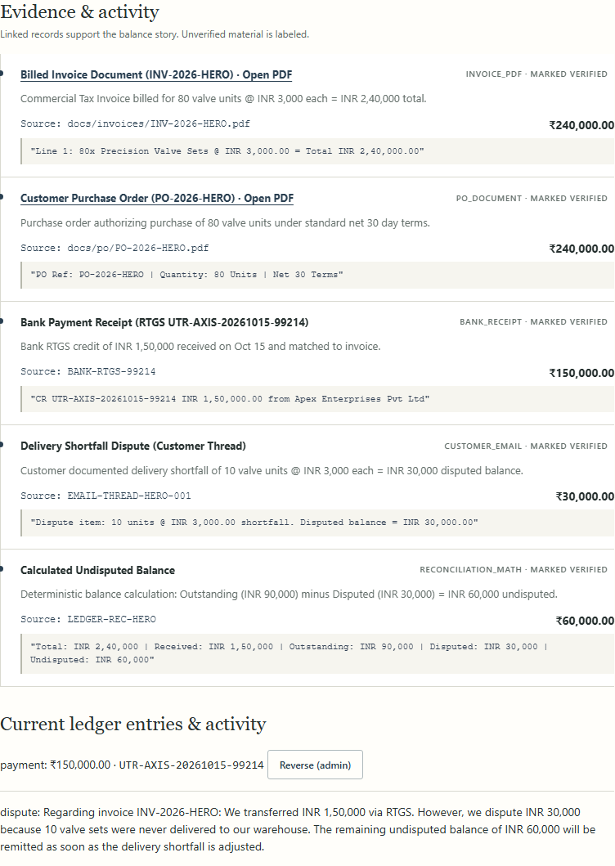
Claims are traceable to evidence
Invoice PDF
Purchase order
Payment receipt
Customer dispute
Calculated balance
06
Notes:
Screenshot from local seeded app. Synthetic documents and messages. Source: scripts/seed_hero_case.py; frontend/app.js. An unsupported claim is omitted from the balance view.

Slide 7
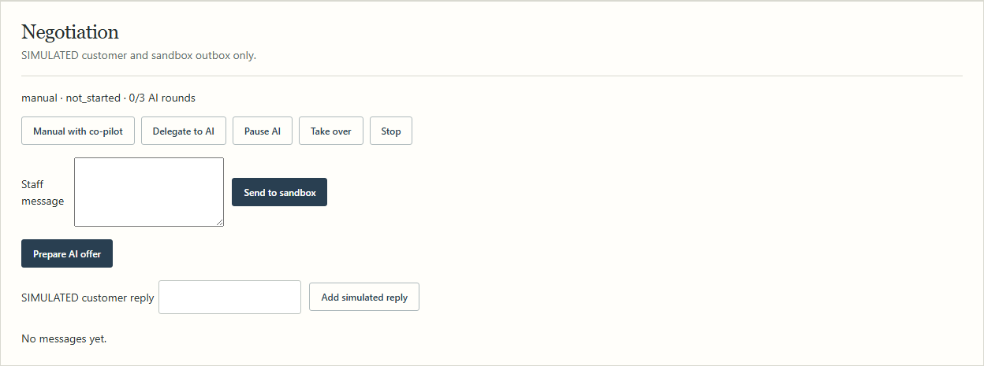
Features the team can demo now
Manual co-pilot
Delegated mode
Injection defense
Staff owns the message.
Approval and takeover controls.
Unsafe instructions escalate.
07
Notes:
Screenshot from running seeded app. Functionality verified in offline scripts/demo_hero.py: Manual/Delegate transcript, exact-version approval, injection escalation. No live sends.

Slide 8
Governance and responsibility
Money
Server-side Decimal and integer-cent rules calculate balances; the model cannot alter the ledger.
Messages
Staff approves the exact draft version. WhatsApp and email remain sandbox outboxes.
Autonomy
Internal notes and unsent drafts only. Pause, take over and stop are available per case.
Closure
A promise never closes a case. A matched SIMULATED payment creates PARTIALLY_RESOLVED.
Trust
Untrusted uploads and customer text cannot override policy. Every action is auditable.
08
Notes:
Sources: .codex/prompt.md sections 2, 3, 8; README.md; app/services/controlled_agent.py; app/services/negotiation.py. All payment and messaging descriptions refer to this demo configuration.

Slide 9
Reusability
Reusable core
Replaceable edges
A source-linked case model, deterministic balance engine, versioned approval and audit trail can serve new industries and channels.
CSV/PDF/image intake, read-only Shopify, Gemini wording, sandbox messaging and SIMULATED Razorpay sit behind separate services.
Pilot setup: SQLite and local identity. Production requires managed tenancy, migrations, backups and provider tests.
09
Notes:
Sources: README.md; docs/PROJECT_ANALYSIS_AND_SYSTEM_STATE.md; app/services/; app/api/. Production roadmap is documented, not implemented.

Slide 10
ROI and business value
₹60,000
₹30,000
eligible to pursue in the hero case
kept out of the collection request
Potential value
Less staff reconciliation time, fewer incorrect demands, and a clearer queue of undisputed cash.
Pilot KPI: measure minutes per case, draft correction rate, eligible balance contacted and verified receipts. Recovery uplift is not yet measured.
10
Notes:
Hero amounts are synthetic, from seed and demo scripts. Benefits are hypotheses. No measured ROI or recovery claim is made; proposed pilot KPIs are forward-looking.

Slide 11
MVP readiness
Offline end-to-end demo
CSV + PDFs → source-linked case → edited approval → sandbox negotiation → SIMULATED matched payment
30 / 30
10 / 10
5 / 10
synthetic ledger splits correct
offline upload routing correct
files reached Review without entry
Limits: verified dispute amounts supplied to the 30-case ledger test; live image extraction accuracy unmeasured; offline images need staff review.
11
Notes:
Sources: docs/evaluation.md, freshly regenerated by successful scripts/demo_hero.py run on 2026-10-24. Counts are synthetic and do not establish customer recovery performance.

Slide 12
Originality and innovation
The narrow wedge
Evidence-linked handling of partial payments and disputes for India-focused small credit teams.
The technical combination
Rules own money and policy; AI helps with language and classification; staff own customer contact.
Next proof point: a measured pilot on real, consented cases and document samples.
12
Notes:
Positioning source: .codex/prompt.md. Do not claim no autonomous receivables tools exist; competitors include HighRadius, Fazeshift and Stuut. This slide states the product niche and architecture, not novelty of autonomous collections in general.

