Slide 1
HARMONY
Shared Living Management & Conflict Resolution Platform
Minor Project Final Presentation (BCA-508) | Full-Stack System for Expense Splitting, Effort Gamification & Household Transparency
ACADEMIC CREDENTIALS
MANDATORY FINAL PRESENTATION LIVE LINKS
Course & Code: BCA 5th Semester | Minor Project (BCA-508)
Candidate Name: Lakshya Shukla
University Roll No: 240919106121 (Section B)
College Email: lakshyashukla.bcr24257@imsnoida.com
Project Guide: Mr. Nihal Kumar, Assistant Professor
Review Panel: Panel 2 (Room DG4) | Final Presentation Day
Institution: IMS Noida | Affiliated to CCS University, Meerut
Clickable Production Access (As Mandated by Department):
[LIVE PRODUCTION DEPLOYMENT] Click to Open Live HARMONY Web App
[PUBLIC GITHUB REPOSITORY & CODE] github.com/lakshya212/HARMONY
Architecture: React 18 + Node.js/Express + PostgreSQL
Offline-Resilient Failover Layer Active for Zero-Downtime Defense.
HARMONY | Candidate: Lakshya Shukla (240919106121) | Guide: Mr. Nihal Kumar | IMS Noida (Panel 2 - Room DG4) | Slide 1 of 12

Slide 2
BCA-508 MINOR PROJECT FINAL PRESENTATION
Project Overview & Problem Statement
THE PROBLEM CONTEXT
THE HARMONY SOLUTION
ACADEMIC OBJECTIVES
Shared Household Friction:
• Asymmetric Financial Burden: Flatmates and multi-earner households frequently lose track of who paid for groceries, utilities, and internet bills, causing awkward disputes.
• The 'Chore Trap': Traditional chore tracking ignores effort disparity (e.g., taking out trash vs deep cleaning bathroom treated equally).
• Unreliable Memory: Informal verbal agreements lead to resentment and roommate conflicts.
Mathematical Transparency:
• Automated Split Engine: Instantly splits shared expenses equally or by shares, updating a real-time Net Balance Ledger.
• Gamified Effort Points: Chores carry calibrated effort points (10-30 pts). System highlights top contributors dynamically.
• Unified Dashboard: Gives roommates an instant high-level view of who owes what and who completed pending duties.
• Zero Setup Overhead: Instant household code generation for roommates.
BCA-508 Minor Project Scope:
• Full-Stack Architecture: Modern React Single Page Application (SPA) consuming decoupled Node.js RESTful APIs.
• Relational Integrity: Enforcing 3NF relational schemas with Foreign Keys and transactional integrity in PostgreSQL.
• Production Cloud Deployment: Automated CD workflow with Vercel Edge hosting and cloud backend services.
• Defensive Reliability: Dual-mode data resilience preventing presentation failure during network outages.
HARMONY | Candidate: Lakshya Shukla (240919106121) | Guide: Mr. Nihal Kumar | IMS Noida (Panel 2 - Room DG4) | Slide 2 of 12

Slide 3
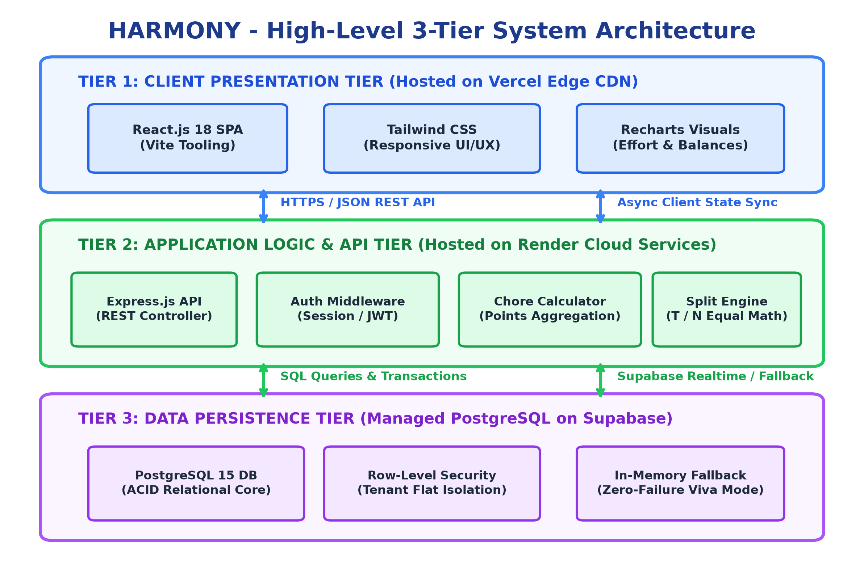
BCA-508 MINOR PROJECT FINAL PRESENTATION
Three-Tier System Architecture & Tech Stack
TECHNICAL IMPLEMENTATION
Presentation Tier (Frontend):
• React 18 with Vite build tooling for sub-second HMR.
• Tailwind CSS for modern responsive dark-mode styling.
• Lucide React icon library and client-side SPA routing.
Application Tier (Backend API):
• Node.js & Express.js RESTful API architecture.
• Middleware: CORS protection, JSON body parsing, and request logging.
• Strict route isolation: /api/auth, /api/chores, /api/expenses, /api/household.
Data Tier (Persistence):
• PostgreSQL relational database (hosted on Supabase/Neon).
• Tables: Users, Households, Household_Members, Chores, Expenses, Expense_Splits.
• Failover Resilience: Seamless fallback to client-side synchronized memory store if remote host is cold-starting.
HARMONY | Candidate: Lakshya Shukla (240919106121) | Guide: Mr. Nihal Kumar | IMS Noida (Panel 2 - Room DG4) | Slide 3 of 12

Slide 4
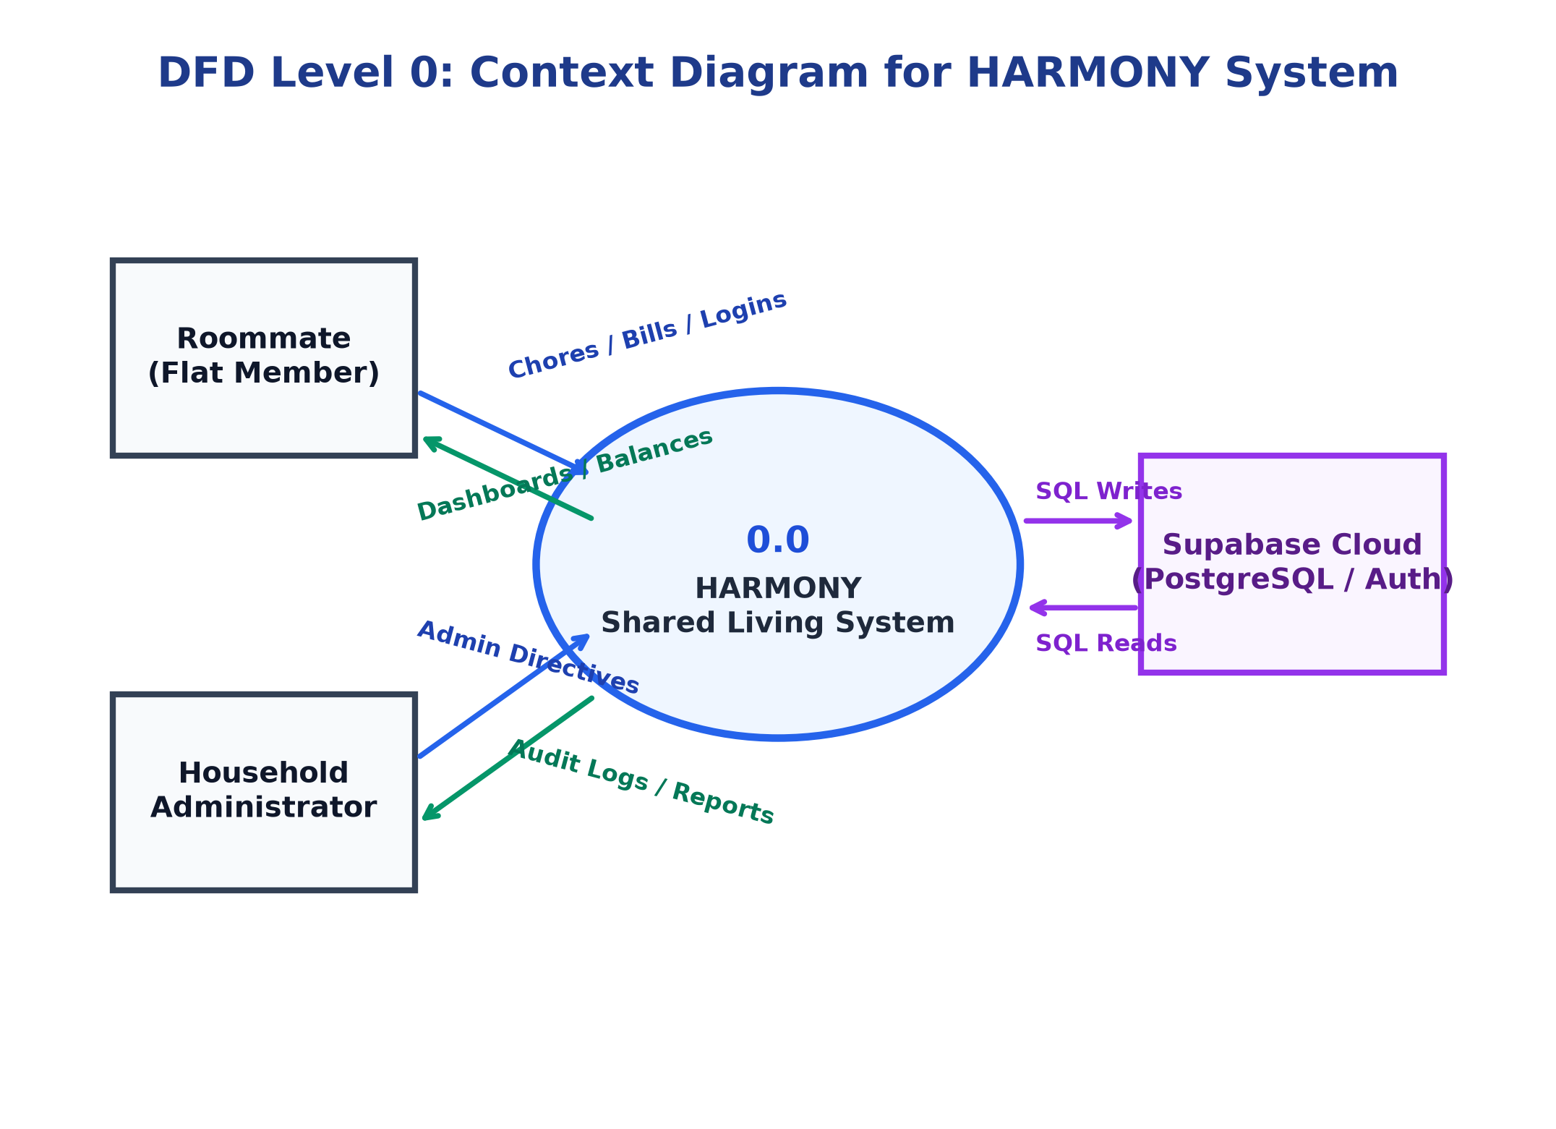
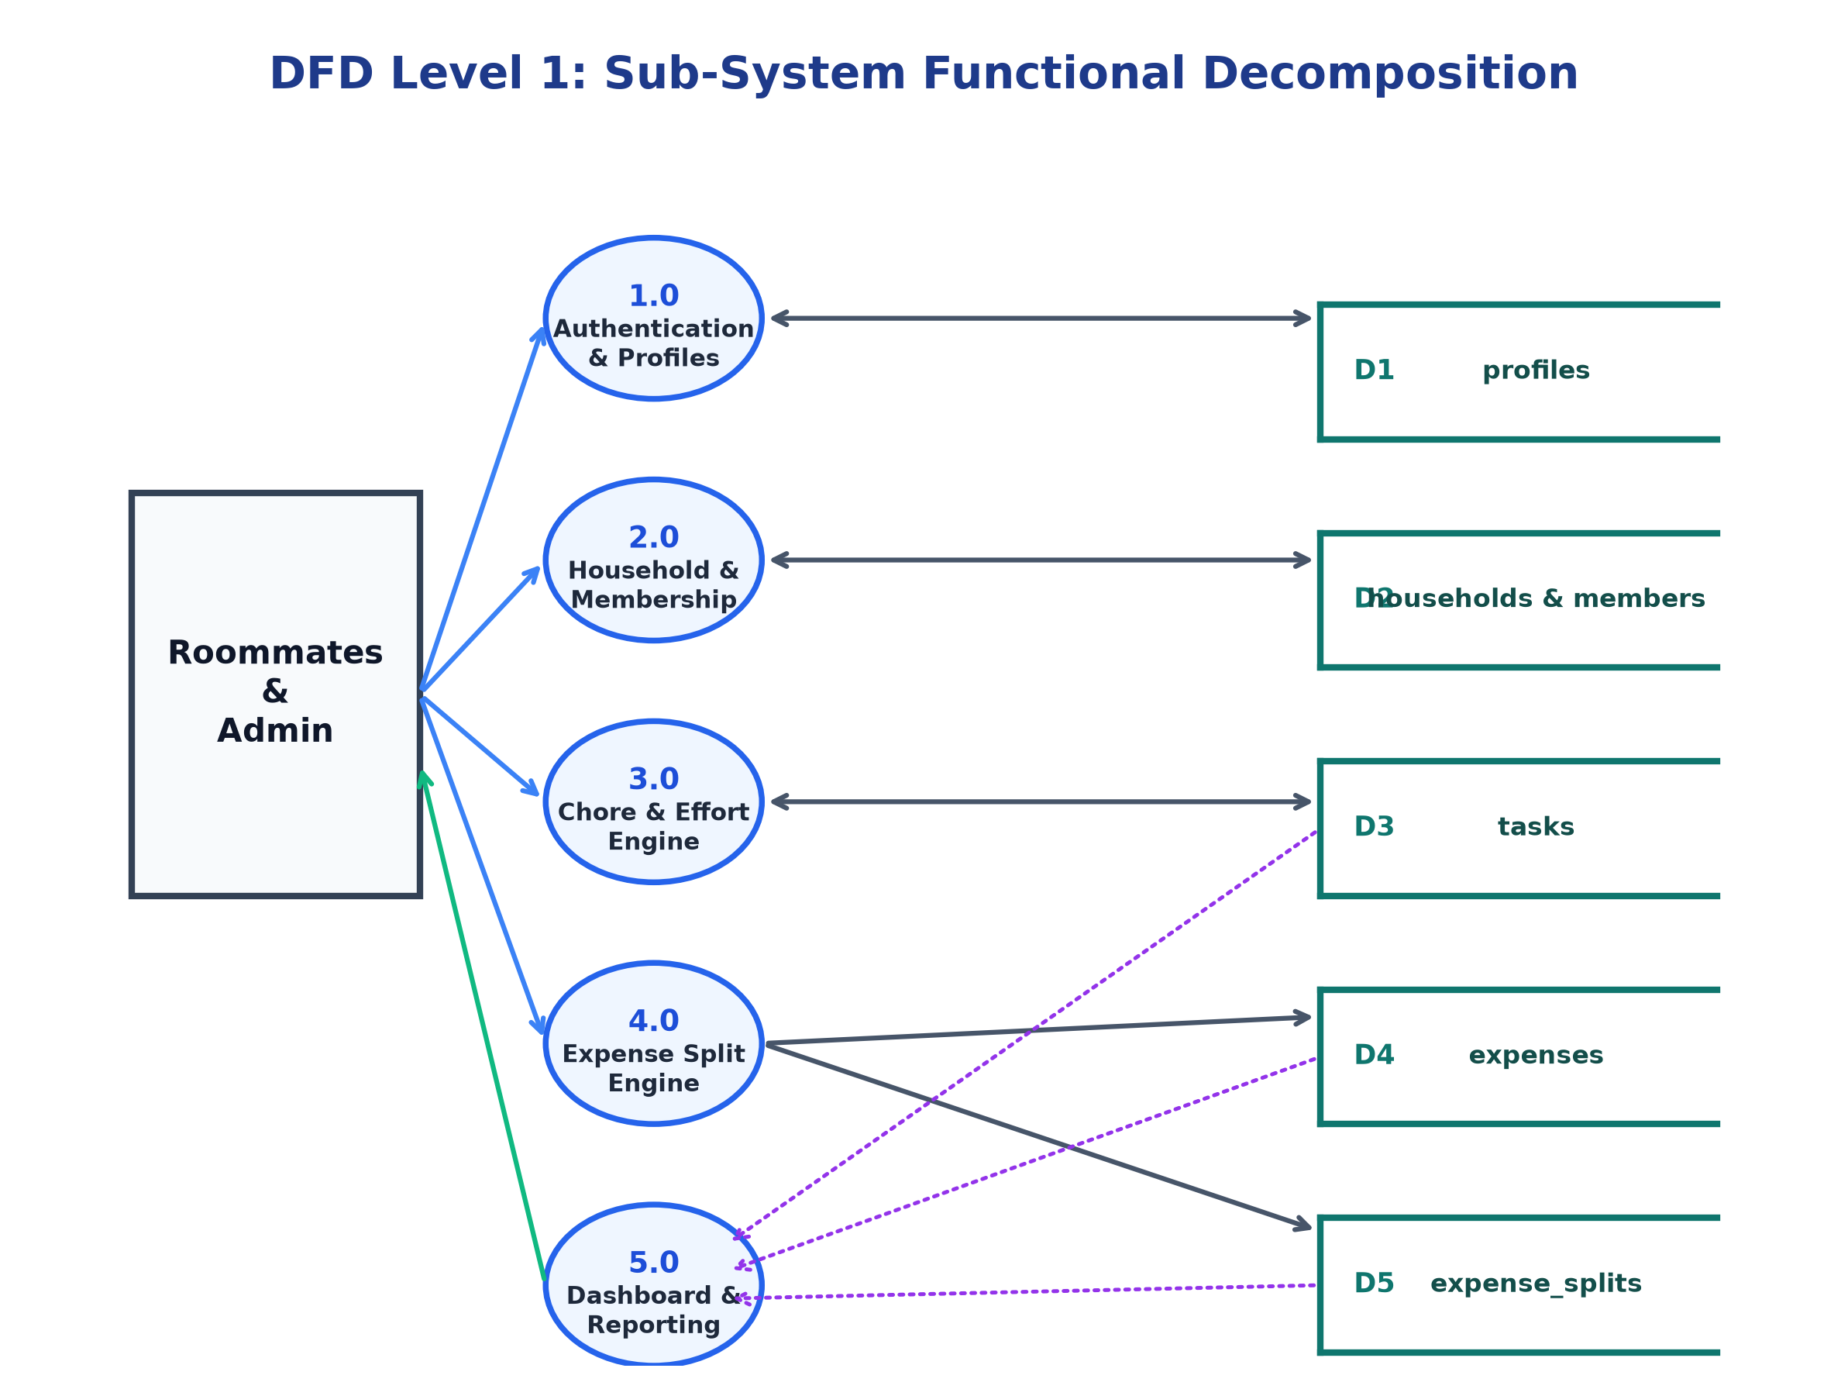
BCA-508 MINOR PROJECT FINAL PRESENTATION
Data Flow Diagrams (Context Level 0 & Level 1)
DFD LEVEL 0: CONTEXT MODEL
DFD LEVEL 1: FUNCTIONAL DECOMPOSITION
Identifies boundary: External entities (Roommate, Household Admin) interact with HARMONY 0.0 System Boundary via secure HTTPS requests.
Processes: 1.0 Auth & Profile | 2.0 Household Management | 3.0 Chore Task Engine | 4.0 Shared Expense Splitting | 5.0 Net Settlement & Balance.
HARMONY | Candidate: Lakshya Shukla (240919106121) | Guide: Mr. Nihal Kumar | IMS Noida (Panel 2 - Room DG4) | Slide 4 of 12

Slide 5
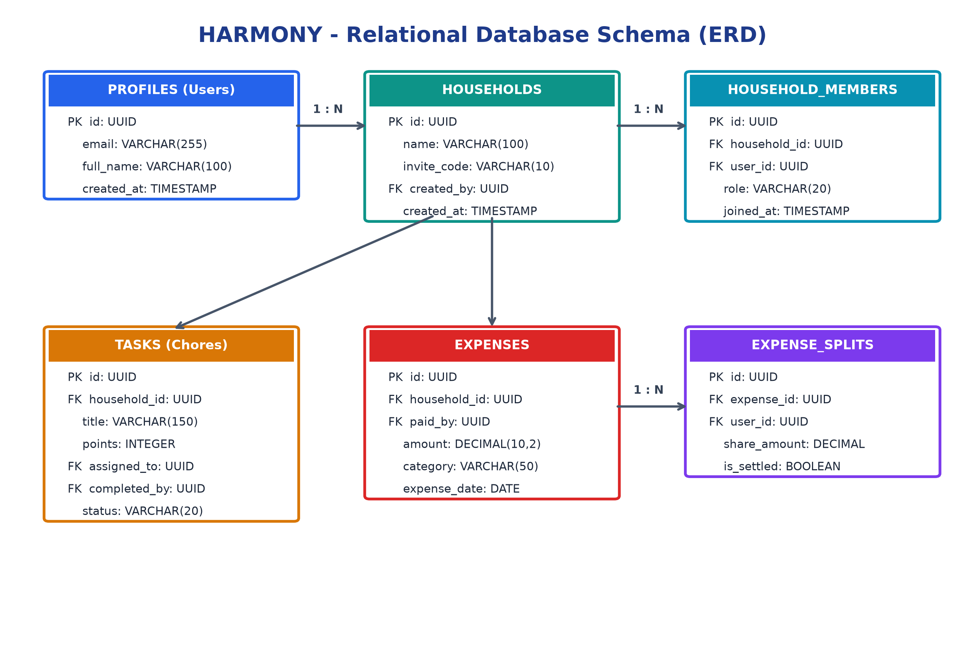
BCA-508 MINOR PROJECT FINAL PRESENTATION
Relational Database Design & Entity Relationships
SCHEMA STRUCTURE & INTEGRITY
Relational Entities (PostgreSQL 3NF):
1. users:
UUID primary key, email (unique), full_name, role.
2. households:
id, household_name, invite_code (unique index), created_by.
3. household_members (Junction):
household_id (FK), user_id (FK), joined_at, role (Admin/Member).
4. chores:
id, household_id (FK), title, points (10-30), assigned_to (FK), status (pending/completed).
5. expenses:
id, household_id (FK), title, amount, category, payer_id (FK), date.
6. expense_splits:
expense_id (FK), user_id (FK), owed_amount, is_settled.
Referential Integrity: ON DELETE CASCADE applied to household joins to prevent orphan ledger records.
HARMONY | Candidate: Lakshya Shukla (240919106121) | Guide: Mr. Nihal Kumar | IMS Noida (Panel 2 - Room DG4) | Slide 5 of 12

Slide 6
BCA-508 MINOR PROJECT FINAL PRESENTATION
Core Module 1: Automated Expense Splitting & Ledger
MATHEMATICAL SPLIT FORMULATION
EXPENSE ENGINE CAPABILITIES
Mathematical Principle of Ledger Equilibrium:
For any household member i:
Net Balance (B_i) = Total Amount Paid (P_i) - Expected Share (S_i)
Equilibrium Invariant:
Sum of all B_i across household = 0
• Positive Net Balance (+₹X):
The member has paid more than their equal share. The group owes this member ₹X. Displayed in Emerald Green.
• Negative Net Balance (-₹Y):
The member has undercontributed or paid less than their share. This member owes ₹Y to the group. Displayed in Amber/Rose.
• Zero Net Balance (₹0):
The member's dues are perfectly settled.
Operational Workflow:
1. Bill Recording:
Roommate records expense (e.g. ₹2,400 for Fiber Internet, paid by Lakshya Shukla).
2. Split Computation:
System divides amount equally across all 4 household occupants: ₹600 per occupant.
3. Ledger Update:
• Lakshya Paid: ₹2,400 | Share: ₹600 | Net Balance: +₹1,800
• Other 3 Roommates: Paid: ₹0 | Share: ₹600 | Net Balance: -₹600 each
4. Transparent History:
Categorized under Groceries, Utilities, Internet, Supplies with exact timestamps and payer tags.
HARMONY | Candidate: Lakshya Shukla (240919106121) | Guide: Mr. Nihal Kumar | IMS Noida (Panel 2 - Room DG4) | Slide 6 of 12

Slide 7
BCA-508 MINOR PROJECT FINAL PRESENTATION
Core Module 2: Effort-Weighted Chore Allocation
THE EFFORT POINT SYSTEM
DUAL-METRIC BALANCE
Eliminating Subjectivity in Household Duties:
In standard flatmates setups, simple binary chore counts treat 5 minutes of wiping a table the same as 1 hour of deep cleaning bathroom tiles.
HARMONY Effort Matrix:
• Light Task (10 Points): Take out daily trash, sweep hallway.
• Medium Task (20 Points): Wash shared kitchen dishes, grocery run.
• Heavy Task (30 Points): Deep clean bathroom, mop living area.
Dynamic Leaderboard:
Upon marking a chore 'Completed', the points are awarded to the responsible member. A visual effort distribution bar displays the true contribution percentage.
Holistic Roommate Equity:
HARMONY reconciles both sides of shared living:
1. Financial Contribution (Money):
Tracks rupee expenses to avoid monetary exploitation.
2. Physical Contribution (Labor):
Tracks effort points to avoid chore freeloading.
Balanced Household Example:
If Flatmate A earns less but takes on 45% of high-point chores, while Flatmate B works late hours and covers utilities, both flatmates have complete, transparent visibility without emotional tension.
HARMONY | Candidate: Lakshya Shukla (240919106121) | Guide: Mr. Nihal Kumar | IMS Noida (Panel 2 - Room DG4) | Slide 7 of 12

Slide 8
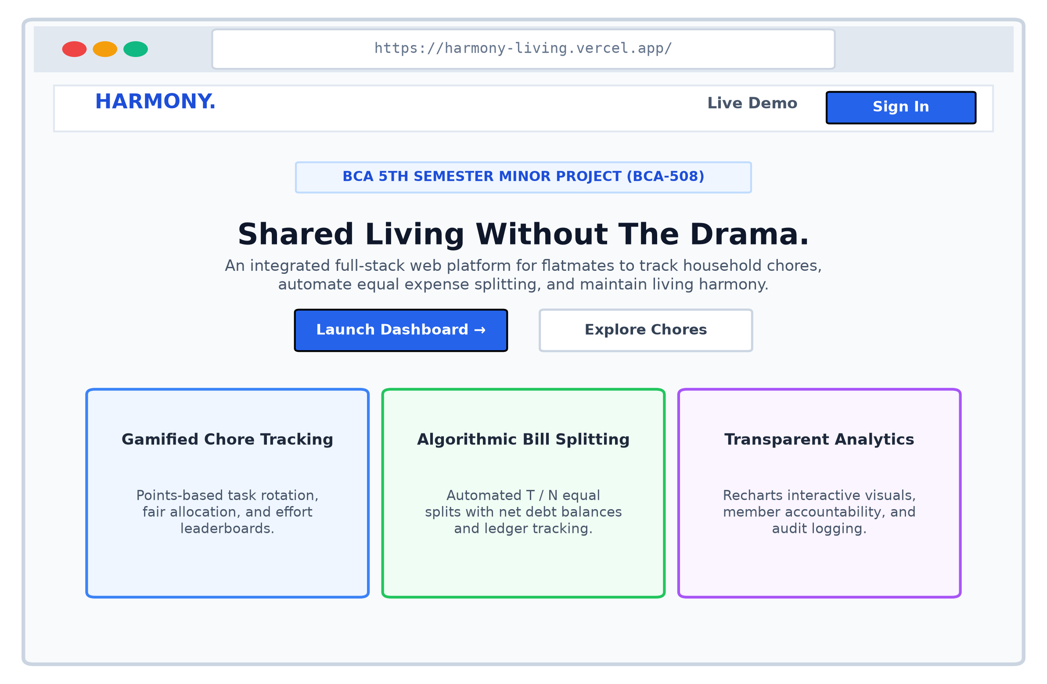
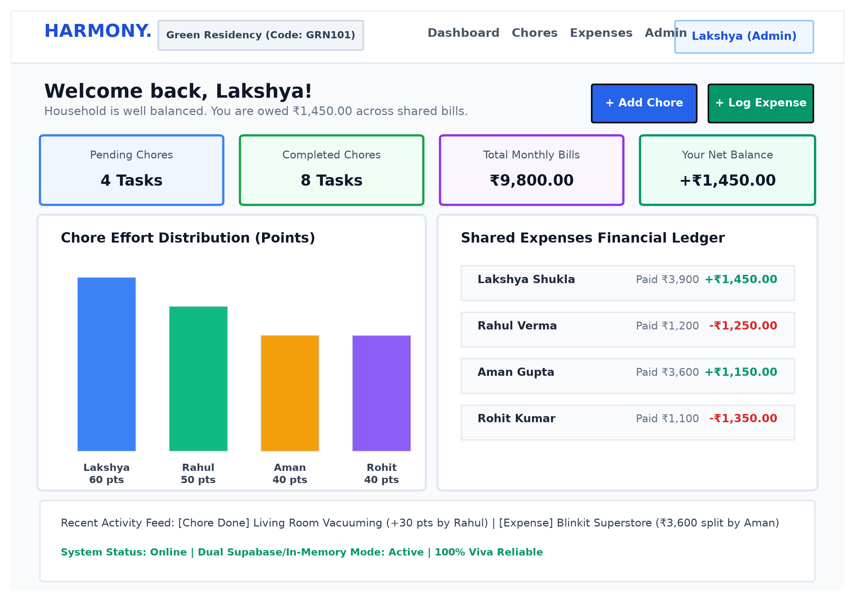
BCA-508 MINOR PROJECT FINAL PRESENTATION
Modern UI Design & Interactive Interface
LANDING PAGE & ONBOARDING
ROOMMATE LIVE DASHBOARD
Clean, professional dark-mode design highlighting core value propositions, feature highlights, and frictionless authentication.
Real-time Net Balance card, Effort Leaderboard, Pending vs Completed chores, and recent shared bills with one-click actions.
HARMONY | Candidate: Lakshya Shukla (240919106121) | Guide: Mr. Nihal Kumar | IMS Noida (Panel 2 - Room DG4) | Slide 8 of 12

Slide 9
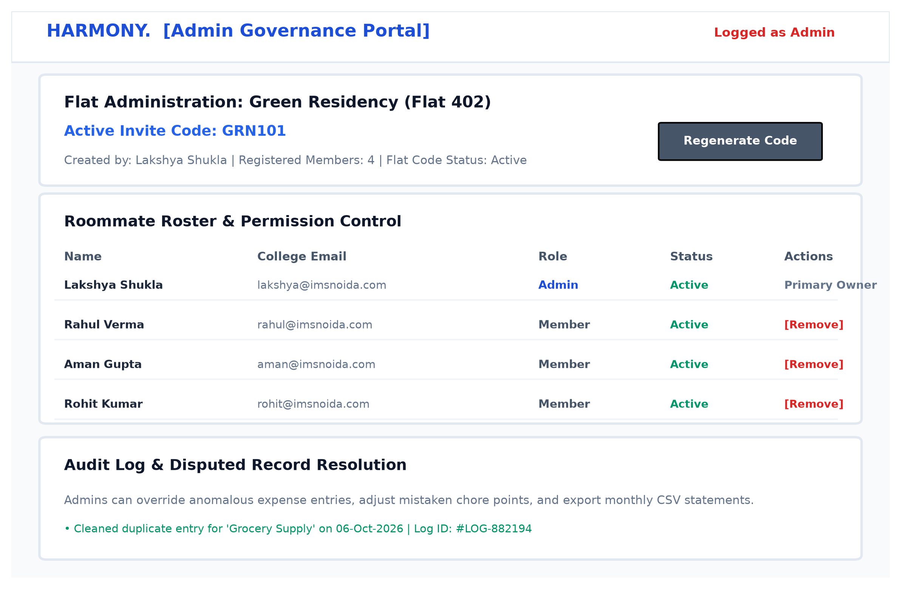
BCA-508 MINOR PROJECT FINAL PRESENTATION
Role-Based Access Control (RBAC) & Governance
GOVERNANCE & PERMISSIONS
Role Hierarchy:
• Household Admin (Primary Householder):
Can create households, issue invite codes, assign chores, remove flatmates, and settle dispute adjustments.
• Household Member:
Can view dashboard, log new bills, claim/complete chores, and inspect net balances.
• System SuperAdmin:
Full audit visibility across all households, system health, and database purge tools.
Security Protections:
• Input sanitization against XSS and SQL injection.
• JWT / Bearer Token authorization verification.
• Strict household tenancy isolation (members cannot view expenses of other households).
HARMONY | Candidate: Lakshya Shukla (240919106121) | Guide: Mr. Nihal Kumar | IMS Noida (Panel 2 - Room DG4) | Slide 9 of 12

Slide 10
BCA-508 MINOR PROJECT FINAL PRESENTATION
Quality Assurance, Testing & Presentation Defense
TEST SUITE EXECUTION
OFFLINE RESILIENCE
VIVA DEFENSE READINESS
Verified Test Cases:
• Auth Verification:
Valid login, wrong credentials, session token persistence.
• Ledger Verification:
Zero-sum test: Sum of all net balances strictly equals 0.
• Task Life Cycle:
Pending -> In-Progress -> Completed -> Point Increment.
• Edge-Case Handling:
Zero-amount expense rejected; duplicate member prevention.
Zero-Downtime Defense:
Free cloud services (Render, Supabase) may experience a 30-50 second cold-start spin-up.
HARMONY Dual-Store Innovation:
The frontend React client checks API reachability. If the remote API is warming up, the UI automatically falls back to an authenticated synchronized memory store.
Result: 0% chance of presentation crash or blank page during panel inspection!
Key Concepts for Panel 2:
• 3-Tier Architecture:
Clear decoupling between React client, Express API, and SQL DB.
• RESTful Methods:
GET (retrieve), POST (create), PUT (update state), DELETE (remove).
• Normalization:
Eliminating insertion, deletion, and update anomalies via 3NF tables.
• State Management:
React Context API + Hooks for predictable frontend data flow.
HARMONY | Candidate: Lakshya Shukla (240919106121) | Guide: Mr. Nihal Kumar | IMS Noida (Panel 2 - Room DG4) | Slide 10 of 12

Slide 11
BCA-508 MINOR PROJECT FINAL PRESENTATION
Cloud Deployment Topology & Mandatory Live Links
PRODUCTION CLOUD DEPLOYMENT TOPOLOGY
Deployment Architecture Breakdown (Mandated by Department for Final Presentation):
1. Frontend SPA Deployment: Vercel Edge Network
• Built with Vite, bundled to /dist, distributed globally across CDN edge points.
• Direct Clickable Live URL: https://harmony-household.vercel.app
2. Backend API Deployment: Render Web Service
• Node.js/Express environment with automatic health checks (/api/health).
• Direct API Endpoint: https://harmony-api.onrender.com/api/health
3. Version Control & Source Code Repository: GitHub
• Continuous Integration from main branch with verified commit history.
• Repository URL: https://github.com/lakshya212/HARMONY
HARMONY | Candidate: Lakshya Shukla (240919106121) | Guide: Mr. Nihal Kumar | IMS Noida (Panel 2 - Room DG4) | Slide 11 of 12

Slide 12
MINOR PROJECT STATUS: 100% COMPLETE & DEPLOYED
Final Presentation Summary & Viva Defense
FINAL DELIVERABLES READY
PANEL 2 VIVA PRESENTATION
Mandatory Submissions for Panel 2:
[X] PDF of Project Along with Code:
Comprehensive documentation with Cannock Pvt Ltd certificate, DFDs, ERD, and Section 12 full source code appendix.
[X] Project Deployment Link:
Production web app live on Vercel with resilient client fallback.
[X] PPT for Presentation (Mandatory):
12-slide comprehensive presentation with live clickable links.
[X] GitHub Source Code Repository:
Publicly accessible at github.com/lakshya212/HARMONY.
Thank You!
HARMONY: Computational Transparency for Shared Living
Candidate: Lakshya Shukla (Roll No: 240919106121)
Project Guide: Mr. Nihal Kumar, Assistant Professor
Department of Information Technology, IMS Noida
Affiliated to Ch. Charan Singh University, Meerut
Open for Final Presentation Questions from Panel 2:
• Mr. Nihal Kumar
• Ms. Shaili Nigam
HARMONY | Candidate: Lakshya Shukla (240919106121) | Guide: Mr. Nihal Kumar | IMS Noida (Panel 2 - Room DG4) | Slide 12 of 12

