Slide 1
Job Creation

Slide 2
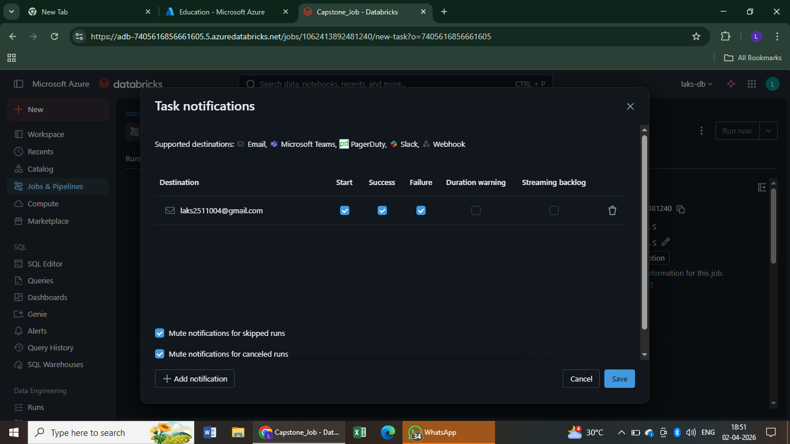
Creation of Notification

Slide 3
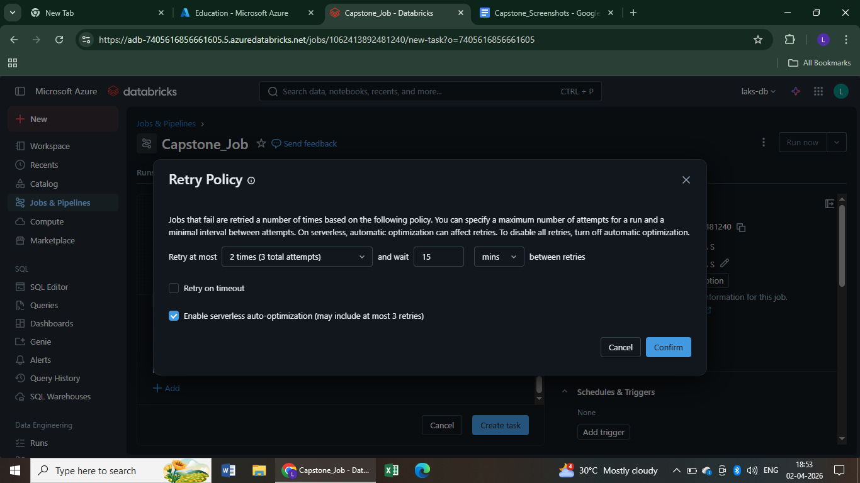
Retry Policy

Slide 4
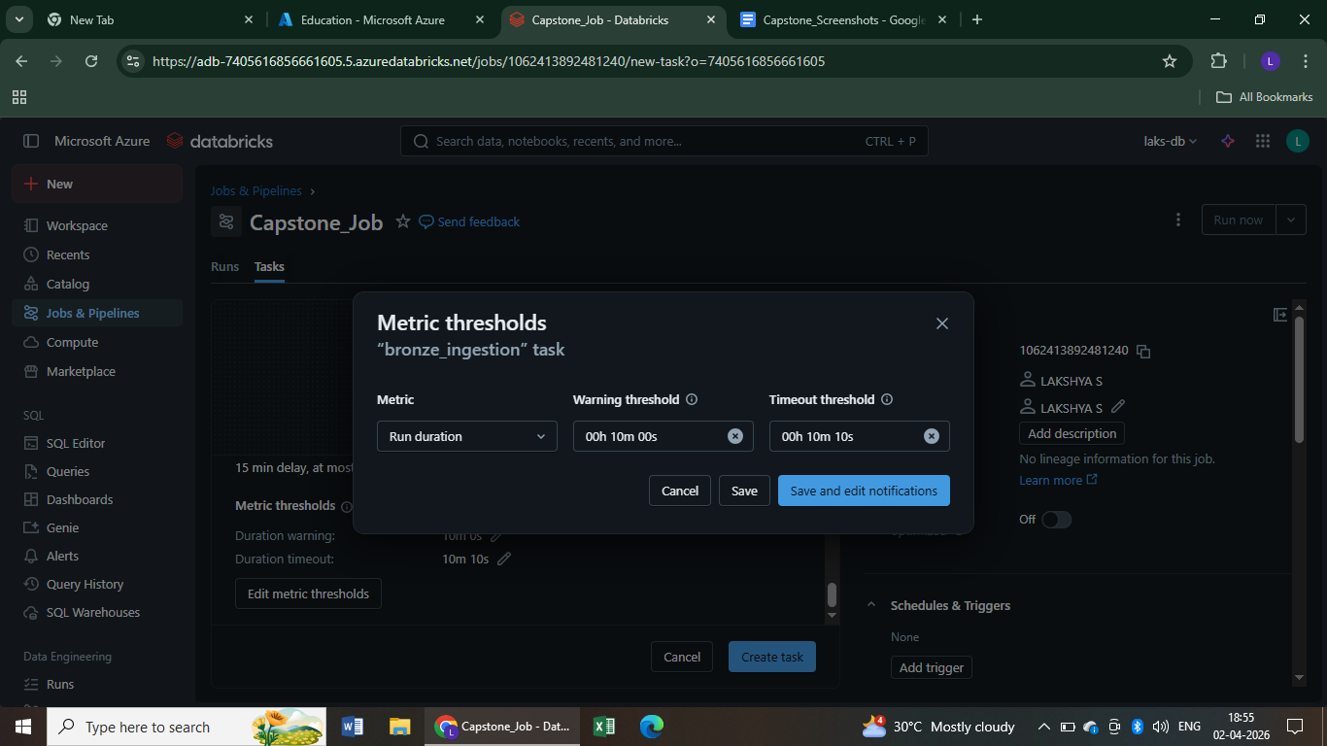
Metric Thresholds

Slide 5
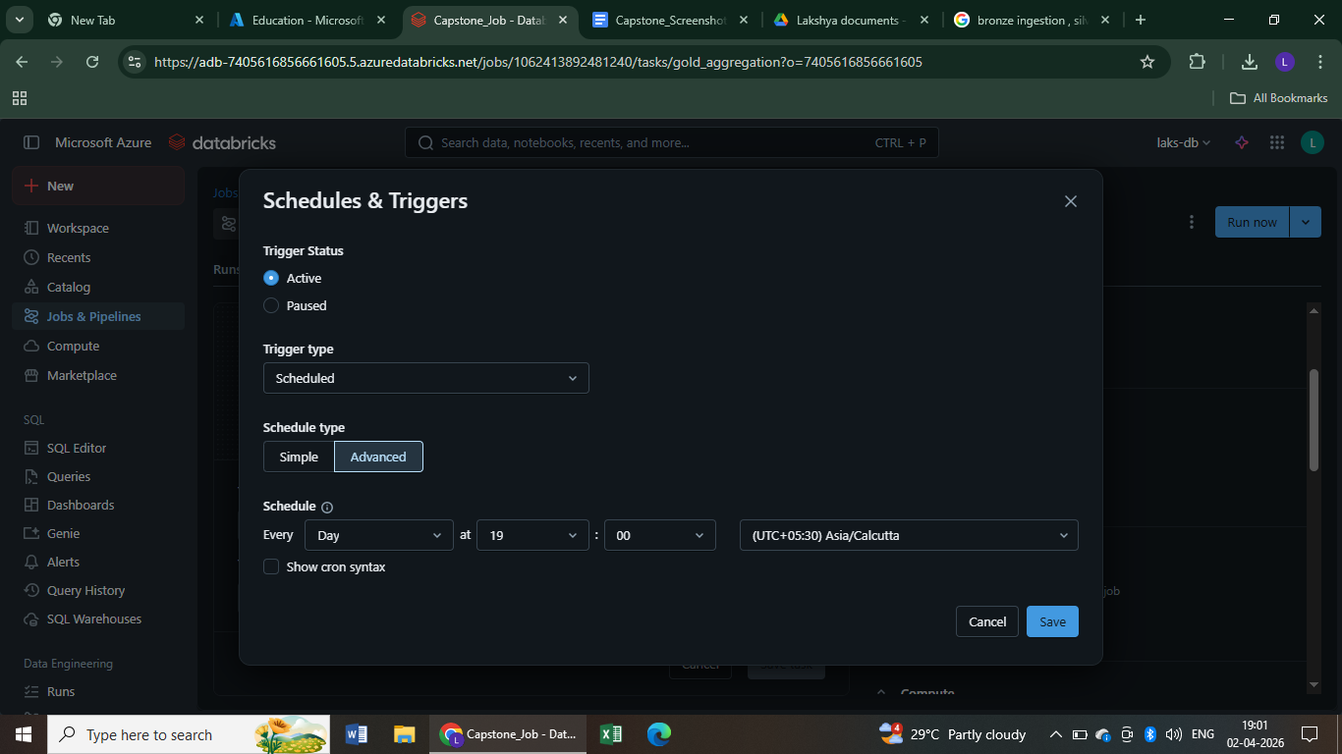
Schedule and Trigger

Slide 6
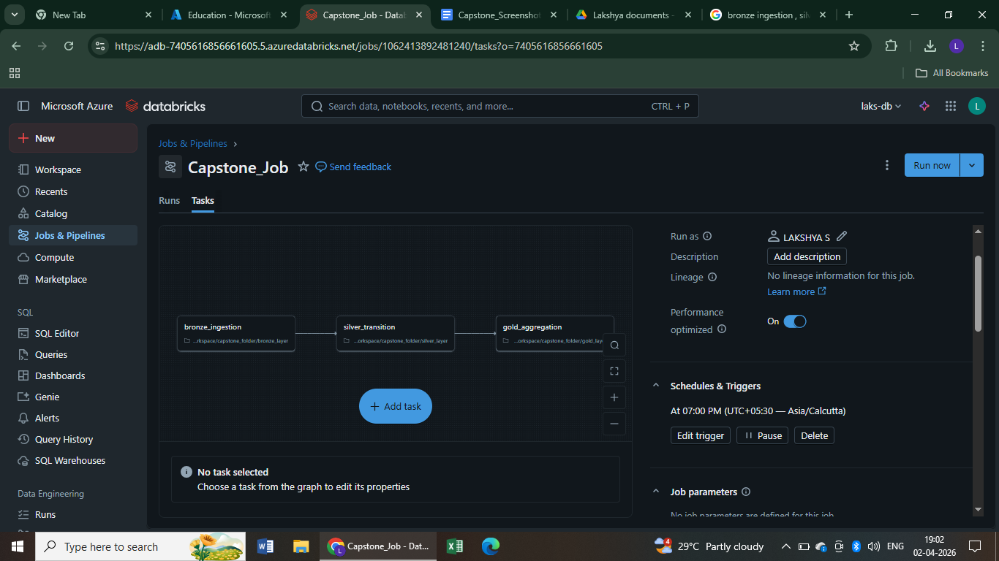

Slide 7
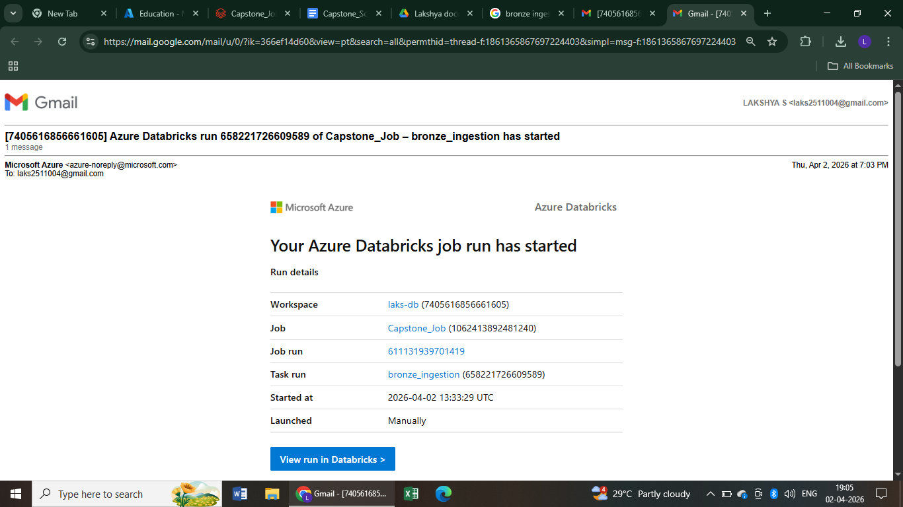
Mail When Job Started

Slide 8
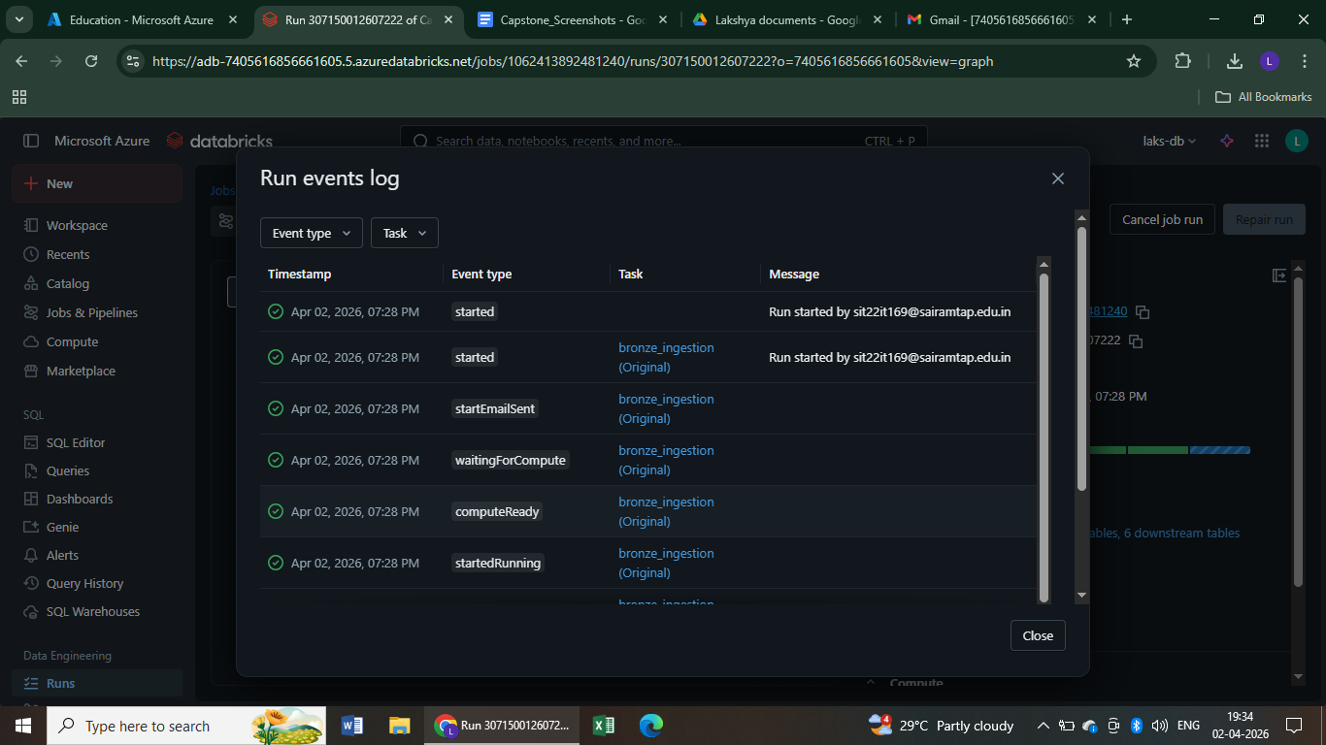
Run event Logs

Slide 9
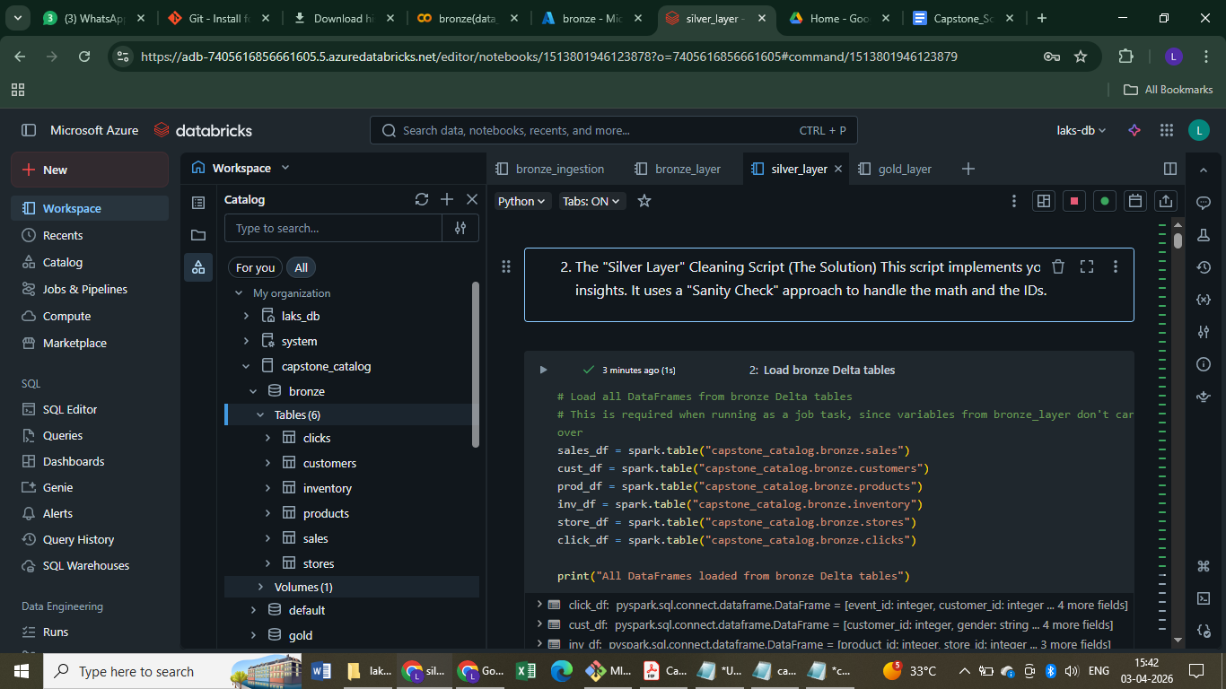
With unity catalog

Slide 10
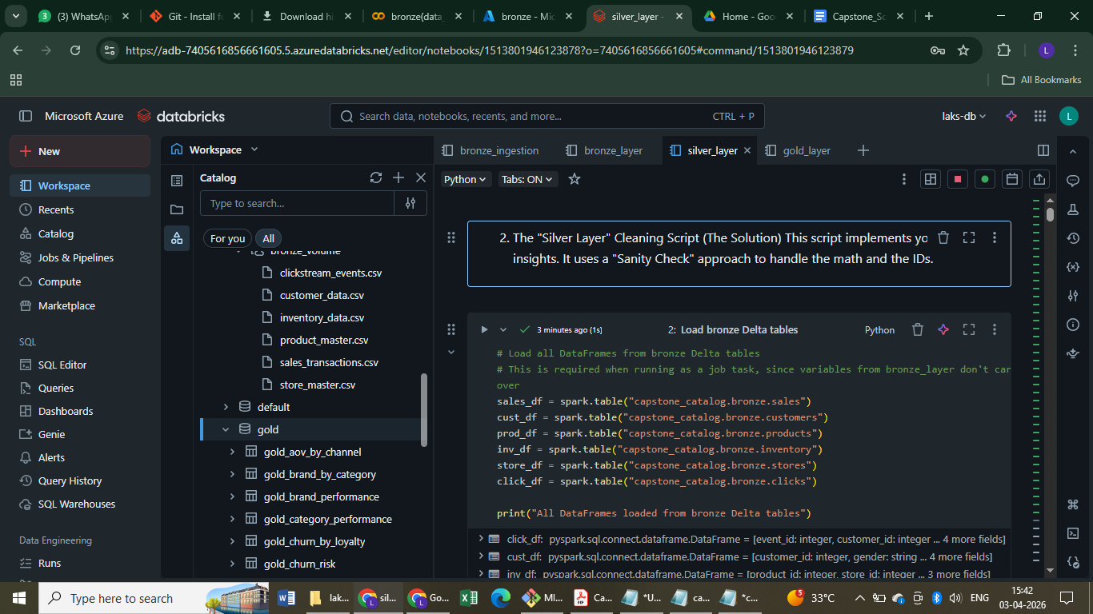

Slide 11
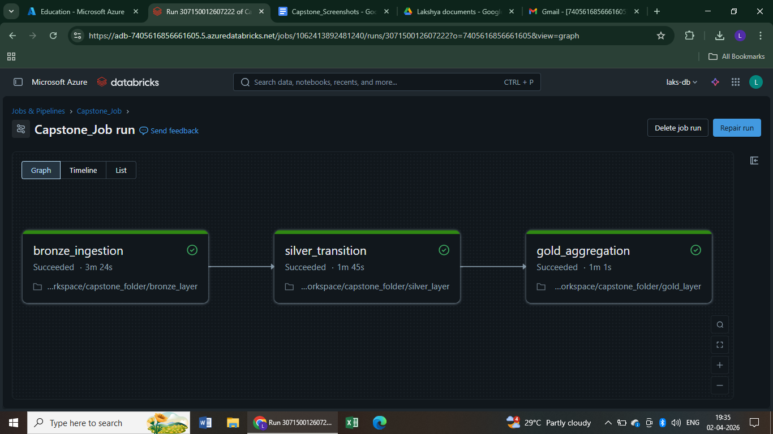
Job pipeline

Slide 12
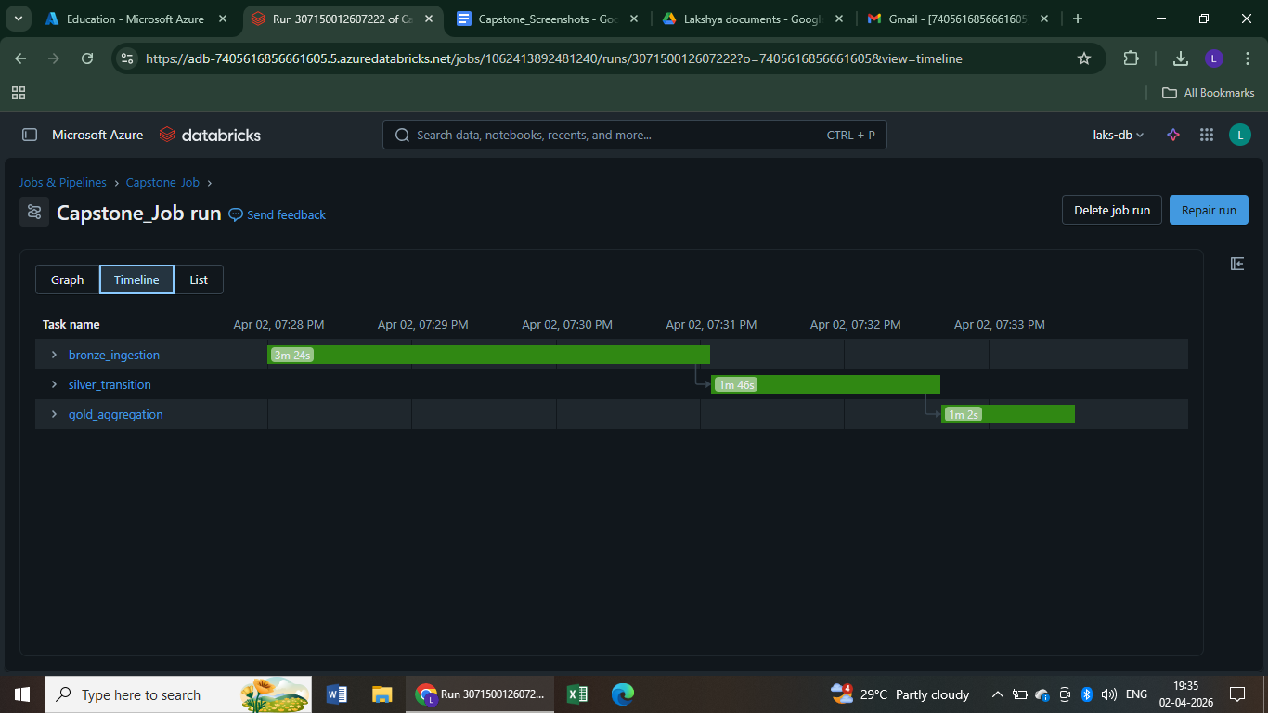
Timeline

Slide 13
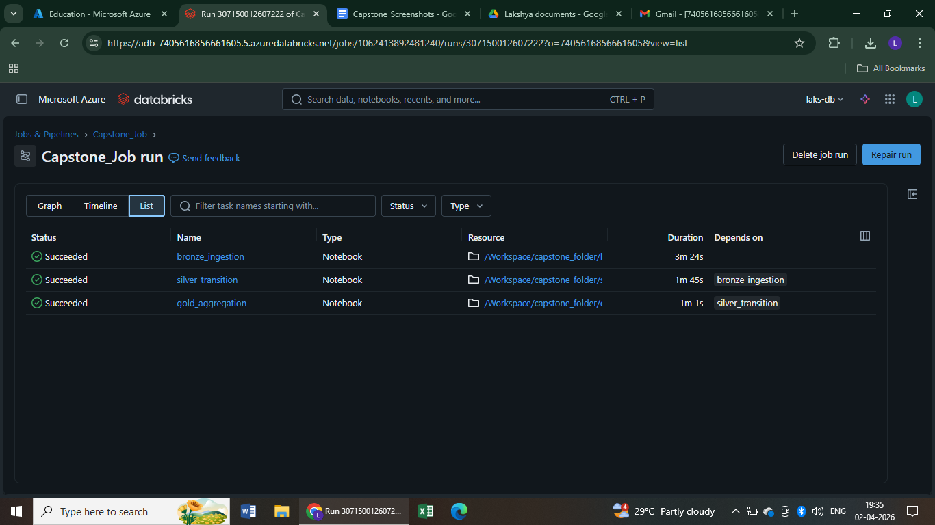
List

Slide 14
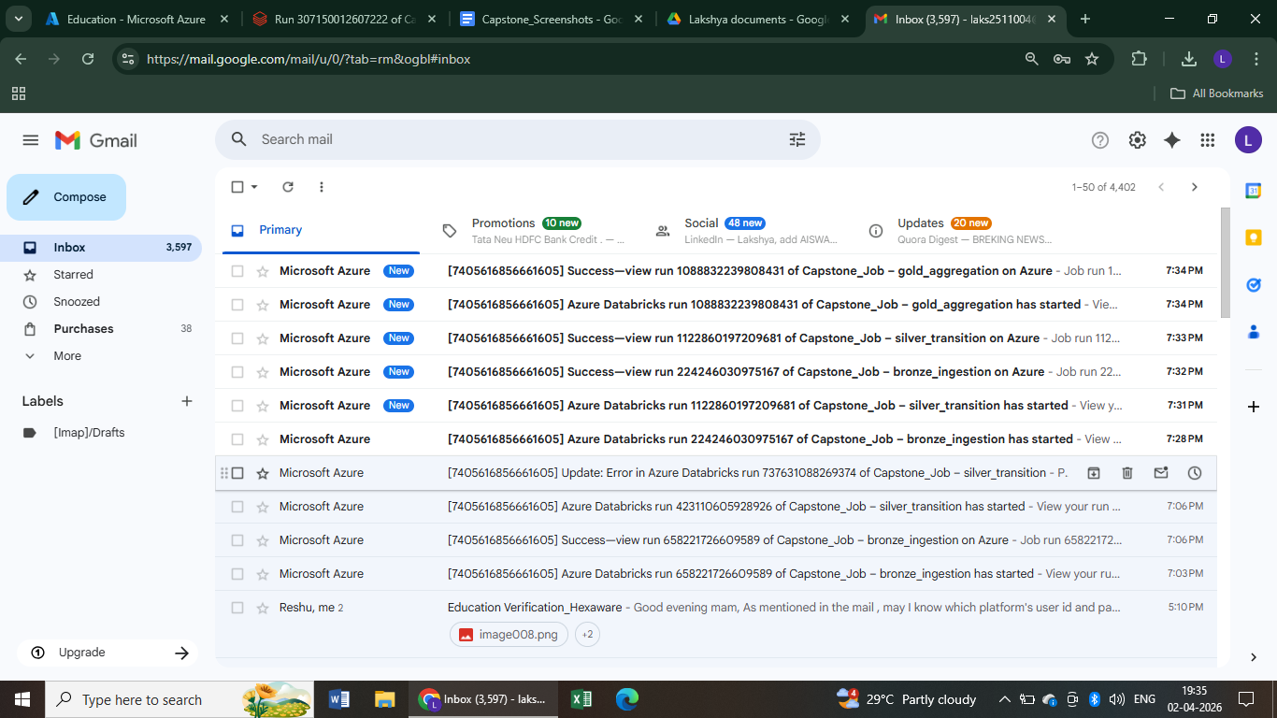
Success mails

Slide 15
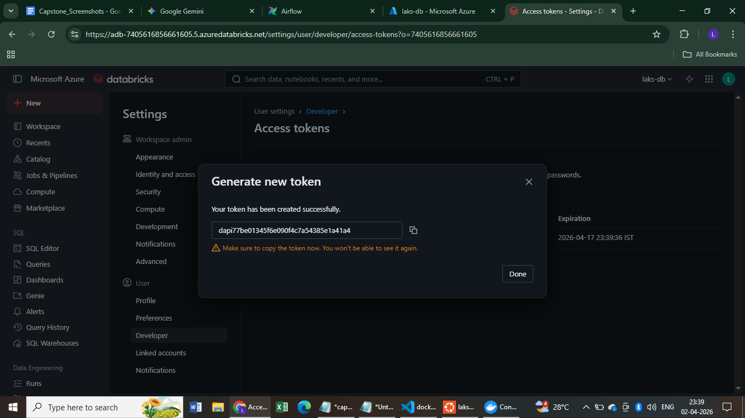
Databricks access token (airflow)

Slide 16
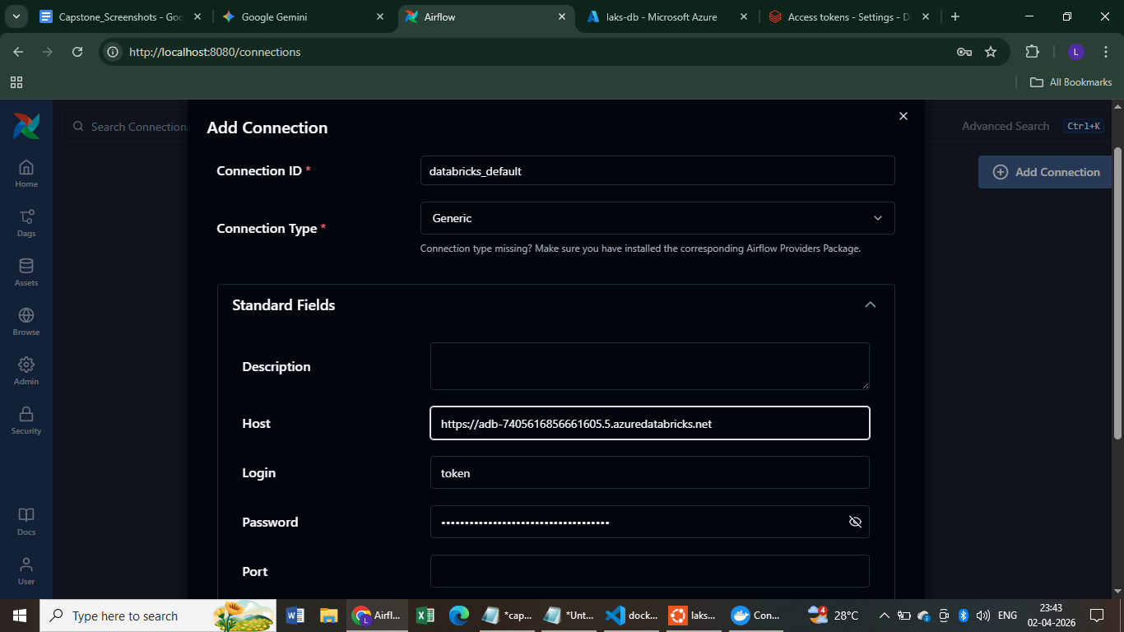

Slide 17
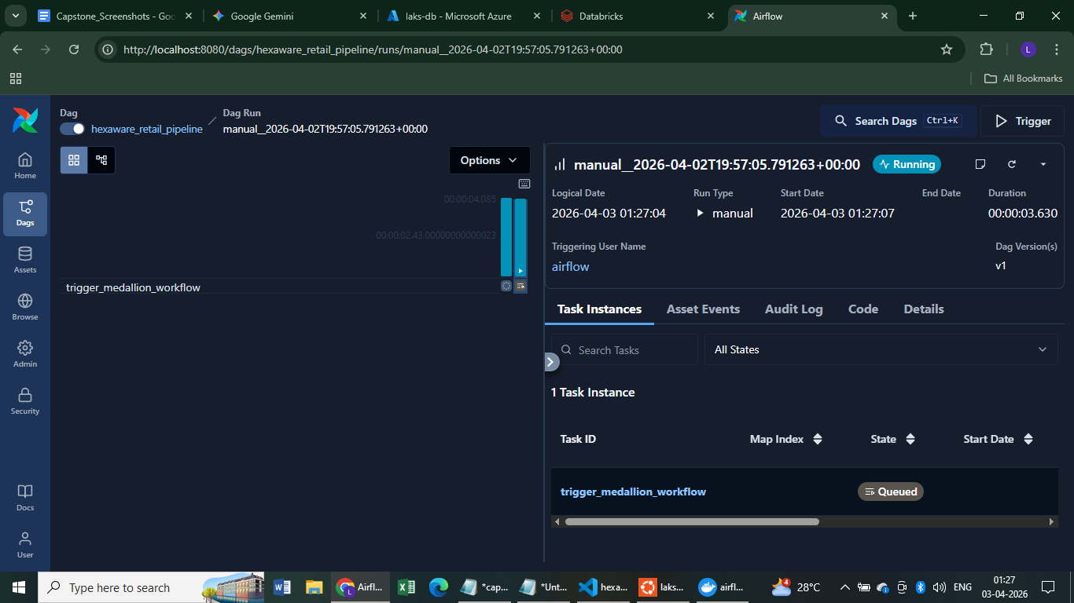

Slide 18
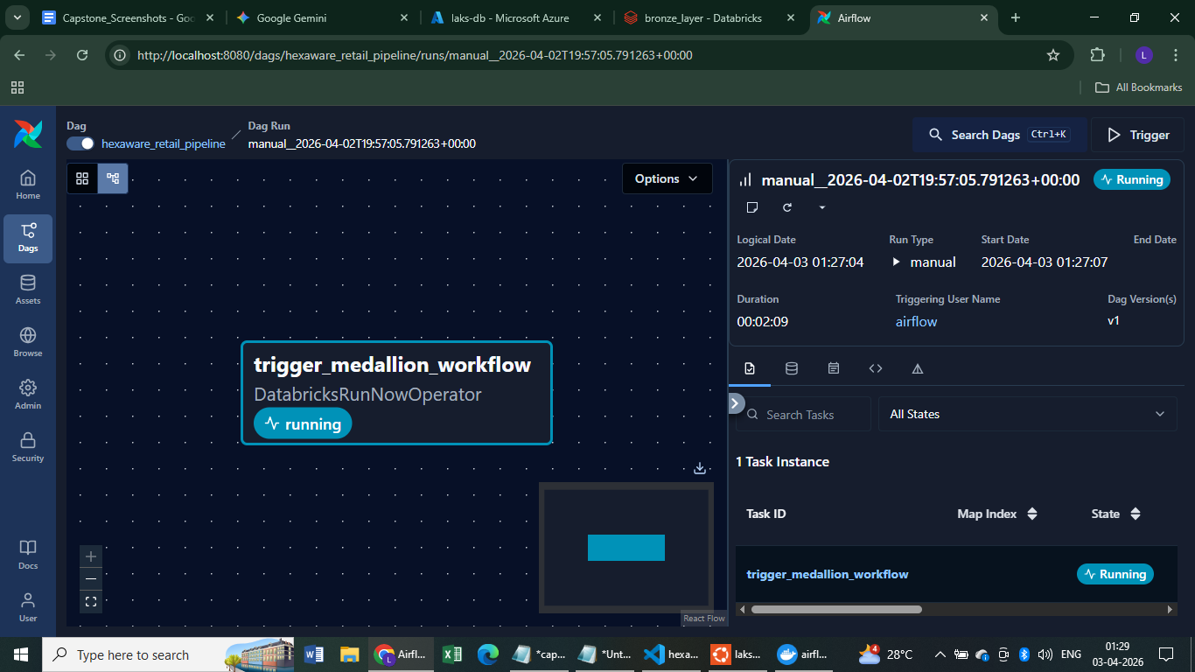

Slide 19
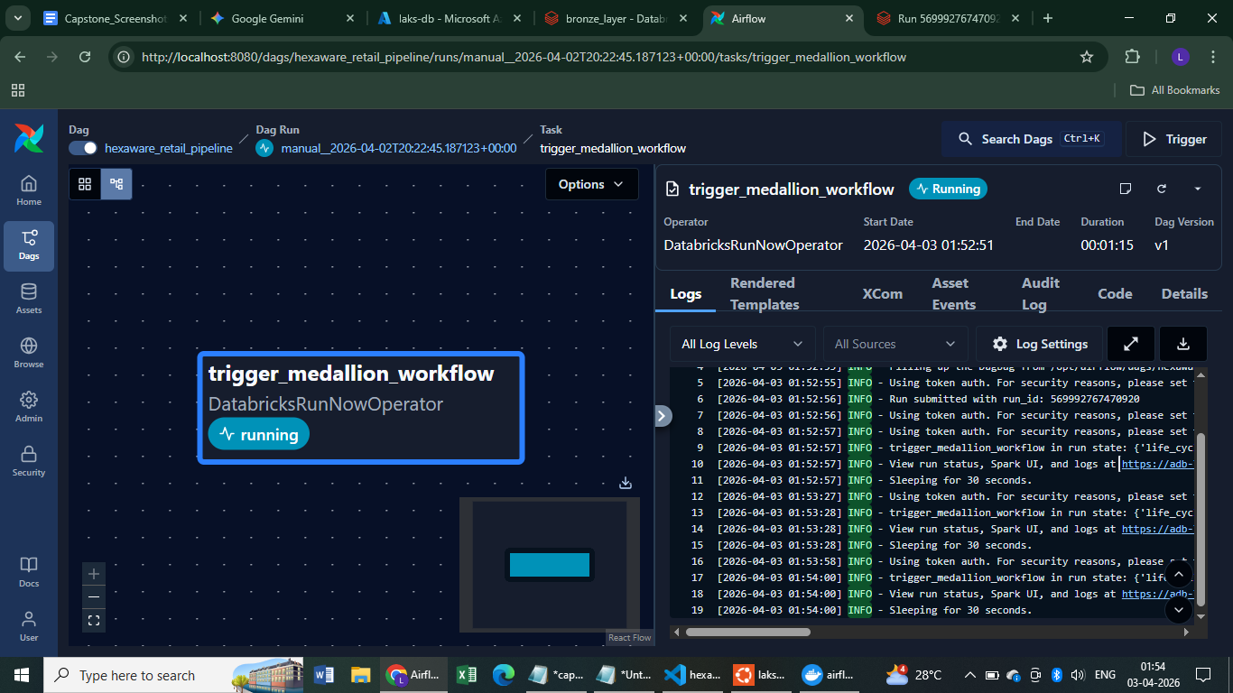

Slide 20
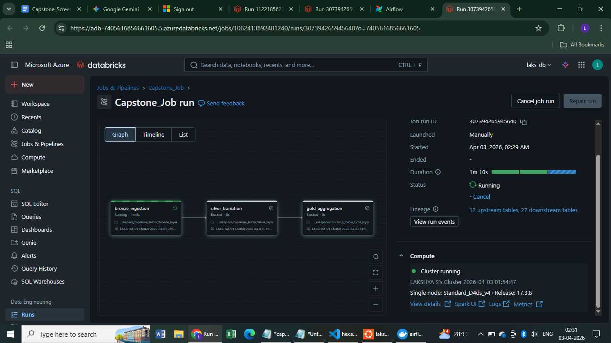

Slide 21
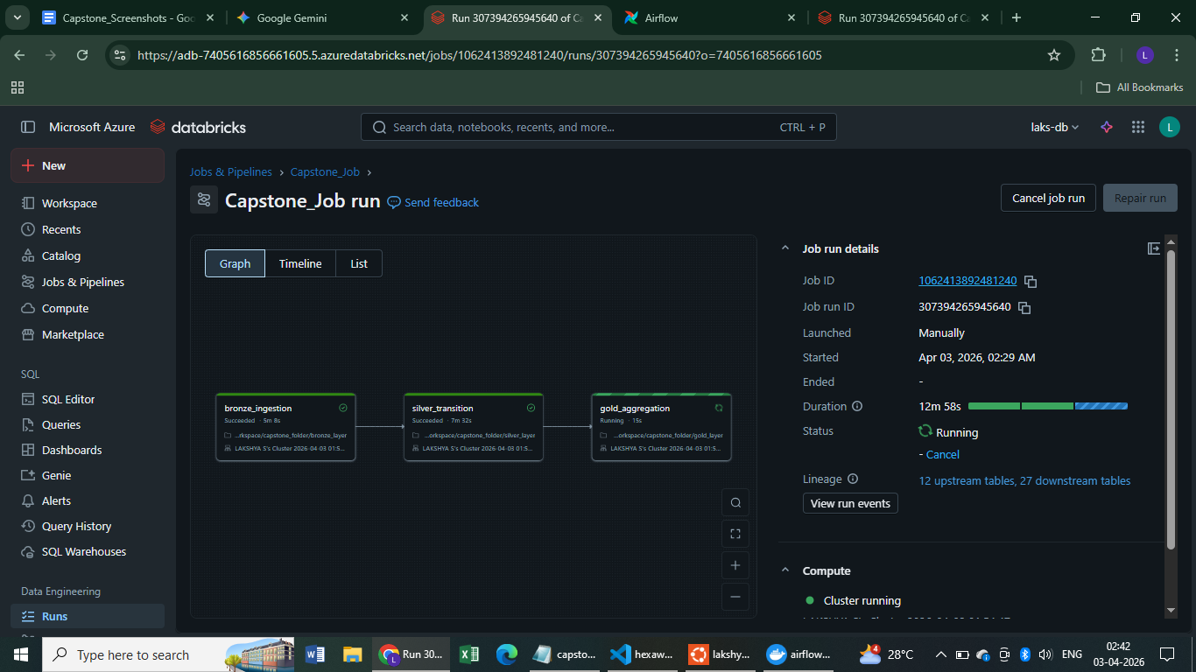

Slide 22
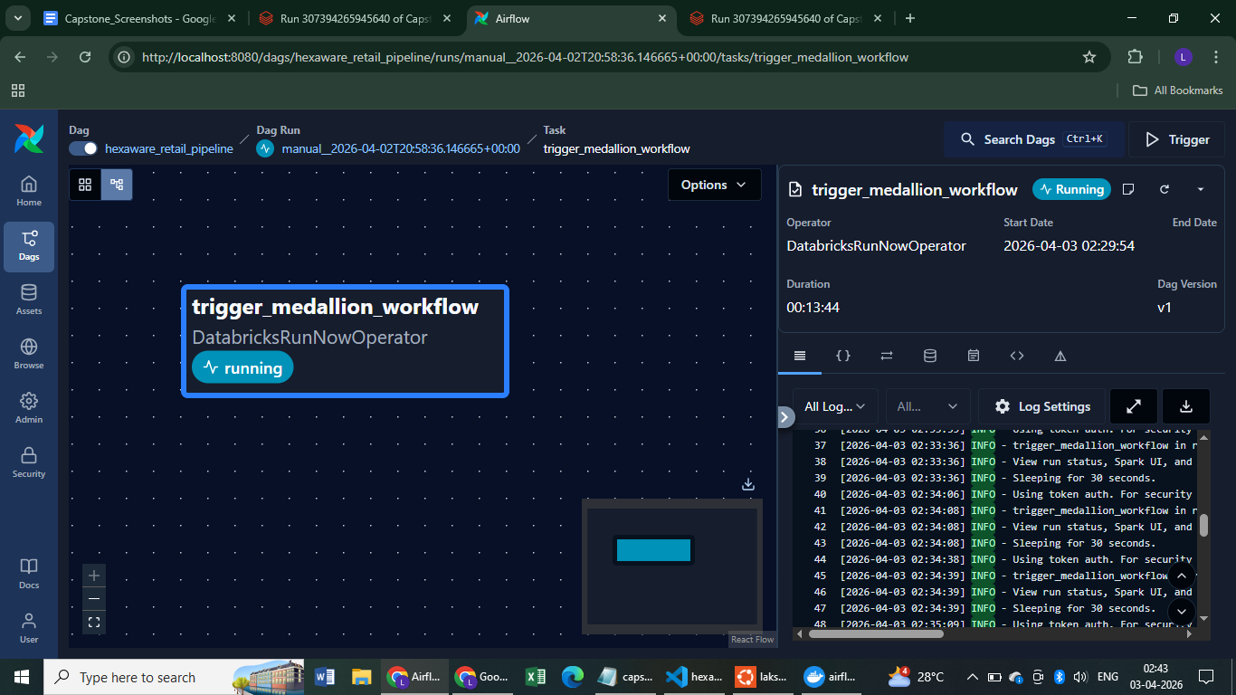

Slide 23
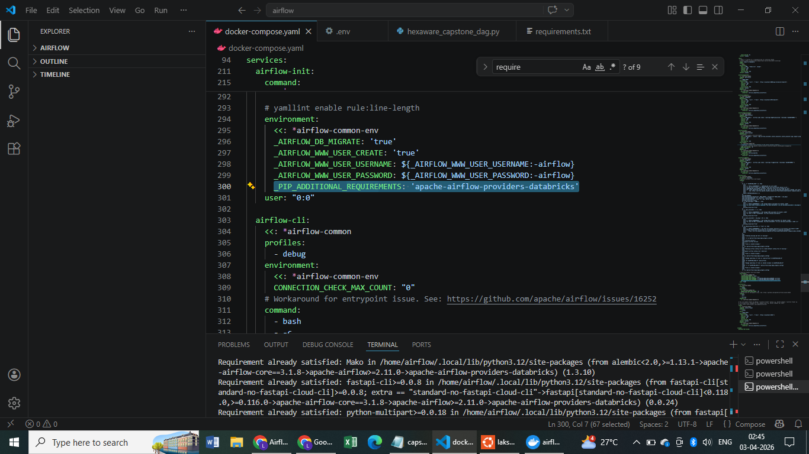
Change in YML File to Bring Databricks

Slide 24
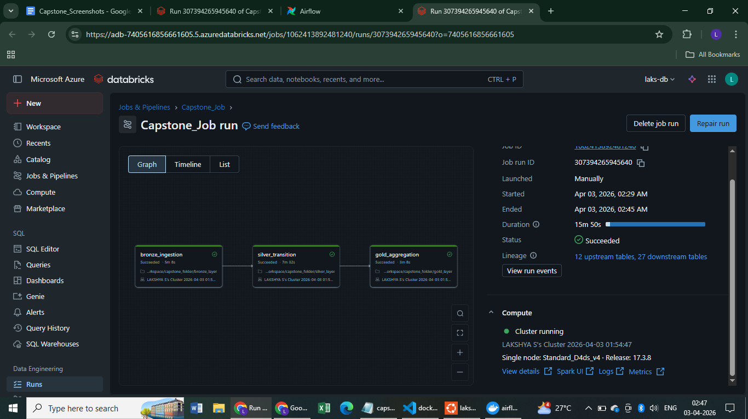
Databricks Library Under Connection

Slide 25
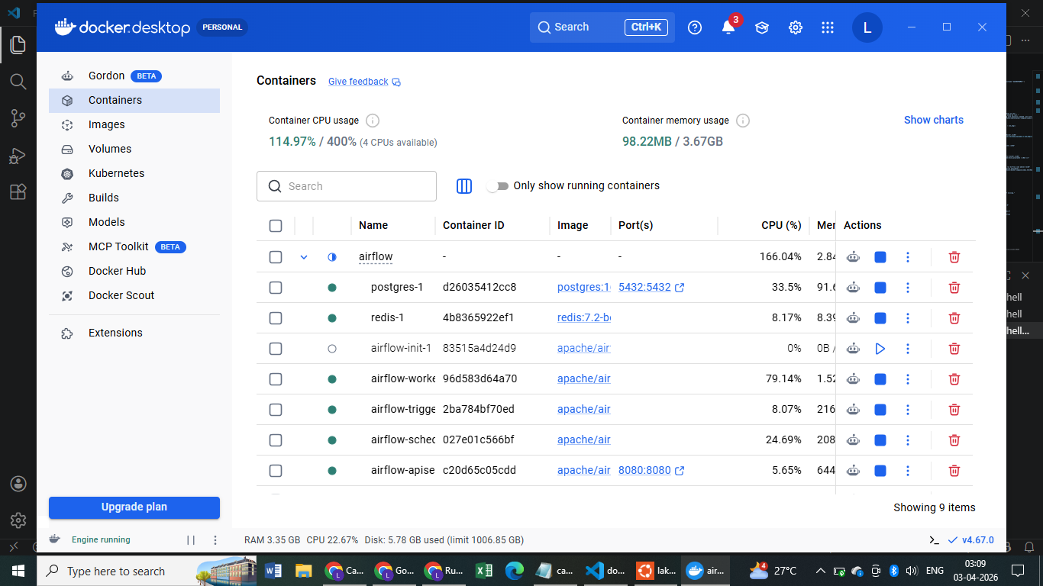
Docker desktop

Slide 26
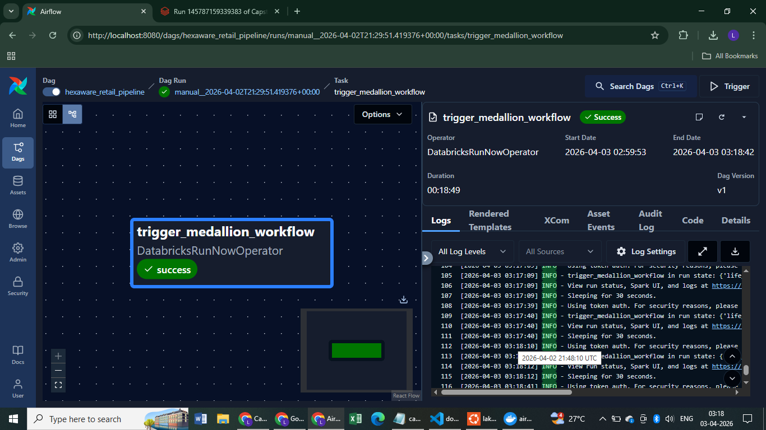
Dag run success

Slide 27
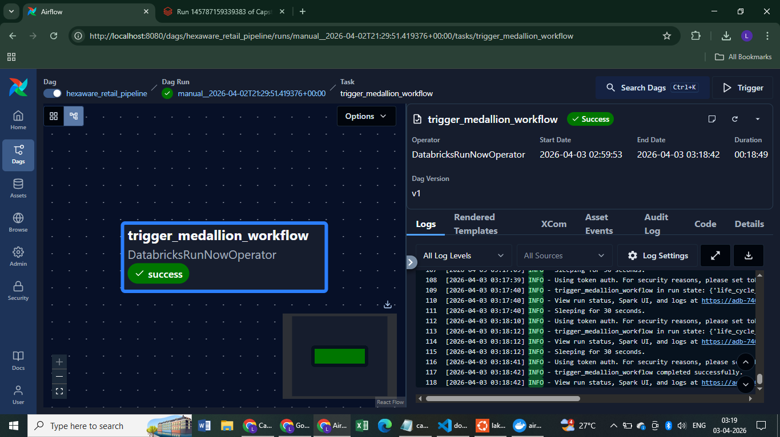

Slide 28
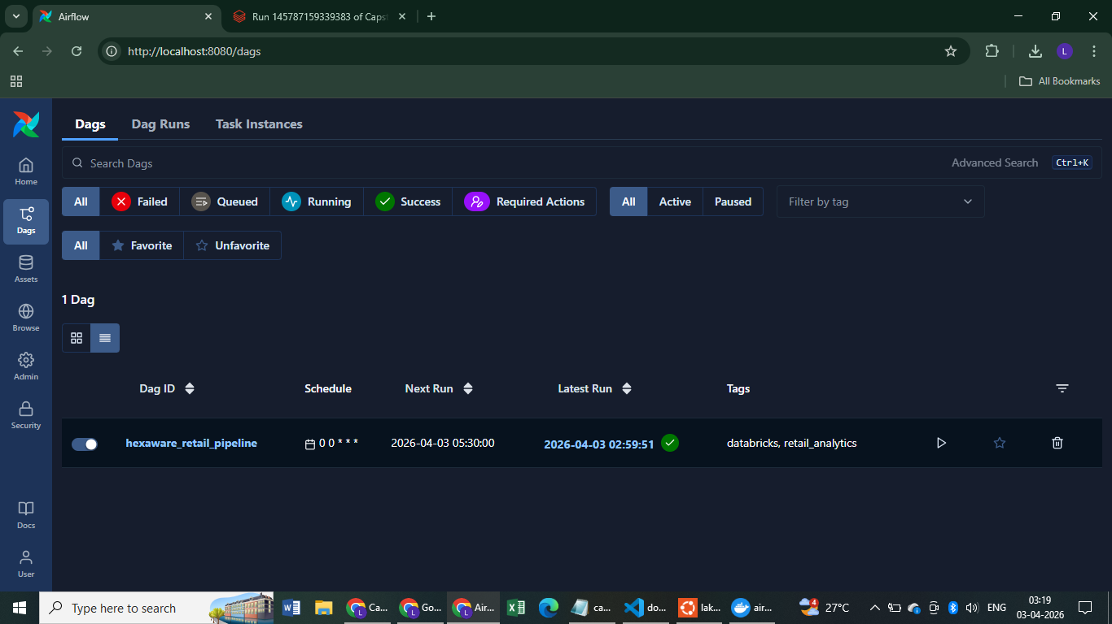

Slide 29
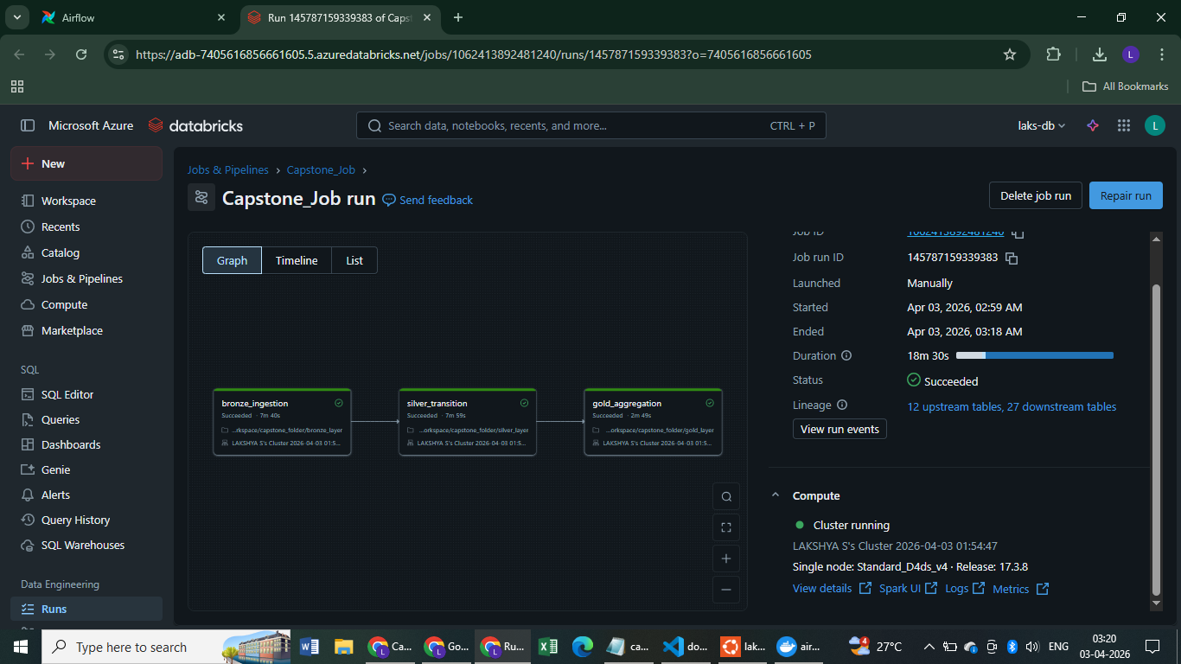

Slide 30
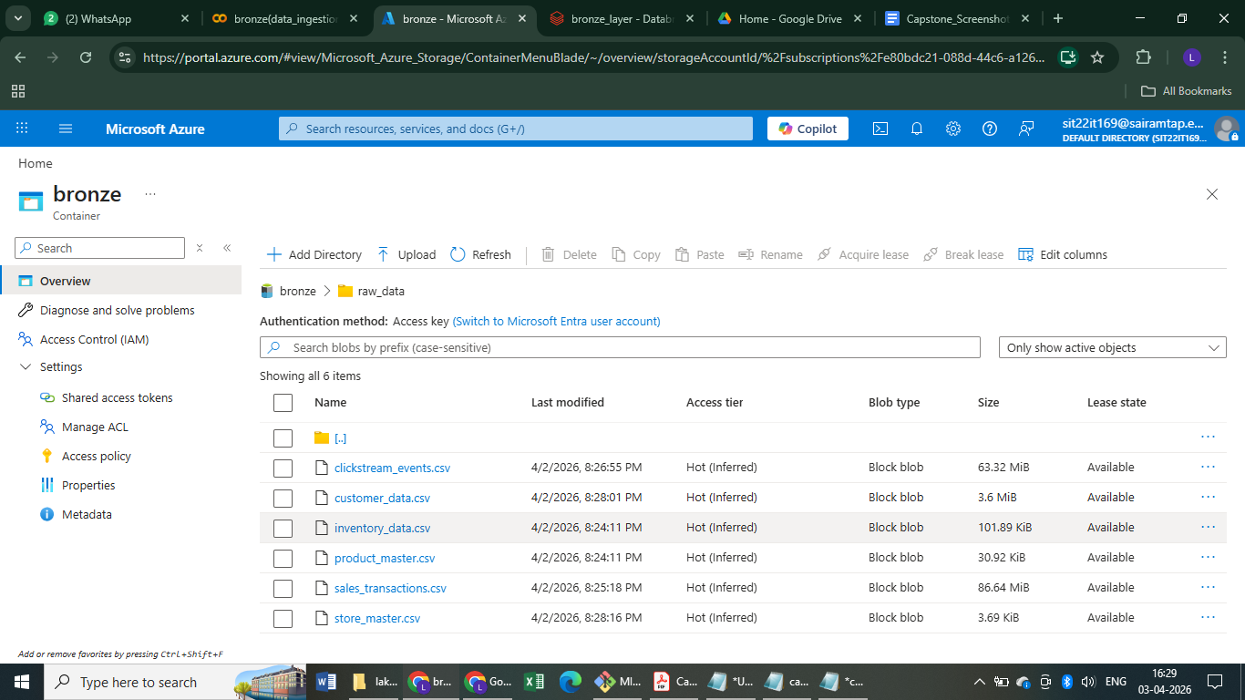
With ADLS Connection

Slide 31
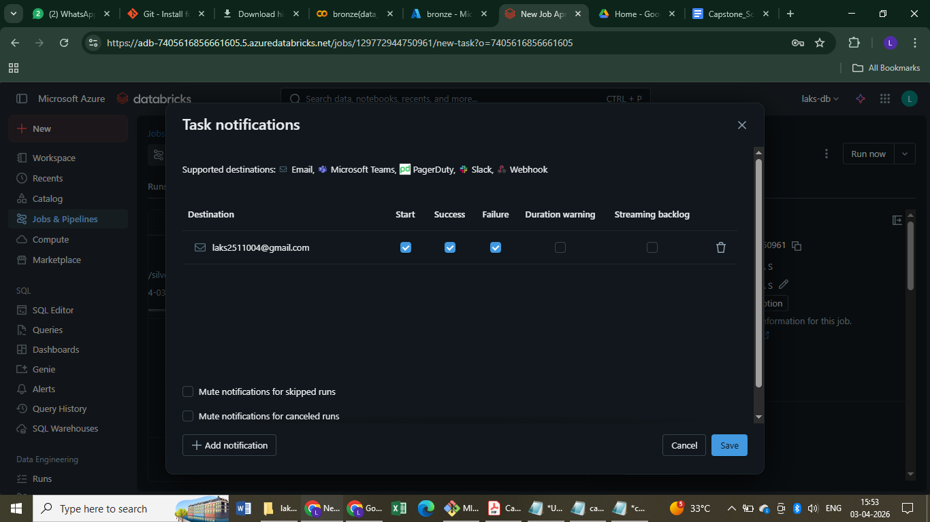
With ADLS Connection (2)

Slide 32
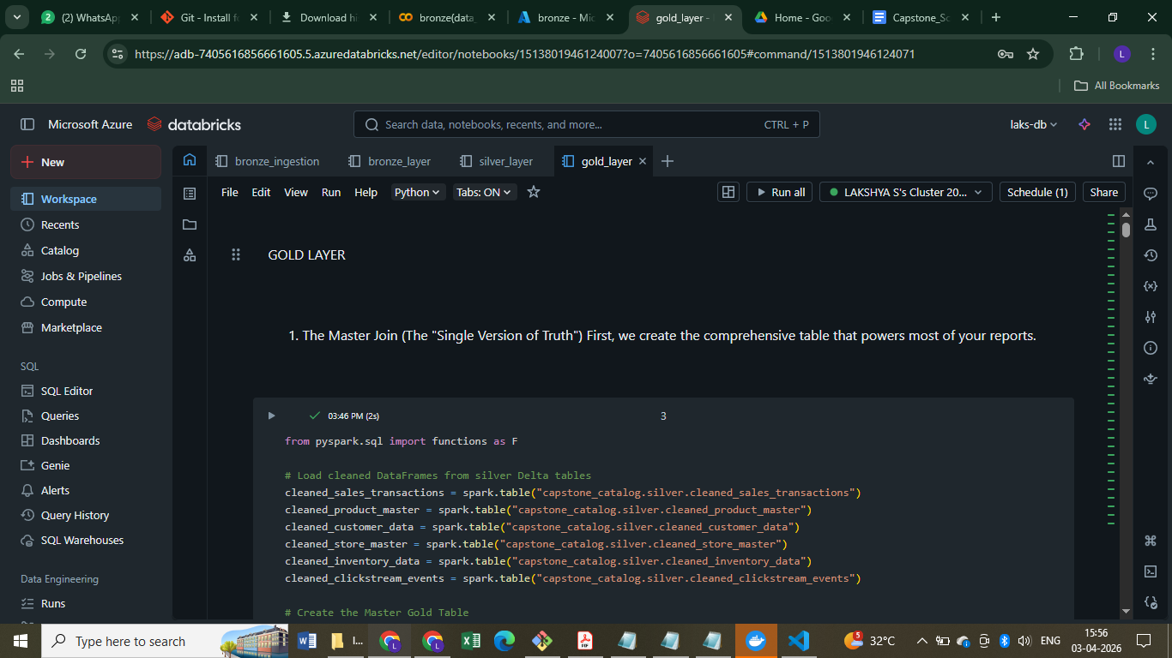
With ADLS Connection (3)

Slide 33
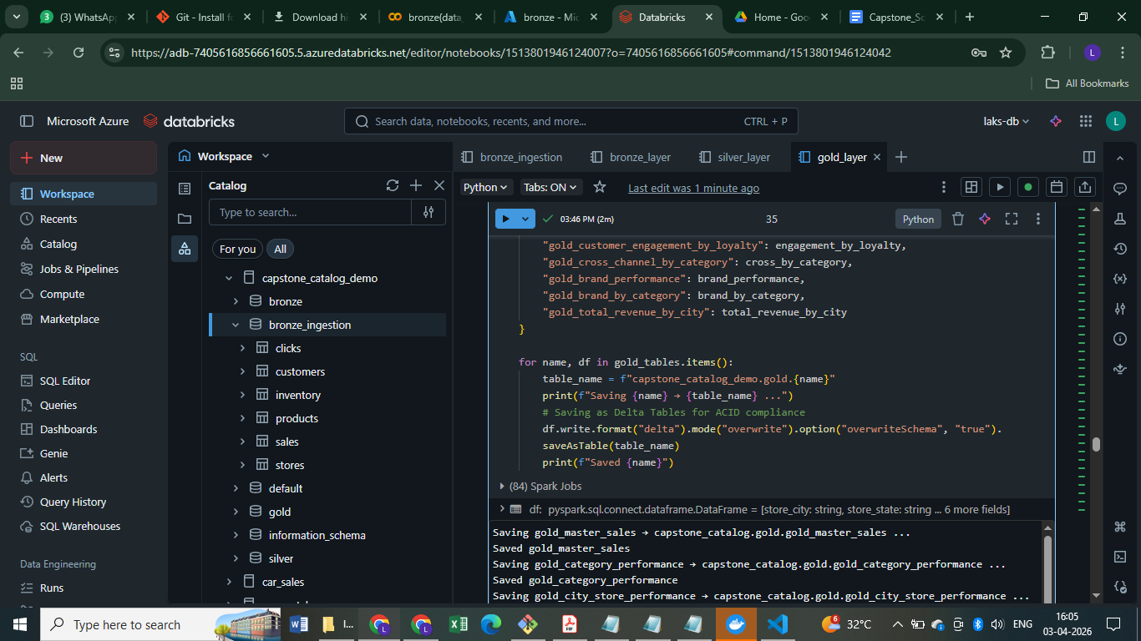
With ADLS Connection (4)

Slide 34
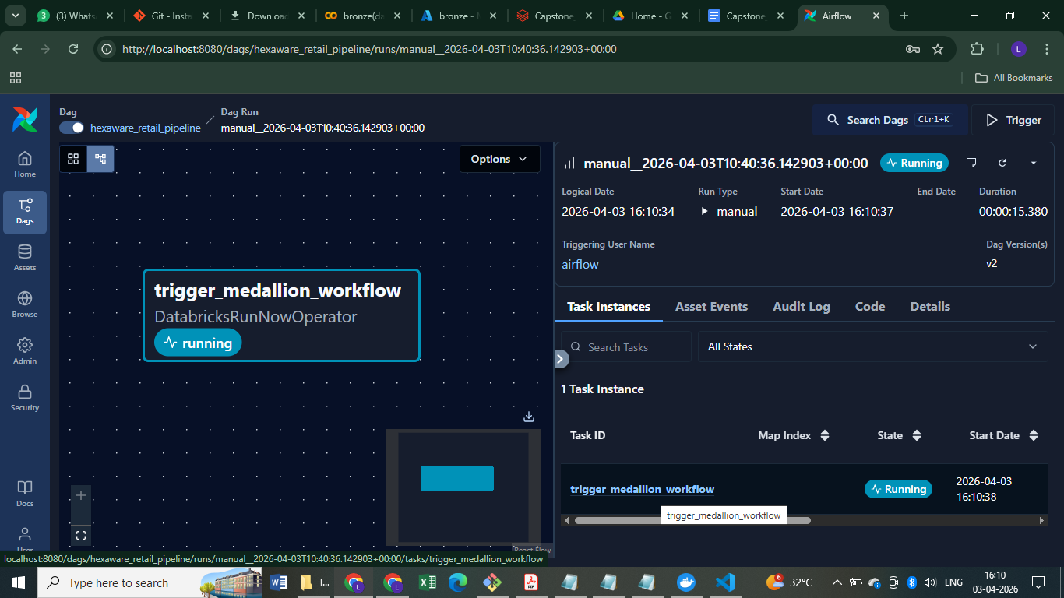
With ADLS Connection (5)

Slide 35
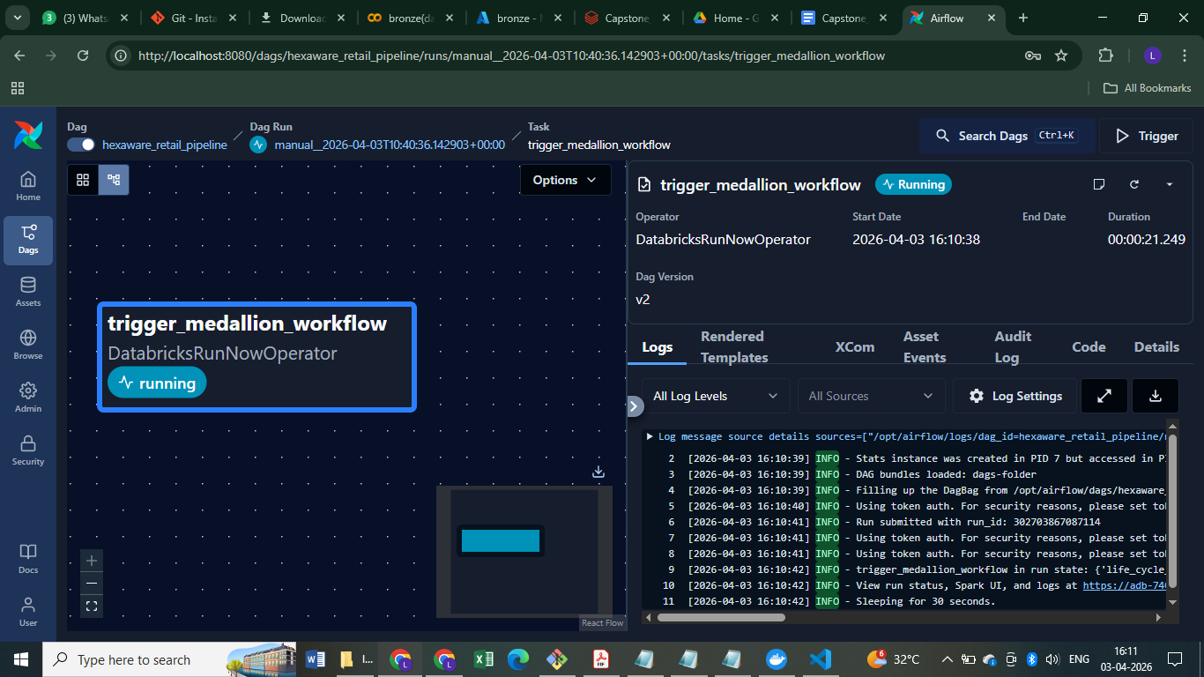
With ADLS Connection (6)

Slide 36
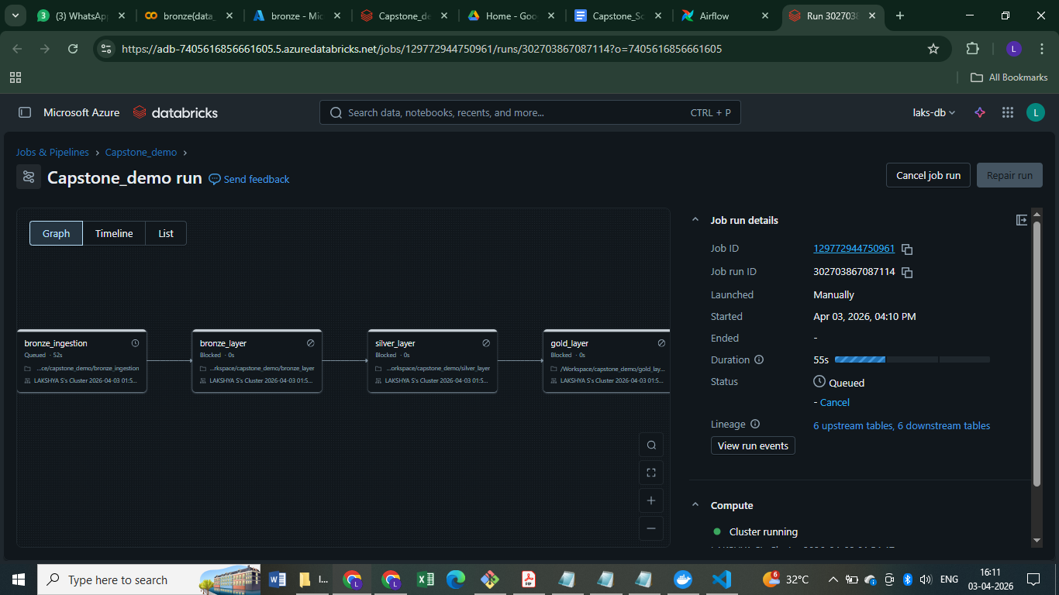
With ADLS Connection (7)

Slide 37
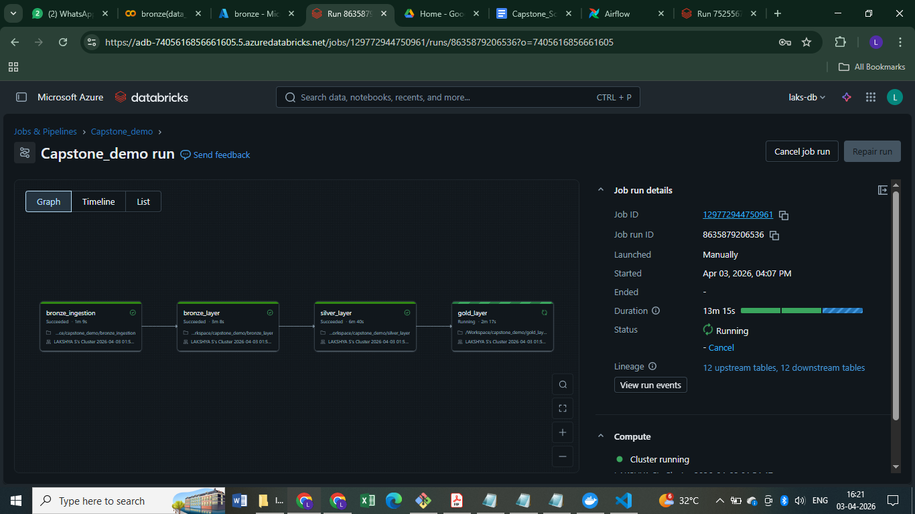
With ADLS Connection (8)

Slide 38
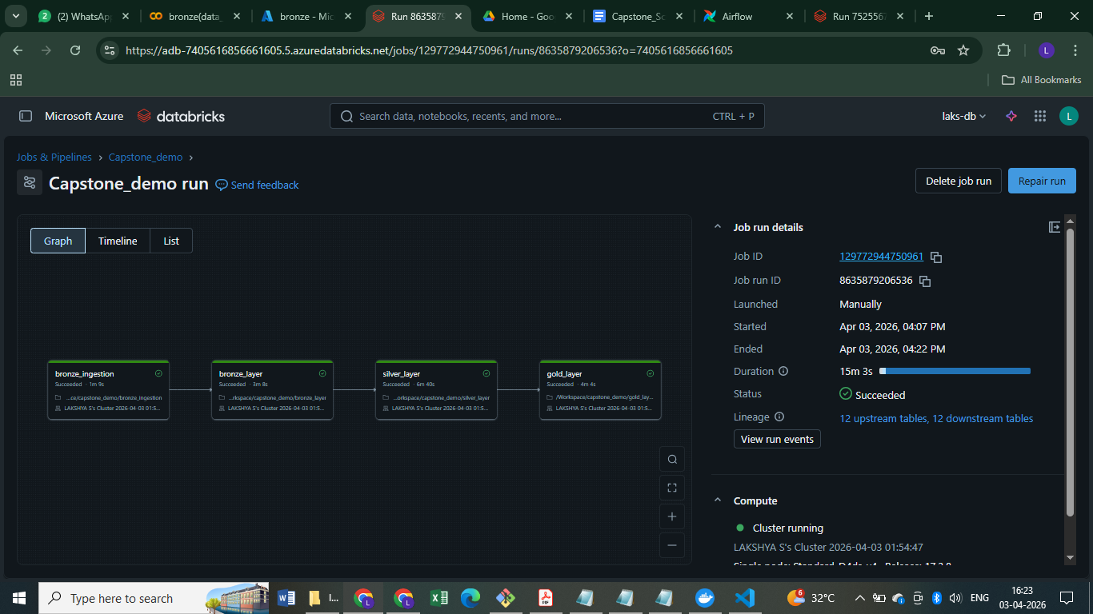
With ADLS Connection (9)

Slide 39
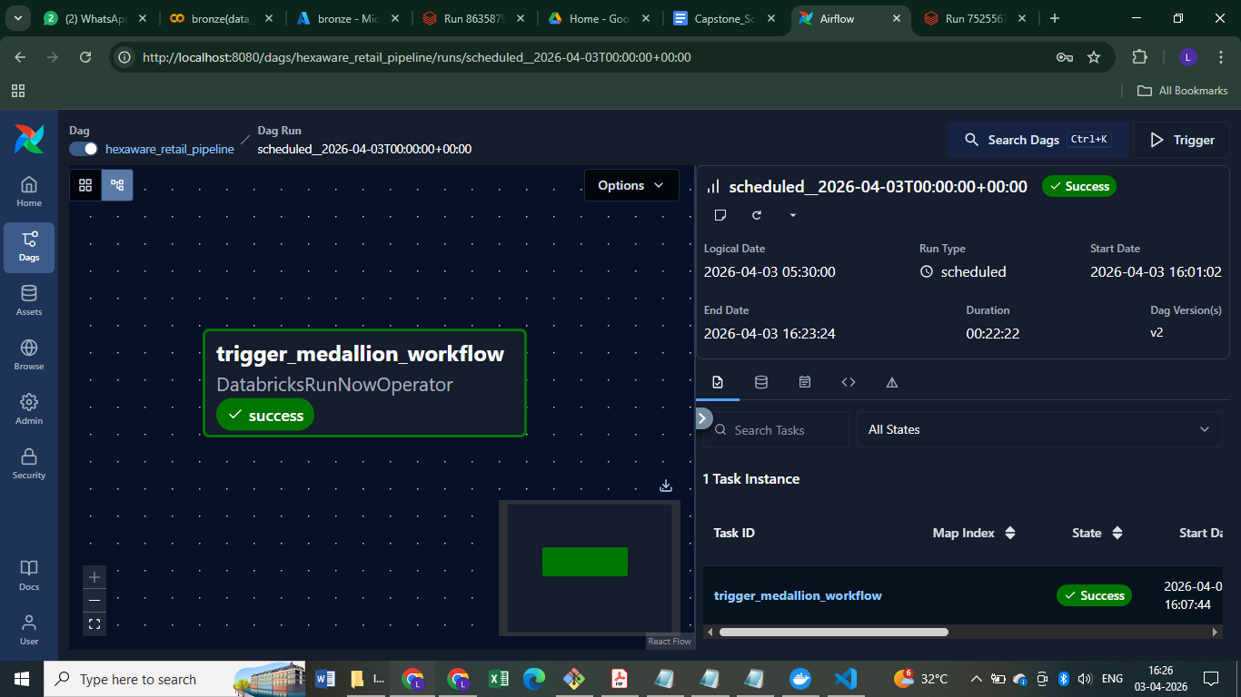
With ADLS Connection (10)

Slide 40
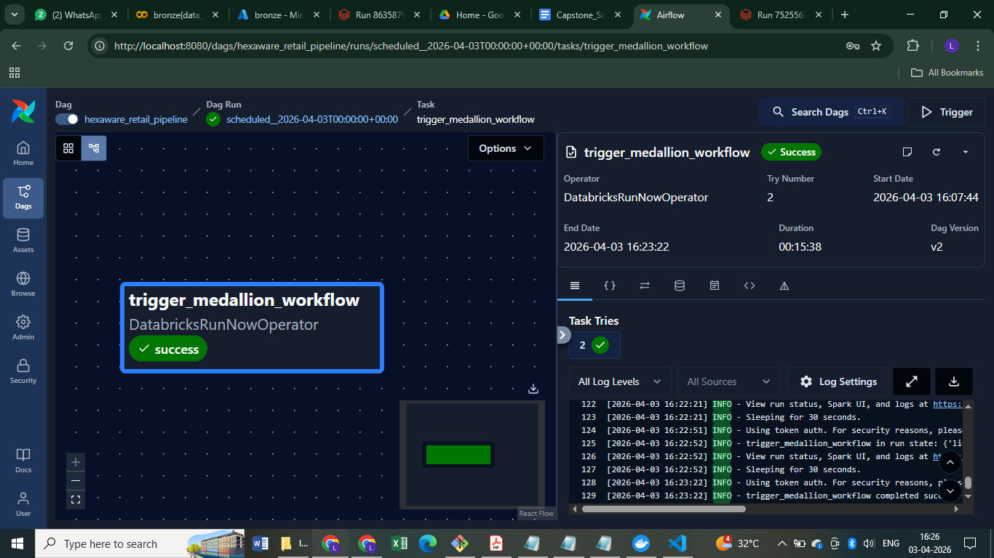
With ADLS Connection (11)

Slide 41
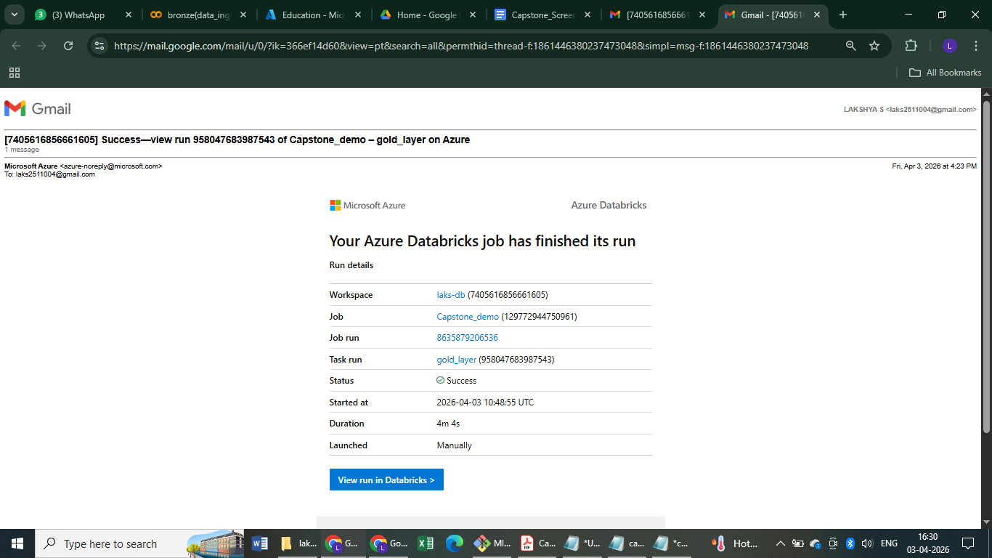
Success Mail

Slide 42
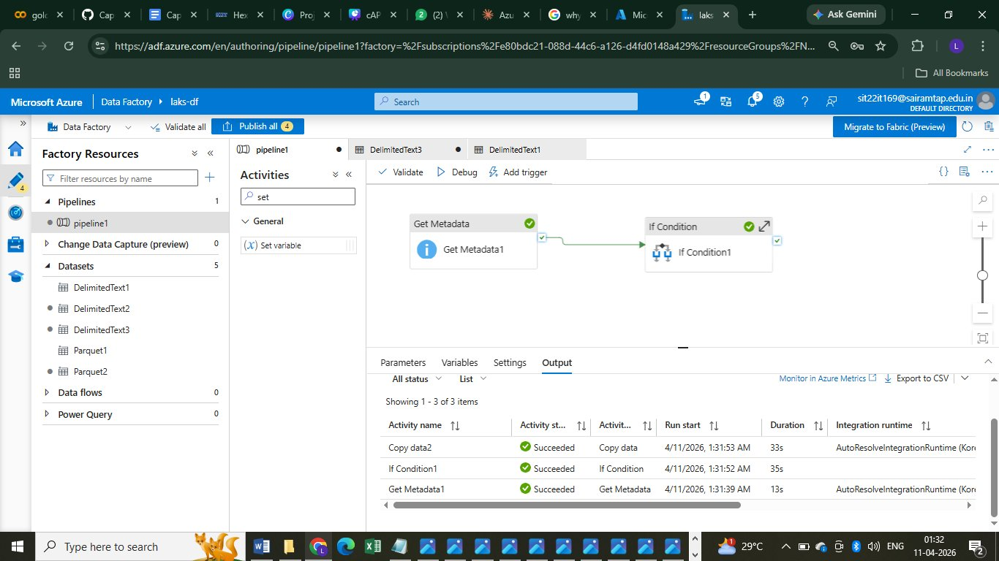
ADF Pipeline — Get Metadata + If Condition (Succeeded)

Slide 43
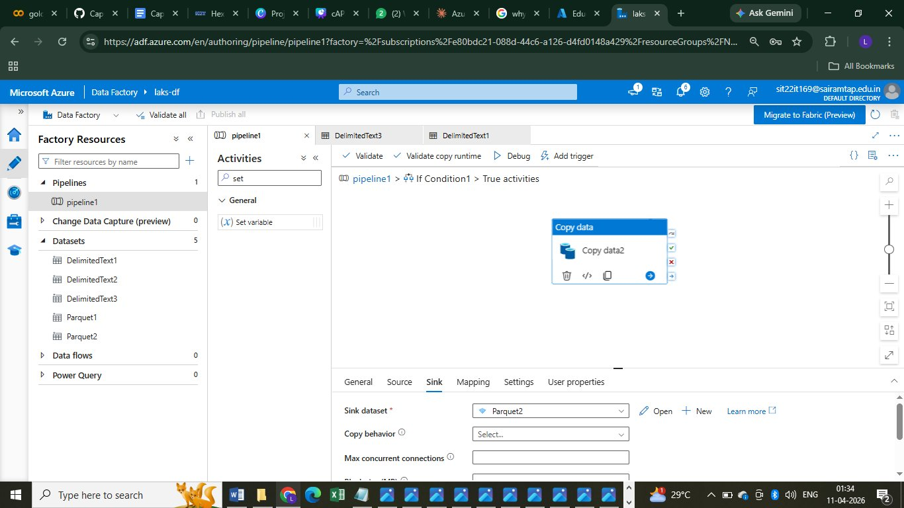
ADF Pipeline — True Branch: Copy data2 (Sink: Parquet2)

Slide 44
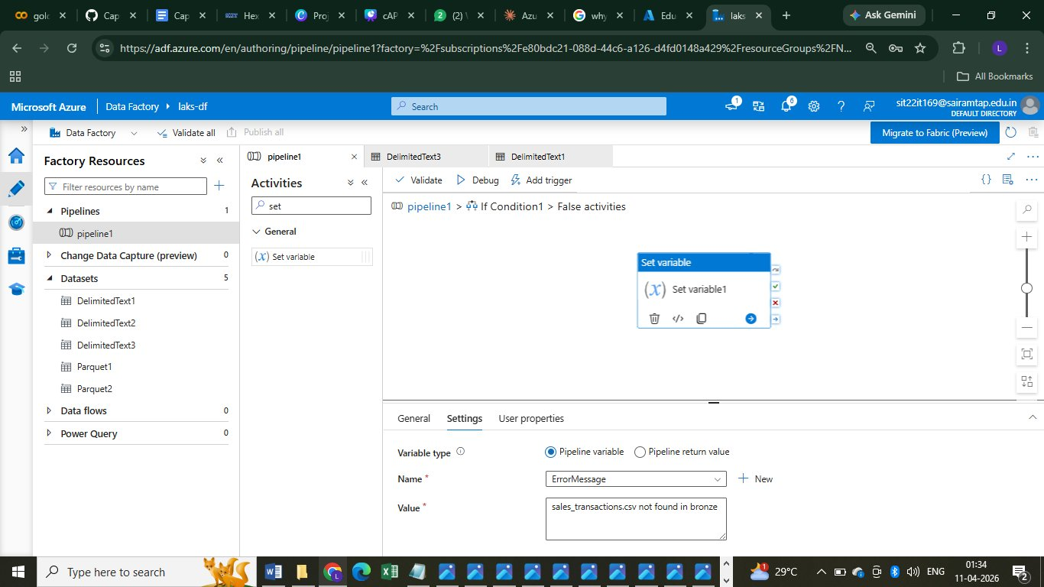
ADF Pipeline — False Branch: Set Variable (File not found)

Slide 45
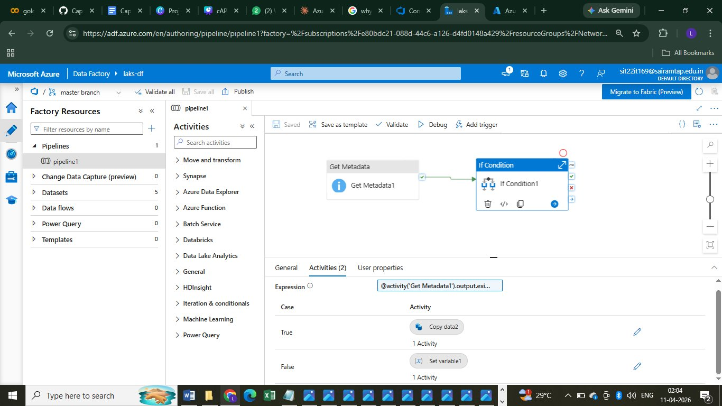
ADF Pipeline — Full Pipeline View with If Condition

Slide 46
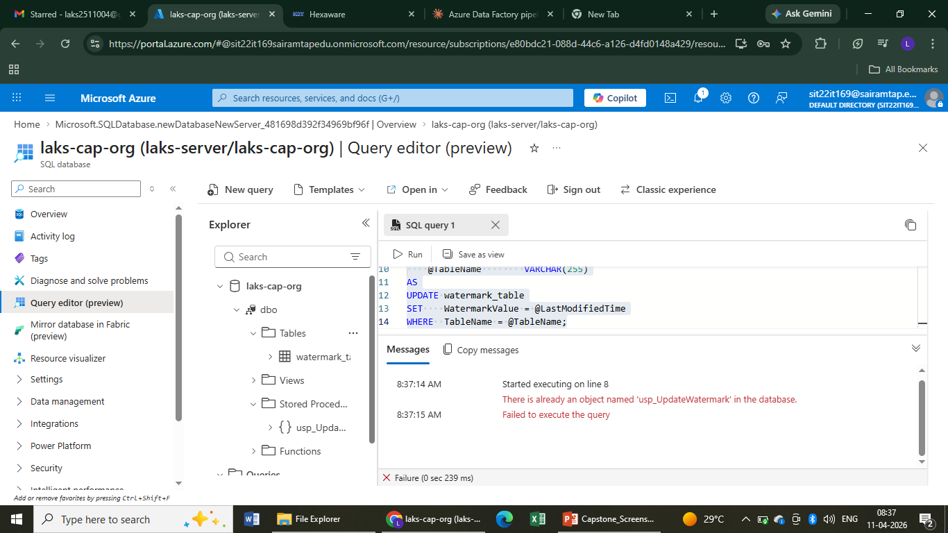

Slide 47
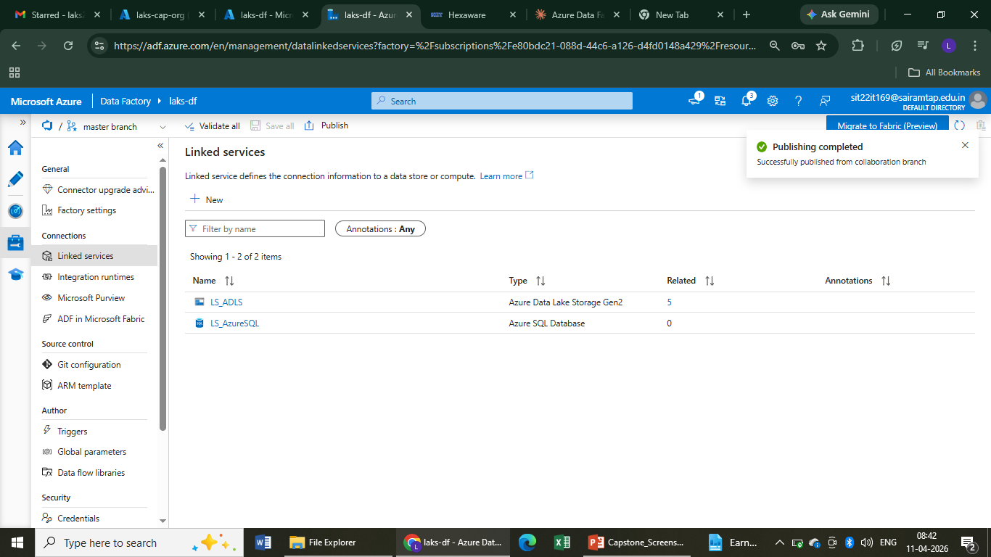

Slide 48
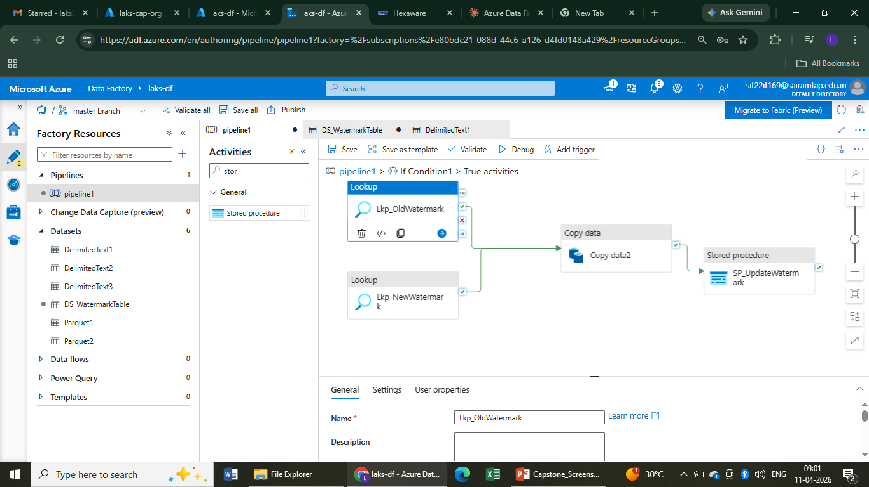

Slide 49
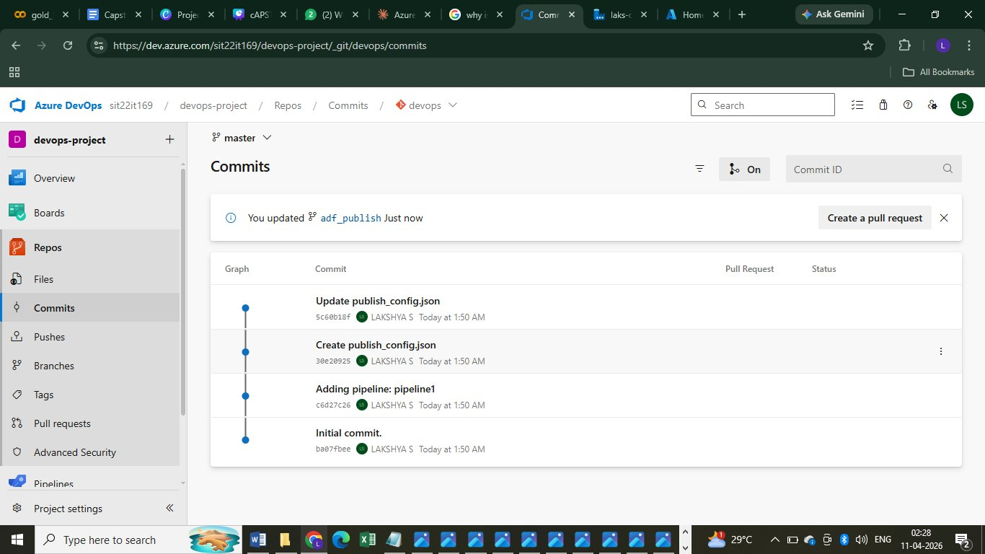
Azure DevOps — ADF Pipeline Git Commits

Slide 50
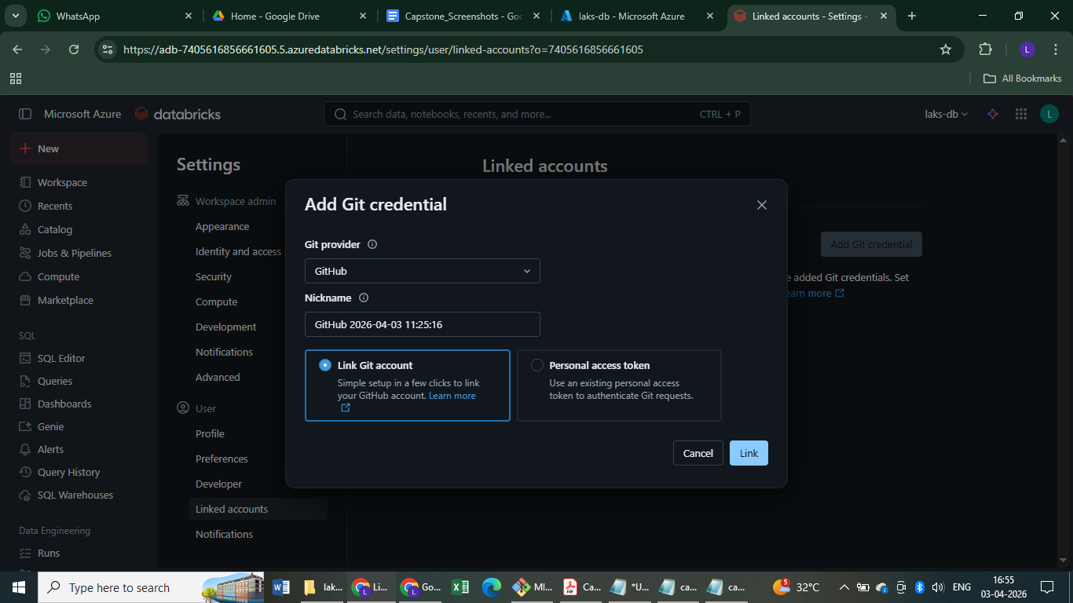
Git connection

Slide 51
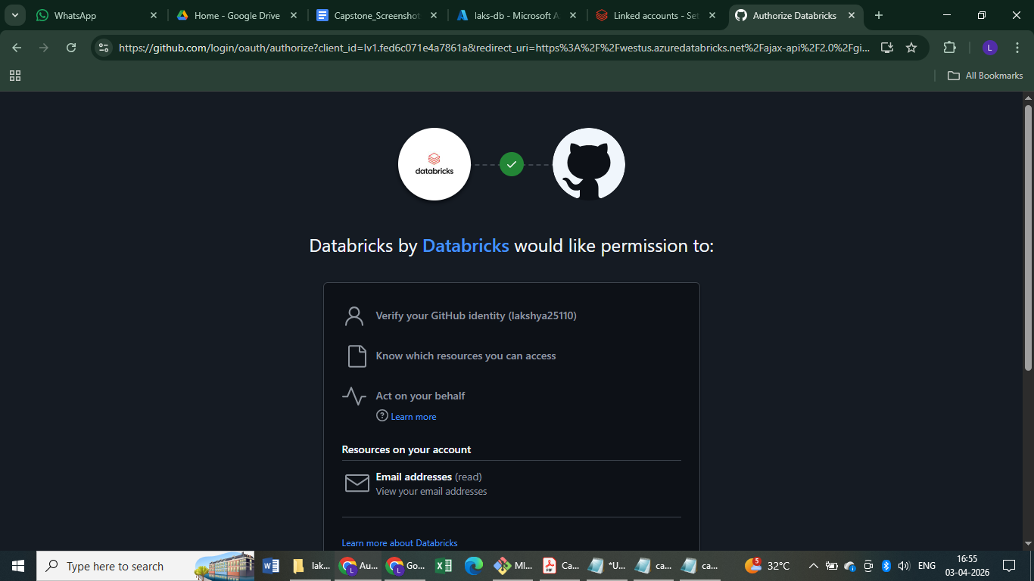

Slide 52


Slide 53

Success Mail (6)

Slide 54


Slide 55


Slide 56


Slide 57


Slide 58

Visualization

Slide 59

Visualization (2)

Slide 60

Visualization (3)

Slide 61

Visualization (4)

Slide 62

Visualization (5)

Slide 63

Visualization (6)

Slide 64

Visualization (7)

Slide 65

Visualization (8)

Slide 66

Visualization (9)

