Slide 1


WIKINOW
This is our fully functional Wikipedia app, designed to provide quick and seamless access to Wikipedia content.

Slide 2


STRUCTURE
01
02
03
04
05
SIGN IN & UP
FIRST PAGE
MIC
POST
CHECKING AI
Users can easily sign in or sign up to access the app
Presentations are communication tools that can be used as demonstrations.
This page features Google’s microphone integration for seamless voice searches, improving user convenience.
This page allows users to seamlessly post their articles. With an intuitive UI, users can easily input and submit content
We used ai to check if the content is human written or ai generated

Slide 3
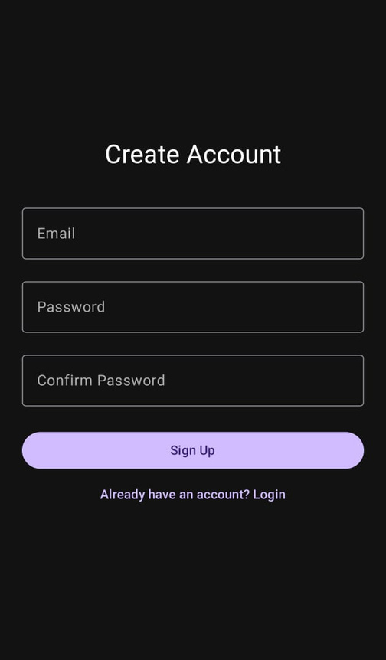
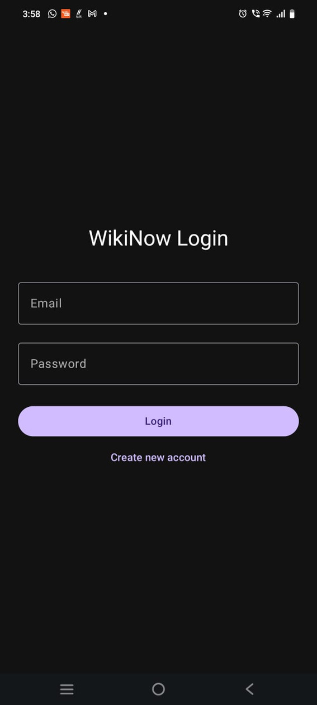



CREATE ACCOUNT & LOGIN
SIGN IN AND SIGN UP
These are the login and sign-up screens of our app, featuring various UI elements and full backend connectivity for user authentication.
LETS GET STARTED

Slide 4
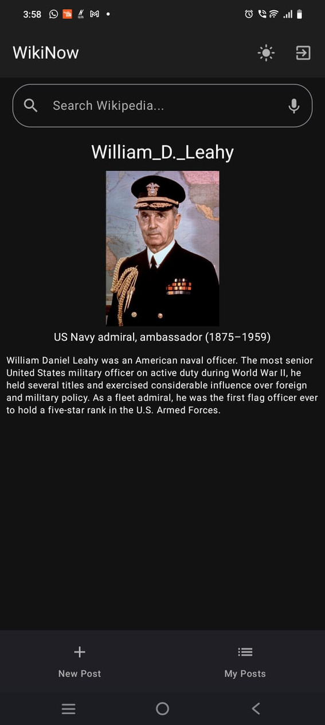

FIRST PAGE
UI ELEMENTS
Our home screen is designed for convenience and engagement — it showcases a 'Featured Post of the Day', includes a voice-enabled search bar, quick-access buttons to add or view your posts, a toggle for dark and light modes, and a simple logout option.
FEATURES
Featured post changes daily.

Slide 5
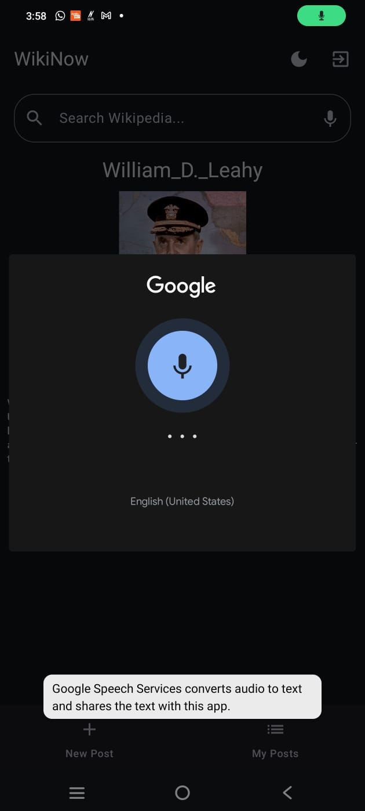
SPEECH TO TEXT
SEARCHING VIA AUDIO
On this page, we’ve implemented Google’s microphone functionality, allowing users to perform voice searches seamlessly. This integration makes searching for content more efficient and hands-free, enhancing the user experience
IMPLEMENTAION
We integrated Google’s Speech-to-Text API with Jetpack Compose to enable voice search functionality. The app utilizes AsyncImage for efficient image loading and displays results using a Card with dynamic Row and Column layouts. The stripHtmlTags extension function is used to clean text excerpts. Search results, including thumbnails, titles, and descriptions, are rendered with responsive, adaptive UI components

Slide 6
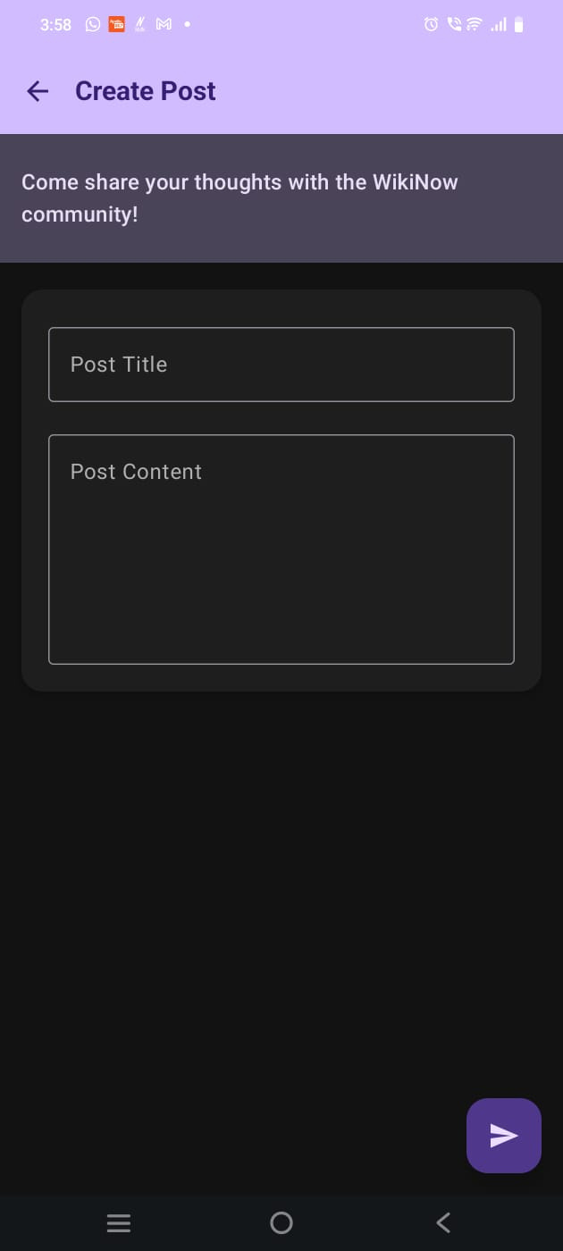
CREATE ARTICLE
POSTING
On this page, we’ve implemented article posting functionality, allowing users to perform post seamlessly.
IMPLEMENTAION
This screen enables users to create and publish articles within the app. Utilizing Jetpack Compose for UI, it integrates Firebase Authentication for user authentication and Firestore for real-time data storage. Users can input article titles and content using OutlinedTextField components. Upon submission, the article is stored in Firebase Firestore under the 'userArticles' collection. The Scaffold layout structure is used for a top app bar and a floating action button to publish articles. Input validation ensures the button is only active when both title and content are provided.

Slide 7
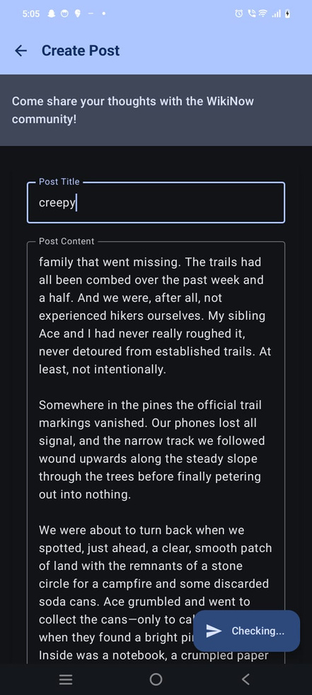
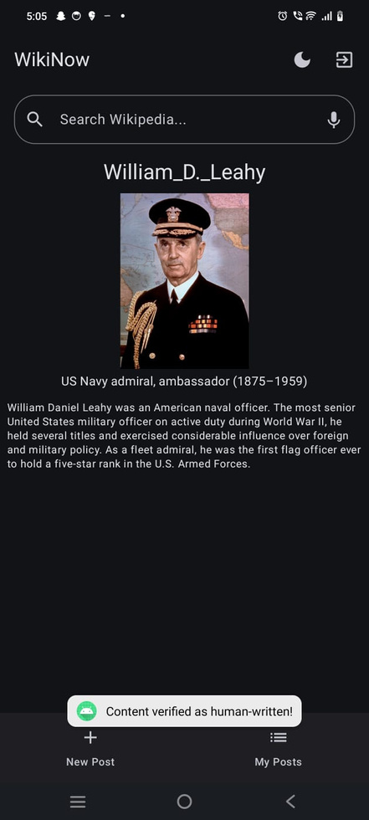
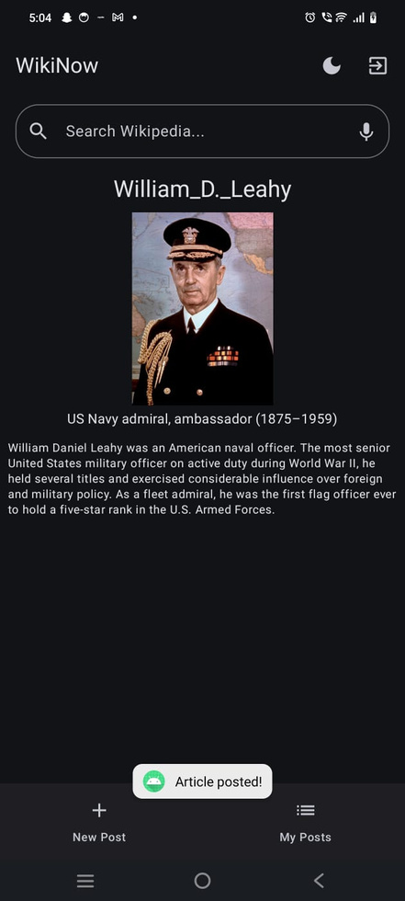
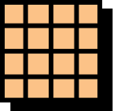
USING AI
CHECKING CONTENT
To maintain content authenticity, we integrated an AI-based detection system that analyzes user-submitted articles to determine whether the content is human-written or AI-generated before posting. This step helps ensure the originality and reliability of shared information.

Slide 8
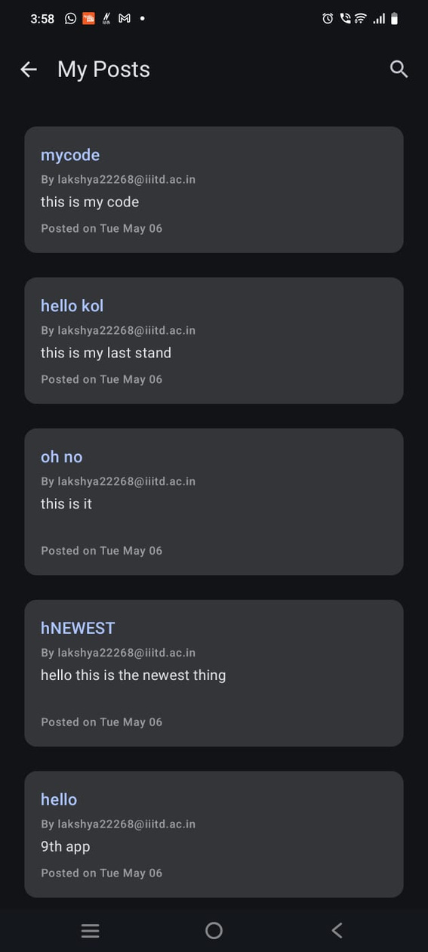
USER POSTS
DESCRIPTION
All user-submitted articles are stored in Firestore and linked to the user’s UID. A dedicated 'History' page fetches and displays these posts, allowing users to view their previously published content using real-time data queries.

Slide 9
OUR FUTURE PLANS
EDIT STREAKS & LEADERBOARDS
AI EDIT HEALTH METER
SUGGESTIONS DRAWER
Track daily edit streaks and show monthly leaderboards. Encourages consistent contributions and healthy competition.
An AI will rate edits on neutrality, grammar, and citation quality. Suggestions will help users improve clarity and accuracy.
A side panel will list all recent suggestions with quick voting and diff previews.
BADGES & EDIT PORTFOLIOS
REAL-TIME COLLABORATION
ONE-TAP CITATION
Users will earn badges for milestones and have a profile showing their top edits and most-viewed articles.
Multiple users can edit the same article live. Firestore sync will ensure real-time updates.
A quick form to add title, link, and date. Automatically formats into a clean reference.

Slide 10

TOOLS USED
ANDROID STUDIO
KOTLIN
FIREBASE
WIKIPEDIA API
GOWINSTON AI API
COMPOSE
GOOGLE MIC

Slide 11
THANKS FOR
WATCHING

