Slide 1
Param Vir Chakra Hero
CQMH Abdul Hamid: The Tank Buster
A Hero of the 1965 Indo-Pak War · India's highest wartime gallantry award
Class 9 History / General Knowledge Project · Prepared by: [Your Name], Class 9
Notes:
Good morning teachers and classmates. Today I am presenting my Class 9 History and General Knowledge project on Company Quartermaster Havildar Abdul Hamid, revered across India as the Tank Buster of the 1965 Indo-Pak War.

Slide 2
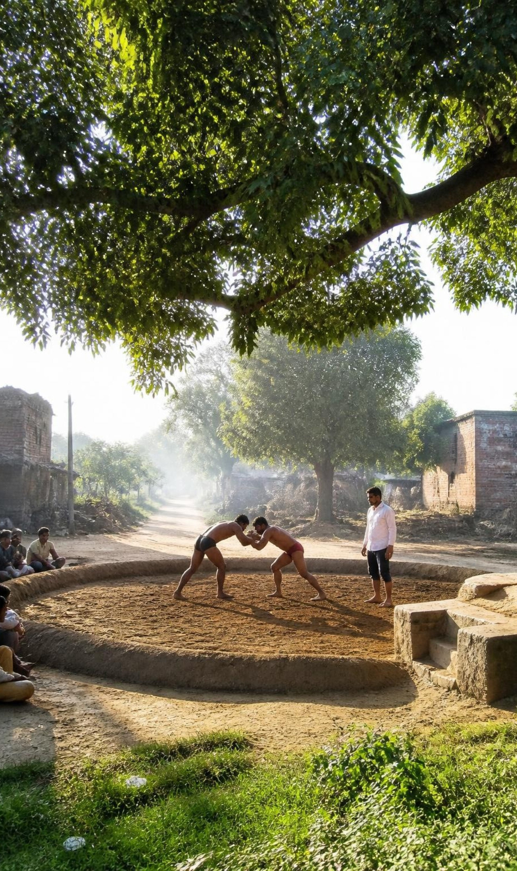
Early Life & Joining the Army: The Path to the Param Vir Chakra
BORN | July 1, 1933 · Dhamupur village, Ghazipur (Uttar Pradesh)
YOUTH | Grew up enjoying wrestling, swimming, and sports
ENLISTED | 4th Grenadiers battalion of the Indian Army · December 1954
2
Notes:
Abdul Hamid was born on July 1, 1933, in Dhamupur village in Ghazipur, Uttar Pradesh. Known for physical prowess, wrestling, and discipline, he enlisted in the prestigious 4th Grenadiers battalion in December 1954.

Slide 3
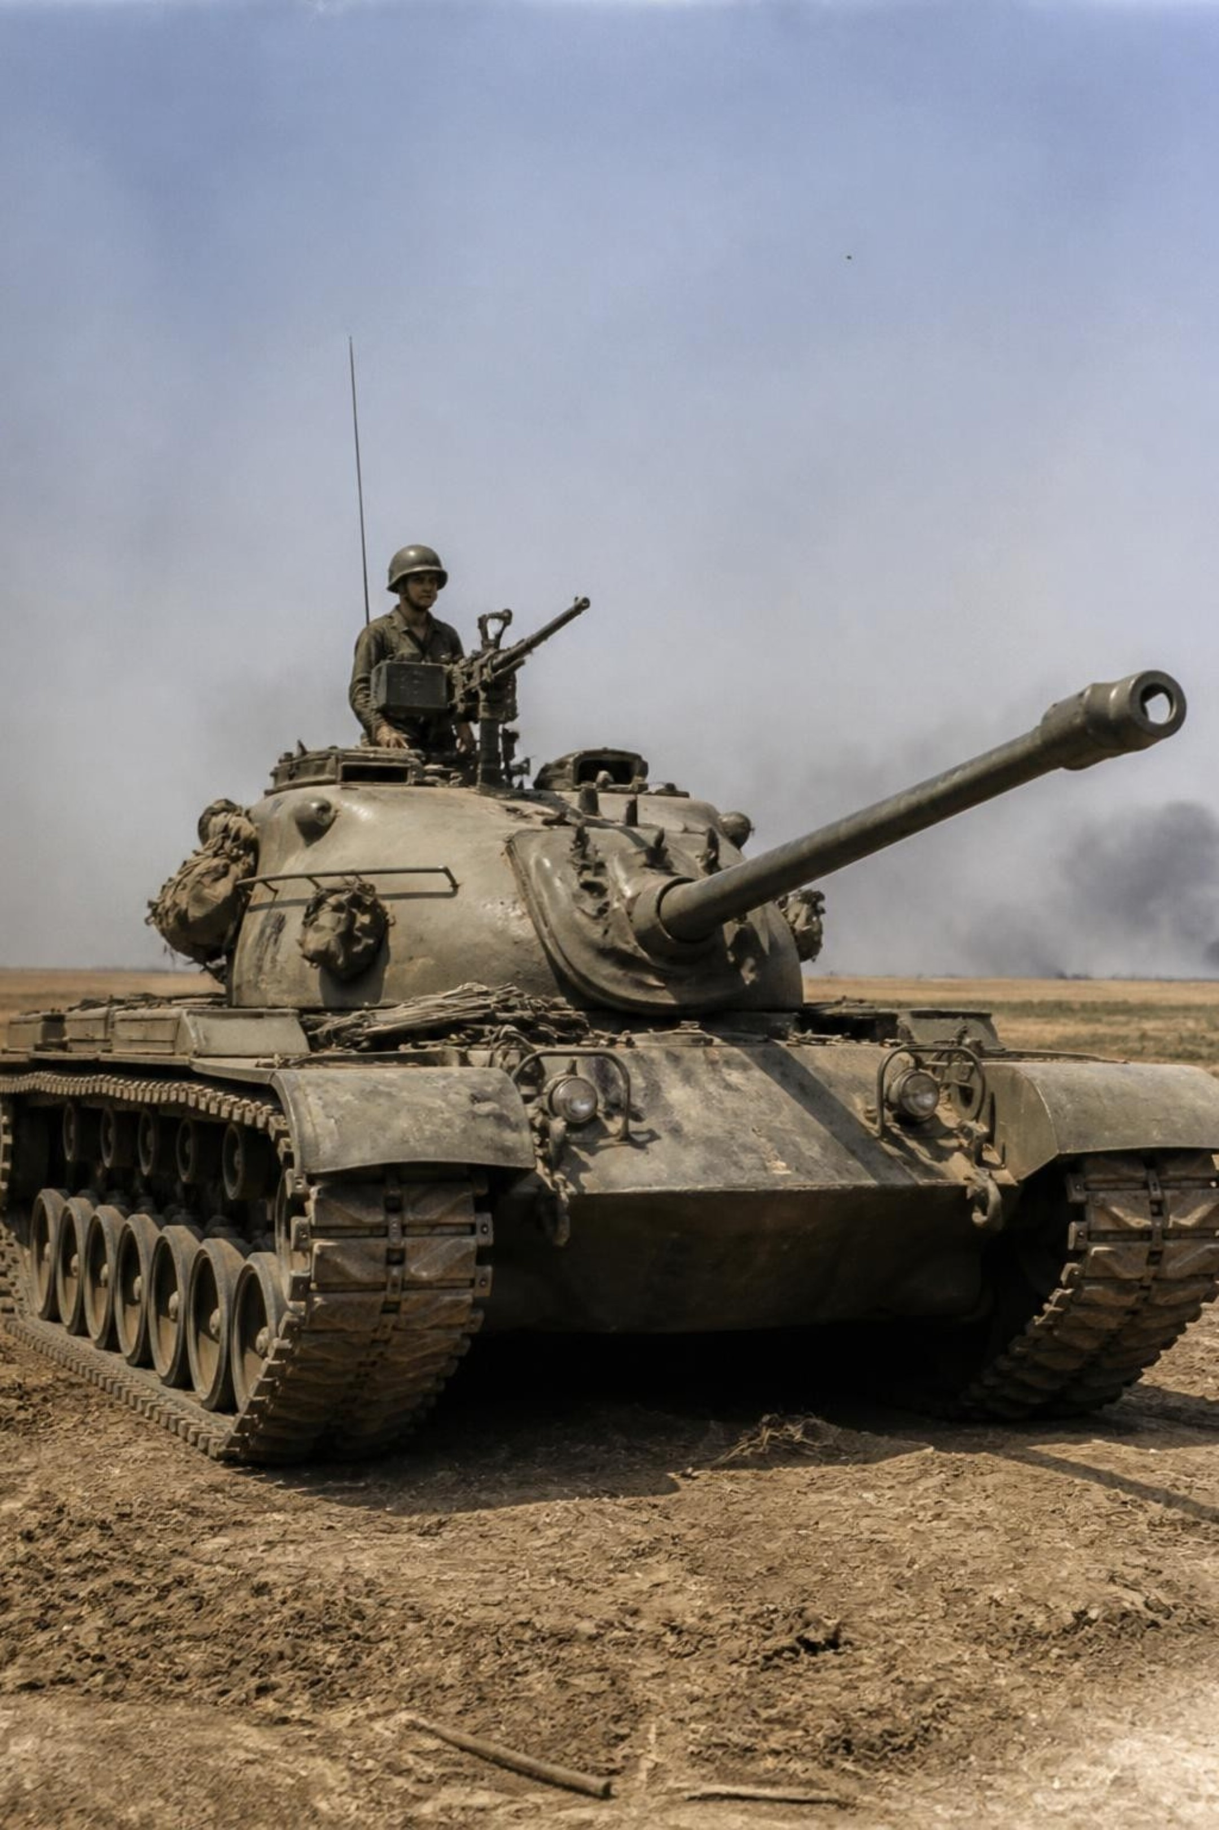
September 1965
The 1965 Battle of Asal Uttar
Pakistani forces launched a massive tank attack in Khem Karan sector.
They used advanced American-made Patton tanks.
Indian forces had fewer tanks and lighter weapons, so they needed smart strategy to hold the line.
3
Notes:
September 1965: Pakistani forces launched a massive tank attack in Khem Karan sector. They used advanced American-made Patton tanks. Indian forces had fewer tanks and lighter weapons, so they needed smart strategy to hold the line.

Slide 4
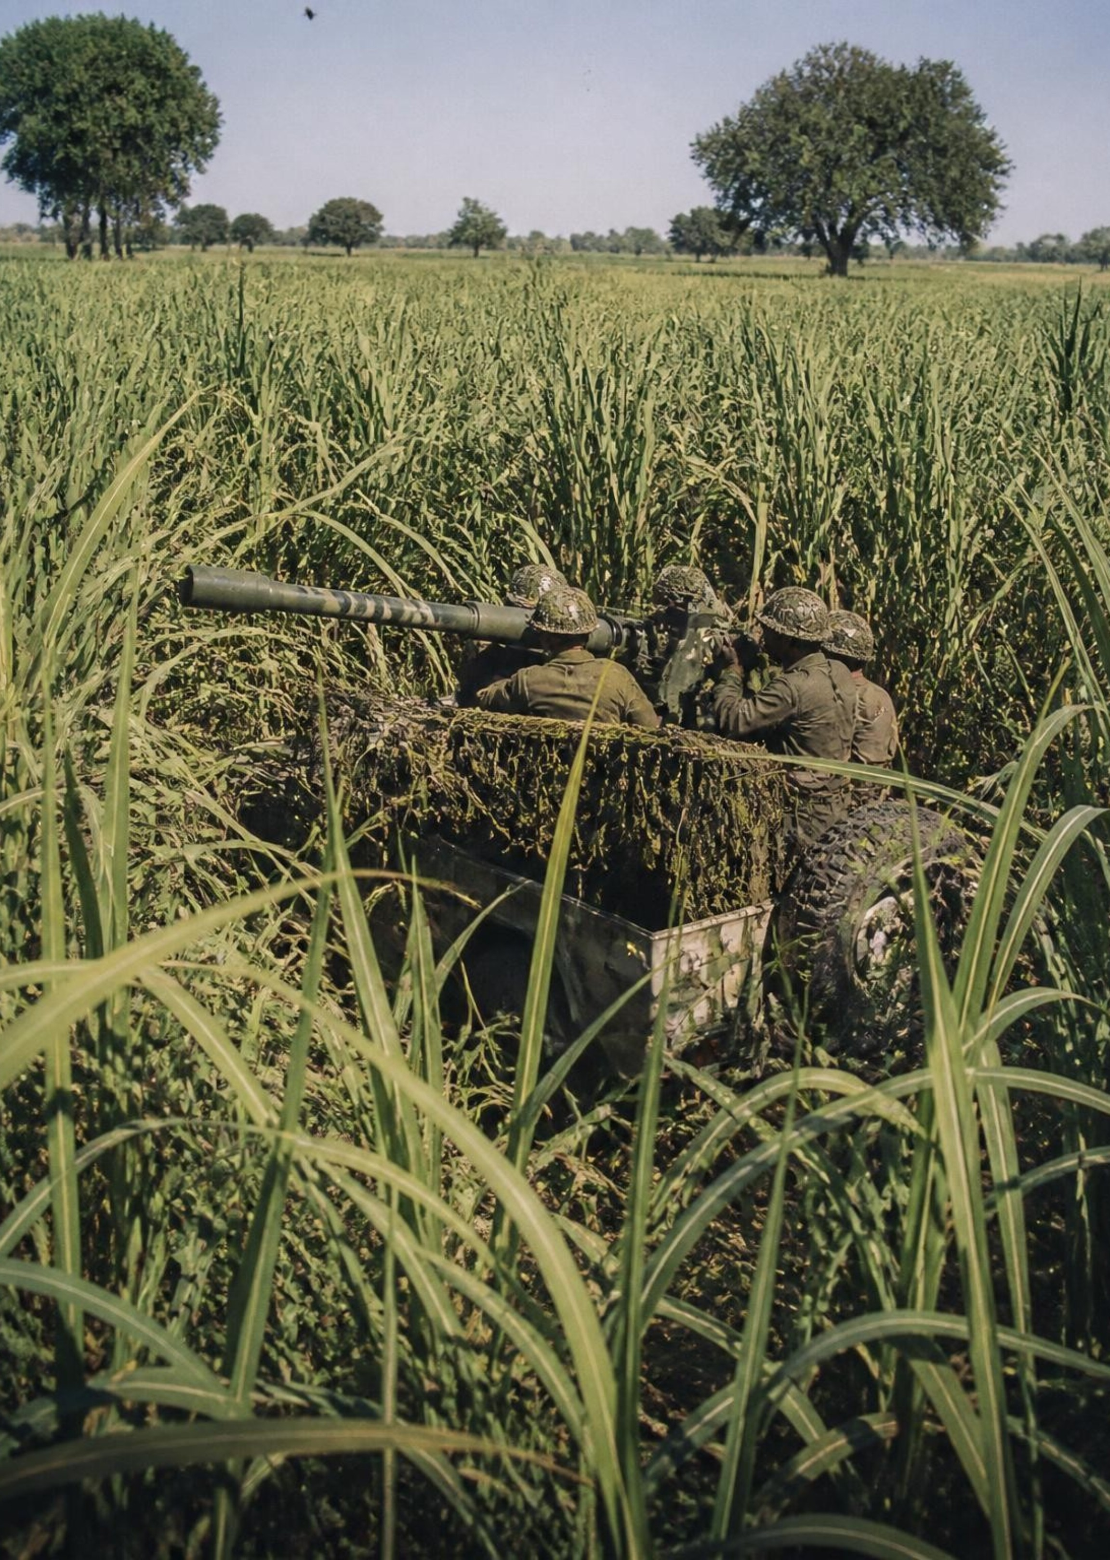
Abdul Hamid's Brave Action
Armed with a 106mm Recoilless Rifle mounted on a light Jeep
Hid his jeep inside tall sugar cane fields for cover
Waited patiently for enemy tanks to get close before firing
Single-handedly destroyed multiple Patton tanks over three days
4
Notes:
Mounted on an unarmored jeep with a 106mm Recoilless Rifle, Abdul Hamid concealed his position inside tall sugarcane fields. He waited for enemy tanks to enter point-blank range, knocking them out with deadly precision over three relentless days.

Slide 5
Spotted another enemy tank and fired to destroy it
At the same moment, his jeep was targeted by enemy tank fire
Fought bravely until his last breath to defend Indian territory
Supreme Sacrifice: 10 September 1965
5
Notes:
On September 10, 1965, Hamid spotted yet another tank advancing toward his position and fired, destroying it. Simultaneously, a shell hit his jeep. He made the supreme sacrifice defending his homeland until his very last breath.

Slide 6
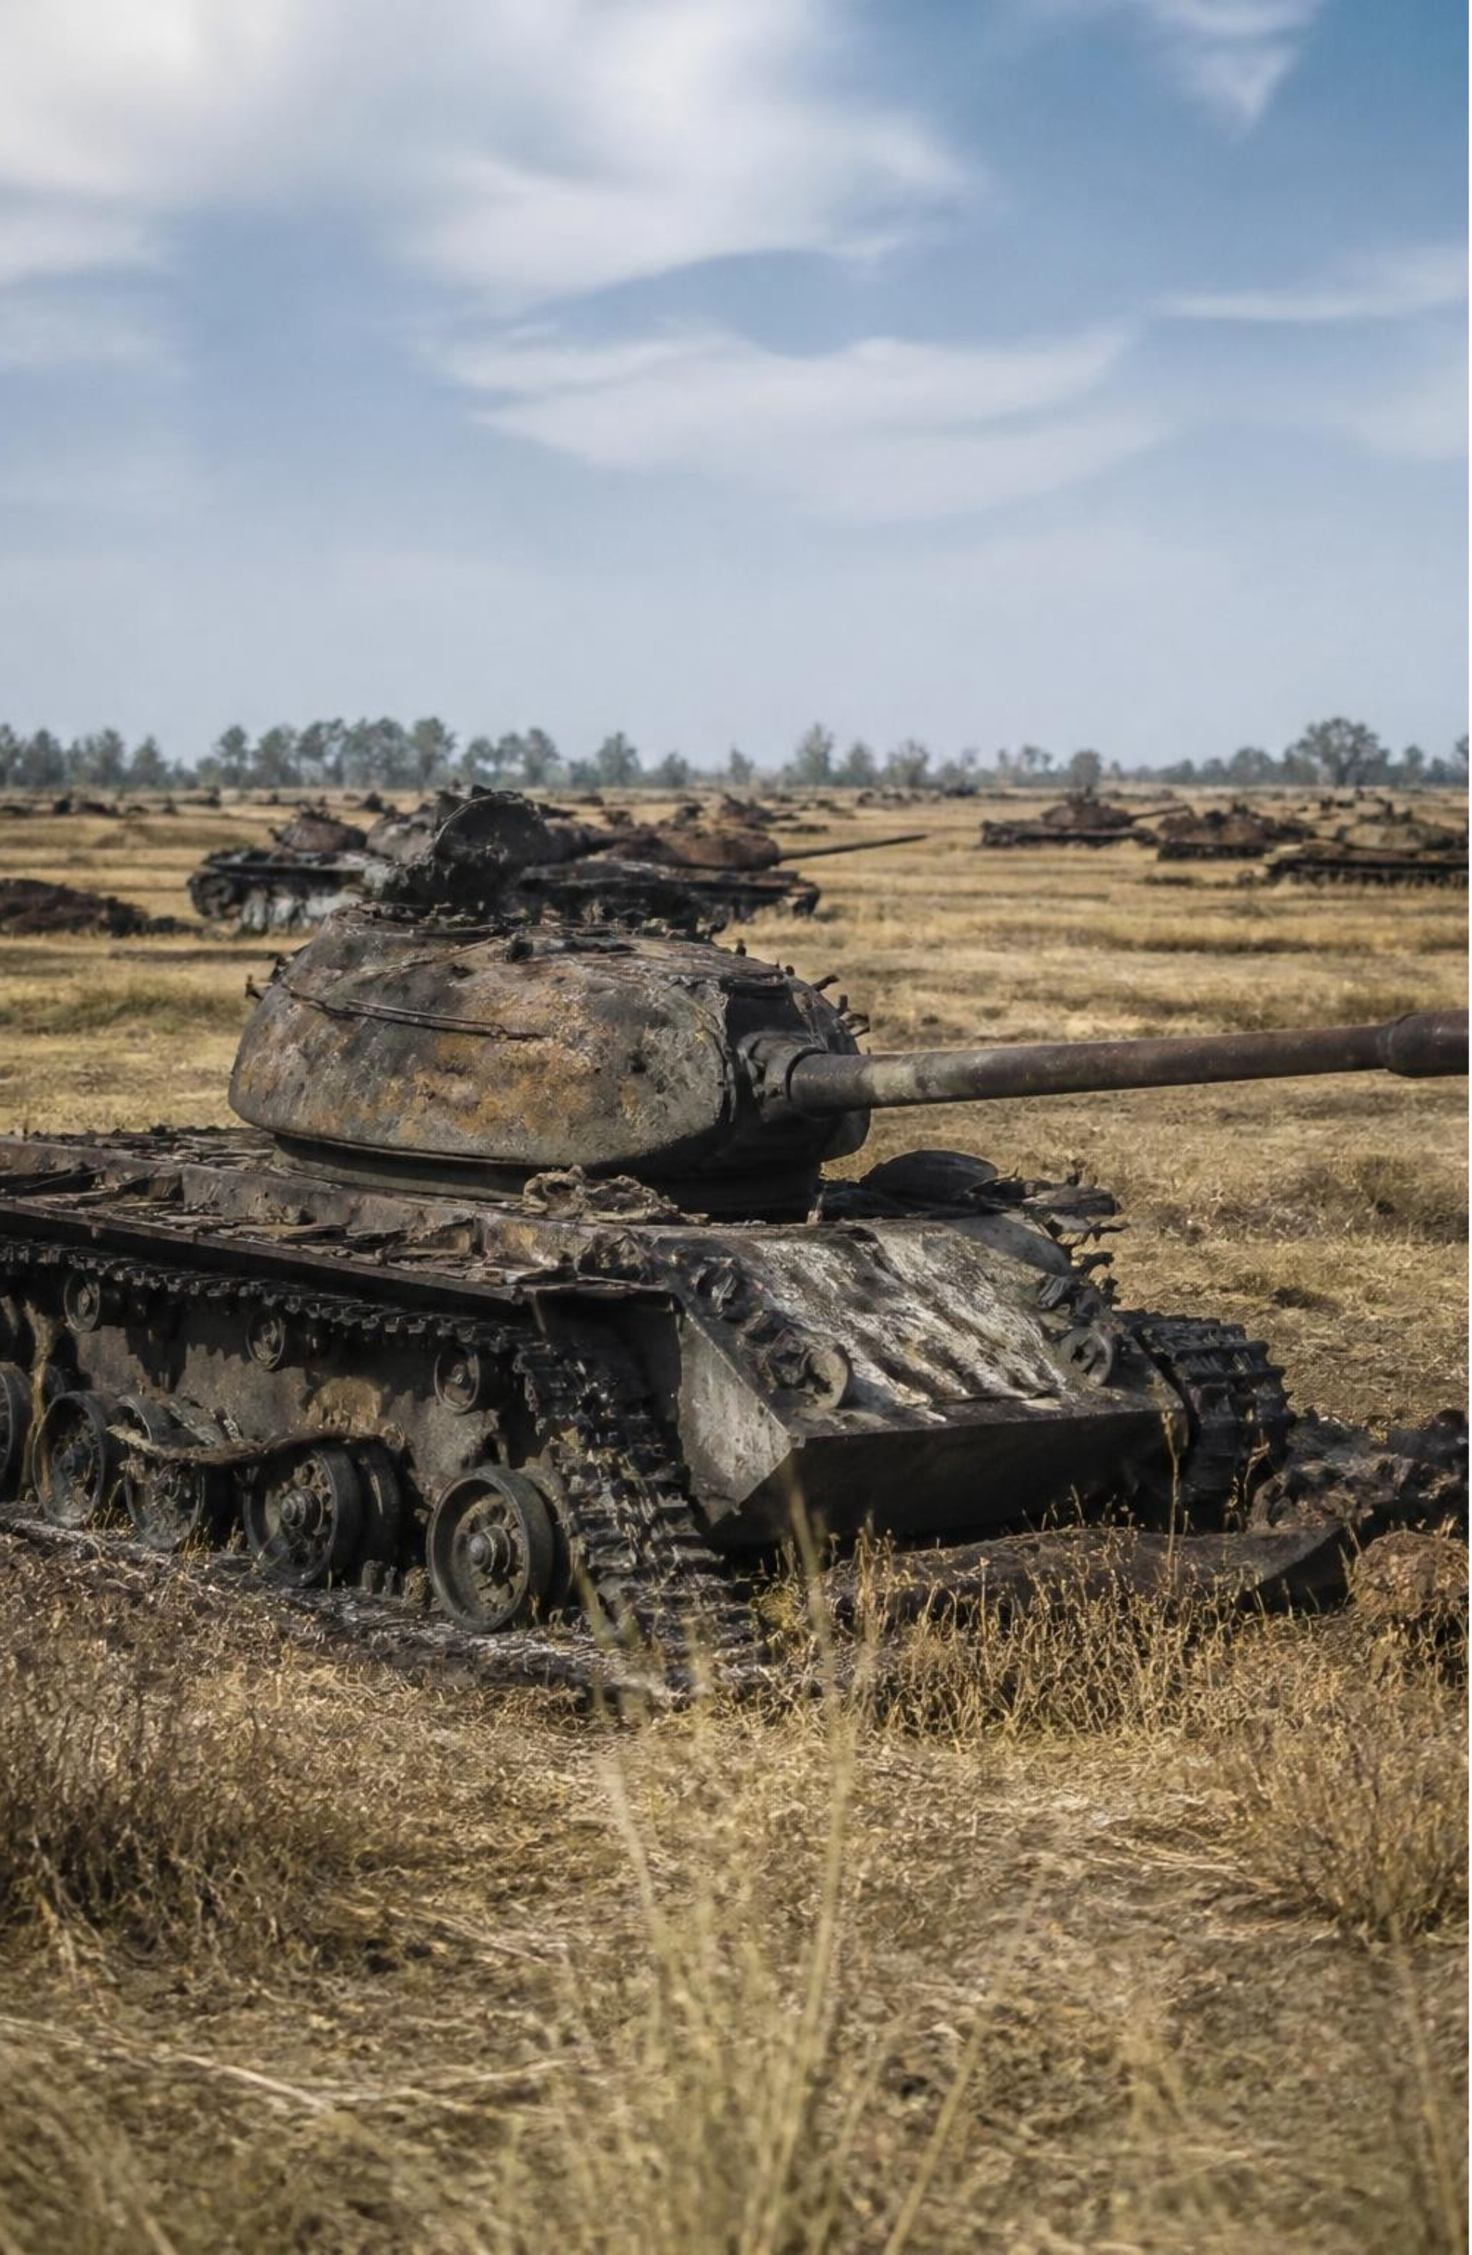
Impact of His Bravery
8
enemy Patton tanks destroyed in total during the battle
The battle zone became "Patton Nagar", the graveyard of Pakistani tanks.
Broke the main enemy tank attack and saved the Khem Karan sector.
6
Notes:
Hamid destroyed 8 Patton tanks during the battle, halting Pakistan's primary armored thrust. The battleground became known as Patton Nagar, the graveyard of Patton tanks, safeguarding Indian territory in Punjab.

Slide 7
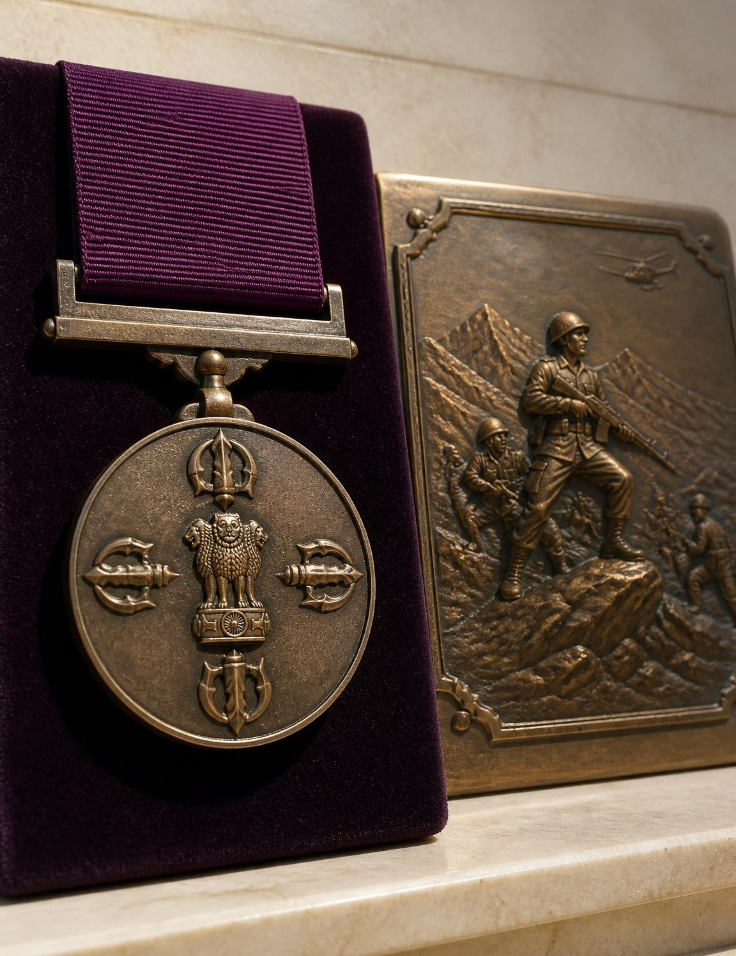
Supreme Honor
The Param Vir Chakra: His Highest Military Honor
Posthumously awarded the Param Vir Chakra, India's highest wartime gallantry medal
Remembered as a symbol of courage, discipline, and devotion to the nation
7
Notes:
Posthumously awarded the Param Vir Chakra, India's highest wartime gallantry medal. Remembered as a symbol of courage, discipline, and devotion to the nation.

Slide 8
Conclusion: What We Learn
Heroism depends on courage and strategy, not just heavy equipment
His legacy continues to inspire young Indians today
Jai Hind!

