Slide 1
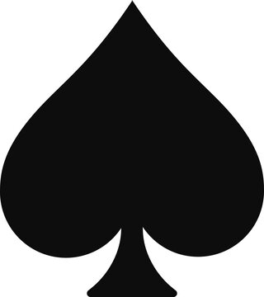
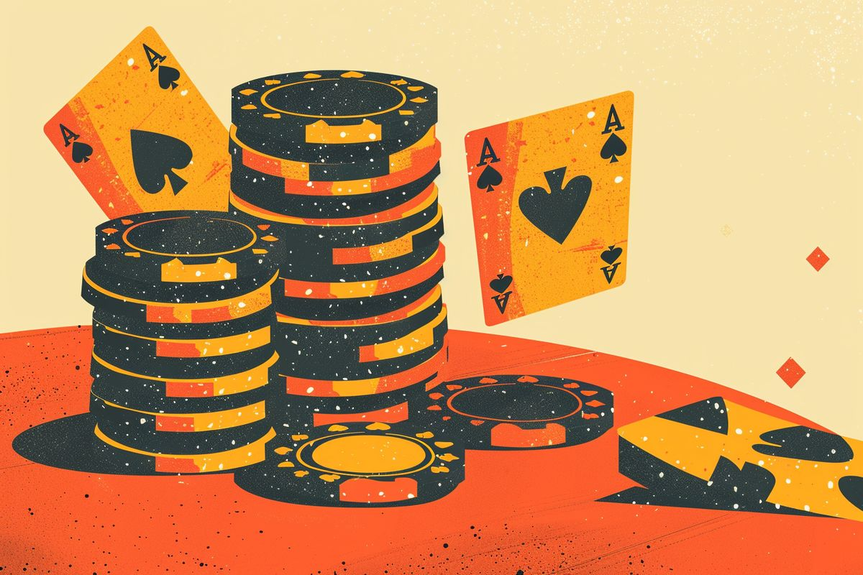
CS 4824 | Machine Learning | Final Project
Poker Player Profiling: Heuristics vs. K-Means Clustering
Grouping Texas Hold'em players by how they bet.
Lakshya J. | Aryan S. | Shreya A. | Claire S.
Notes:
Hello everyone, our project is Poker Player Profiling: Heuristics vs. K-Means Clustering.

Slide 2

Introduction
Goal
Sort poker players into groups based on how they bet
Poker players have different “styles” of play; useful for modeling opponents
Past Approach: Use fixed cut offs on VPIP and PFR (two statistics) to categorize players
Our Approach: Explore whether K-Means finds better groups via clustering
Dataset
IRC Poker Database from the University of Alberta
Over 10 million Texas Hold'em hands played on IRC servers between 1995 and 2001
Notes:
The goal is to group poker players based on how they bet, since different players have different play styles.
Traditionally, players are categorized using two stats: VPIP and PFR. VPIP is how often a player voluntarily puts money into the pot, and PFR is how often they raise before the flop.
Instead of relying only on fixed cutoffs, we wanted to see if K-Means clustering could find better groupings directly from the data.

Slide 3
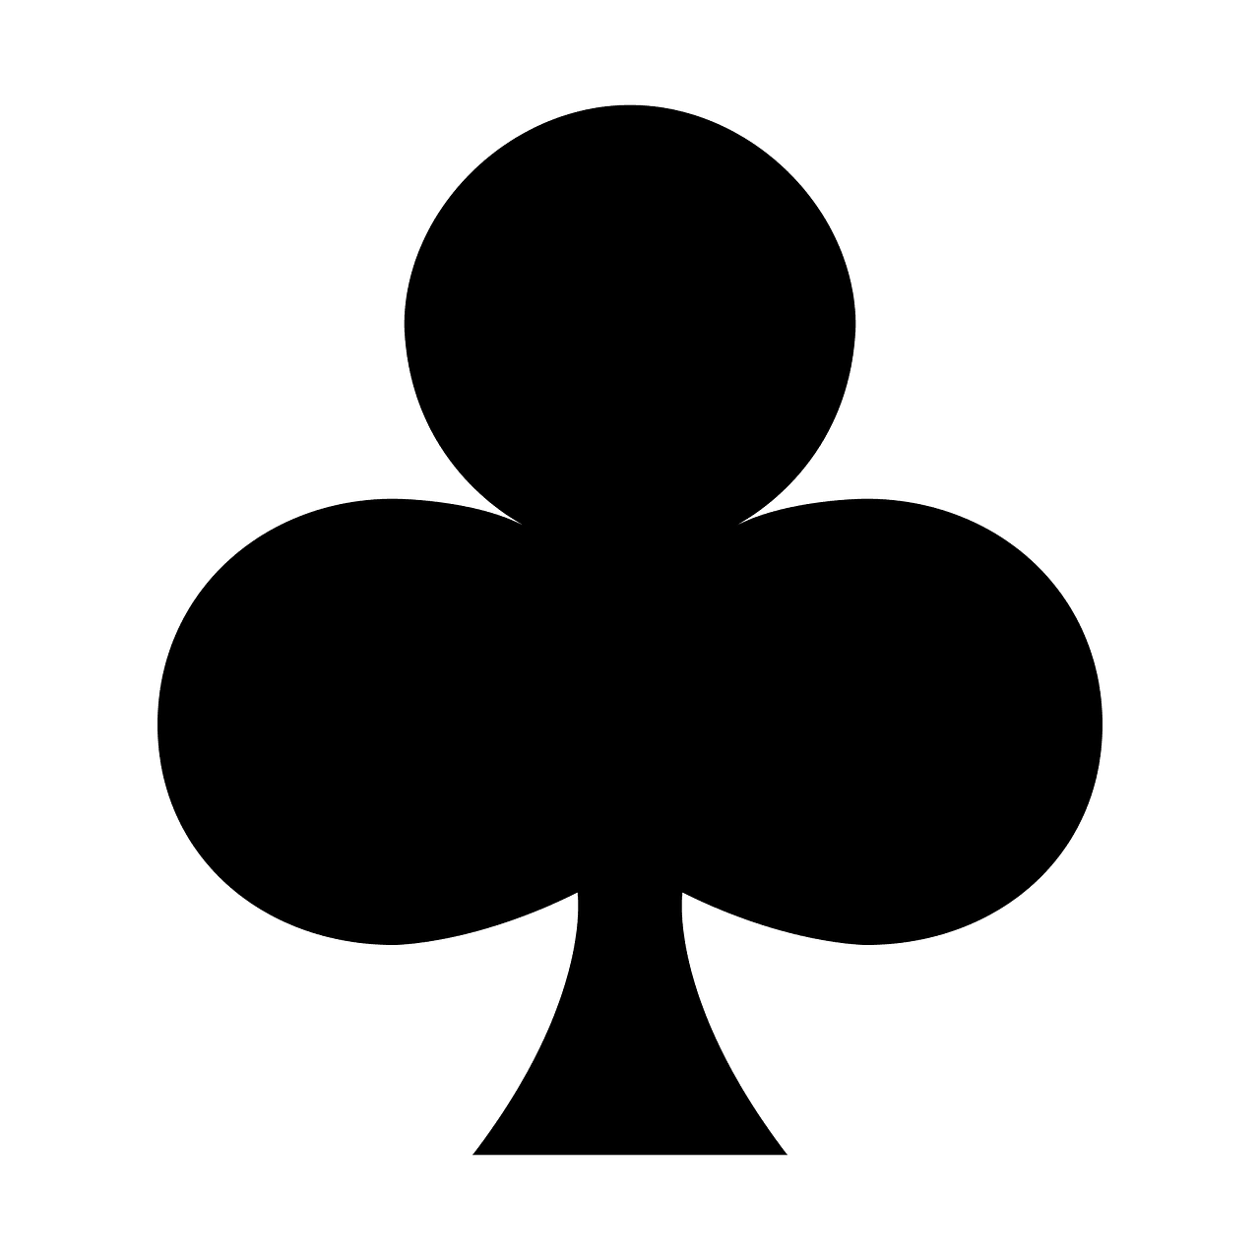
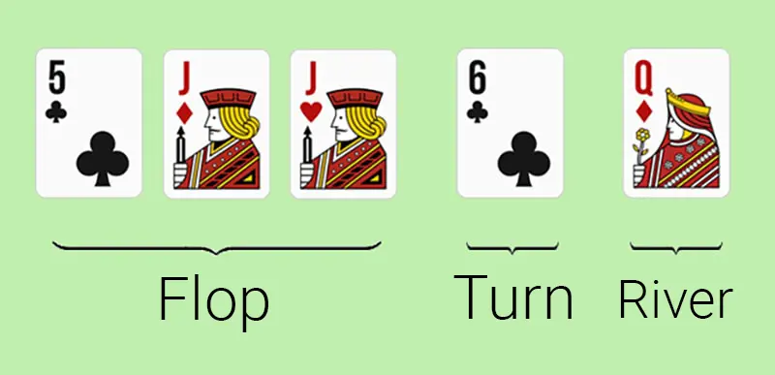
Related Works
IRC Poker Database (University of Alberta)
The public hand-history dataset we collected data from
poker.cs.ualberta.ca/ircpokerdatabase.html
Categorizing Players Using VPIP/PFR Heuristics
Long-standing practice in the poker community
Players are sorted into TAG, LAG, Fish, and Rock using fixed ranges given by calculating different statistics
This is our ground truth
K-Means clustering
Standard unsupervised method for grouping similar items
We apply it to players’ VPIP and PFR values and compare it to the heuristic
Notes:
For related work, our first source was the IRC Poker Dataset, which has over 10 million holdem hands, from 1995 to 2001.
The second part is, the traditional poker profiling method based on VPIP and PFR heuristics. In poker, these stats are commonly used to label players as TAG, LAG, Fish, or Rock.
This heuristic method became our baseline to compare with the clustering approach that groups similar players together based on their VPIP and PFR values. The goal was to determine which approach better to categorize players.

Slide 4
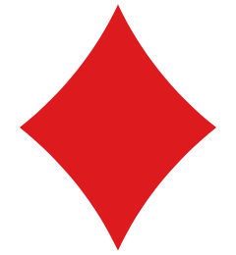
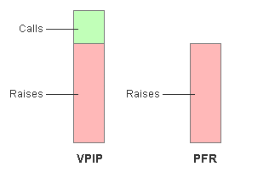
Methodology: Data & Features
Steps
Filtering
Find every player log file across the human Hold'em channels:
83,815 files
Players before filter: 24,786
Removed (less than 30 hands): 8,347
Parse each line into a record: player, hand id, position, and the action string for each round
Players used for clustering: 16,439
Channels included
From the preflop action string, compute two flags per hand
VPIP: percentage of hands in which player voluntarily puts money into the pot preflop
How “tightly” a person plays
PFR: percentage of hands player makes preflop raise
Add up flags per player to get VPIP and PFR percentages
Keep only player with at least 30 hands
Standardize VPIP and PFR before clustering
holdem, holdem1, holdemii
Notes:
The first step we took was to preprocess the data and extract the useful information. We used a total of around 84,000 files from 3 channels (Holdem, Holdem1, holdemii) and parsed out information like player identification and the preflop action string for each round. This action string is a concise, text-based representation of every bet, raise, call, or fold that occurred before the flop in a poker hand.
Using this preflop action string the VPIP and PFR is calculated.
We tallied these up across all hands to get a single VPIP and PFR percentage for each player.
It is important to note that only players with 30 or more played hands were used as those who played less provide less reliable hands.

Slide 5
Methodology: Two Approaches
A) Heuristic baseline
B) K-Means clustering
Fixed cut-offs: VPIP = 25%, PFR = 15%.
Splits players into K groups by minimizing within-group distance
VPIP | < 25% | Tight
 | >= 25% | Loose
PFR | < 15% | Passive
 | >= 15% | Aggressive
J = Σ_{k} Σ_{x ∈ Ck} ‖ x − μ_{k} ‖²
Final model uses K = 4 to match the four poker archetypes
Also tested K = 2 to 8 to check what the data prefers
elbow method, silhouette score
Each player goes into one of four categories:
TAG: tight, aggressive
LAG: loose, agressive
Fish: loose, passive
Rock: tight, passive
Same cutoffs applies to everyone
Built with scikit-learn
n_init = 20 (Run 20 consecutive times with random centroid initialization)
Cluster quality measured by Silhouette Score (range −1 to +1; higher is better)
Notes:
This slide shows the two approaches we conducted.
For the heuristic approach, for example if the VPIP is less than 25% and the PFR is < 15%, the player exhibits Tight and Passive behavior, thus belonging to the Rock category. Similar rigid rules are applied for the rest of the categories.
The K-means approach splits players into K groups by minimizing within-group distance. We ran K-means with K equal to 2 to 8, to check what the data prefers. The cluster quality was measured by the silhouette score, where a higher score indicates a better cluster. In the end, the final model uses K = 4 to match the four poker archetypes.

Slide 6
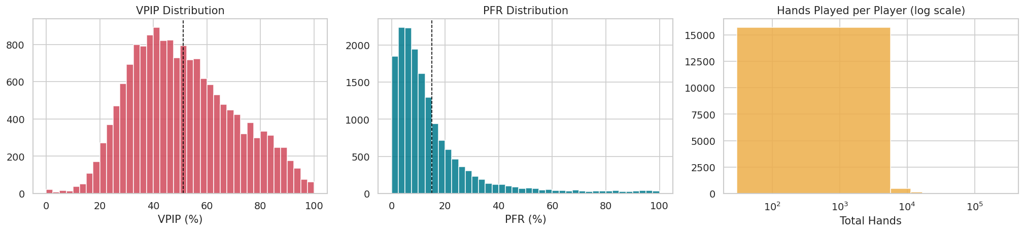
Results: Feature Distributions
Quick stats (n = 16,439)
VPIP: mean 51.08%, std 19.14
PFR: mean 15.01%, std 16.64
Hands per player: median 225, max 280,960
Correlation VPIP vs PFR: 0.485
Sanity checks
PFR > VPIP violations: 0 (should be 0)
Duplicate player rows: 0
Heuristic label counts
Fish: 10,140 · LAG: 5,225
Rock: 1,042 · TAG: 32
Notes:
Looking at the VPIP distribution, the average player is putting money in the pot about 51% of the time, which is pretty loose by most modern poker standards. The distribution is pretty spread out with a standard deviation of 19 points.
PFR is a little different, with a mean of 15% but a very right skewed distribution. Most players cluster on the low end, which means they are passive raisers in the preflop part of the game.
When we apply the heuristic labels, we see an imbalance between the categories:
10 thousand players are classified as fish
5 thousand as lag
1 thousand as rock
only 32 as tag
We concluded that the small number of TAG players likely reflects both the era's player tendencies and also the limitations of applying modern cutoffs designed for GTO play to a 1990s dataset.

Slide 7
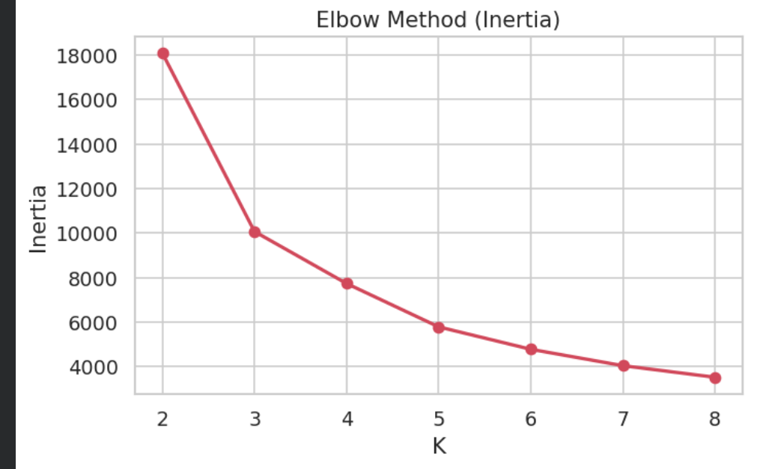
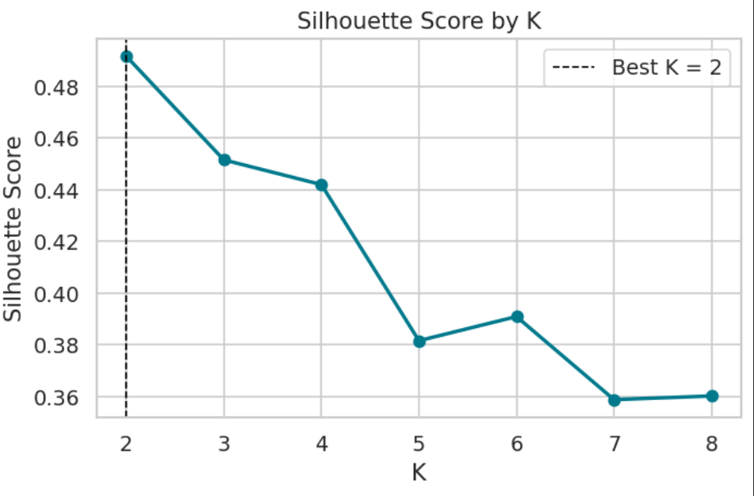
Results: Choosing K
Scores for K = 2 to 8
K
Inertia
Silhouette
2
18,086.23
0.4917
3
10,067.76
0.4516
4
7,730.94
0.4420
]
5
5,781.48
0.3816
6
4,775.33
0.3909
7
4,038.98
0.3588
8
3,518.03
0.3602
What we picked
Best by silhouette: K = 2 (0.4917)
Final reported model: K = 4 (0.4420): to match the four poker archetypes
Scores drop after K = 5, more groups don't help
Notes:
To choose the K value, we tested values from K equals 2 through 8 and compared both inertia and silhouette scores.
Inertia measures how compact the clusters are internally, so lower values are better. Silhouette score measures how well-separated the clusters are, with values closer to 1 indicating stronger clustering quality.
As shown in the table, the highest silhouette score occurs at K equals 2, with a score of about 0.49. This suggests that the strongest natural split in the data is binary — likely separating tighter players from looser players.
However, we ultimately selected K equals 4 for the final model. Even though the silhouette score is slightly lower at about 0.44, using four clusters aligns with the four traditional poker archetypes.
This gave us a balance between clustering quality and interpretability, while also allowing a direct comparison with the heuristic profiling system

Slide 8
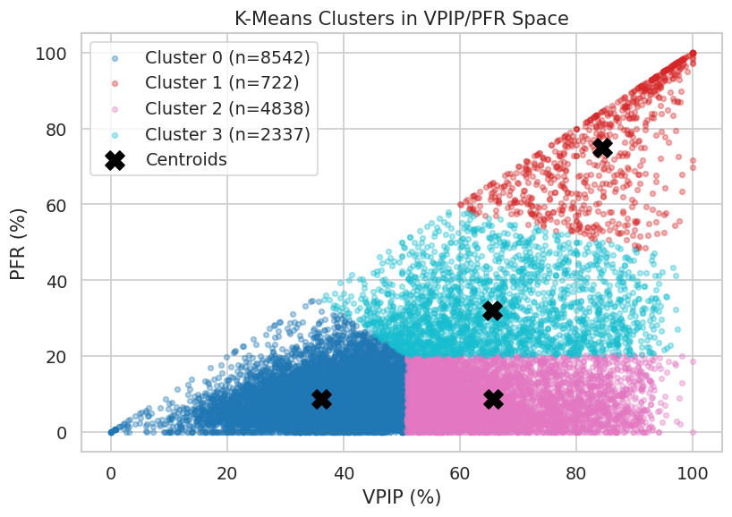
Results: Final Clusters (K = 4)
Cluster centers and sizes
Cluster vs heuristic label
Cluster
Size
VPIP
PFR
Cluster
Fish
LAG
Rock
TAG
0
8,542
36.11
8.88
0
6,150
1,318
1,042
32
1
722
84.39
74.86
1
0
722
0
0
2
4,838
65.65
8.74
2
3,990
848
0
0
[ PLACEHOLDER · FIGURE 3 ]
3
2,337
65.59
32.00
3
0
2,337
0
0
Cluster scatter plot (VPIP vs PFR, colored by cluster)
From: 04-kmeans-all-human-holdem.ipynb "Visualize the Cluster Assignments"
Notes:
Here we show the final K-means clustering results using K equals 4, where each color is a different cluster in the graph.
Cluster 0 is the largest group, containing about 8,500 players. We interpret this cluster as tight-passive players.
Cluster 2 contains loose-passive players, who enter hands but don’t raise preflop, creating a very large gap between VPIP and PFR.
Cluster 3 represents moderately aggressive loose players, with high VPIP and higher PFR values.
Finally, Cluster 1 is the smallest but most extreme cluster. These players enter and raise in almost every hand. We labeled this cluster hyper-aggressive.
The table on the right compares these clusters against the heuristic labels. One important result is that the heuristic LAG category gets split across multiple K-means clusters. This suggests that the heuristic system groups together players who actually behave quite differently.

Slide 9
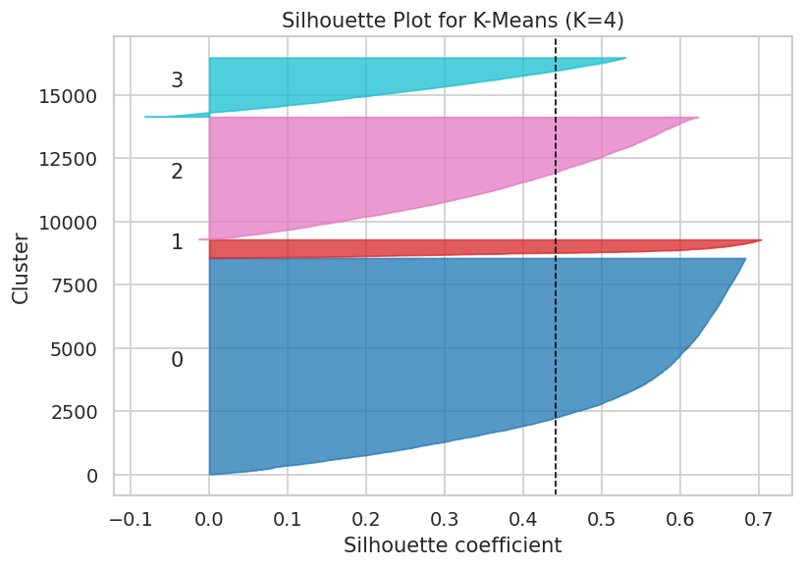
Analysis: K-Means vs. Heuristic
Silhouette scores
Method
Groups
Score
Heuristic baseline
4
0.1347
K-Means (K = 4)
4
0.4420
K-Means (best K, K = 2)
2
0.4917
[ PLACEHOLDER · FIGURE 4 ]
What this tells us
Per-sample silhouette plot for the K = 4 model
K-Means at K = 4 produces tighter, better separated groups than the heuristic
The heuristic's "LAG" label gets split across three K-Means clusters and the data has more structure than fixed cutoffs can show
The same direction holds on the smaller sampled subset (n = 344)
K-Means K = 4 silhouette 0.4595 vs heuristic 0.0990
From: 04-kmeans-all-human-holdem.ipynb "Silhouette Plot"
Notes:
So, how do these two approaches actually compare?
The fixed cutoffs are drawing boundaries that don't align well with where the data naturally separates.
Looking at the silhouette plot on the left, you can see that clusters 2 and 3 are particularly tight and well-separated, while cluster 0 has more variance, which makes sense given it's the largest group.
KEEP FOR QUESTIONS DO NOT READ
We also validated this on a smaller sampled subset of 344 players, and the same differences between the two methods showed up, with K-Means at 0.4595 versus the heuristic at 0.0990.

Slide 10
Conclusion & Future Work
Conclusion
Limitations
K-Means on standardized VPIP and PFR gives tighter groups than fixed-threshold rules
At K = 4, silhouette is 0.4420 (K-Means) vs 0.1347 (heuristic)
Only preflop actions are used; flop, turn, and river are ignored
Each player is one static average over their full history
Data is from 1995–2001; modern poker differs
K-Means assumes round, equal size clusters
The data's strongest natural split is binary (K = 2, silhouette 0.4917)
K-Means beats the heuristic on the project's main metric
Future work
Add postflop features (3-bet %, c-bet %, etc.)
Try a more recent dataset
Before and after economic turmoil and rise of GTO play
Try oher clustering methods that don't assume round clusters
Notes:
To wrap things up, our main takeaway is that K-Means clustering produces more meaningful player groupings than the traditional heuristic approach.
We also want to discuss the limitations of our approach. We only used preflop features (VPIP and PFR). Postflop behavior is left out. Also, the dataset itself is from 1995 to 2001, but poker strategy has changed dramatically since then, especially with the rise of GTO play.
Ultimately, it was pretty interesting to see how a simple unsupervised approach can outperform domain-specific heuristics.
KEEP FOR QUESTIONS DO NOT READ
For future work, the most natural next step would be to add postflop features. We'd also want to test on a more modern dataset, ideally something that spans before and after the poker boom, to see how player profiles shift. And finally, since K-Means assumes round, equal-sized clusters, trying methods like DBSCAN or Gaussian Mixture Models might capture the actual shape of the data better.

Slide 11
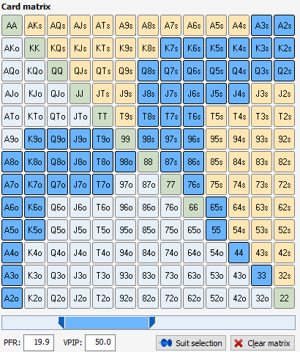
Thank You!

