Slide 1
Electricity Bill Generator
Name: Lakshya Bisht
SAP ID: 590027070
B. Tech CSE
UPES

Slide 2
Problem DEFINITION
Electricity bill calculation is generally done through complex tariff rules including slabs, fixed charges, government duties, and late payment charges.
Manually calculating these charges is time-consuming and often leads to errors.
Many users also find it difficult to track and manage electricity usage records for multiple consumers.

Slide 3
OBJECTIVE OF THE PROJECT
Project Objectives
The objective of this project is to:
• Automate electricity bill calculation
• Reduce human calculation errors
• Apply real tariff slabs in logic
• Generate a formatted electricity bill
• Store and manage multiple customers
• Enable searching customer data
• Improve understanding of C programming concepts

Slide 4
SCOPE OF THE PROJECT
Project Scope
This project demonstrates:
• Slab-wise electricity billing
• Customer data management
• Late payment charge handling
• Searching by ID or Name
• Structured programming design
• Function modularity
• User input validation
• Personalized bill generation
This project simulates real-world billing used by power companies under residential connections.

Slide 5
CONCEPTS USED
C Programming Concepts Implemented
The following concepts are implemented:
• Structures
• Functions
• Arrays
• Conditional statements
• File handling
• String handling
• Input validation
• Modular programming
• Pointers to structures

Slide 6
DATA STRUCTURE USED
Customer information is stored using a structure:
typedef struct
{
int id;
char name[50];
float units;
float load; //Connected load in kW
float energyCharge;
float fixedCharge;
float duty; //Electricity duty
float surcharge;
float totalBill;
} Customer;

Slide 7
BILL CALCULATION LOGIC
Tariff Calculation Logic
Energy Charges (Slabs):
• Below 100 units → ₹3.65/unit
• 101–200 units → ₹5.25/unit
• 201–400 units → ₹7.15/unit
• Above 400 units → ₹7.80/unit
Additional Charges:
• Fixed charge based on load
• Government duty (15%)
• Surcharge (₹0.10/unit)
• Late payment fee (1.25%)

Slide 8
PROGRAM FLOW
Program Flow
1. User selects option from menu
2. Customer inputs details
3. Bill is calculated
4. Data is stored
5. Receipt is generated
6. Search operations are performed
7. Output displayed in formatted form

Slide 9
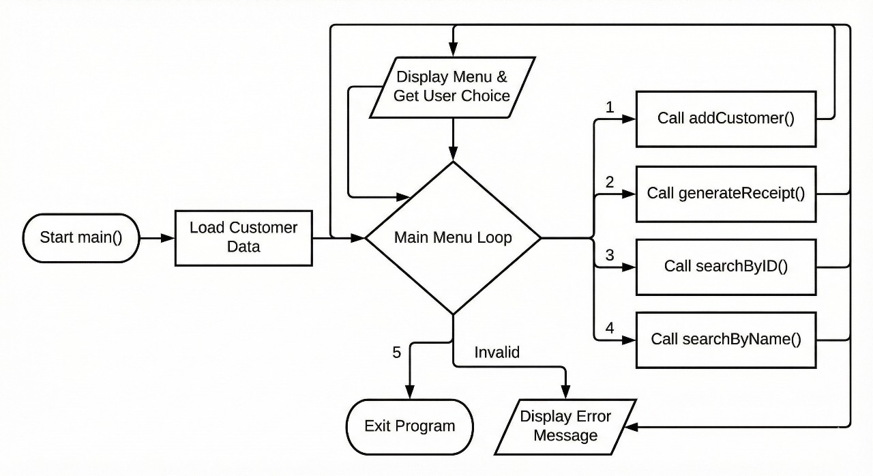
FLOWCHART

Slide 10
FUNCTIONS USED
Function
purpose
calculateBill()
addCustomer()
generateReceipt()
searchByID()
searchByName()
Calculates complete bill
Stores user data
Displays formatted bill
Finds customer by ID
Finds customer by name

Slide 11
SEARCH FEATURE
This project allows:
• Searching customer by ID
• Searching customer by Name
• Quick record access
• Improved data management
This makes the project closer to real utility software.

Slide 12
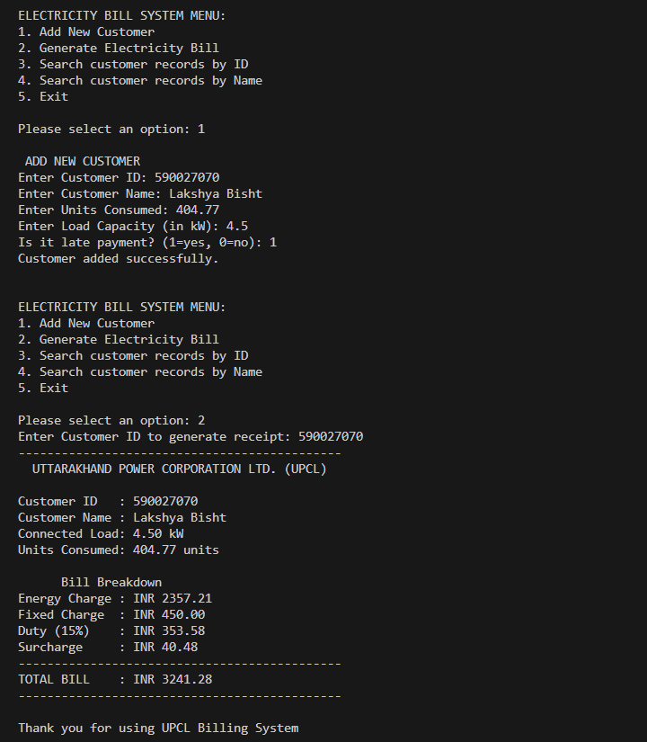
SAMPLE OUTPUT-1

Slide 13
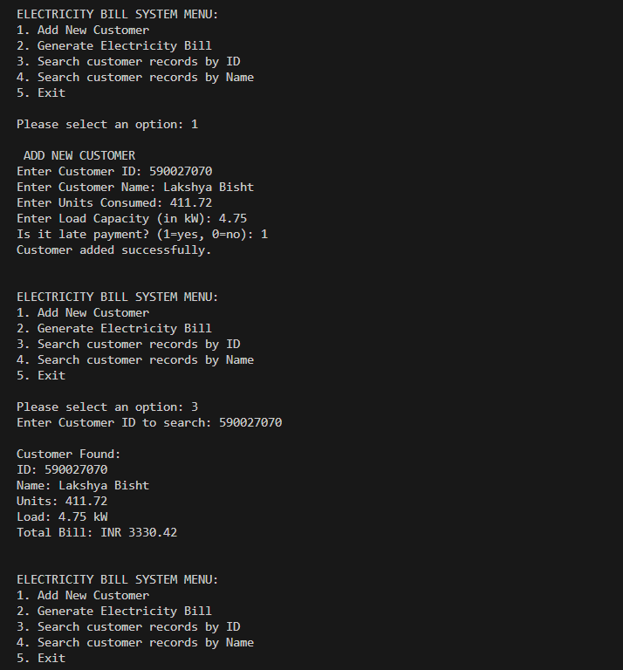
SAMPLE OUTPUT-2

Slide 14
Error handling
Input Validation
Handled cases:
• Duplicate ID
• Negative units
• Invalid load capacity
• Wrong late-payment input
• Limit check for customers
This makes the program reliable and stable.

Slide 15
NOVELTY
Project Highlights:
• Slab implementation
• Realistic tariff
• Late fee system
• Search feature
• Bill breakdown
• Customer management system
• Professional user interface
• Professional GitHub repository

Slide 16
LIMITATIONS
Current Limitations
• No monthly billing history
• No date and time on bill
• No Graphical Interface (GUI)
• Single month billing

Slide 17
FUTURE SCOPE
Future Enhancements:
Billing history
Export to PDF
GUI application
Date and Time stamp on bill
Admin panel (password protected)
Online Payment Feature

Slide 18
REFERENCES
• Classroom lectures/notes
• Let Us C Book
• UPCL Official Tariff
• Youtube lectures
• Project discussion with faculty

Slide 19
concLUSION
This project helped me understand how real-world electricity billing works and how it can be implemented using C programming. Through this project, I also improved my understanding of structures, functions, and logical conditions in C. Handling customer records and generating formatted bills made the project more practical and meaningful.
Overall, this project was a good learning experience and helped me gain confidence in implementing logic-based programs in C.

Slide 20
Thank you

