Slide 1
HTML,CSS & JAVA SCRIPT FOR WEB DEVLOPERS
By:- lakshya Chawla

Slide 2
OUTLINE OF COURSE
To Learn the basics of HTML, the technology which forms the basic skeleton of every web-page and to master its different tags.
To Learn to design and style a web-page using different CSS properties .
To learn fundamentals of JavaScript like variables, operators, functions, events, DOM Manipulation etc.

Slide 3
HYPER TEXT MARKUP LANGUAGE

Slide 4
WHAT IS HTML?
HTML STANDS FOR HYPER TEXT MARKUP LANGUAGE
HTML IS A MARKUP LANGUAGE
A MARKUP LANGUAGE IS A SET OF MARKUP TAGS
THE TAGS DESCRIBE DOCUMENT CONTENT
HTML DOCUMENTS CONTAIN HTML TAGS AND PLAIN TEXT
HTML DOCUMENTS ARE ALSO CALLED WEB PAGES

Slide 5
HTML TAGS
Html tags are keywords (tag names) surrounded by ANGLE BRACKETS
like <html>
Html tags normally come in pairs like <p> and </p>
The first tag in a pair is the START TAG, the second tag is the END TAG
The end tag is written like the start tag, with a SLASH before the tag name
START and END tags are also called OPENING TAGS and CLOSING
TAGS

Slide 6
HTML EXAMPLE
<html>
<body>
<h1>my first heading</h1>
<p>my first paragraph.</p>
</body>
</html>
EXAMPLE EXPLAINED
The text between <html> and </html> DESCRIBES THE WEB PAGE
The text between <body> and </body> is the VISIBLE PAGE CONTENT
The text between <h1> and </h1> is DISPLAYED AS A HEADING
The text between <p> and </p> is DISPLAYED AS A PARAGRAPH

Slide 7
HTML TAG
Html headings are defined with the <h1> to <h6> tags
<h1>this is a heading</h1>
Html paragraphs are defined with the <p> tag.
<p>this is a paragraph.</p>
Html links are defined with the <a> tag.
<a href="http://espesolutions.com">this is a link</a> Html images are defined with the <img> tag.
<img src=“espelogo.jpg” alt=“espesolutions.com”>

Slide 8
DROP-DOWN LIST
Let a user select one or more choices from limited number of options.
SYNTAX:
<html>
<body>
<select>
<option value=“fiat">fiat</option>
<option value="audi">audi</option>
</select>
</body>
</html>

Slide 9
CASCADING STYLE SHEETS

Slide 10
WHAT IS CSS?
Css stands for cascading style sheets
Styles define how to display html elements
Styles were added to html 4.0 to solve a problem
External style sheets can save a lot of work
External style sheets are stored in css files
CSS SYNTAX
A CSS rule set consists of a selector and a declaration block:

Slide 11
CSS EXAMPLE
A css declaration always ends with a semicolon, and declaration groups are surrounded by curly braces:
p {
color: red;
text-align: center;
}
CSS SELECTORS
Css selectors are used to "find" (or select) html elements based on their id, classes, types, attributes, values of attributes and much more.
element selector
id selector
class selector

Slide 12
THE ELEMENT SELECTOR
The element selector selects elements based on the element name.
p {
text-align: center;
color: red;
}
THE ID SELECTOR
The id selector uses the id attribute of an html tag to find the specific element.
An id should be unique within a page, so you should use the id selector when you want to find a single, unique element.

Slide 13
<p id=“para1”>hi</p> #para1
{
text-align: center;
color: red;
}
THE CLASS SELECTOR
The class selector finds elements with the specific class.
The class selector uses the html class attribute.
Html elements with class="center"
.center{
text-align : center;
color: red;
}

Slide 14
THREE WAYS TO INSERT CSS
There are three ways of inserting a style sheet:
External style sheet
Internal style sheet
Inline style
EXTERNAL STYLE SHEET
An external style sheet is ideal when the style is applied to many pages. with an external style sheet, you can change the look of an entire web site by changing just one file.
<head>
<link rel="stylesheet" type="text/css“ href="mystyle.css">
</head>

Slide 15
INTERNAL STYLE SHEET
An internal style sheet should be used when a single document has a unique style. you define internal styles in the head section of an html page, inside the <style> tag, like this:
<head>
<style> body {
background-color: linen;
}
h1 {
color: maroon; margin-left: 40px;
}
</style>
</head>

Slide 16
INLINE STYLES
An inline style loses many of the advantages of a style sheet (by mixing content with presentation). use this method sparingly!
To use inline styles, add the style attribute to the relevant tag. the style attribute can contain any css property.
EXAMPLE:
<h1 style="color:blue;margin-left:30px;">this is aheading.</h1>

Slide 17
STYLING LINKS
Links can be styled with any css property (e.g. color, font-family, background, etc.).
The four links states are:
A:LINK - A normal, unvisited link
A:VISITED - A link the user has visited
A:HOVER - A link when the user mouses over it
A:ACTIVE - A link the moment it is clicked

Slide 18
EXAMPLE:
/* UNVISITED LINK */
a:link {
color: #ff0000;
}
/* VISITED LINK */
a:visited {
color: #00ff00;
}
/* MOUSE OVER LINK */
a:hover {
color: #ff00ff;
}
/* SELECTED LINK */
a:active {
color: #0000ff;
}

Slide 19
TABLE WIDTH, HEIGHT, TEXT ALIGNMENT AND PADDING
Width and height of a table is defined by the width and height properties. table{
width: 100%;
}
th{
height: 50px;
}
td{
text-align: right;
padding: 15px;
}

Slide 20
JAVASCRIPT

Slide 21
Why Study JavaScript?
JavaScript is one of the 3 languages all web developers must learn:
1. HTML to define the content of web pages
2. CSS to specify the layout of web pages
3. JavaScript to program the behavior of web pages

Slide 22
JavaScript Can Change HTML Content
One of many JavaScript HTML methods is getElementById().
The example below "finds" an HTML element (with id="demo"), and changes the element content (innerHTML) to "Hello JavaScript":
Example
document.getElementById("demo").innerHTML = "Hello JavaScript";

Slide 23
PROJECT

Slide 24

MAIN PAGE

Slide 25
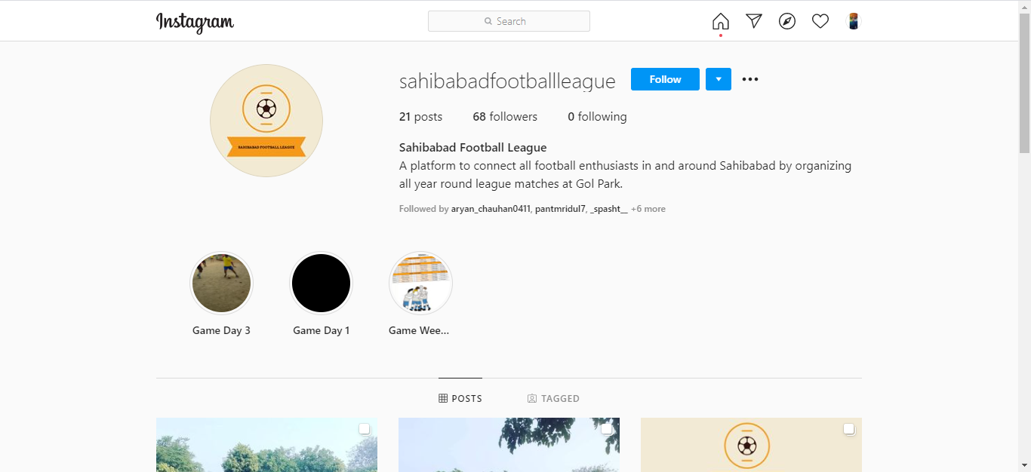
CONTACT

Slide 26

PICTURE GALLERY

Slide 27
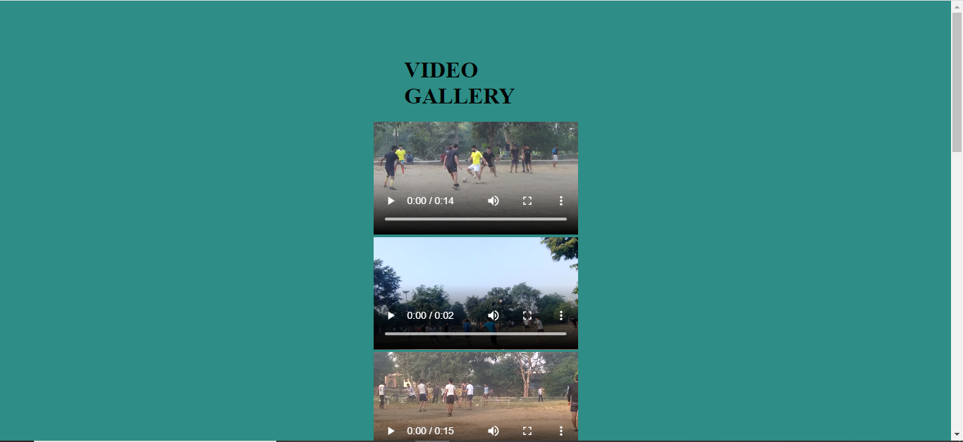
VIDEO GALLERY

Slide 28

CERTIFICATE

Slide 29
THANKYOU

