Slide 1
Chinook music store analysis
-Laksh Yadav

Slide 2

PROBLEM STATEMENT
Hired as a data analyst at Chinook, and your objective is to analyze music record sales data to gain insights and make recommendations for the company's strategy in the physical music market.

Slide 3
DATA OVERVIEW
Chinook database consists of 11 tables
These tables contains all information about their employees , customers and the songs (album, artists, tracks, genre, playlist )
The customer base is from 24 different countries.
There are tracks/album's from 25 different genres.
There are 275 different artists who have their songs in chinook database.

Slide 4
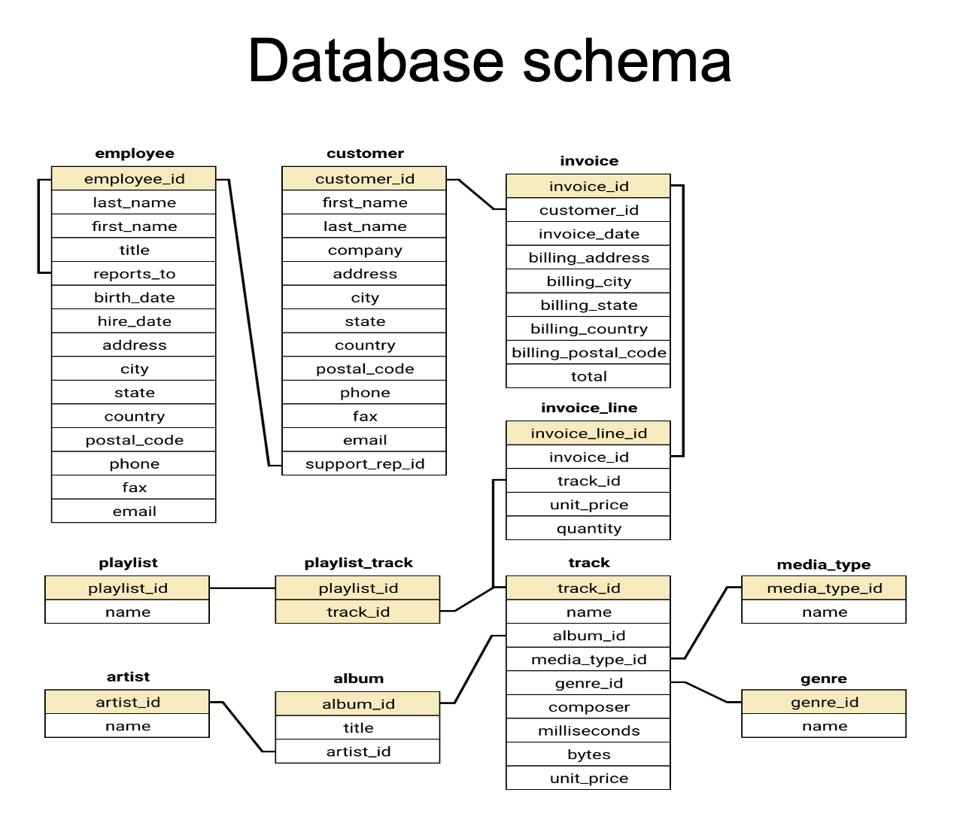
DATABASE BLUEPRINT

Slide 5
DATA INSIGHTS (CUSTOMER DEMOGRAPHIC)
There are a total number of 59 customers .
Customers are spread across 24 nations through out the world
The customer demographic is very diverse.
Maximum number of customers com from USA .
Half of the countries have only 1 customer in out customer database.

Slide 6
DATA INSIGHTS (GENRE SALE DISTRIBUTION)
Rock genre is generating the most sales hence the most popular genre across the world.
The genre following rock are Metal and alternative & punk.
There are 7 genre which do not have any sales and stand last.

Slide 7

Data insights (Churn rate )
What is churn rate ?
The percentage of customers or users who stop doing business with a company or using a product or service over a specific period of time
The churn rate for chinook entire dataset is at a great number i.e. 4.08 %
The lower the churn rate percentage the higher the customer retention
The higher the churn rate percentage the higher is the number of people who have stopped using the service.

Slide 8
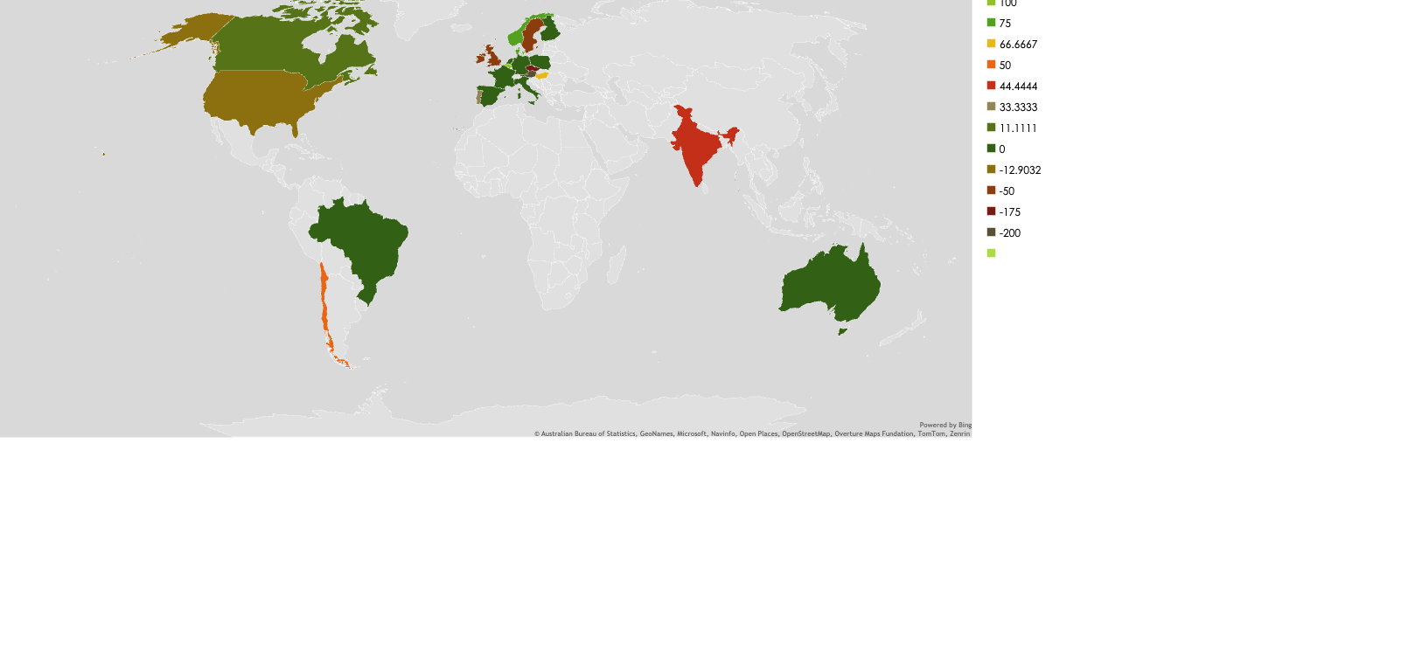
DATA INSIGHTS (CHRUN RATE )

Slide 9

Recommendations
Chinook needs to branch into more countries and with that increase it’s customer base.
The brand must keep a check on churn rate in suggested nations.
Customer retention must be the priority of all priorities so as to grow revenue.
Focus in USA (and other developed countries like Europe, Canada ) market and Run more promotional campaign

Slide 10

CONCLUSION
Trends discovered by country, genre and artist
Company have to expand size of market by more promoting and marketing.
You can enhance the revenue of the company with customer retention.
Different performance key metrics which were analysed: —
No of purchases by customer.
Amount spent per customer.

Slide 11
THERE IS MUSIC IN THE AIR , MUSIC ALL AROUND US; THE WORLD IS FULL OF IT AND YOU SIMPLY TAKE AS MUCH AS YOU REQUIRE —EDWARD ELGAR

