Slide 1


McDonald's Sales Performance Dashboard
Presented by:
Lakshya Dubey Data Analysis using Excel
Notes:
slidesppt.net

Slide 2

McDonald’s
Project Overview
This project analyzes McDonald’s Sales Data using Excel to understand Revenue Trends, Customer Ordering Patterns and Product Performance. An Interactive Dashboard is built using Pivot Tables, Charts, Slicers, and Timeline filters.
Notes:
slidesppt.net

Slide 3
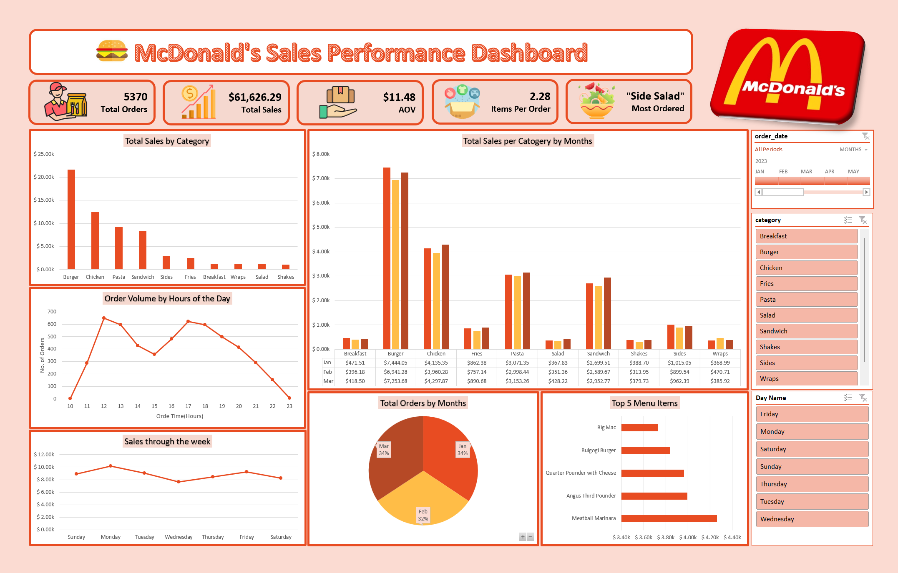

Slide 4

Key Insights:
Revenue by Category
🍔 Burgers generate the Highest Revenue, making them the core sales driver.
🍟 Chicken and Pasta also contribute significantly.
🥗 Wraps, Salads, and Shakes contribute the least to Total Revenue.
Revenue is concentrated in a few major categories.
Notes:
slidesppt.net

Slide 5
Key Insights:
Order Trends & Peak Hours
📈 Sales peak during 12–2 PM (Lunch) and 6–8 PM (Dinner).
⏰ Order volume drops during late night and early morning hours.
Business is highly dependent on peak meal times.

Slide 6
Key Insights:
Top Performing Menu Items
🥗 Side Salad is the most frequently ordered item.
💰 The Top 5 Revenue-Generating items are: Meatball Marinara, Quarter Pounder with Cheese, Angus Third Pounder, Bulgogi Burger, and Big Mac.
📊 A small group of high-performing items drives a significant portion of Total Revenue.
🎯 These key menu items influence overall revenue generation.

Slide 7
Key Insights:
Average Order Value (AOV)
📦 Average items per order ≈ 2.3
💵 The Average Order Value reflects moderate customer spending behaviour.
Increasing AOV can significantly boost total revenue.
Bundle or combo strategies may improve basket size.

Slide 8
Key Insights:
Sales Performance by Day of Week
🔄 Mid-week days show relatively stable but slightly lower performance. Monday and Friday generate slightly higher revenue compared to other weekdays.
📉 Weekend sales remain consistent but do not outperform peak weekdays.
💡 Sales performance is influenced more by specific days than just weekday vs weekend grouping.
📌 Targeted promotions on slower mid-week days could help balance weekly revenue.

Slide 9
Key Insights:
Monthly Sales Performance
📊 Sales remain relatively stable across months, indicating consistent demand.
🔄 Revenue patterns suggest steady customer purchasing behaviour.
💡 Stable monthly performance reflects strong brand consistency.

Slide 10


Conclusion
The analysis shows that sales performance is mainly driven by a few high-performing categories and top menu items. Peak revenue occurs during lunch and dinner hours, highlighting the importance of key meal times. Monday and Friday contribute strongly to weekly sales, proving that specific weekdays can outperform others.
The Average Order Value suggests moderate customer spending, with opportunities to increase revenue through better upselling strategies. Overall, the data reflects stable demand and provides clear insights for improving operational and sales performance.
Notes:
slidesppt.net

Slide 11


THANK YOU!
Let’s Connect on:
https://github.com/lakshyadubey1
www.linkedin.com/in/lakshyadubey45
Presentation template source: slidesppt.net (Creative Commons Attribution)

