Slide 1


Audible Data Cleaning Project
Data Cleaning and Standardization Using
Power Query
Presented by: Lakshya Dubey

Slide 2
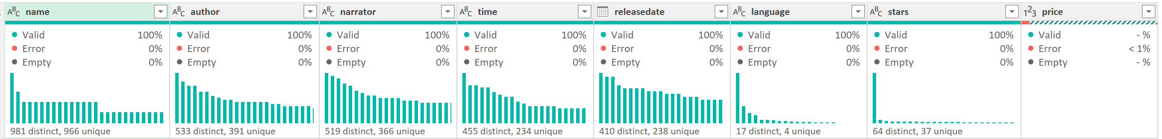
Project Overview
· The dataset contains audiobook details such as:
· Name, Author, Narrator
· Release Date, Language
· Duration, Ratings, Price
· The objective of this project is to:
· Clean inconsistent text values
· Standardize formats
· Convert columns into analysis-ready data types
· All transformations were performed using Power Query.

Slide 3
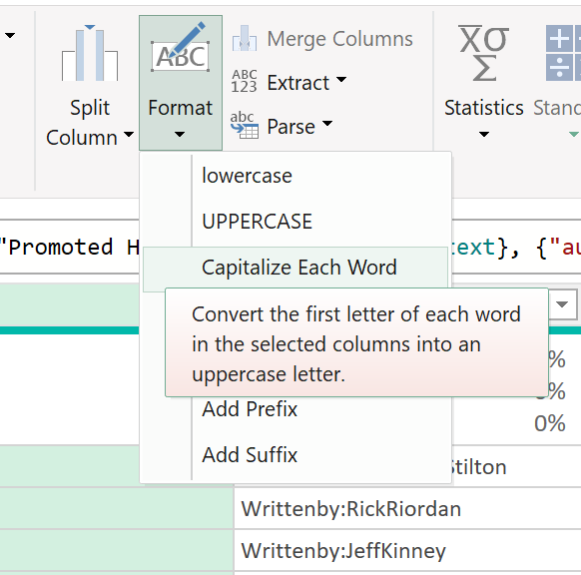
1. Standardize the name column to ensure consistent title casing.
Applied “Capitalize Each Word” from Format to ensure consistent title casing.

Slide 4
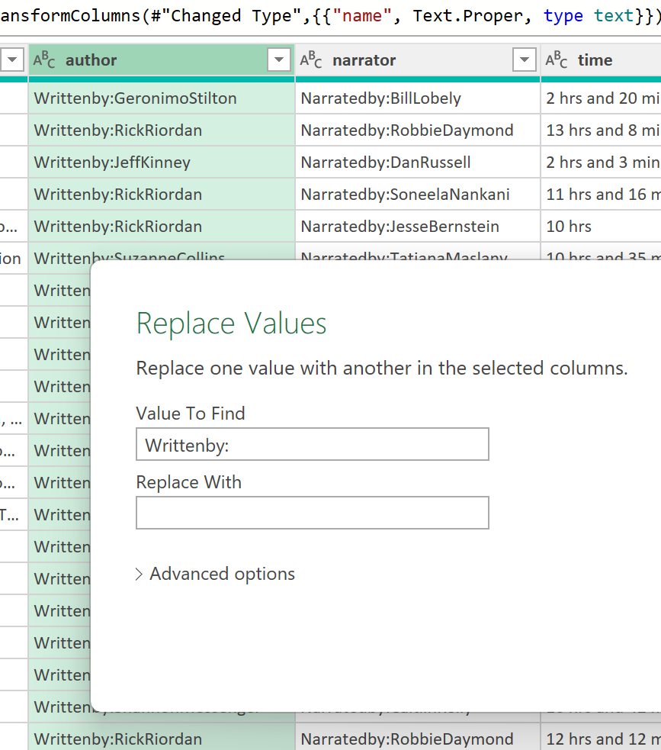
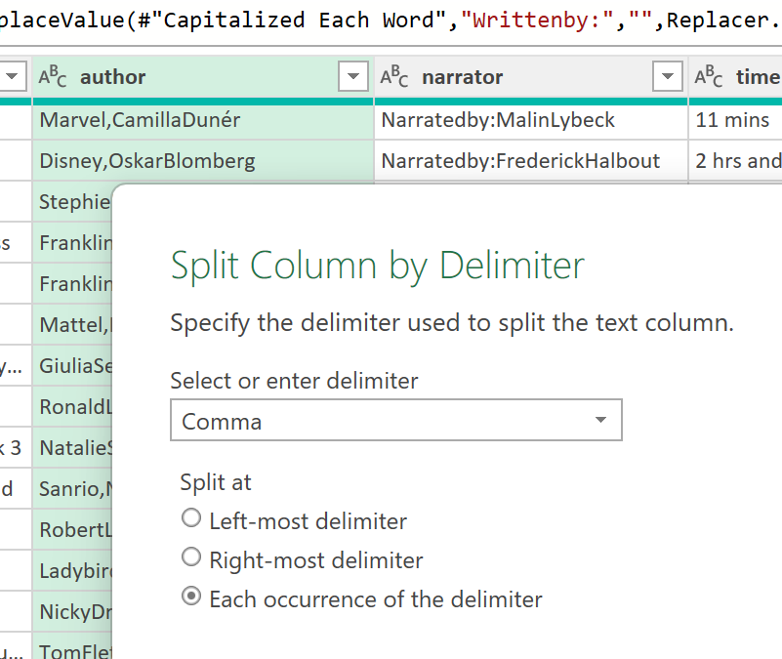
2. Separate combined names in the author column if there are multiple authors.
Removed the prefix “Written by:” before Separating.
Used “Split Column by Delimiter (Comma)” to separate multiple authors into columns.

Slide 5
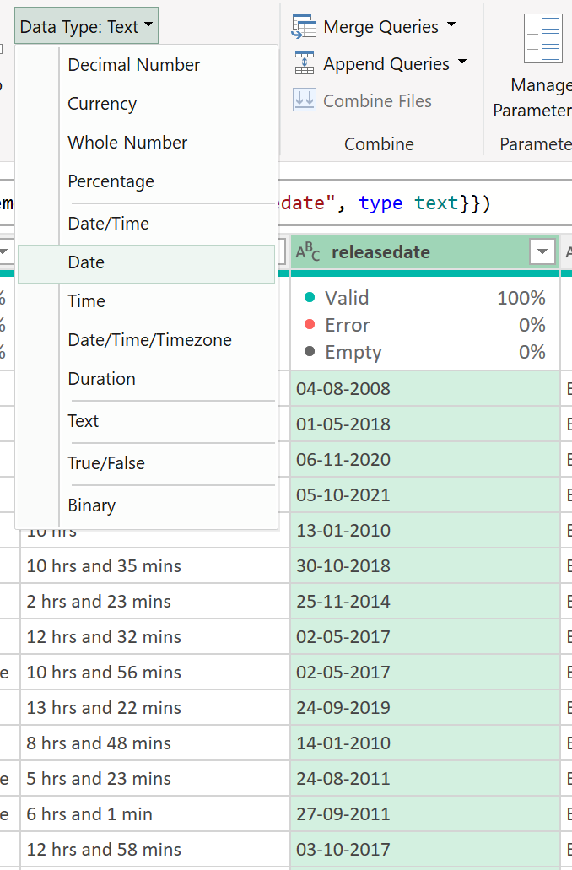
3. Ensure all entries in the “releasedate” column follow a consistent date format (DD-MM-YYYY).
Converted the “releasedate” column from Text to Date type so all values follow a consistent (DD-MM-YYYY) format.

Slide 6
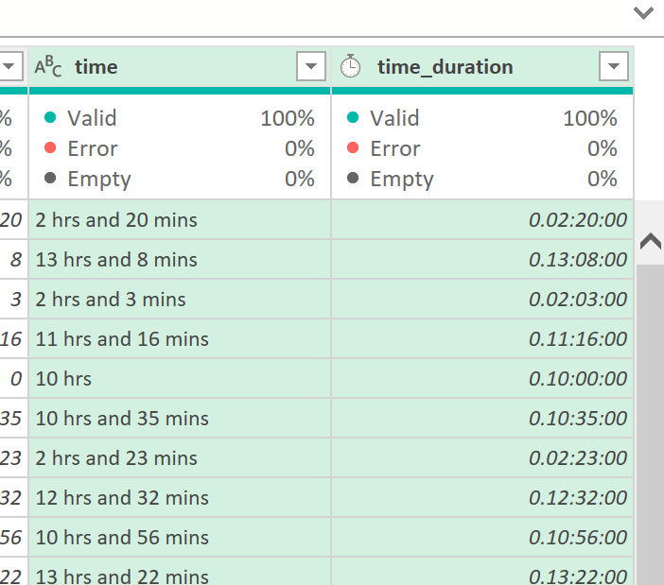
4. Convert the time column from text format to a duration format that Excel recognizes.
Extracted hours and minutes using Text Before and Text After Delimiter.
Handled values with only minutes or only hours during extraction. Then merged both columns and renamed the result to “time_duration”.
Converted the extracted values into a “Duration” data type.

Slide 7
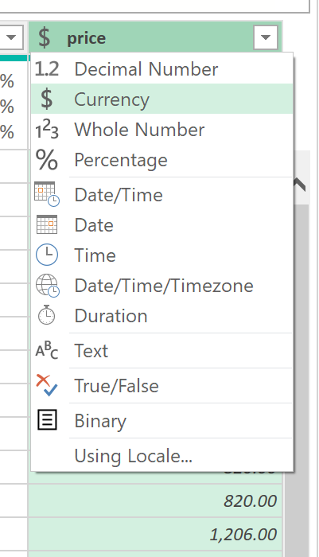
5. Ensure the “price” column is in a numeric format, and identify any non-numeric values.
Replaced Non-numeric value like ‘Free’ with numeric value like ‘0’ using “Replace values” function.
Converted “price” column from text to ‘Currency’ format.

Slide 8
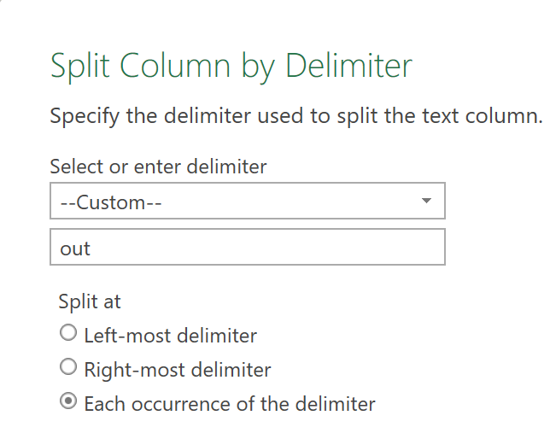
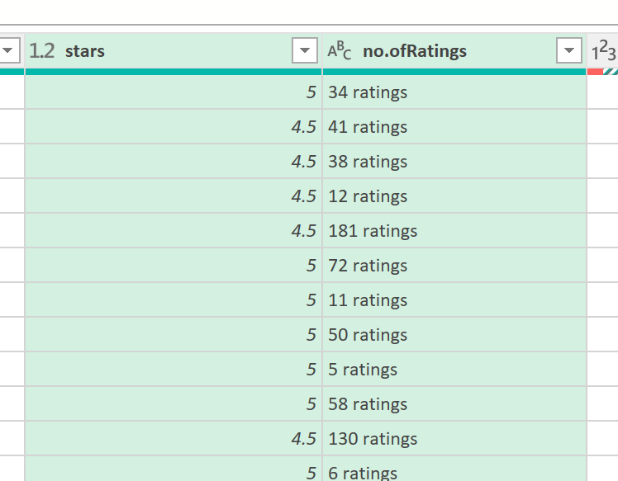
6. Convert text ratings in the “stars” column to numeric values.
Split the stars column using the delimiter ‘out of 5 stars’ to separate ratings and rating counts. After Renaming + Cleaning. Renamed the second column as ‘no.ofRatings’ and replaced ‘Not rated yet’ and null values with 0.
Converted the “stars” column type from text to ‘Decimal Number’ format.

Slide 9
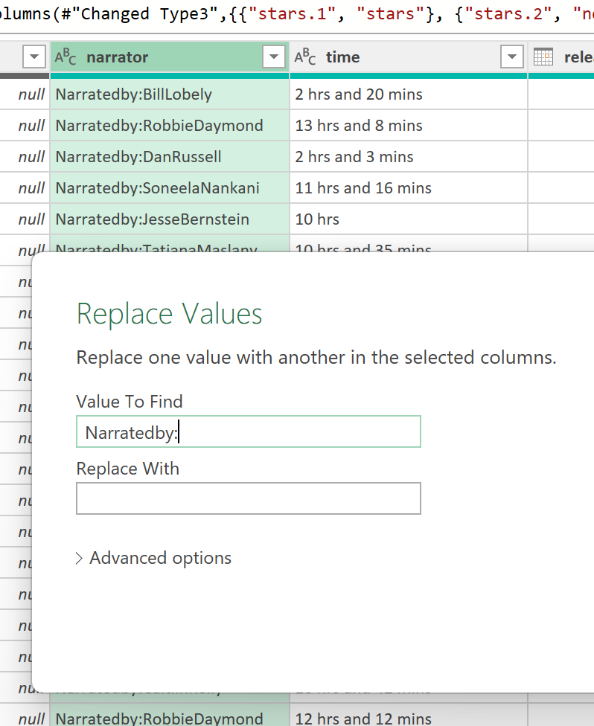
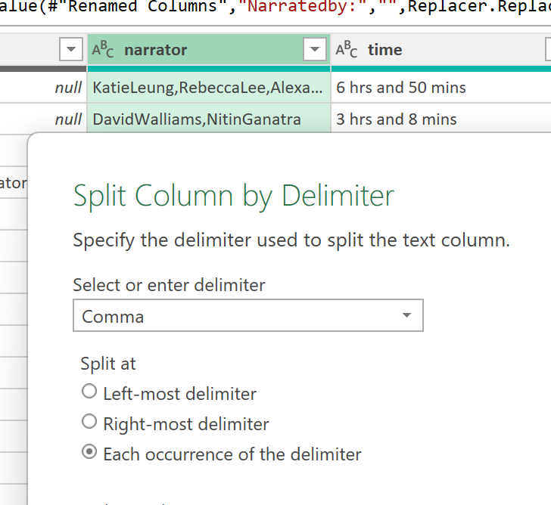
7. Split the narratedby column into multiple columns if multiple narrators are listed.
Removed the prefix “Narratedby:” before Separating.
Used “Split Column by Delimiter (Comma)” to separate multiple narrators into columns.

Slide 10
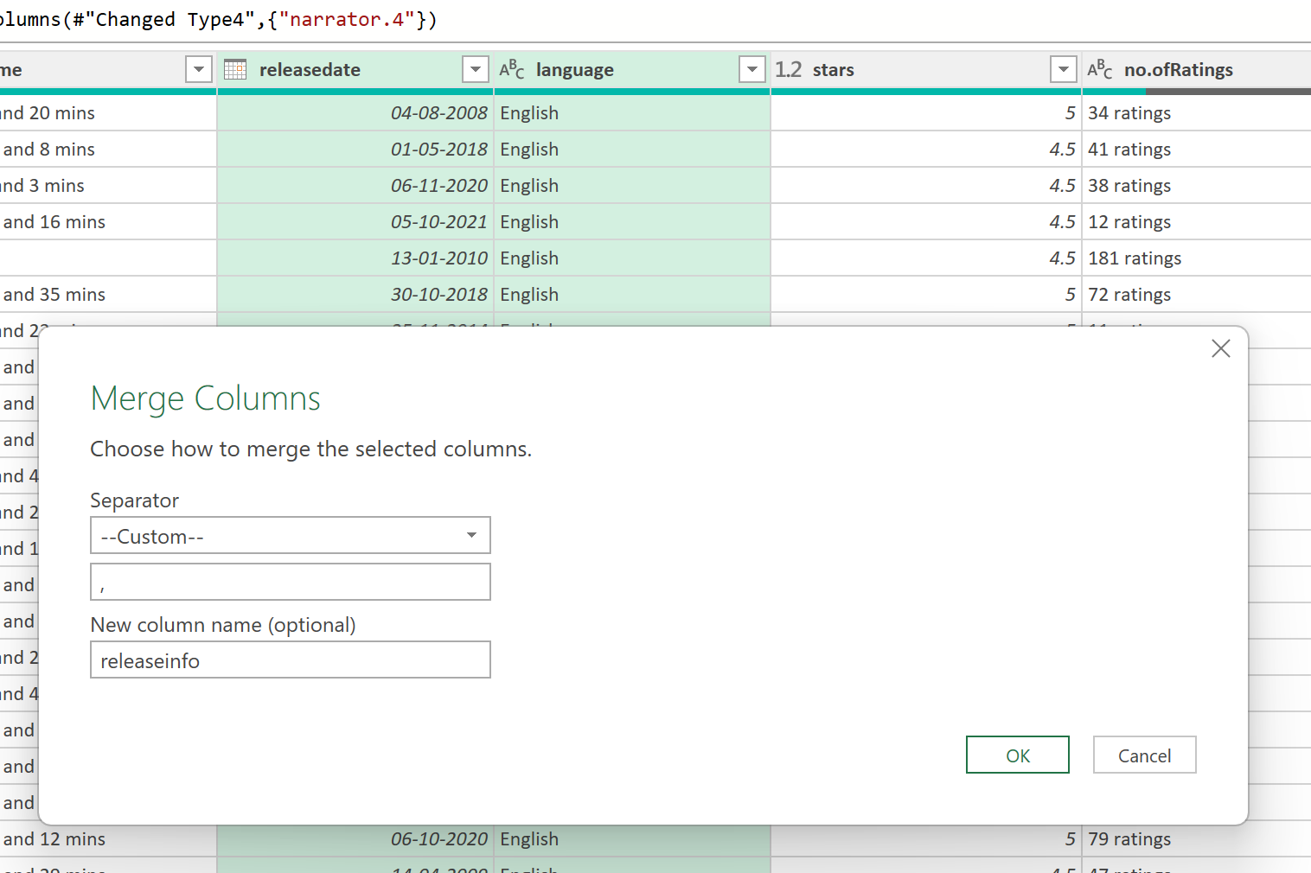
8. Merge the releasedate and language columns into a single new column named releaseinfo with the format "DD-MM-YYYY, Language."
Selected both columns, then used “Merge Columns” using separator “, ” and named it “releaseinfo”.

Slide 11
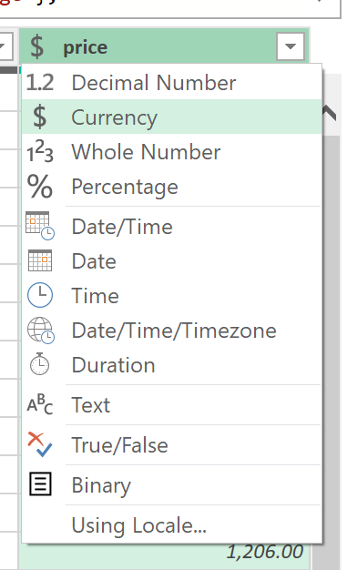
9. Ensure all currency values in the price column are formatted consistently with two decimal places.
To Ensure that all currency values are formatted consistently with two decimal places, “price” column must be in “Currency” format.

Slide 12
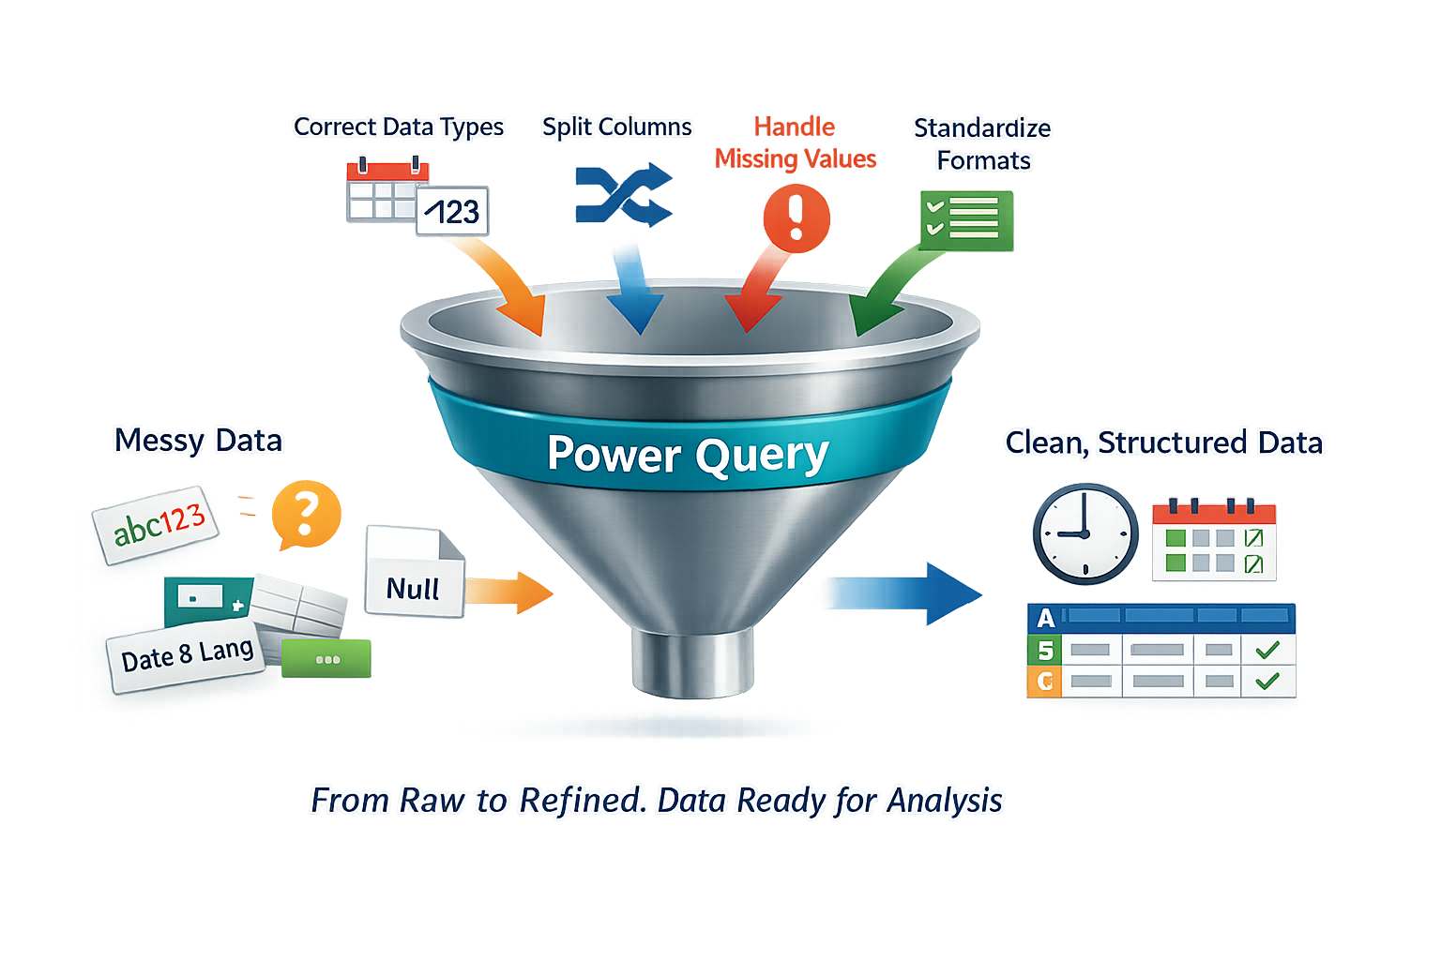
Project Summary
In this project, the Audible dataset was cleaned using Power Query by correcting data types, separating combined text fields, handling missing and invalid values, and standardizing formats.
Power Query made it easy to transform messy data into a clean and structured format using simple, step-by-step transformations, making the dataset ready for further analysis and reporting.

Slide 13




Thank You
LET’S CONNECT ON:
https://github.com/lakshyadubey1
www.linkedin.com/in/lakshyadubey45

