Slide 1

CAPSTONE PROJECT PROJECT TITLE
Presented By
Student Name: LAKSHYA KUMAR GAURIYAN
College Name: dit university
Department: civil engg.
Email ID: LAKSHYAK40@GMAIL.COM
AICTE Student ID: STU67e380ce02a271742962894

Slide 2
OUTLINE
Problem Statement
Proposed System/Solution
System Development Approach
Algorithm & Deployment
Result
Conclusion
Future Scope
References

Slide 3
Problem Statement
Heart disease is one of the leading causes of death worldwide. Diagnosing it accurately is a major challenge due to multiple influencing factors like cholesterol levels, obesity, smoking, blood pressure, and heredity. Manual diagnosis is prone to error and time-consuming, necessitating intelligent solutions to assist doctors.

Slide 4
Proposed Solution
This project aims to develop a machine learning-based system to predict heart disease. The system will analyze patient data (e.g., age, blood pressure, cholesterol, etc.) and apply classification algorithms to identify the risk of heart disease, assisting in early diagnosis and treatment.
Data Collection:
Gather data on age, cholesterol, blood-pressure and other relevant factors.
Utilize real-time data sources to enhance prediction accuracy.
Data Pre-processing:
Clean and pre-process the collected data to handle missing values, outliers, and inconsistencies.
Feature engineering to extract relevant features from the data that might impact heart health.
Machine Learning Algorithm:
Implement a machine learning algorithm, such as a classification model (Logistic Regression), to predict heart disease on historical patterns.
Consider incorporating other factors like age, sex, cholesterol, fasting blood-sugar to improve prediction accuracy.
Evaluation:
Assess the model's performance using appropriate metrics such as Mean Absolute Error (MAE), Root Mean Squared Error (RMSE), or other relevant metrics.
Fine-tune the model based on feedback and continuous monitoring of prediction accuracy.
Result

Slide 5
System Approach
Language Used: Python
Libraries: Pandas, NumPy, Matplotlib, Seaborn, Scikit-learn
Steps:
Data collection from UCI Heart Disease dataset
Exploratory Data Analysis (EDA)
Data pre-processing (handling missing values, encoding)
Model training and testing
Performance evaluation

Slide 6
Algorithm & Deployment
Algorithm Selection: Logistic Regression Why Logistic Regression?
Simple and interpretable
Efficient for binary classification
Performs well with linearly separable data
Suitable for medical data prediction like disease/no disease
Data Input:
Age, Sex, Chest Pain Type, Resting Blood Pressure, Cholesterol, Fasting Blood Sugar, Rest ECG, Max Heart Rate, Exercise-induced Angina, ST depression, etc.
Training Process:
Data preprocessing: handling missing values, encoding categorical variables
Splitting data into training and test sets (70/30)
Model training using Scikit-learn's LogisticRegression()
Evaluation using cross-validation and classification metrics
Prediction Process:
Input new patient data
Preprocess similar to training phase
Use trained model to classify as ‘Disease’ or ‘No Disease’
Display result via a user interface or API endpoint

Slide 7
Result
Accuracy: ~87% (as per training/testing split)
Evaluation Metrics:
Confusion Matrix
Confusion Matrix:
[[ 80 17]
[ 11 104]]
Classification Report
Area Under the ROC Curve (AUC) on Test Set: 0.92
Test Precision: 0.87
Test Recall: 0.90
Test F1-score: 0.88
Mean Squared Error (MSE): 0.1319
Root Mean Squared Error (RMSE): 0.3631
Mean Absolute Error (MAE): 0.1319
Visualization: Correlation heatmap, Bar plots for feature distribution, Area under ROC-Curve

Slide 8
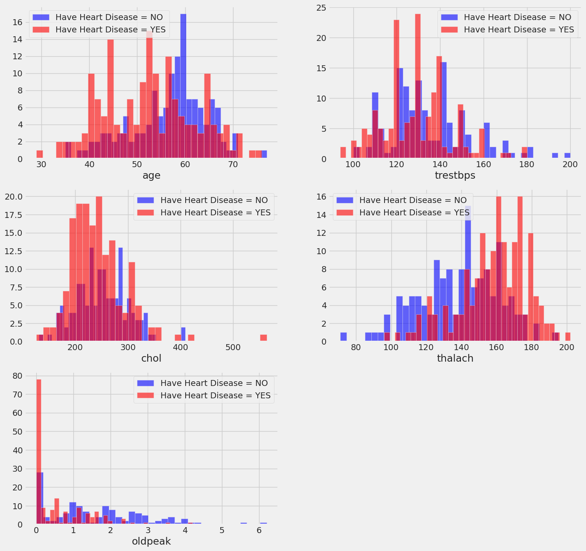
Result

Slide 9
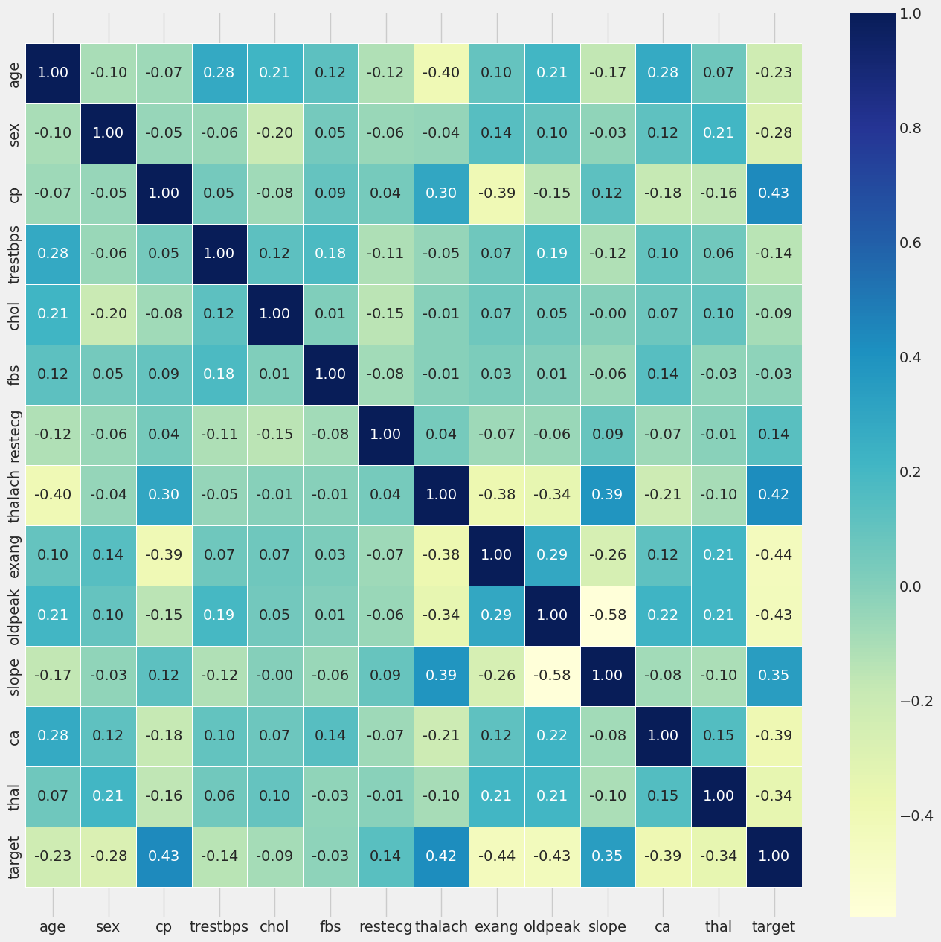
Result

Slide 10
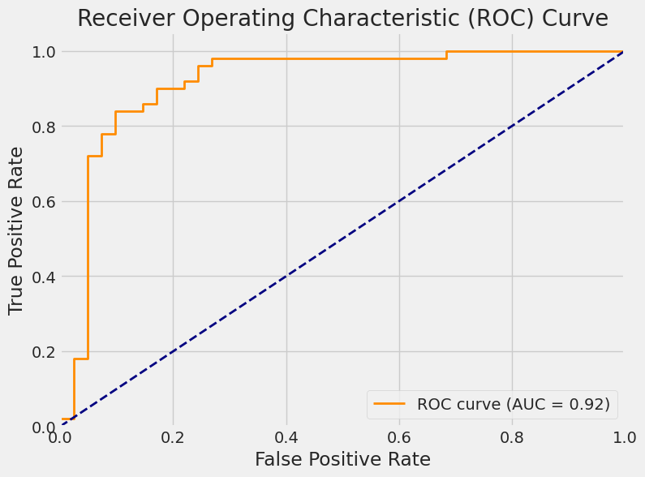
Result

Slide 11
Conclusion
The machine learning model built using Logistic Regression was effective in predicting heart disease. It demonstrates potential as a diagnostic support tool for early detection. The approach is scalable and can integrate into health monitoring systems.

Slide 12
Future scope
Use more complex models (Random Forest, XGBoost, Deep Learning)
Integrate real-time patient monitoring data
Build a mobile-friendly diagnostic tool
Collaborate with hospitals for real-world validation and deployment

Slide 13
References
UCI Machine Learning Repository – Heart Disease Dataset
Scikit-learn Documentation
Research articles on ML in healthcare
GitHub Link: Link

Slide 14
Thank you

