Slide 1
Flow Behaviour
Profiling
Mentor
Jayachandra K
Manager
Saikat
Cross-Platform & Linux Integration
College Mentor
Priyanka Mitra
Progress Update
Program
HPE CPP3
Hewlett Packard Enterprise | June 2026

Slide 2
Challenge & Strategy
Challenge:
Transitioning from a Windows-only environment to a Linux based backend while maintaining a single, unified codebase.
Strategy:
We decoupled the OS-dependent code from the main Flask logic.
The system now detects the host environment at runtime.
Separate windows_sniffer.py and linux_sniffer.py logic.
Dynamic module loading via services/__init_.py.
Hewlett Packard Enterprise | June 2026

Slide 3
Core Linux Integrations
Hardware Hook
Integrated libpcap and tcpdump system libraries to allow direct communication with Ubuntu network stacks.
Permissions
Implemented Linux Capabilities (setcap) to allow raw packet sniffing without requiring full root/sudo access.
Interface Discovery
Utilized psutil for cross-platform NIC discovery, providing clean names like eth0 or wlan0 to the UI.
Hewlett Packard Enterprise | June 2026

Slide 4
Process Lifecycle & Engine Optimization
Clean Process Termination
Windows terminate() calls often left "zombie" sniffer processes active on Linux, locking the network interface.
Implemented Process Group IDs (PGID).
Native os.killpg signaling for graceful shutdowns.
Prevents memory leaks and interface locking.
Engine Optimization
Gevent: Replaced the standard Flask server with gevent to handle native WebSockets on Linux.
Zero-Latency Yielding: Integrated the CPU to switch between the file watcher and the SocketIO stream instantly.
Conditional Guarding: Wrapped async calls in try/except blocks to ensure Windows users aren't affected by Linux-specific libraries.
Hewlett Packard Enterprise | June 2026

Slide 5
Multi-platform Tech Stack
Component | Windows Engine | Linux Engine
Capture Driver | Npcap / WinPcap | libpcap-dev
Async Kernel | Standard Threading | Gevent / Greenlets
Process Control | .terminate() | os.killpg (POSIX)
Testing | Windows PC | Oracle VirtualBox (Ubuntu)
Hewlett Packard Enterprise | June 2026

Slide 6
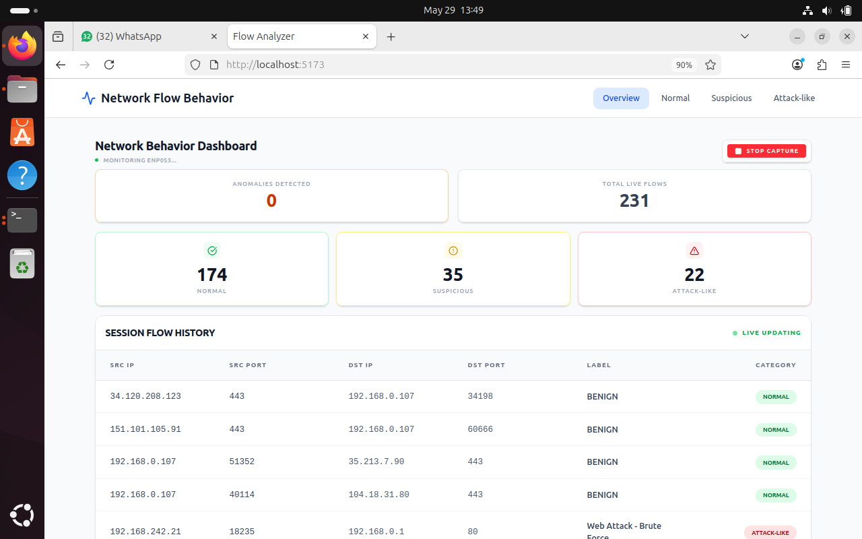
Linux (Ubuntu)
Hewlett Packard Enterprise | June 2026

Slide 7
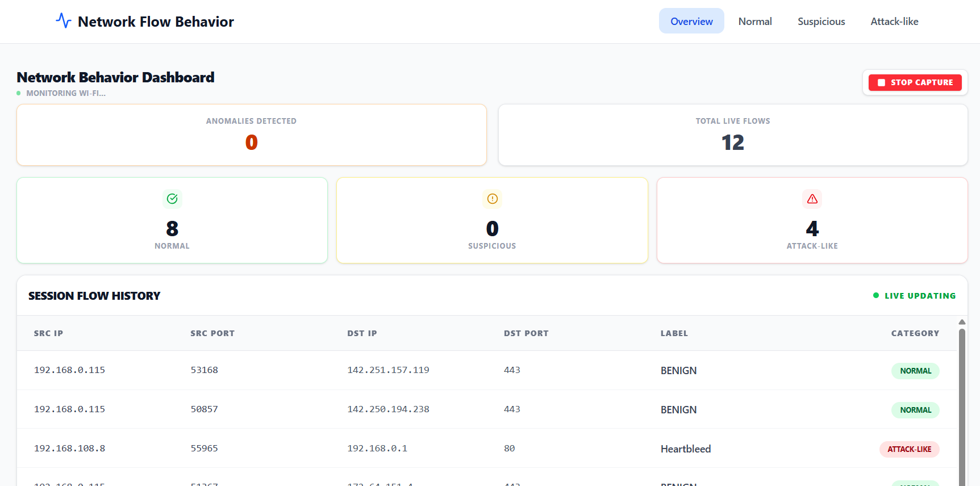
Windows OS
Hewlett Packard Enterprise | June 2026

