Slide 1
PROGRESS REPORT
Flow Behaviour Profiling
7 Weeks of Work
Project 7 week wise progress
Mid Review Presentation
Weeks 1 – 7 Progress Summary
Wk 1
Wk 2
Wk 3
Wk 4
Wk 5
Wk 6
Wk 7
Data
Collection
Label
Design
Model
Training
Rule-Based
Labeling
Hybrid
System
Live
Capture
Attack
Detection
Mentor: Jayachandra K Manager: Saikat College Mentor: Priyanka Mitra Program: HPE CPP3
Hewlett Packard Enterprise | 2026

Slide 2
Project Overview
THE PROBLEM
OUR SOLUTION
Modern networks generate billions of packets per hour. Security teams cannot manually inspect each one. Without intelligent classification, threats go undetected and analysts waste time on false positives.
Build an ML pipeline that analyzes network flows and automatically classifies each as Normal, Suspicious, Misconfigured, or Attack-like - enabling pre-security analytics and faster response.
Normal
Suspicious
Misconfigured
Attack-like
Dataset: CICIDS2017 | 16M+ flows | 80+ features | Canadian Institute for Cybersecurity
HPE CPP3 | Mid Review Presentation

Slide 3
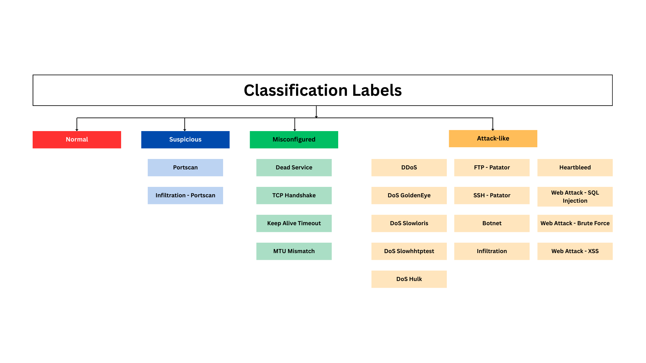
Classification of Labels into 4 Categories
HPE CPP3 | Mid Review Presentation

Slide 4
Data Collection & Label Design
Data Collection
Label Design & Mapping
Dataset
CICIDS2017 - 16M+ flow records, 80+ features per flow, Monday - Friday traffic scenarios
Classification
Mapping
Mapped all CICIDS attack types to 4 project labels: Normal, Suspicious, Misconfigured, Attack-like
Source
Canadian Institute for Cybersecurity (Kaggle) - widely used benchmark
Misconfigured
Sub-types
4 sub-types defined: Dead Service, TCP Handshake Failure, Keep-Alive Timeout, MTU Mismatch
Format
CSV with pre-extracted NetFlow-style features including labeled traffic
Attack Behavior
Studied flow indicators for all 13 CICIDS attack types - ports, packet rates, TCP flags, duration
DDoS, Brute Force, Botnet, Infiltration — both benign and attack traffic
Identified required dataset features per label; validated availability in CICIDS2017 columns
Scenarios
Feature Mapping
Parameters
Core ID, Traffic Volume, Time Behavior, Packet Structure, TCP Flags, Flow Stability
Dataset Merge
Merged all daily CSVs and added higher-level classification label column
HPE CPP3 | Mid Review Presentation

Slide 5
ML Model Training and Evaluation
Data Collection
(CICIDS2017 Dataset)
Data Processing
(Cleaning, Label Encoding, Feature Scaling)
Feature Extraction
(Selecting important features)
Model Evaluation
(Finding Accuracy, Precision, F1-Score)
Model Training
(Train ML Model)
Train - Test - Split
(80% training and 20% testing)
Random Forest (Supervised) Model
Final Model Selection
Isolation Forest (Unsupervised) Model
HPE CPP3 | Mid Review Presentation

Slide 6
Supervised & Unsupervised Models Evaluated
Key Model Insights
Random Forest — highest macro accuracy (89.59%), consistent across all 27 attack classes
XGBoost — 88.95% accuracy, And train with boosting advantage.
How Each Model Works
How Each Model Works
Logistic Regression
Isolation Forest
It calculated weights for each one, and predicted which class a flow belongs to. It draws a straight mathematical line between classes.
Randomly isolates data points. Anomalies (attacks) are isolated faster because they are different from normal flows they end up in shorter branches.
XGBoost
One-Class SVM
Builds trees sequentially — each new tree fixes errors made by the previous one. This "boosting" corrects mistakes progressively.
Learns a boundary around normal traffic. Any flow that falls outside this boundary is flagged as anomalous — a potential attack.
Observations
Logistic Regression — linear model, misses complex attack patterns, macro only 83.70%
Macro accuracy is the true measure — overall accuracy hides per-class weakness
Random Forest
Local Outlier Factor
Builds independent decision trees on random data subsets, takes majority vote. Each tree sees different data — reduces overfitting, class_weight='balanced' ensures rare attack classes aren't ignored.
Compares the density of a flow's neighborhood to its neighbors. Flows in low-density regions (far from others) are flagged as outliers.
We used scikit-learn library for Classification, regression , outlier detection.
accuracy score, classification_report ( gives precision, recall , f1 score ) , confusion matrix ( gives prediction errors ).
HPE CPP3 | Mid Review Presentation

Slide 7
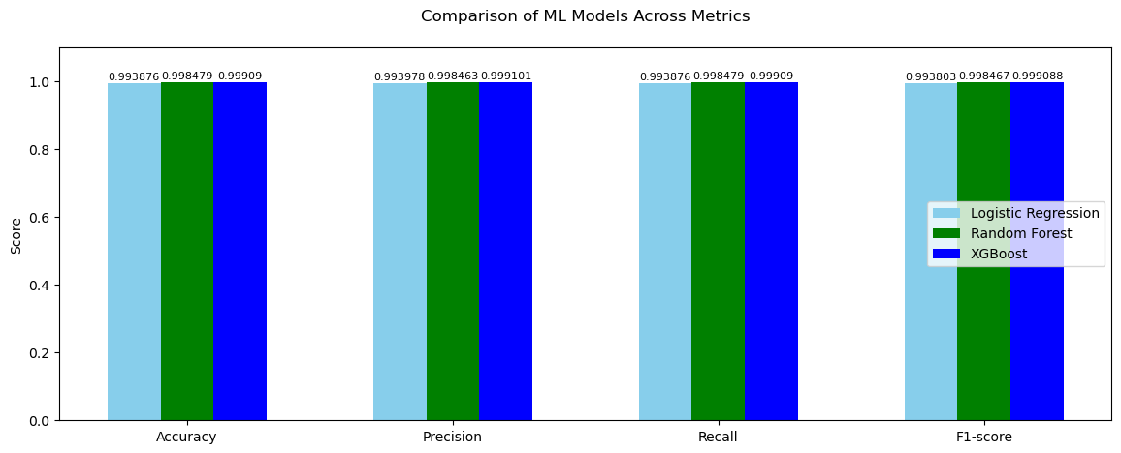
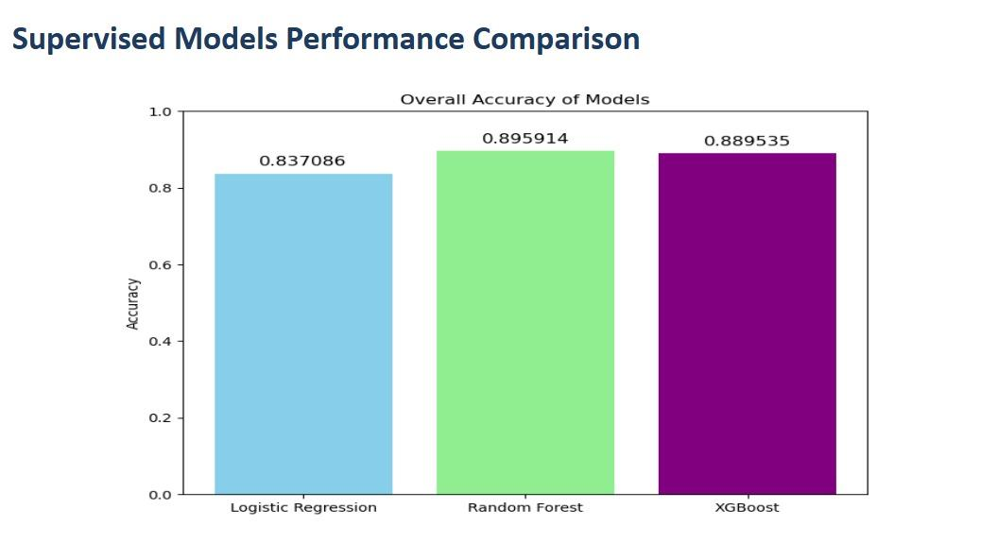
Model Accuracy Evaluation
SUPERVISED MODELS
SUPERVISED MODELS
Logistic Regression
83.70%
Linear model; misses complex attack patterns
XGBoost
88.95%
Fastest training; best speed-accuracy
Random Forest
89.59%
Consistent across all 27 attack classes
Final Approach: ( Random Forest ) leads for supervised due to its high accuracy and robust behavior across network classes.
HPE CPP3 | Mid Review Presentation

Slide 8
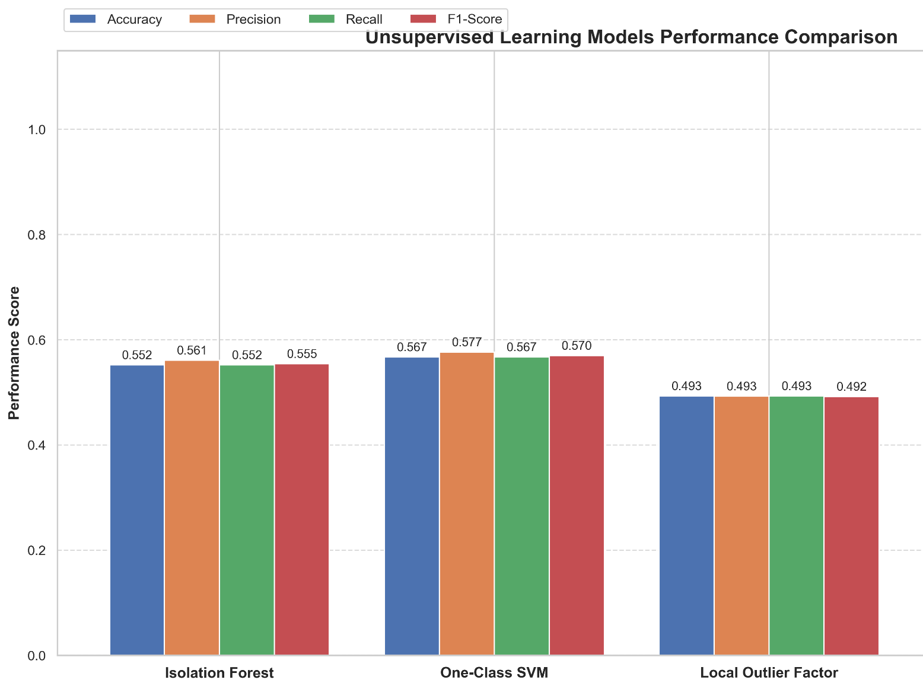
Model Accuracy Evaluation
UNSUPERVISED MODELS
UNSUPERVISED MODELS
Local Outlier Factor
49.3%
Density-based; flags flows far from normal clusters
Isolation Forest
55.2%
Fast anomaly detection, effective for high-volume data
One-Class SVM
56.7%
Learns boundary around normal traffic
Final Approach: ( Isolation Forest ) for unsupervised due to its fast and effective anomaly detection in high-volume, unknown attack scenarios.
HPE CPP3 | Mid Review Presentation

Slide 9
Rule-Based Labeling & UI Design
Rule-Based Labeling Engine
UI Design - Figma
Heartbleed
ACK Flag Count > 4000
▸ Dashboard Layout
Designed full network monitoring UI in Figma with classification panels for all 4 labels
FTP/SSH Patator
Avg Pkt Size > 5, Dst Port = 21 or 22
Portscan
Avg Pkt Size ≤ 5, Fwd Packets/s > 10,000
▸ Flow Table
Real-time flow table showing source/destination IPs, ports, protocol, and label assigned
DoS Hulk
Avg Pkt Size > 600, Bwd Pkt Std > 1500, IAT < 500K
▸ Label Views
DDoS
Avg Pkt Size > 600, Bwd Pkt Std > 3000, IAT ≥ 500K
Separate tabs for Normal, Suspicious and Attack-like categories
Botnet
Avg Pkt Size > 5, Dst Port = 8080
▸ Visual Stats
Web Attacks (XSS)
Avg Pkt Size varies, Dst Port 80/443, ACK Flag > 10
Charts and counters for traffic distribution and classification breakdown
DoS Slowloris/Slowhttp
Bwd Pkt Std = 0, IAT > 40M–80M range
▸ Prototype
A complete interactive prototype ready for frontend implementation
Infiltration
Avg Pkt Size >5, Bwd Pkt Std = 0, IAT > 20M
HPE CPP3 | Mid Review Presentation

Slide 10
Hybrid System & UI Integration
ARCHITECTURAL FLOW
Network
Traffic
Feature
Extraction
Rule-Based
Engine
Supervised
ML Model
Unsupervised
ML Model
Dashboard
& Alerts
Real-Time Dashboard
Heuristic Accuracy
Live classification dashboard showing incoming flow classifications with breakdown by label category
Rule-based engine validated - high accuracy for known attack patterns using packet size, flags, and port indicators
Individual Class Tabs
UI Integration
Separate dashboard tabs for Normal, Suspicious, Misconfigured, and Attack-like flows for targeted analyst review
Backend ML model integrated with React frontend - flows classified in near-real-time and rendered on the dashboard
HPE CPP3 | Mid Review Presentation

Slide 11
Live Traffic Capture & Classification
Live Traffic Capture
Suspicious Category Detection
Integrated live packet capture directly into the system. Network flows captured in real time are processed through the feature extraction pipeline and fed to the ML classifier.
Live dashboard successfully captures and displays Suspicious category flows - including port scans and reconnaissance traffic - with real-time label assignment.
Label Reasoning Engine
Architectural Update
Implemented label reasoning feature: for each classified flow, the dashboard shows the specific features (packet size, flags, ports) that triggered the classification decision.
Updated system architecture to include a live capture module feeding into the processing pipeline - bridging the gap between static CSV-based testing and real network environments.
HPE CPP3 | Mid Review Presentation

Slide 12
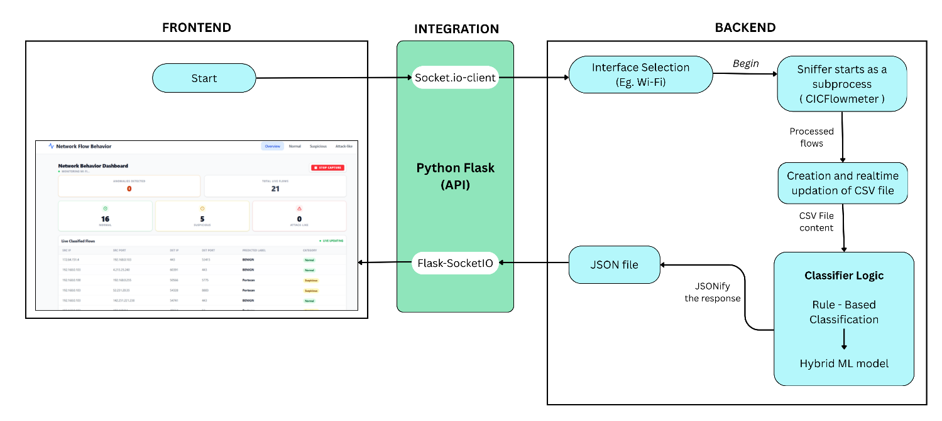
Architectural Flow Diagram
HPE CPP3 | Mid Review Presentation

Slide 13
Attack Detection & Live Flow Testing
01
Synthetic Flows Simulation
Attack-Like labels immediately reflected on the live dashboard, validated end-to-end pipeline
Method: Known attack synthetic flows randomly simulated with the actual real-time flows
02
Nmap Reconnaissance
Flows captured as Suspicious/Attack-like on the dashboard, confirmed real traffic classification
Method: Used Nmap security scanner to perform port scanning and network reconnaissance
03
hping3 Flood Attack (Ubuntu VM)
SYN flood successfully detected and classified as Suspicious on the live monitoring dashboard
Method: Ran hping3 SYN flood from VirtualBox Ubuntu VM targeting the Windows host IP address
HPE CPP3 | Mid Review Presentation

Slide 14
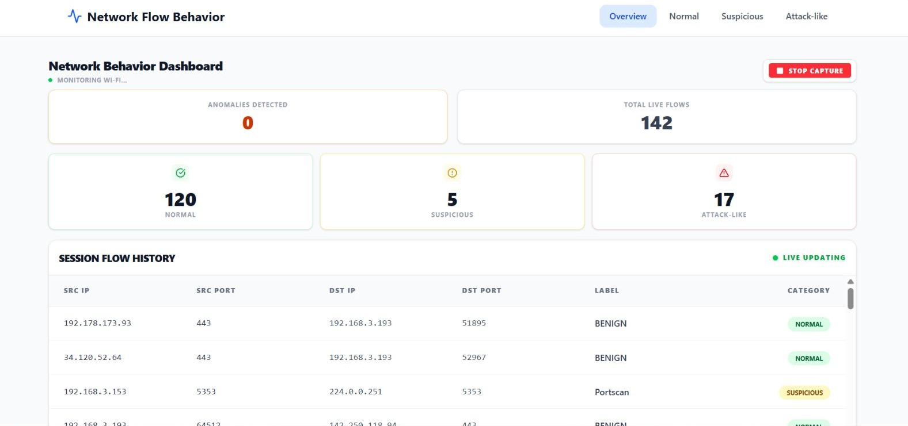
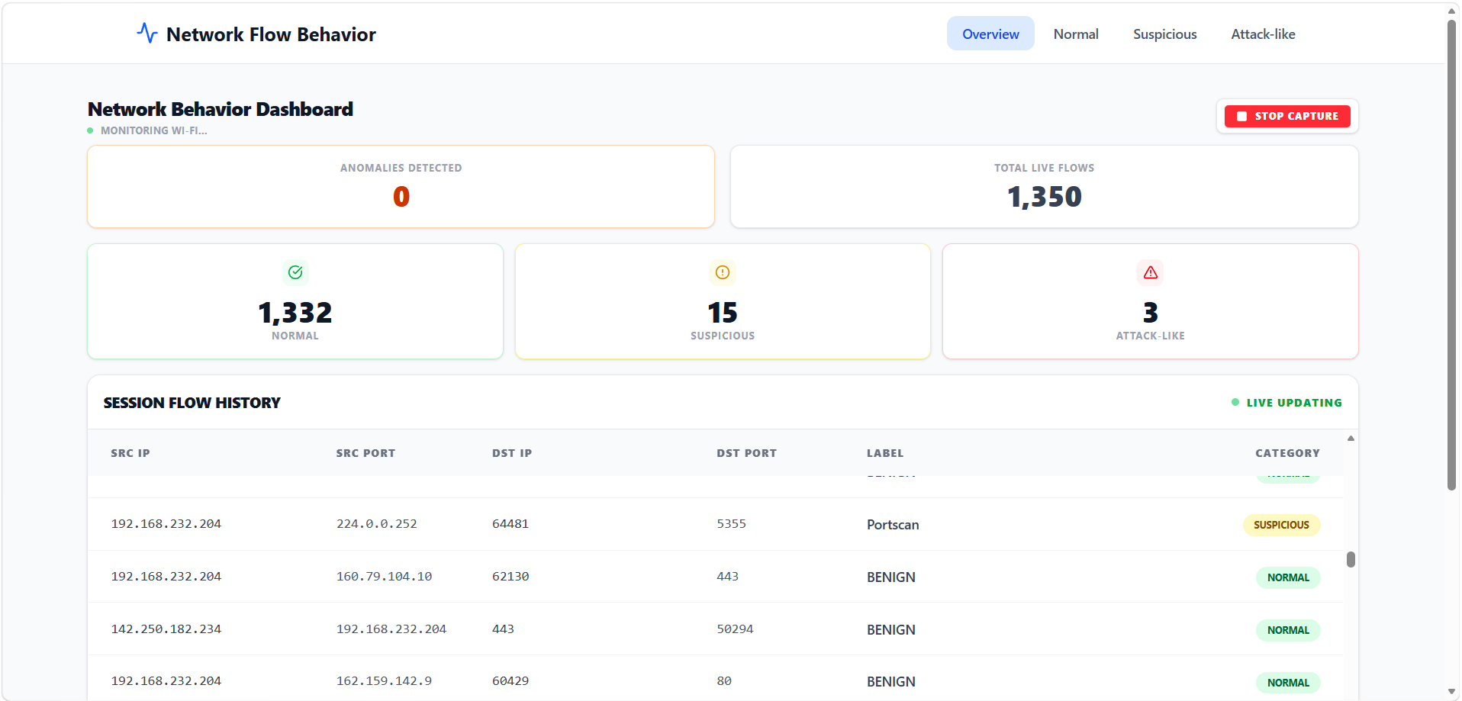
Dashboard UI
HPE CPP3 | Mid Review Presentation

Slide 15
Summary & Progress Overview
16M+
89.6%
27
4
3
Flow Records
Processed
Best Model
Accuracy
Attack Classes
Classified
Classification
Labels
Real Attack
Tests
1
Data Collection
CICIDS2017 dataset: 16M+ flows, 80+ features, benchmark imported from Kaggle
2
Label Design
Mapped 27 attack classes to 4 labels; designed Misconfigured sub-types
3
Model Training
Hybrid Random Forest (supervised) + Isolation Forest (unsupervised approach) for robust classification and anomaly detection.
4
Rule-Based Engine
Heuristic rules for 20+ attack subtypes; Figma UI prototype designed
5
Hybrid System
Integrated ML + rule engine; full dashboard UI implemented and connected
6
Live Capture
Real-time packet capture pipeline; label reasoning feature implemented
7
Attack Testing
Validated with Synthetic flows simulation, Nmap scans, and hping3 SYN flood from Ubuntu VM
HPE CPP3 | Mid Review Presentation

Slide 16
Upcoming updates & Future Scope
Key Metrics &
Visual Components
Different
Dataset
Testing
Telemetry
Application
Packaging
Uploaded File
Analysis
Linux
Support
HPE CPP3 | Mid Review Presentation

