Slide 1
Mentor
Jayachandra K
Manager
Saikat
College Mentor
Priyanka Mitra
Program
HPE CPP3
Flow Behaviour Profiling
Data Collection
Week 1 Progress Update
Hewlett Packard Enterprise | March 2026

Slide 2
Project Overview
THE PROBLEM
OUR SOLUTION
Modern networks generate billions of packets per hour. Security teams cannot manually inspect each one. Without intelligent classification, threats go undetected and analysts waste time on false positives.
Build an ML pipeline that analyzes network flows and automatically classifies each as:
Normal,
Suspicious,
Misconfigured,
Attack-like — enabling pre-security analytics and faster response.
Flow Classification Labels:
Normal
Suspicious
Misconfigured
Attack-like
HPE CPP3 | Week 1 Update

Slide 3
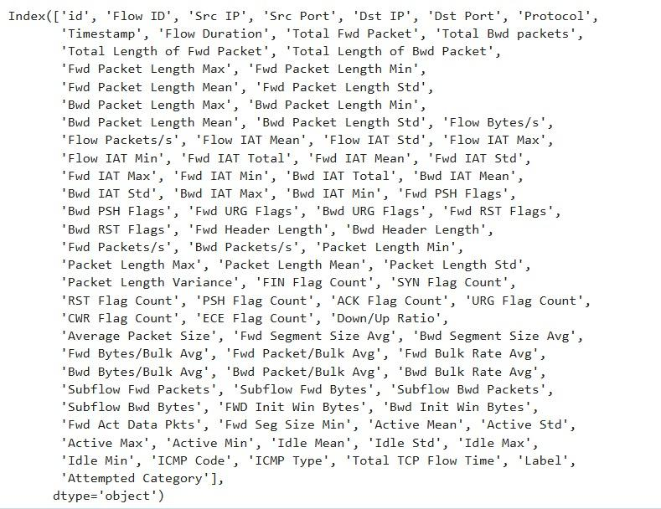
Week 1 : Data Collection ​
All Parameters
Dataset
https://www.kaggle.com/datasets/ernie55ernie/improved-cicids2017-and-csecicids2018
CORE FLOW IDENTIFICATION PARAMETERS
• Source IP – IP address of the sender
• Destination IP – IP address of the receiver
• Source Port – port used by the sender application
• Destination Port – service port on the receiver
• Protocol – TCP, UDP, or ICMP These help detect patterns like scanning or repeated connections.
HPE CPP3 | Week 1 Update

Slide 4
Dataset: CICIDS2017
16M+
80+
2017
Flow Records
Features per Flow
Benchmark Year
Dataset Details
Why CICIDS2017?
Source: Canadian Institute for Cybersecurity (Kaggle)
Format: CSV (pre-extracted flow features)
Data Type: Network flows with labeled traffic
Coverage: Monday–Friday traffic scenarios
Contains both benign and attack traffic for supervised labeling
Pre-extracted NetFlow-style features match our pipeline input
Includes DDoS, brute force, botnet, and infiltration scenarios
Widely used benchmark — enables comparison with published research
HPE CPP3 | Week 1 Update

Slide 5
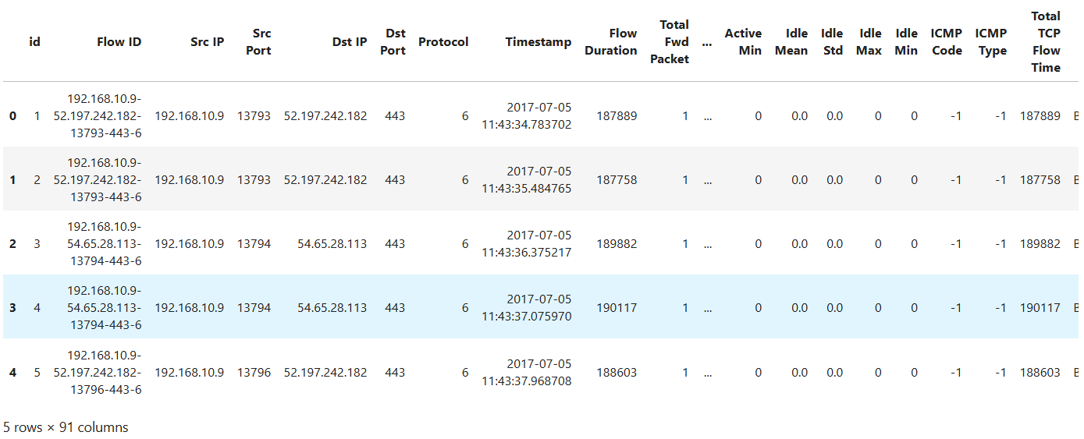
Example / Sample Data
df.head() — First 5 rows x 91 columns | CICIDS2017 Dataset imported from Kaggle
HPE CPP3 | Week 1 Update

Slide 6
Flow Parameters
Parameter Categories
Core Flow ID: Src IP, Dst IP, Src Port, Dst Port, Protocol
Traffic Volume: Total Packets, Bytes, Fwd/Bwd Packets, Packet Rate, Byte Rate
Time Behavior: Flow Duration, IAT (Inter-Arrival Time), Burstiness, RTT Variance
Packet Structure: Avg/Min/Max Packet Size, Packet Size Entropy
TCP Flags (Attack signals): SYN, ACK, FIN, RST Flag Counts
Flow Stability: Active Time, Idle Time, Flow Lifetime, Flow Frequency
HPE CPP3 | Week 1 Update

