Slide 1
Mentor
Jayachandra K
Flow Behaviour Profiling
Manager
Saikat
Network Flow Classification
College Mentor
Priyanka Mitra
Week 2 Progress Update
Program
HPE CPP3
Hewlett Packard Enterprise | March 2026

Slide 2
Week 2 — Work Completed
01
Classification Label Mapping
02
Misconfigured Sub-Label Design
Mapped all CICIDS dataset attack types to 4 project labels: Normal, Suspicious, Misconfigured, and Attack-like.
Defined 4 Misconfigured sub-types (Dead Service, TCP Handshake, Keep-Alive Timeout, MTU Mismatch) with detection logic.
03
Attack Flow Behavior Study
04
Feature-to-Label Mapping
Studied detailed flow behavior indicators for all 13 CICIDS attack types including ports, packet rates, flags, and duration ranges.
Identified required dataset features for each sub-label and validated availability in CICIDS2017 columns.
HPE CPP3 | Week 2 Update
HPE CPP3 | Week 2 Update

Slide 3
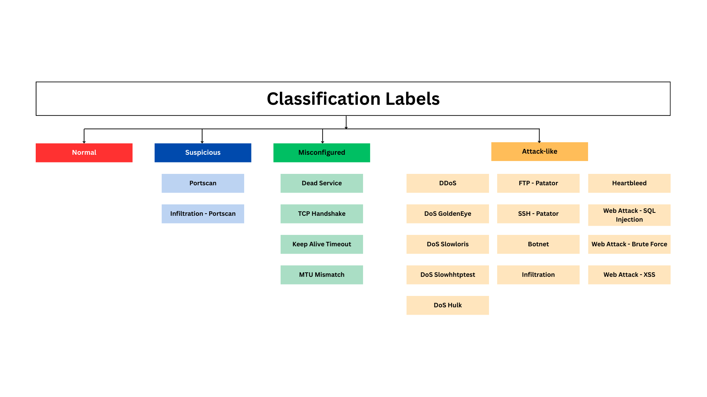
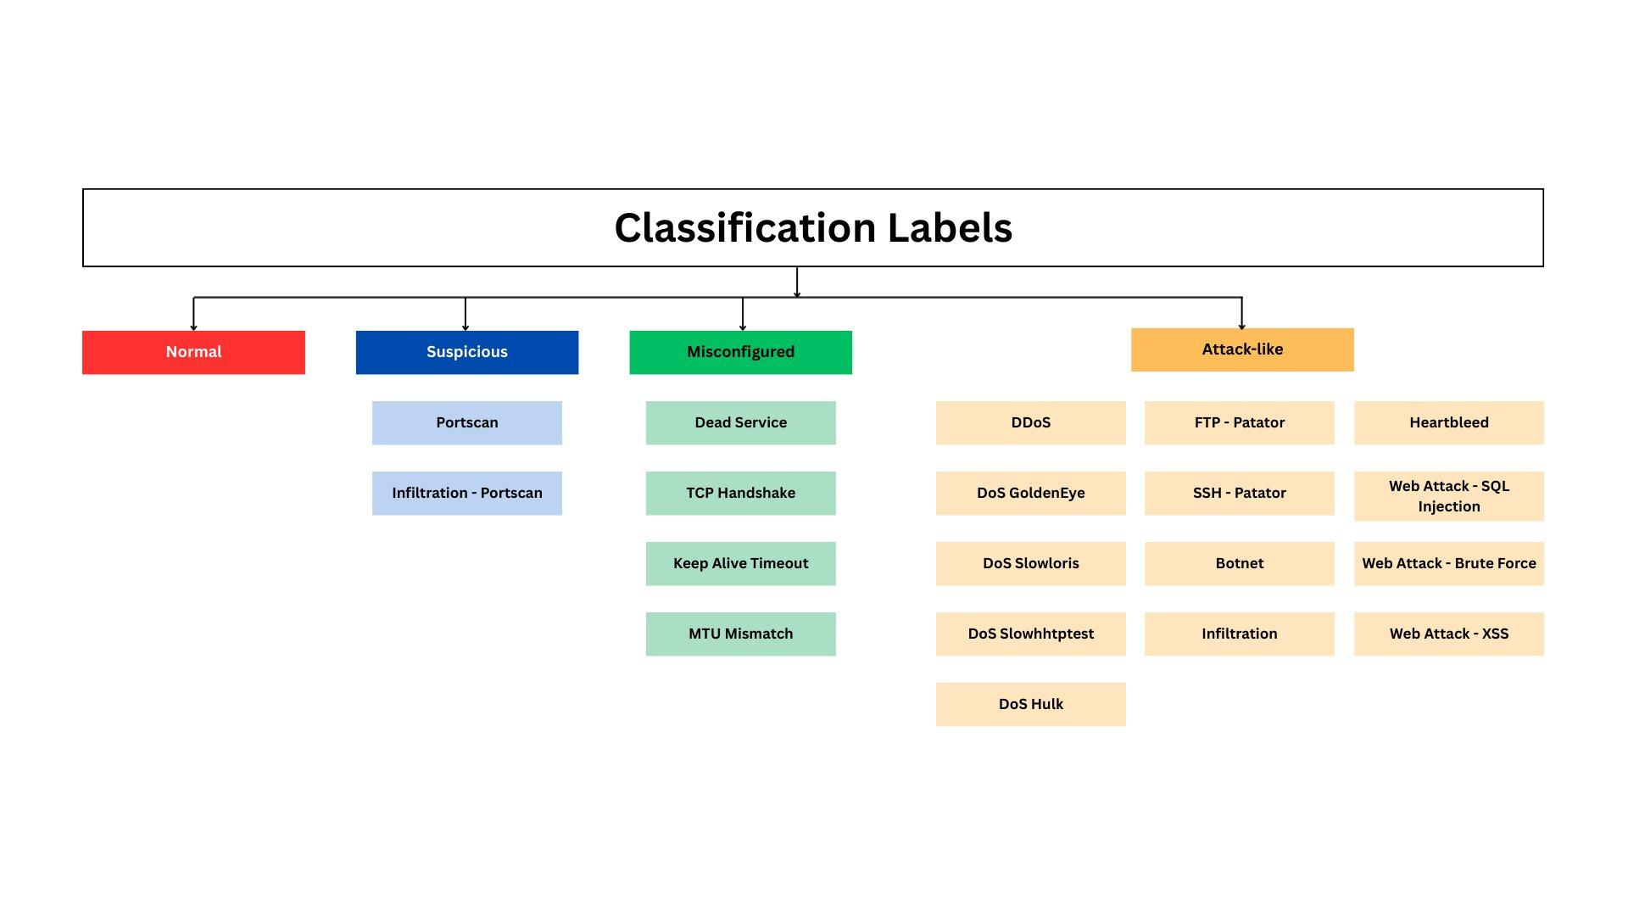
Classification Labels
Mapping CICIDS dataset attack categories to our 4 project classification labels
HPE CPP3 | Week 2 Update
HPE CPP3 | Week 2 Update

Slide 4
Suspicious Label — Detection & Key Features
Reconnaissance or internal scanning flows — not confirmed attacks but warrant analyst attention
Portscan
Infiltration – Portscan
External host probing many ports to find open services.
Attacker inside the network scanning internally to pivot to other systems.
Key Indicators
Key Indicators
Total Packets: 1–3 per probe
Source IP: Internal / private address range
Flow Duration: < 1 second
Flow Duration: < 1 second per probe
SYN Flag: ≥ 1 (connection probe)
Flow Frequency: High from same source IP
Avg Pkt Size: 0–100 bytes (tiny packets)
Dst Port: Multiple ports targeted rapidly
Dataset Features Used
Dataset Features Used
Total Packets
Flow Duration
SYN Flag Count
Total Packets
Flow Duration
Flow Frequency
Dst Port
Avg Pkt Size
Dst Port
Src IP Range
HPE CPP3 | Week 2 Update

Slide 5
Misconfigured Label — Sub-Types
4 sub-types defined for the Misconfigured label based on network behavior patterns
1
Dead Service / Unreachable Endpoint
3
Keep-Alive Timeout
Destination port is a known service port (80/443/22). Flow duration is very short with very few forward packets — server not responding.
Flow duration much higher than average. Packets per second much lower than normal — connection held open with almost no data exchange.
Dst Port
Flow Duration
Total Fwd Packets
Flow Duration
Flow Packets/s
2
TCP Handshake Failure
4
MTU Mismatch
SYN count much higher than normal. ACK count much lower than normal. RST count elevated — connection repeatedly failing to complete.
Average packet size much lower than expected for the service. High packet count relative to bytes — packets being fragmented due to MTU mismatch.
SYN Flag Count
ACK Flag Count
RST Flag Count
Average Packet Size
Total Packets
Flow Bytes/s
HPE CPP3 | Week 2 Update
HPE CPP3 | Week 2 Update

Slide 6
Attack-Like — Flow Behavior Indicators
5 attack groups from CICIDS dataset with key flow behavior indicators for ML label training
FTP & SSH Brute Force 40–200 packets • Long duration (10–300s) • Low packet rate • High ACK count • Balanced Fwd/Bwd
Port 21/22
DoS / DDoS Extremely high packet rate (1K–200K pkt/s) • Very short flows • High bytes/s • Hulk / GoldenEye / Slowloris / SlowHTTPTest / DDoS
Port 80/443
Web Attack 5–20 packets • Short sessions (1–10s) • Balanced Fwd/Bwd • Brute Force / XSS / SQL Injection
Port 80/443
Botnet 2–20 packets • Very long duration • Low packet rate (<5 pkt/s) • Periodic C2 communication • Small heartbeat packets
Variable
Infiltration & Heartbleed 5–50 packets • Long sessions • Irregular Fwd/Bwd ratio • Large payload • Variable destination ports
Variable
HPE CPP3 | Week 2 Update

