Slide 1
Mentor
Jayachandra K
Flow Behaviour Profiling
Manager
Saikat
Model Training & Evaluation
College Mentor
Priyanka Mitra
Week 3 Progress Update
Program
HPE CPP3
Hewlett Packard Enterprise | March 2026

Slide 2
Week 3 — Work Completed
01
Supervised Model Training
02
Unsupervised Model Training
Worked on 5 models : Logistic Regression, Random Forest, XGBoost on 80% of CICIDS dataset with 27 attack class labels.
Trained Isolation Forest, One-Class SVM and Local Outlier Factor on 80% of CICIDS dataset or 50,000 samples for anomaly detection.
03
Models Testing
04
Model Comparison & Analysis
Evaluated all models on 20% test data. Measured Accuracy, Precision, Recall, F1-Score and Macro Accuracy per class.
Compared all supervised and unsupervised models across metrics. Identified best performing algorithm for our flow classification task.
HPE CPP3 | Week 3 Update

Slide 3
Supervised Learning — Overview & Testing Process
What is Supervised Learning?
Training & Testing Process
1
Load & Clean Data
The model is trained on labeled data — each network flow in our dataset already has a known label (Normal, DDoS, Botnet etc). The model learns the pattern and predicts labels for new unseen flows. Dataset: CIC-IDS2017 | 27 attack classes Split: 80% Training → 20% Testing Models Trained: Logistic Regression,
Random Forest, XGBoost
Load 5 daily CSV files, remove infinity values and duplicates
2
Feature & Label Split
Separate 91 input features (X) from the Label column (y)
3
Label Encoding
Convert 27 text class names to numbers for model training
4
Train / Test Split
80% data used to train, 20% kept aside for unbiased testing
5
Feature Scaling
Normalize all numeric values so no feature dominates others
6
Train & Evaluate
Train each model, predict on test set, measure all metrics
HPE CPP3 | Week 3 Update

Slide 4
Supervised Models Performance Comparison
Model | Accuracy
Logistic Regression | 83.70%
Random Forest (Best) | 89.59%
XGBoost | 88.95%
Key Model Insights
Random Forest — highest macro accuracy (89.59%), consistent across all 27 attack classes
XGBoost — 88.95% accuracy, fastest training, best speed-accuracy balance
Observations
Logistic Regression — linear model, misses complex attack patterns, macro only 83.70%
Macro accuracy is the true measure — overall accuracy hides per-class weakness
HPE CPP3 | Week 3 Update

Slide 5
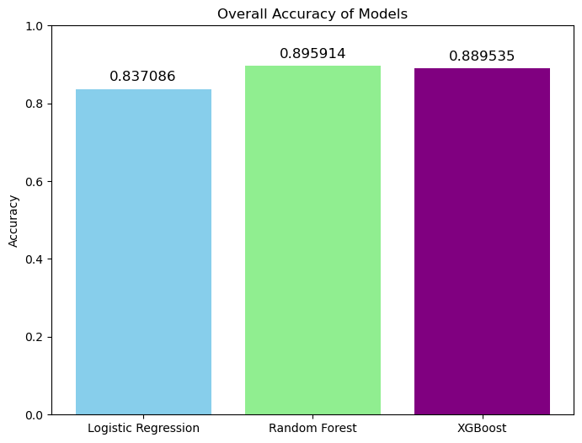
Supervised Models Performance Comparison
HPE CPP3 | Week 3 Update

Slide 6
Unsupervised Learning Overview & Testing Process
What is Unsupervised Learning?
How Each Model Works
Unlike supervised learning, here the model is given data without labels. It must find patterns and anomalies on its own — flagging anything that looks different from normal traffic as a potential threat. Dataset: 80% or 50,000 samples from CIC-IDS2017 Goal: Detect anomalies without knowing attack labels in advance Models Tested: Isolation Forest, One-Class SVM,
Local Outlier Factor
Isolation Forest
Randomly isolates data points. Anomalies (attacks) are isolated faster because they are different from normal flows — they end up in shorter branches.
One-Class SVM
Learns a boundary around normal traffic. Any flow that falls outside this boundary is flagged as anomalous — a potential attack.
Local Outlier Factor
Compares the density of a flow's neighborhood to its neighbors. Flows in low-density regions (far from others) are flagged as outliers.
HPE CPP3 | Week 3 Update

Slide 7
Unsupervised Models Performance Comparison
Model | Accuracy
Isolation Forest | 55.2%
One-Class SVM | 56.7%
Local Outlier Factor | 49.3%
Best Unsupervised Model
One-Class SVM — highest accuracy (56.7%) and F1 (57.0%), best boundary around normal traffic
Isolation Forest — fast anomaly detection, good for high-volume flow data, accuracy 55.2%
Both models can flag unknown zero-day attacks without needing any labels
Key Observation
Scores of 49–57% are expected due to no label information during training
Purpose is different: catching zero-day attacks that supervised models miss i.e. detects whether a flow is normal or an anomaly
HPE CPP3 | Week 3 Update

Slide 8
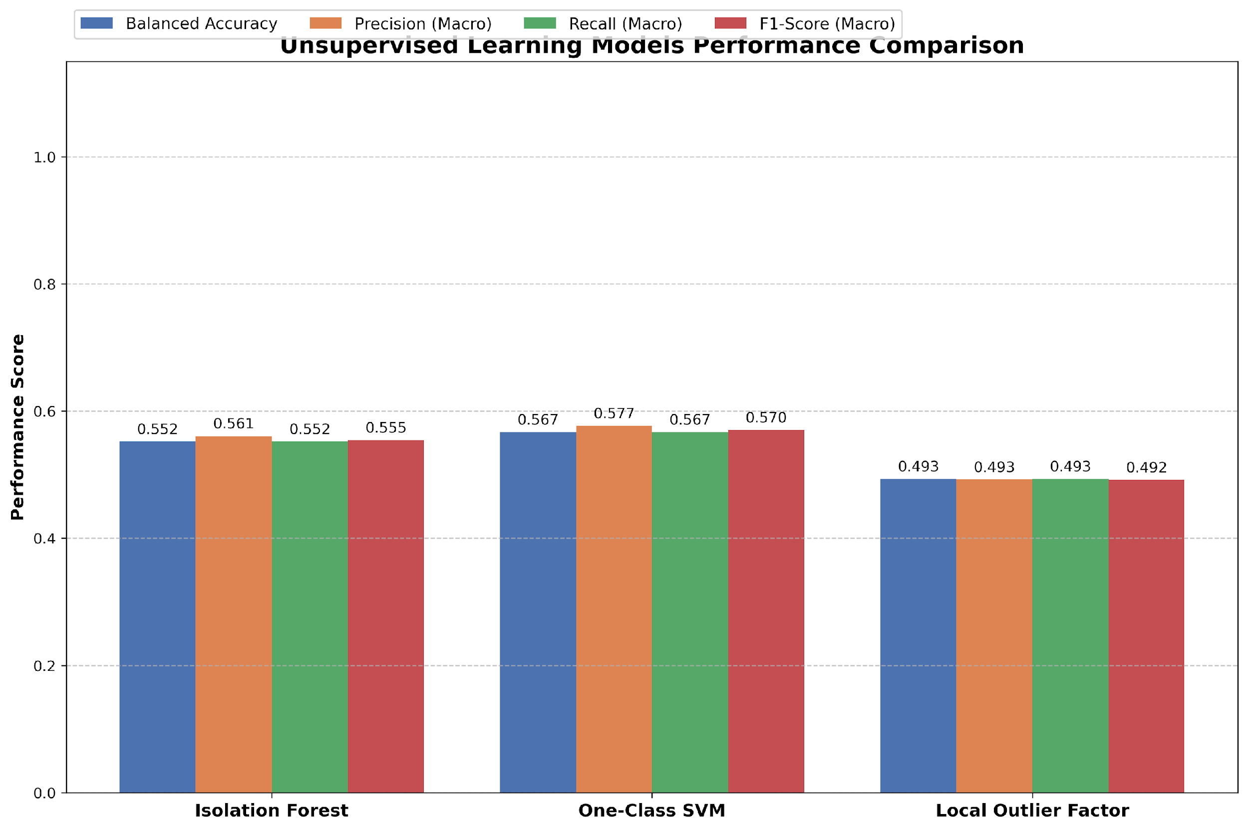
Unsupervised Models — Performance Comparison
HPE CPP3 | Week 3 Update

Slide 9
Conclusion
Supervised Models Work Excellently
Unsupervised Models Work Excellently
Random Forest led with 90% macro accuracy across all 27 classes — proving our feature set and label mapping are strong.
Isolation Forest proved highly effective for fast anomaly detection in high-volume flow data, successfully isolating network anomalies with an accuracy of 55.2%
Unsupervised Models Detect Unknowns
Final Approach - Hybrid System
Though scoring 49–57%, unsupervised models serve a different purpose, catching zero-day or never-before-seen attacks that supervised models cannot detect.
Our project will use supervised models for known attack classification and unsupervised models as an anomaly detection layer, giving complete network coverage.
HPE CPP3 | Week 3 Update

