Slide 1
Mentor
Jayachandra K
Flow Behaviour Profiling
Manager
Saikat
Model Training & Frontend Development
College Mentor
Priyanka Mitra
Week 4 Progress Update
Program
HPE CPP3
Hewlett Packard Enterprise | March 2026

Slide 2
Rule Based Labeling
Label | Dataset Parameters Used
Heartbleed | Avg Pkt Size > 1500, ACK Flag Count > 4000
FTP-Patator | Avg Pkt Size > 5, Dst Port = 21
FTP-Patator - Attempted | Avg Pkt Size ≤ 5, Dst Port = 21
SSH-Patator | Avg Pkt Size > 5, Dst Port = 22
SSH-Patator - Attempted | Avg Pkt Size ≤ 5, Dst Port = 22
Botnet | Avg Pkt Size > 5, Dst Port = 8080
Botnet - Attempted | Avg Pkt Size ≤ 5, Dst Port = 8080
Portscan | Avg Pkt Size ≤ 5, Fwd Packets/s > 10000
Infiltration - Portscan | Avg Pkt Size ≤ 5, Fwd Packets/s > 10000, SYN Flag = 2
DoS GoldenEye | Avg Pkt Size > 600, Bwd Pkt Std ≥ 1500, IAT ≥ 500K
HPE CPP3 | Week 4 Update

Slide 3
Rule Based Labeling
Label | Dataset Parameters Used
DoS GoldenEye - Attempted | Avg Pkt Size ≤ 5, Fwd Packets/s > 200
Infiltration - Attempted | Avg Pkt Size ≤ 5, Fwd Packets/s > 200, RST Flag ≥ 1
DoS Slowhttptest - Attempted | Avg Pkt Size ≤ 5, SYN Flag ≥ 7
DoS Slowloris - Attempted | Avg Pkt Size ≤ 5, SYN Flag = 3, ACK Flag = 0
DoS Hulk - Attempted | Avg Pkt Size ≤ 5, SYN Flag = 3, ACK Flag = 2, IAT > 30M
Web Attack - Brute Force - Attempted | Avg Pkt Size ≤ 5, SYN Flag = 2, IAT > 5.3M
Web Attack - XSS - Attempted | Avg Pkt Size ≤ 5, SYN Flag = 2, IAT > 5M
Web Attack - SQL Injection - Attempted | Avg Pkt Size ≤ 5, SYN Flag = 2, IAT < 5M
DoS Slowhttptest | Avg Pkt Size > 5, Bwd Pkt Std = 0, IAT > 80M
HPE CPP3 | Week 4 Update

Slide 4
Rule Based Labeling
Label | Dataset Parameters Used
DoS Slowloris | Avg Pkt Size > 5, Bwd Pkt Std = 0, IAT > 40M
Infiltration | Avg Pkt Size 150–190, Bwd Pkt Std = 0, IAT > 30M
Web Attack - XSS | Avg Pkt Size 700–800, Dst Port = 80/443, ACK Flag > 150
Web Attack - Brute Force | Avg Pkt Size 300–450, Dst Port = 80/443, ACK Flag > 150
Web Attack - SQL Injection | Avg Pkt Size 200–300, Dst Port = 80/443, ACK Flag ≥ 10, Bwd Pkt Std 800–1000
DoS Hulk | Avg Pkt Size > 600, Bwd Pkt Std > 1500, IAT < 500K
DDoS | Avg Pkt Size > 600, Bwd Pkt Std > 3000, IAT ≥ 500K
DoS GoldenEye | Avg Pkt Size > 600, Bwd Pkt Std ≥ 1500, IAT ≥ 500K
BENIGN | Avg Pkt Size ≤ 5, No rule matched (default)
HPE CPP3 | Week 4 Update

Slide 5
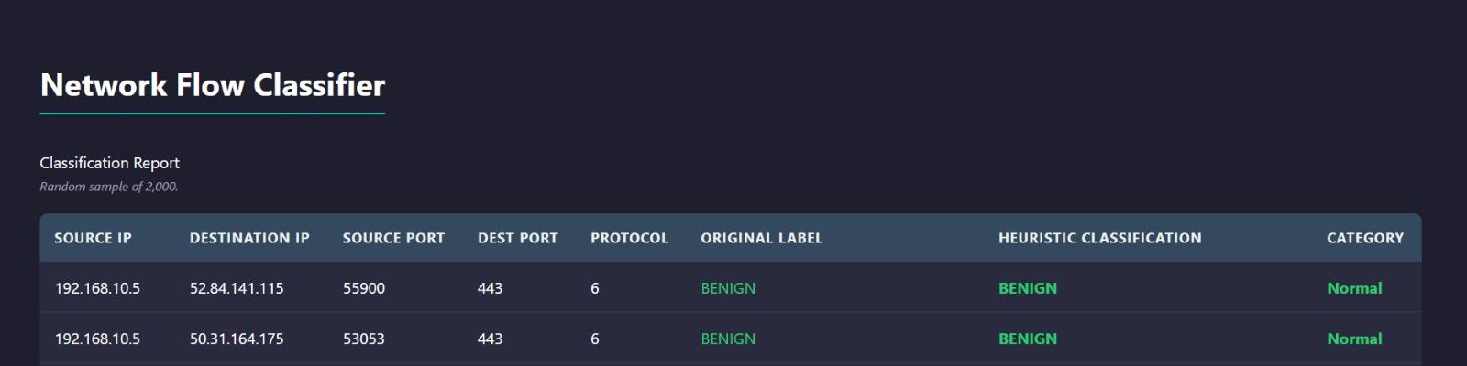
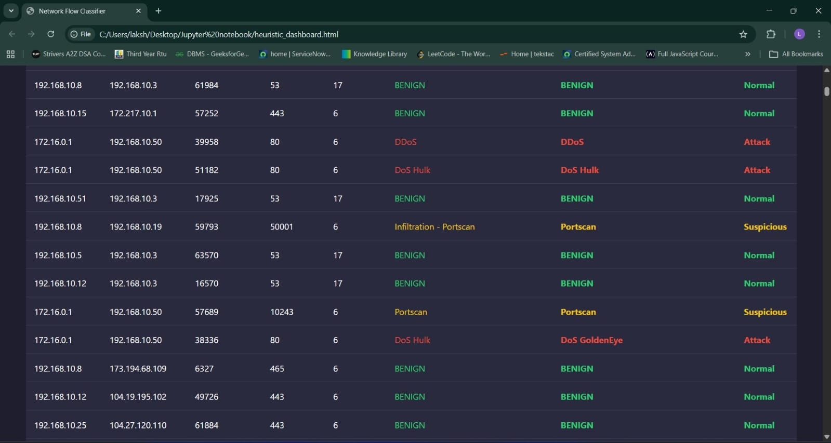
Frontend Page after classification of network
HPE CPP3 | Week 4 Update

