Slide 1
Mentor
Jayachandra K
Flow Behaviour Profiling
Manager
Saikat
Hybrid Model and UI Integration
College Mentor
Priyanka Mitra
Week 5 Progress Update
Program
HPE CPP3
Hewlett Packard Enterprise | March 2026

Slide 2
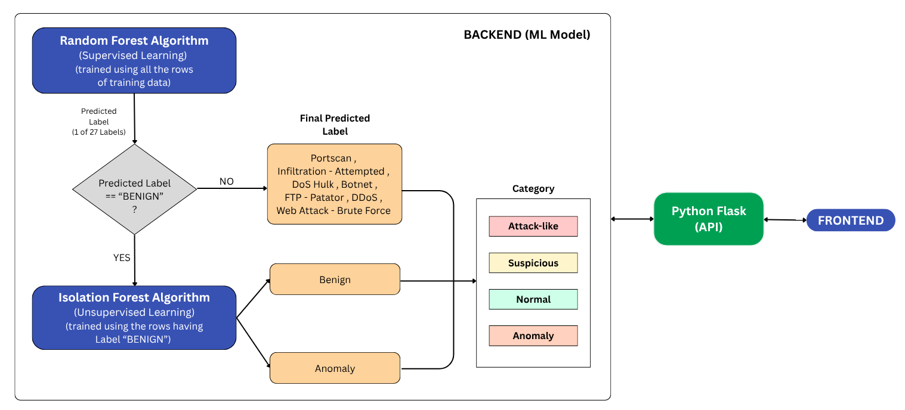
Architectural Flow
HPE CPP3 | Week 5 Update

Slide 3
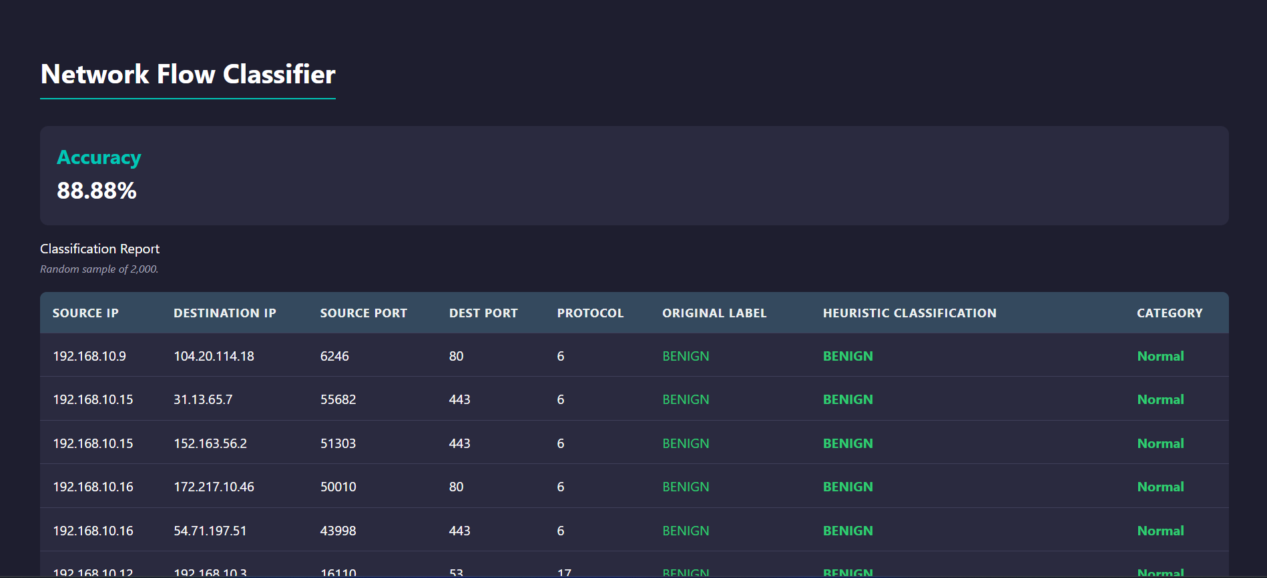
Heuristic Accuracy
HPE CPP3 | Week 5 Update

Slide 4
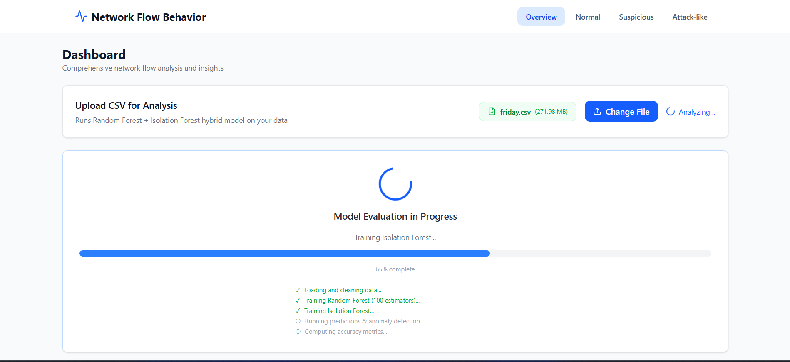
UI Dashboard
HPE CPP3 | Week 5 Update

Slide 5
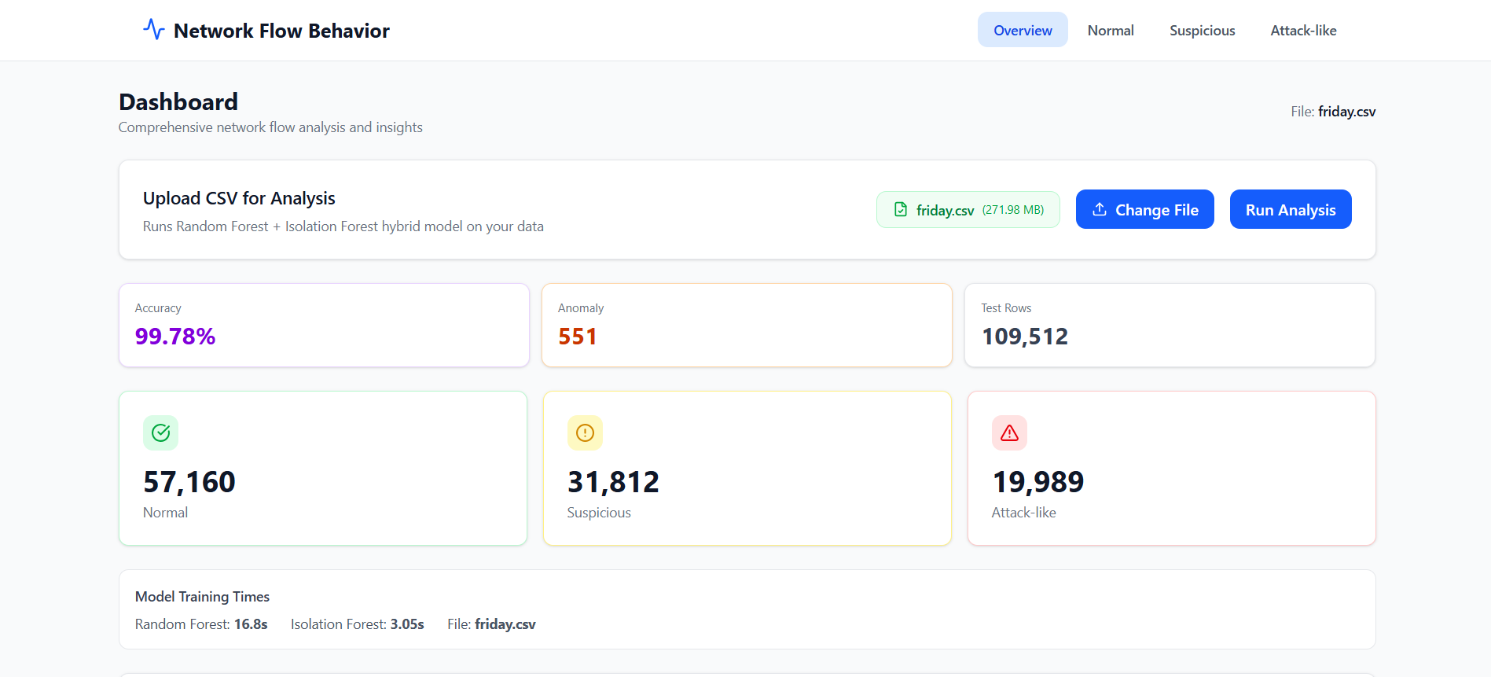
UI Dashboard
HPE CPP3 | Week 5 Update

Slide 6
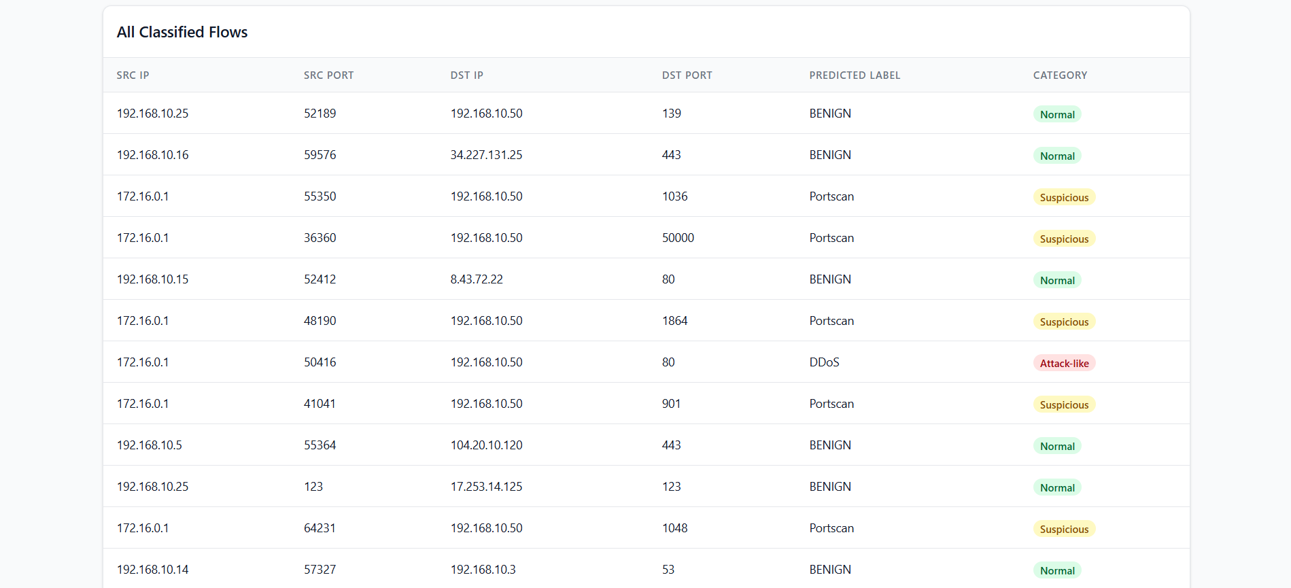
UI Dashboard
HPE CPP3 | Week 5 Update

Slide 7
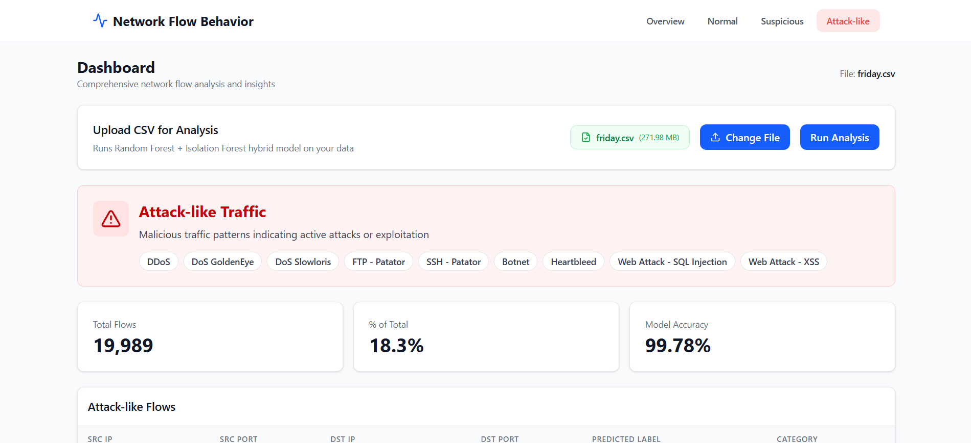
UI Dashboard – Individual Class Tabs
HPE CPP3 | Week 5 Update

