Slide 1
Mentor
Jayachandra K
Flow Behaviour Profiling
Manager
Saikat
Live Traffic Capture and Classification
College Mentor
Priyanka Mitra
Week 6 Progress Update
Program
HPE CPP3
Hewlett Packard Enterprise | March 2026

Slide 2
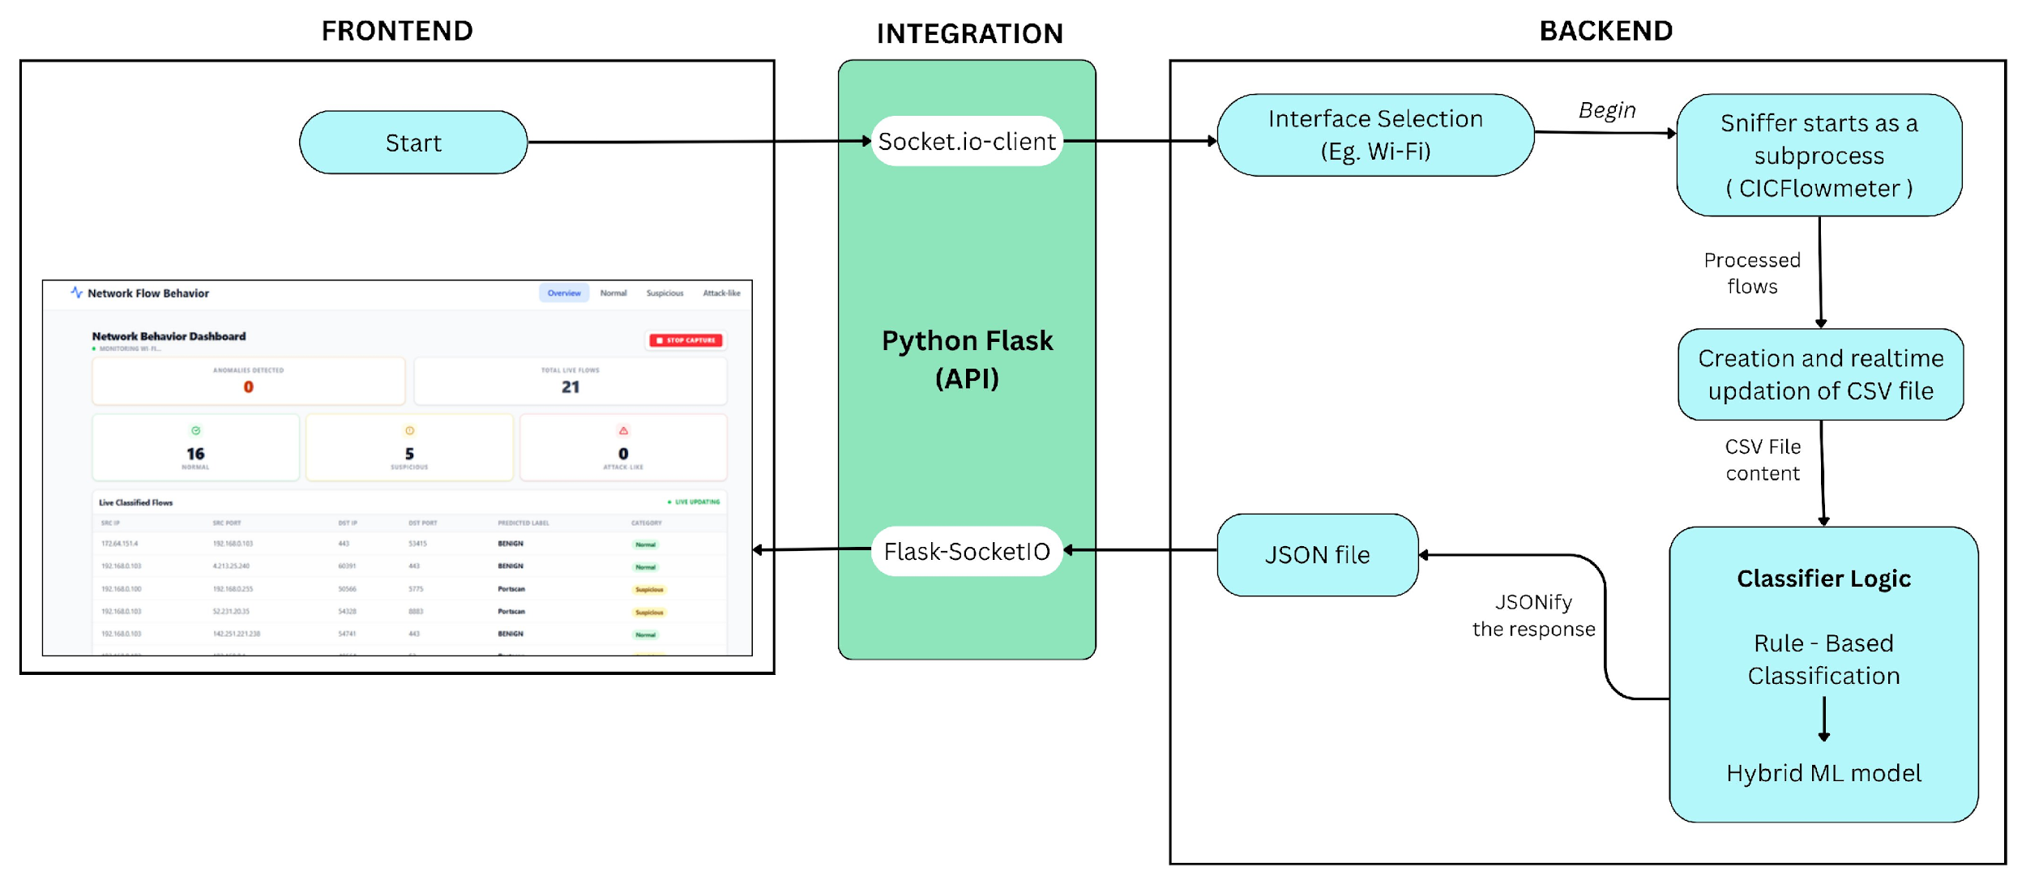
Architectural Flow
Hewlett Packard Enterprise | March 2026

Slide 3
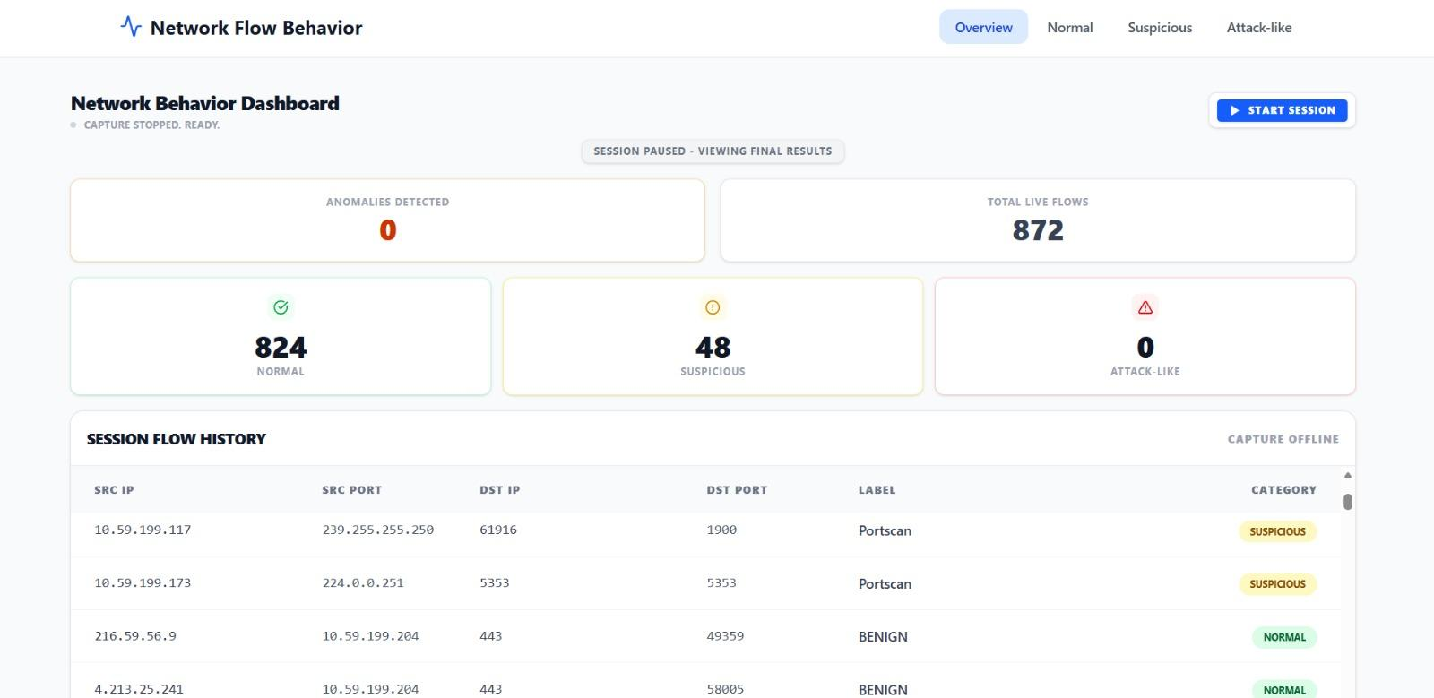
UI Dashboard – Live Capture
Hewlett Packard Enterprise | March 2026

Slide 4
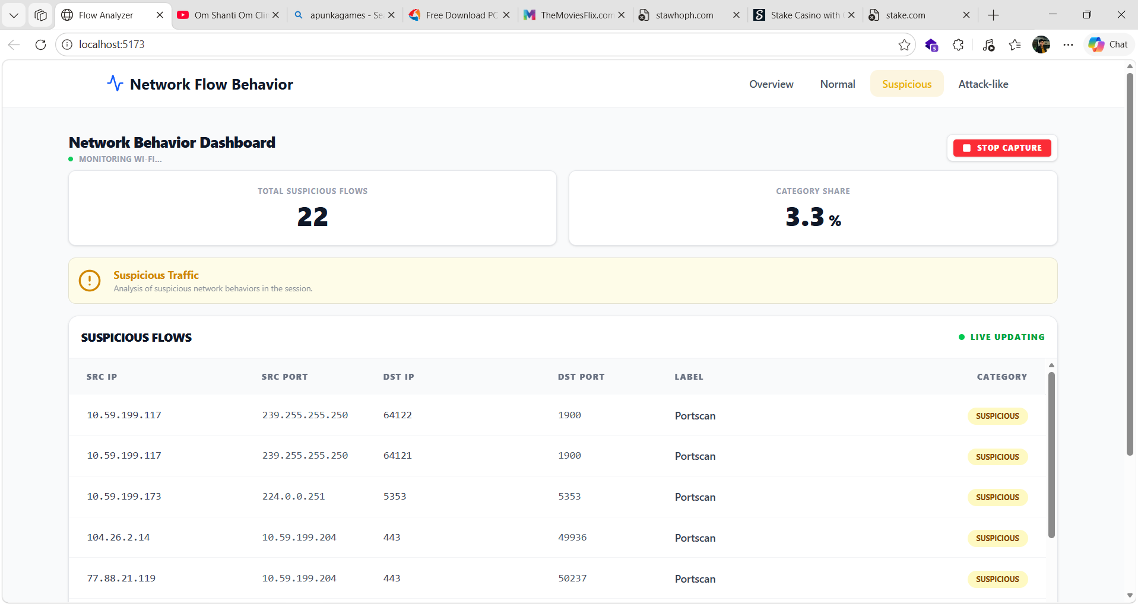
UI Dashboard – Live Capture of Suspicious Category
Hewlett Packard Enterprise | March 2026

