Slide 1
Mentor
Jayachandra K
Flow Behaviour Profiling
Manager
Saikat
Live Flow Monitoring — Attack Like Detections
College Mentor
Week 7 Progress Update
Priyanka Mitra
Program
HPE CPP3
HPE CPP3 | Week 7 Update

Slide 2
Week 8 — Attack Injection Approaches Overview
Three approaches were tested to trigger Attack-Like labels on the Live Flow Monitor dashboard
01
02
03
CSV File Injection
Nmap Reconnaissance
hping3 on Linux VM
Injected known attack flows directly into the real-time CSV file to present Attack-Like labels on the dashboard.
Used Nmap security tool to perform port scanning and reconnaissance — captured as Suspicious / Attack-like flows.
Run hping3 flood attacks from an Ubuntu VirtualBox VM targeting the Windows host IP — detected as Attack-Like.
HPE CPP3 | Week 7 Update

Slide 3
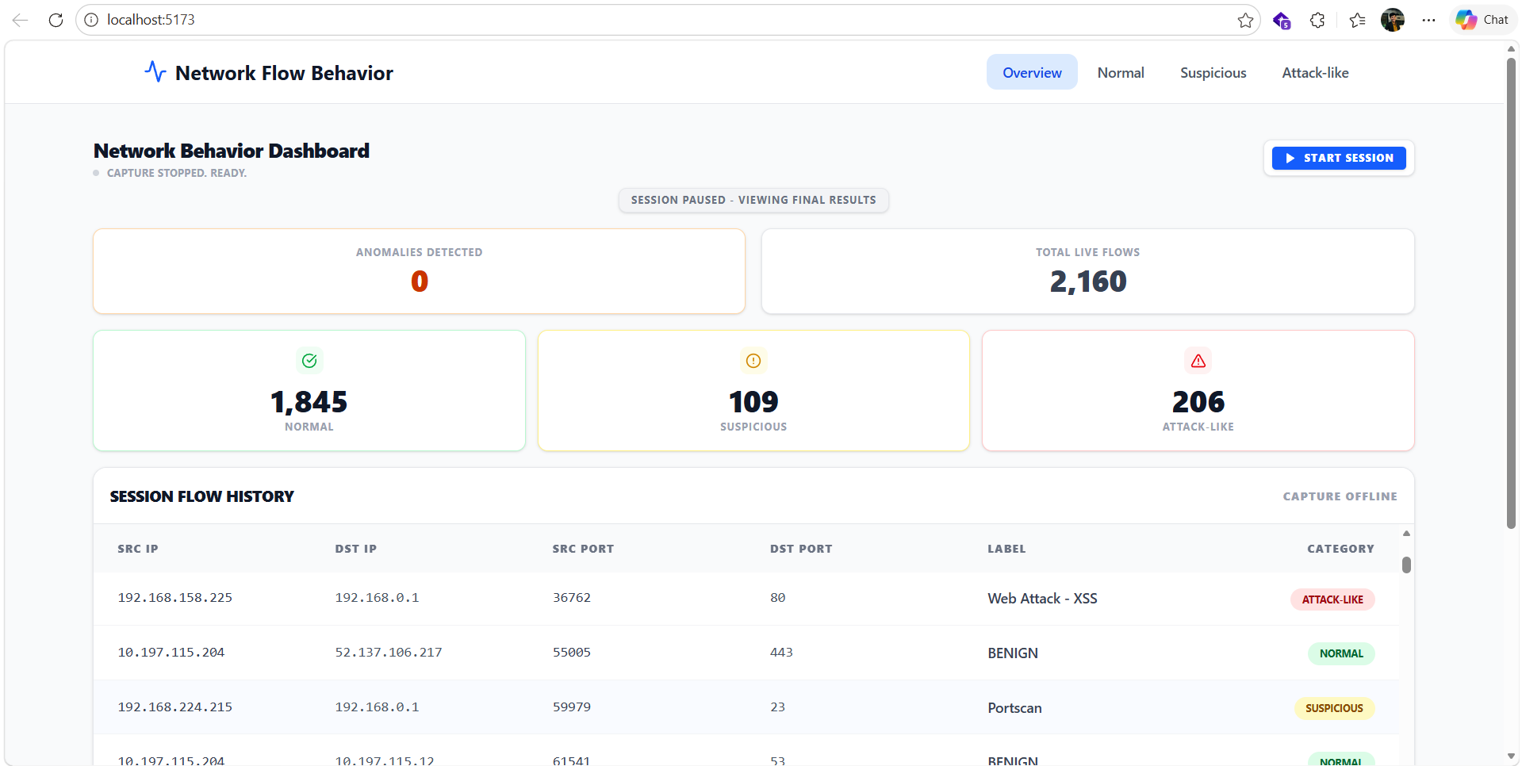
Approach 1 — CSV File Injection into Live Monitor
Attack-like flows were manually injected into the real-time CSV file, immediately reflected on the dashboard.
HPE CPP3 | Week 7 Update

Slide 4
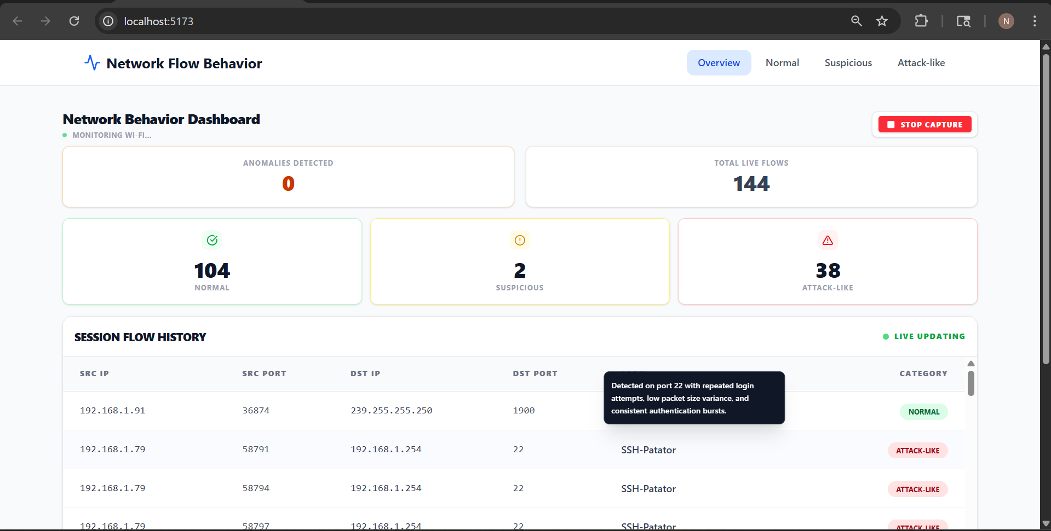
Approach 2 — Nmap Reconnaissance Security tool
HPE CPP3 | Week 7 Update

Slide 5
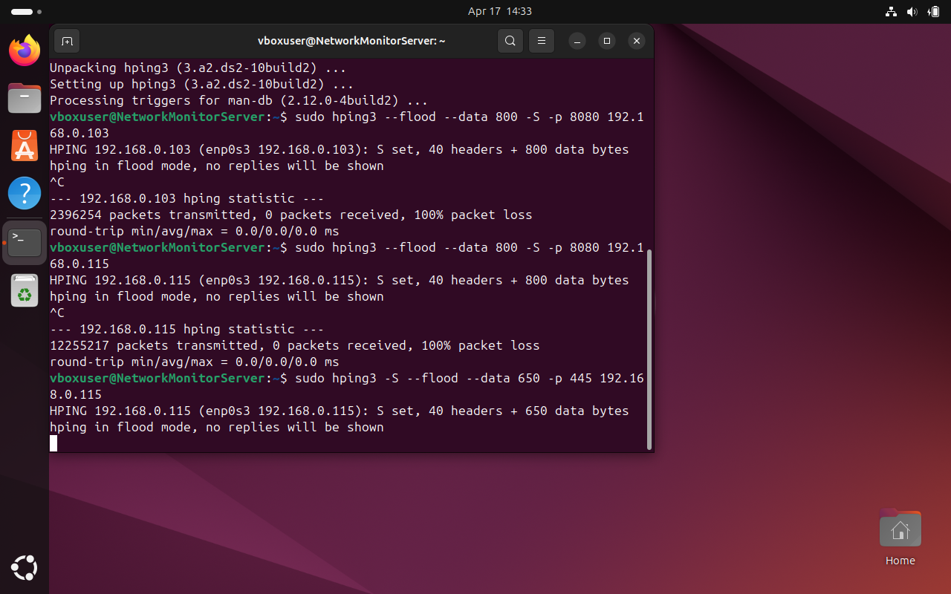
Approach 3 — hping3 Flood Attack from Ubuntu VM
hping3 SYN flood launched from VirtualBox Ubuntu VM targeting Windows host IP.
HPE CPP3 | Week 7 Update

Slide 6
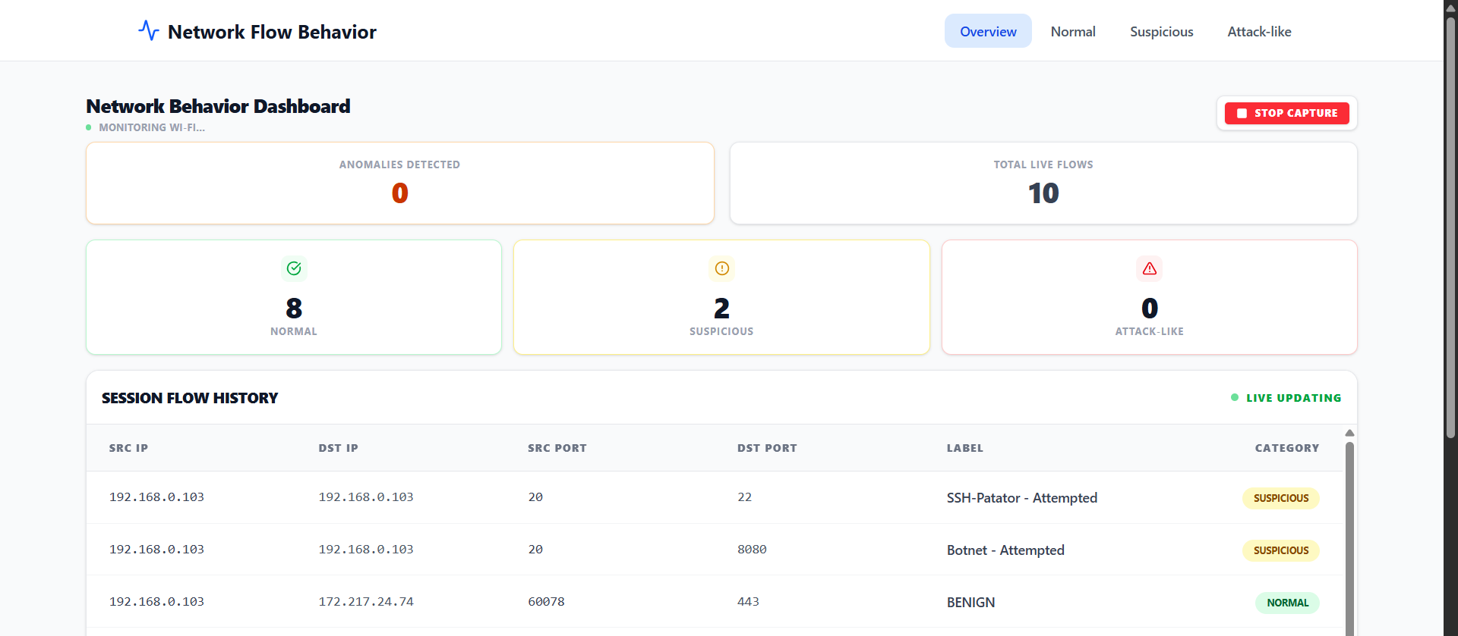
Approach 3 — hping3 Flood Attack from Ubuntu VM
hping3 SYN flood launched from VirtualBox Ubuntu VM targeting Windows host IP.
HPE CPP3 | Week 7 Update

