Slide 1



SYRACUSE UNIVERSITY LOST AND FOUND
By
Manideep and Lakshya

Slide 2
Have you ever Lost Something in campus?

Slide 3
Current scenario
Reach Department of Public Safety (DPS) and drop Complaint
To track the Status visit the DPS office or Email the officer
DPS officers manually track these complaints

Slide 4




How database can simplify this Process?

Slide 5
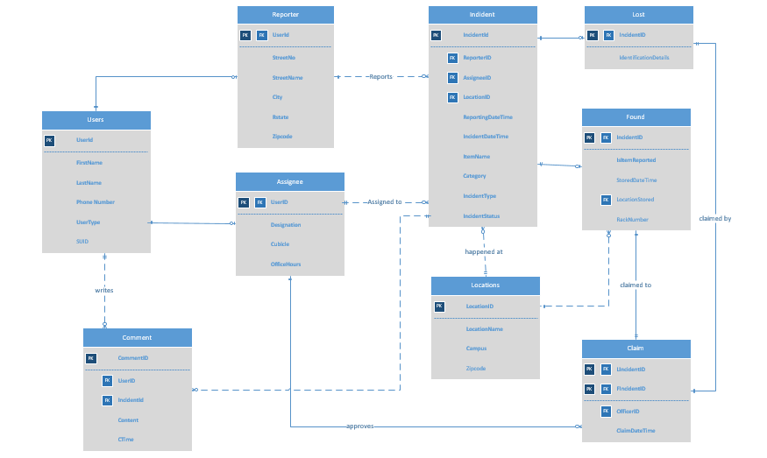
Entity Relationship diagram

Slide 6

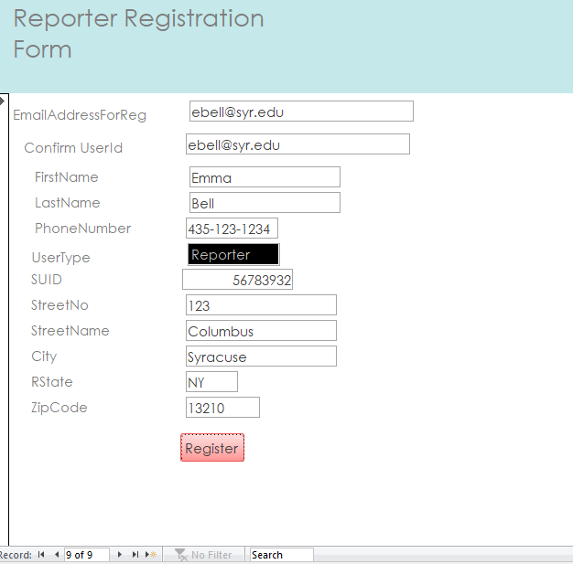
Reporter Registration Form

Slide 7
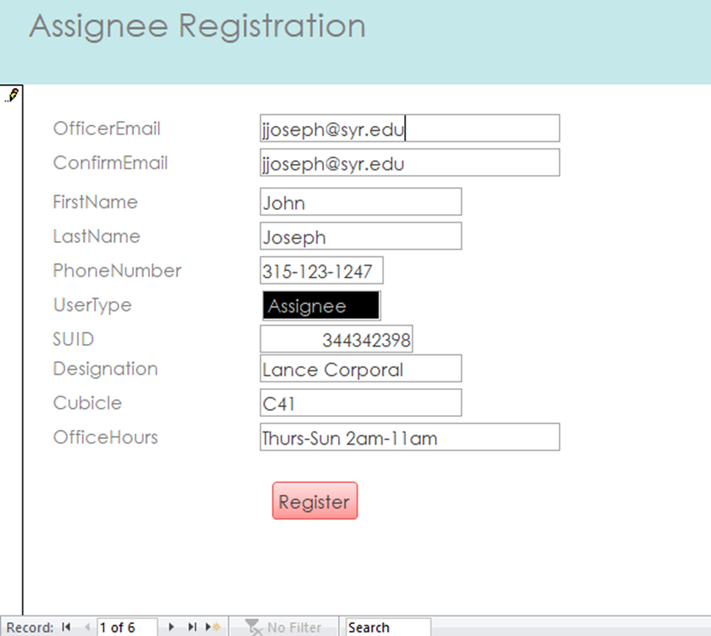
Assignee Registration Form

Slide 8
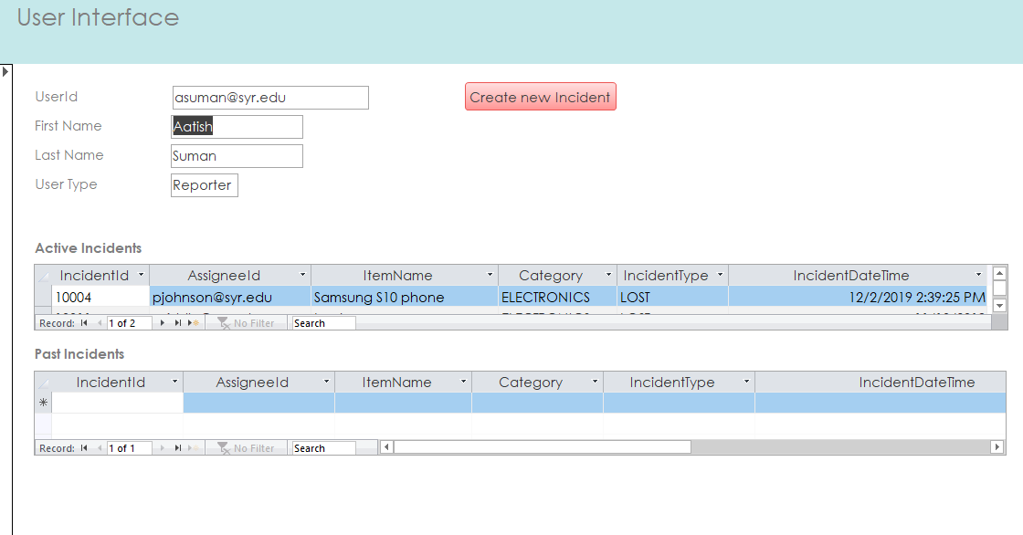
Reporter Interface

Slide 9
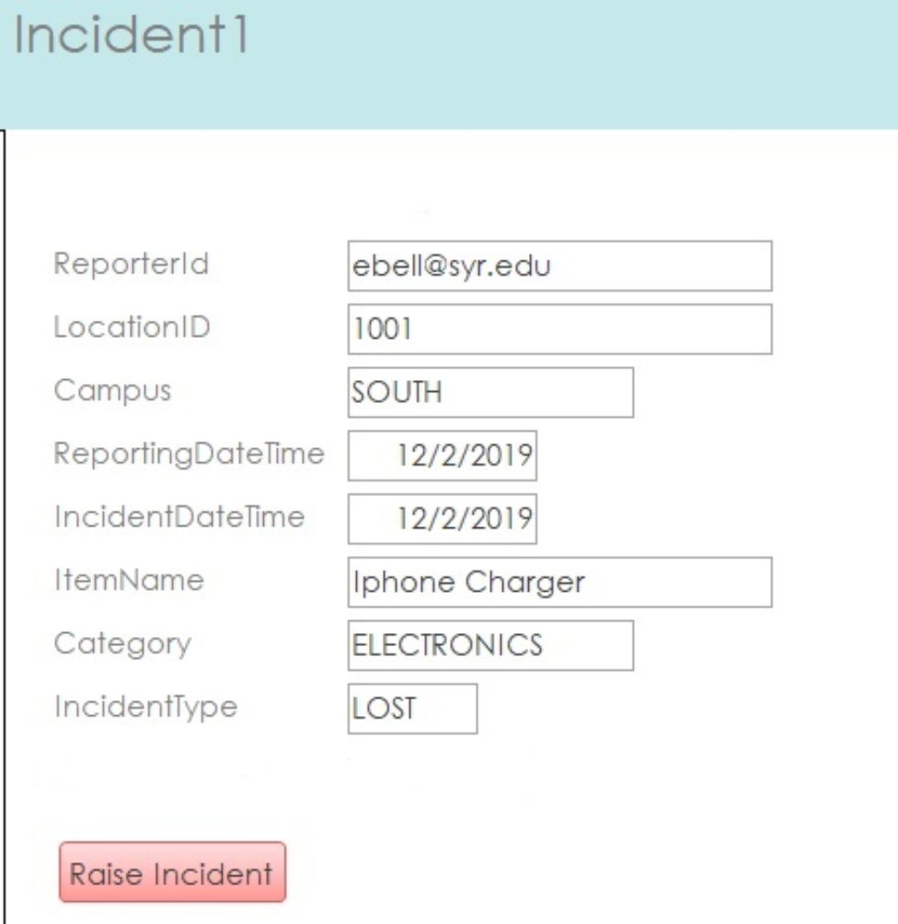
Raising an Incident

Slide 10
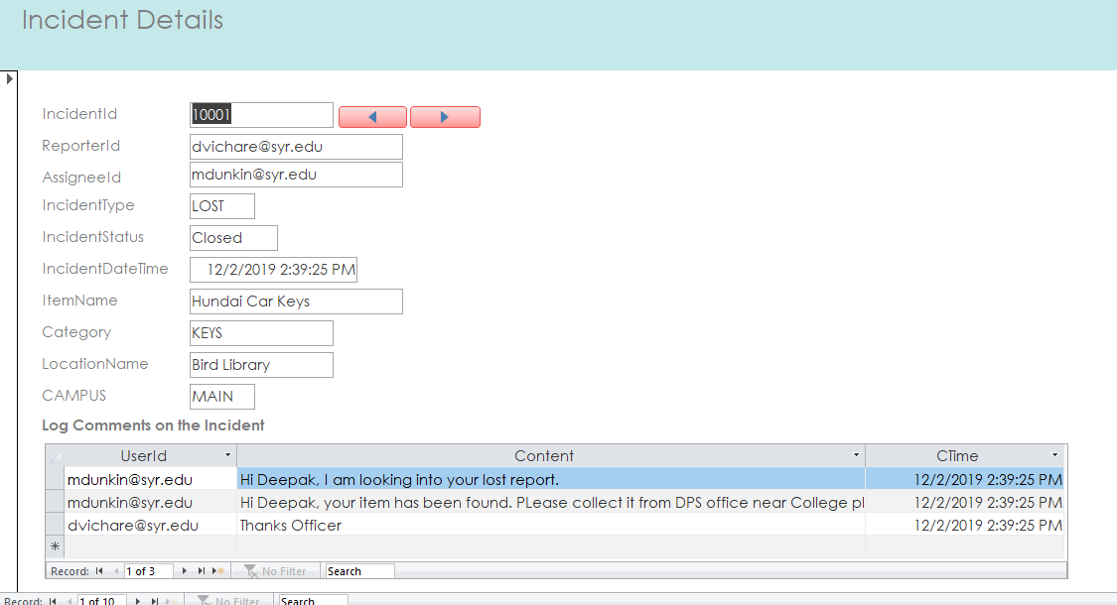
Incident Interface

Slide 11
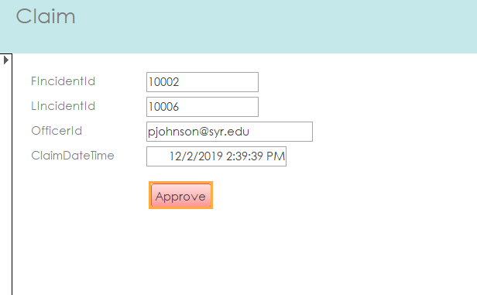
Claim

Slide 12
Major Data Questions
Items claimed so far?
Where is the reported item stored?
How many lost incidents are raised? How many resolved? How many opened?
--Which officer has approved the most claims?
--How many items have been found and stored over the past three months?
Where are the most items lost?Top 5 (Location)

Slide 13
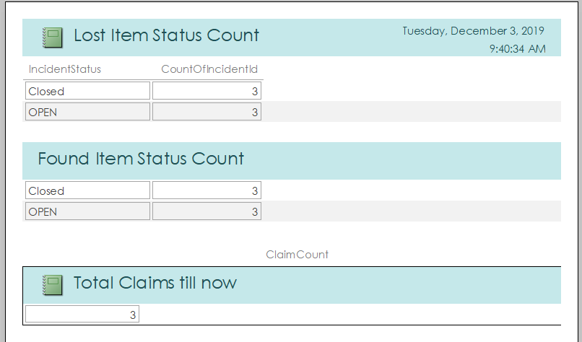
How many lost and found incidents are resolved? and How many opened status? How Many total Claims were made?

Slide 14
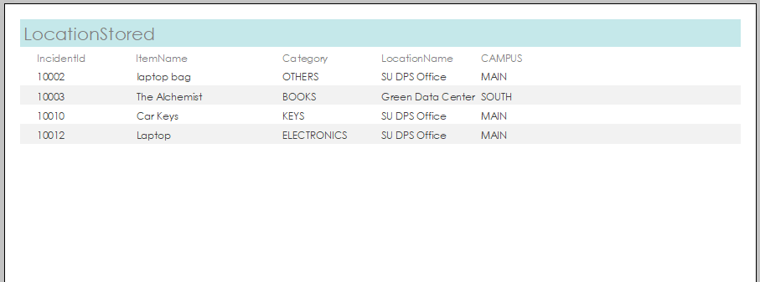
Where is the reported item stored?

Slide 15
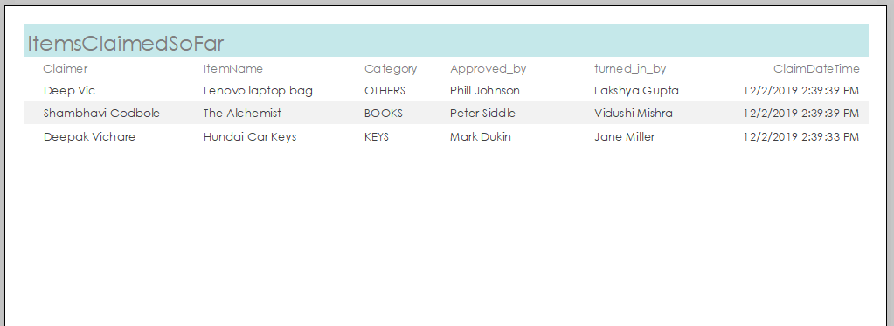
Items claimed so far?

Slide 16
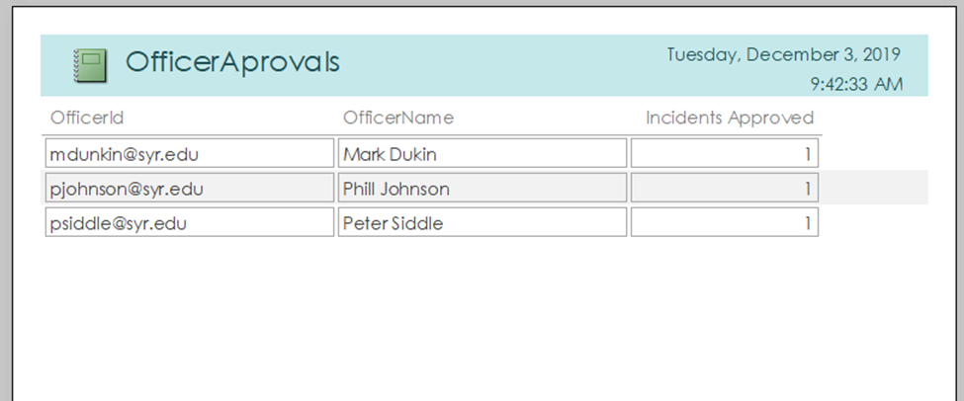
Which officer has approved the most claims?

Slide 17
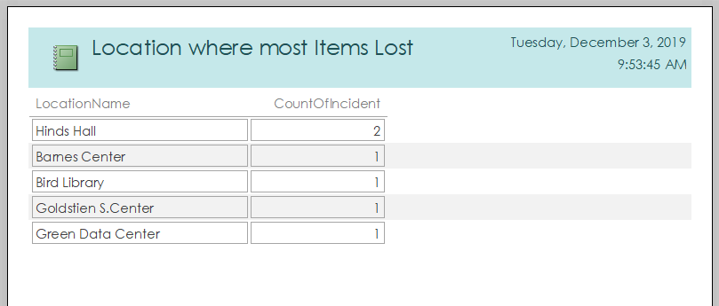
Where are the most items lost?Top 5 (Location)

Slide 18
Thank You

