Slide 1

TCS Stock Data – Live and Latest
Project Synopsis Presentation
Date: 10/12/2025
INDUSTRIAL TRAINING (ECS591)
Degree : B.TECH
SUBMITTED BY:
LAKSHYA JAIN (TCA2309120)
Project Guide:
DR. NAMIT GUPAT
FACULTY OF ENGINEERING & COMPUTING SCIENCES
TEERTHANKER MAHAVEER UNIVERSITY, MORADABAD

Slide 2

Team Details
Student Name | Role
LAKSHYA JAIN (TCA2309120) | PYTHON DEVEPOLER
2

Slide 3
Project Brief
Stock market prediction has always been a challenging yet highly relevant domain in data analytics.
Investors, traders, and financial institutions constantly seek methods to understand price fluctuations and anticipate future trends.
This project applies Python-based data analysis and machine learning techniques to analyze and predict the stock prices of Tata Consultancy Services (TCS)—one of India’s leading IT companies and a key player in the global technology market.
The project covers the end-to-end data analytics workflow: data preprocessing, exploratory data analysis (EDA), feature engineering, predictive modeling, and model evaluation.
3

Slide 4
Methodologies/ Technologies/ Tools to be used
Since this project is primarily data analysis and prediction in Python, it does not use a traditional web-based front-end.
However, visualization of results is performed using Matplotlib and Seaborn libraries.
For interactive exploration, Jupyter Notebook serves as the user interface where graphs, outputs, and code are displayed together.
Major Python libraries include:
  Pandas → Data manipulation and preprocessing.
  NumPy → Numerical operations and mathematical computations.
  Matplotlib & Seaborn → Data visualization.
  Scikit-learn → Model building, training, and evaluation.
4

Slide 5
Context Diagram (Overall Project)
The project workflow can be broken down into the following sequential steps:
Data Acquisition – Importing historical TCS stock price dataset into the system.
Data Preprocessing – Cleaning, handling missing values, and removing outliers.
Exploratory Data Analysis (EDA) – Identifying trends, patterns, and market behavior.
Feature Engineering – Creating additional variables such as lag values and time-based features.
Model Building – Training a Linear Regression model to predict closing stock prices.
Model Evaluation – Comparing actual vs. predicted values using visualizations and metrics.
Future Enhancements – Suggesting advanced ML and time-series models for higher accuracy.
5

Slide 6
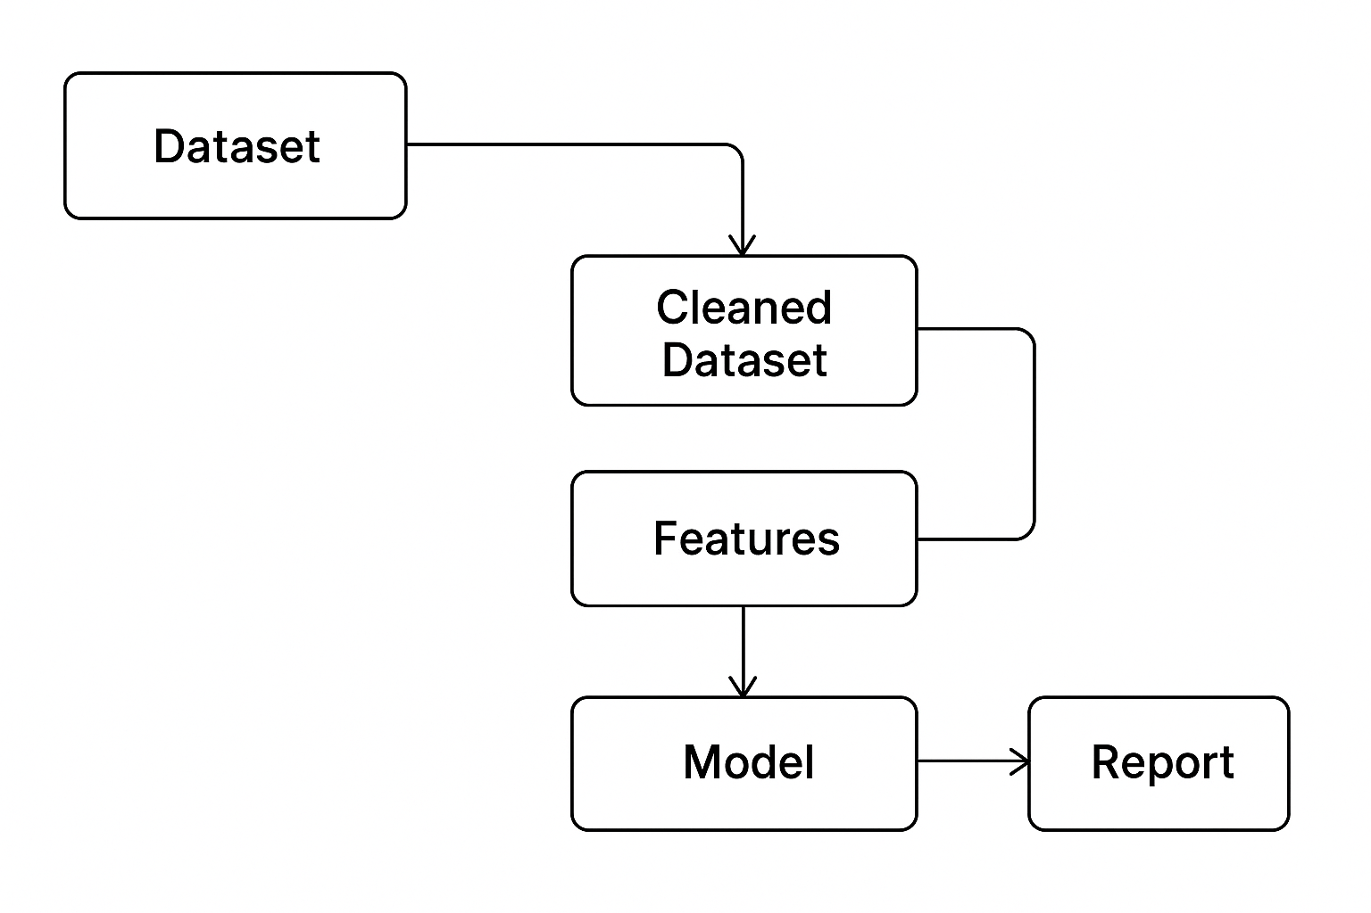
Entity Relationship Diagram (ERD)
6

Slide 7
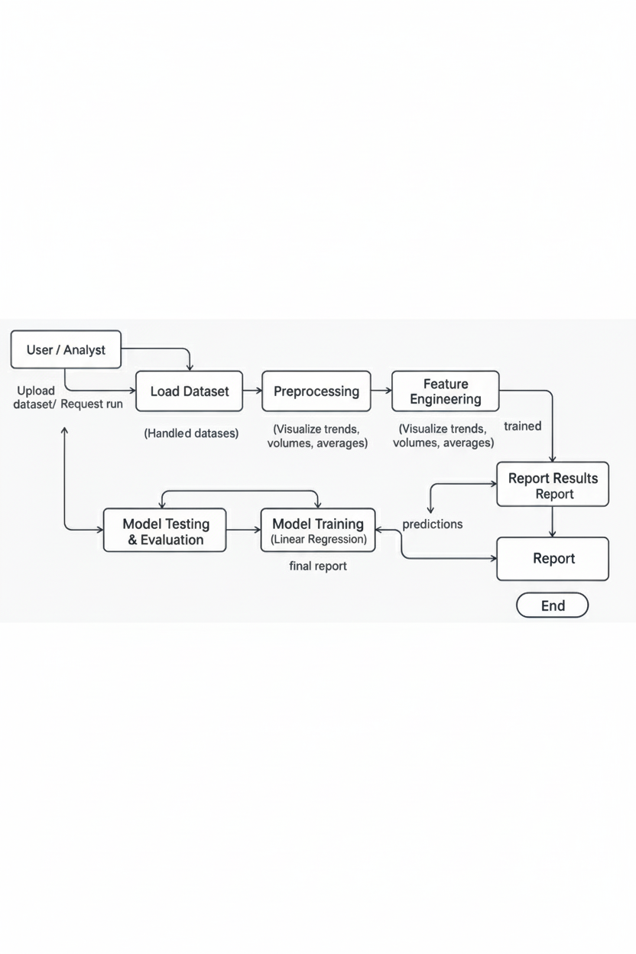
Data Flow Diagram (DFD)
7

Slide 8
\
Advantage of The Project
Practical Application of Python in Data Analytics
  Demonstrates how Python libraries like Pandas, NumPy, Matplotlib, Seaborn, and Scikit-learn can be used effectively in real-world financial data analysis.
Comprehensive Data Pipeline
  Covers the entire workflow from data preprocessing to prediction, providing hands-on experience in cleaning, analyzing, and modeling stock market data.
Financial Market Insights
  Provides meaningful insights into stock price behavior, volume trends, and moving averages, helping investors and analysts understand market dynamics.
Predictive Capability
  Uses machine learning (Linear Regression) to predict stock closing prices, offering a foundation for more advanced forecasting techniques.
Feature Engineering for Better Models
  Enhances dataset quality by extracting features such as lag values, rolling averages, and time-based variables, improving model interpretability and accuracy.
Visualization of Complex Data
  Converts raw numerical stock data into easy-to-understand charts and plots
Extendable Framework
  Provides a baseline that can be extended with advanced algorithms like Random Forest, XGBoost
8

Slide 9
References
Python Software Foundation. Python Documentation. https://www.python.org/doc/
Pandas Development Team. Pandas Documentation. https://pandas.pydata.org/docs/
NumPy Developers. NumPy Documentation. https://numpy.org/doc/
Scikit-learn Developers. Scikit-learn Documentation. https://scikit-learn.org/stable/
Yahoo Finance. Tata Consultancy Services Ltd. Stock Data. https://finance.yahoo.com/
NSE India. Market Data. https://www.nseindia.com/
9

Slide 10
THANKS

