Slide 1
Unit 4
Dictionaries and Strings

Slide 2
Python supports the below-mentioned built-in data types:
Immutable data types:
Number
String
Tuple
Mutable data types:
List
Dictionary
set

Slide 3
Dictionaries
Dictionaries are used to store data values in key: value pairs.
A dictionary is a collection that is unordered, changeable, and does not allow duplicates.
Keys are unique identifiers associated with each value.
Dictionaries are written with curly brackets {} and have keys and values.

Slide 4
Example:
>>> myCat = {'size': 'fat', 'color': 'gray', 'disposition': 'loud’}
Keys: 'size’, 'color’, 'disposition’
Values: 'fat’, 'gray’, 'loud’
>>> myCat['size']
'fat'
>>> 'My cat has ' + myCat['color'] + ' fur.'
'My cat has gray fur.'

Slide 5
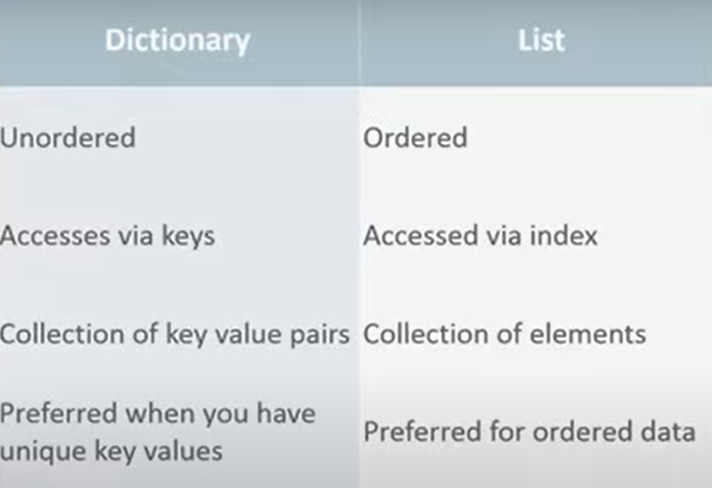
Dictionary vs Lists

Slide 6
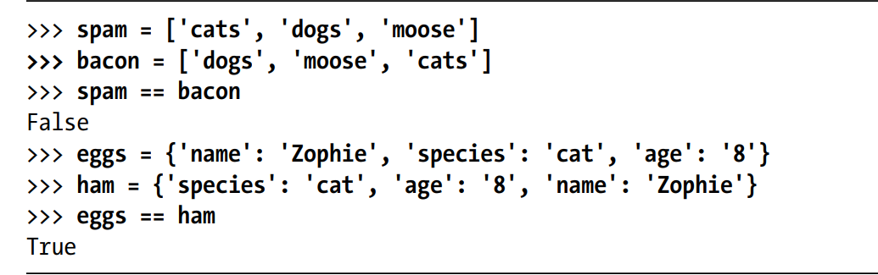
Dictionaries are unordered, unlike lists.
Lists maintain order, but dictionaries do not.

Slide 7
Create a dictionary in Python
numbers = {A: "One", B: "Two", C: "Three"}
print(numbers)
Or print(numbers. Get(B))
Or print(numbers[A])
Here we have created a dictionary named numbers.
Here, keys and values both are of string type.
We can also have keys and values of different data types.

Slide 8
Dictionary with keys and values of different data types
numbers = {1: "One", 2: "Two", 3: "Three"}
print(numbers)
Here, keys are of integer type and values are of string type.

Slide 9
The keys(), values(), and items() Methods
There are three dictionary methods that will return list-like values of the dictionary’s keys, values, or both keys and values:
keys()
values()
items()

Slide 10
>>> spam = {'color': 'red', 'age': 42}
>>> for v in spam.values():
print(v)
red
42

Slide 11
>>> for k in spam.keys():
print(spam[k])
color
age
>>> for i in spam.items():
print(i)
('color', 'red')

Slide 12
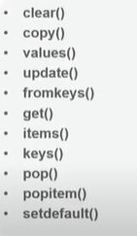
Methods

Slide 13
Add Elements to a Python Dictionary
numbers = {1: "One", 2: "Two", 3: "Three"}
print(‘Dictionary-1’, numbers)
numbers[“4”]=“four”
print(‘updated dictionary’, numbers)
O/P
Dictionary-1 1: "One", 2: "Two", 3: "Three“
updated dictionary 1: "One", 2: "Two", 3: "Three“,4:”four”

Slide 14
Update
numbers = {1: "One", 2: "Two", 3: "Three"}
print(‘Dictionary-1’, numbers)
numbers[2]=“five”
print(‘Dictionary-1’, numbers)
O/P
Dictionary-1 1: "One", 2: “five", 3: "Three“

Slide 15
Accessing Elements from Dictionary
we use the keys to access their corresponding values.
For example,
print(numbers[1]) #prints One
If we try to access the value of a key that doesn't exist, we'll get an error.

Slide 16
Removing elements from Dictionary
We use the del statement to remove an element from the dictionary.
For example,
del numbers[2]
key = 3
x = numbers.pop(key)
print(x)

Slide 17
Dictionary Test
We can test if a key is in a dictionary or not using the keyword in.
Example:
squares = {1: 1, 3: 9, 5: 25, 7: 49, 9: 81}
# Output: True
print(1 in squares) # prints True
print(2 not in squares) # prints True
# tests for key only not value
print(49 in squares) # prints false

Slide 18
Iterating Through a Dictionary
We can iterate through each key in a dictionary using a for loop.
squares = {1: 1, 3: 9, 5: 25, 7: 49, 9: 81}
for i in squares:
print(squares[i])
O/P:
1
9
25
49
8

Slide 19
# initializing string
numbers=input('enter the string :')
# to get count of each element in string
all_freq = {}
for i in numbers:
if i in all_freq:
all_freq[i] += 1
else:
all_freq[i] = 1
# printing result
print("Count of all characters in string is :\n ", all_freq)

Slide 20
Strings
A string is a data structure in Python that represents a sequence of characters.
It is an immutable data type
We use single quotes or double quotes to represent a string in Python
Example:
# create a string using double quotes
string1 = "Python programming“

Slide 21
Access String Characters in Python
We can access the characters in a string in three ways.
Indexing: One way is to treat strings as a list and use index values. For example,
greet = 'hello'
# access 1st index element
print(greet[1]) # "e"

Slide 22
Negative Indexing
Similar to a list, Python allows negative indexing for its strings. For example,
greet = 'hello'
# access 4th last element
print(greet[-4]) # "e“

Slide 23
Slicing
Access a range of characters in a string by using the slicing operator colon
greet = 'Hello'
# access character from 1st index to 3rd index
print(greet[1:4]) # "ell"
greet = 'Hello'
# access character from 1st index to 3rd index
print(greet[1:4]) # "ell“

Slide 24
Python Multiline String
We can also create a multiline string in Python. For this, we use triple double quotes """ or triple single quotes '''. For example,
# multiline string
message = ""“Never gonna give you up
Never gonna let you down ""“
print(message)

Slide 25
Iterate Through a Python String
We can iterate through a string using a for loop. For example,
greet = 'Hello'
# iterating through greet string
for letter in greet:
print(letter)

Slide 26
‘in’ operator in List
In Python, the in operator determines whether a given value is a constituent element of a sequence such as a string, array, list, or tuple.

Slide 27
# input list
lst = ["Hello", 10, “h-section", “ise”, "python", "code"]
if “ise" in lst:
print('Element is in the given list')
if 'bigdata' not in my_list:
print('Element "bigdata" is not present in the given list')

Slide 28
Putting strings inside other strings
Here we insert a string into another string using format method(string formatting).
There are several ways of adding strings in Python:
+ operator
__add__ method
join method
formatting strings

Slide 29
Using The + operator
str1 = "Hello"
str2 = "World"
result = str1 + " " + str2
print(result) # Output: Hello World

Slide 30
Using the_add_add method
str1 = "Hello"
str2 = "World"
result = str1.__add__(" ").__add__(str2)
print(result) # Output: Hello World

Slide 31
Putting strings inside other strings
a = 'old'
b = ' tree'
c = a + b
msg = 'There are'
msg += ' three falcons'
msg += ' in the sky'
print(msg)
print(c)
>>> print("Number {:03d} is here.".format(11))
Number 011 is here.
>>> 'A formatted number - {:.4f}'.format(.2)
'A formatted number - 0.2000'

Slide 32
Using Join methods
words = ["Hello", "World"]
result = " ".join(words)
print(result) # Output: Hello World

Slide 33
Format method
The format() method allows you to embed variables into a string placeholders{}
name = "Alice"
age = 25
greeting = "Hello, my name is {} and I am {} years old.". format(name, age)
print(greeting)
# Output: Hello, my name is Alice and I am 25 years old.

Slide 34
ord() Functions
Purpose :returns ASCII(Unicode) value of a character
x=ord('a')
print(x)

Slide 35
Python chr()
Returns the character corresponding to an ASCII (or Unicode) value.
y = chr(65)
print(y)
print(chr(123))
print(chr(36))
Output:
A
{
$

Slide 36
Python chr()
Returns the character corresponding to an ASCII (or Unicode) value.
y = chr(65)
print(y)
print(chr(123))
Output:
A
{

Slide 37
Escape Sequences in Python
The escape sequence is used to escape some of the characters present inside a string.
Suppose we need to include both double quote and single quote inside a string,

Slide 38
X = "He said, "What's there?""
print(X) # throws error
# escape double quotes
example = "He said, \"What's there?\""
# escape single quotes
example = 'He said, "What\'s there?"'
print(example)

Slide 39
\n: Newline
Inserts a line break.
print("Hello\nWorld")
Output
Hello
World

Slide 40
\t: Tab
Inserts a tab space.
print("Hello\tWorld")
output
Hello World

Slide 41
String Method
Methods Description
upper() converts the string to uppercase
lower() converts the string to lowercase
islower()
isupper()
split() splits string from left

Slide 42
Examples
>>> 'Hello'.upper()
'HELLO'
>>> 'Hello'.upper().lower()
'hello'
>>> 'Hello'.upper().lower().upper()
'HELLO'
>>> 'HELLO'.lower()
'hello'
>>> 'HELLO'.lower().islower()
True

Slide 43
isalpha() returns True if the string consists only of letters and is not blank.
isalnum() returns True if the string consists only of letters and numbers
and is not blank.
isdecimal() returns True if the string consists only of numeric characters

Slide 44
isspace() returns True if the string consists only of spaces, tabs, and newlines and is not blank.
istitle() returns True if the string consists only of words that begin with an uppercase letter followed by only lowercase letters.
>>> 'hello'.isalpha()
True

Slide 45
The startswith() and endswith() String Methods
The startswith() and endswith() methods return True if the string value they are called on begins or ends (respectively) with the string passed to the method; otherwise, they return False.
>>> 'Hello world!'.startswith('Hello')
True
>>> 'Hello world!'.endswith('world!')
True
>>> 'abc123'.startswith('abcdef')
False

Slide 46
The startswith() and endswith() String Methods
>>> 'abc123'.endswith('12')
False
>>> 'Hello world!'.startswith('Hello world!')
True
>>> 'Hello world!'.endswith('Hello world!')
True

Slide 47
The join() and split() String Methods
The join() method is useful when you have a list of strings that need to be joined together into a single string value.
>>> ', '.join(['cats', 'rats', 'bats’])
'cats, rats, bats’
>>> ' '.join(['My', 'name', 'is', 'Simon'])
'My name is Simon'

Slide 48
The join() and split() String Methods
>>> 'ABC'.join(['My', 'name', 'is', 'Simon'])
'MyABCnameABCisABCSimon’
“”.join([“12”,”24”,”36”])
‘122436’

Slide 49
split()
split() is to split a multiline string along the newline characters.
“45578”.split(“57”)
[‘45’, ‘8’]
txt = "welcome to the jungle"
x = txt.split()
print(x)
['welcome', 'to', 'the', 'jungle']

Slide 50
Justifying Text with rjust(), ljust()
The rjust() and ljust() string methods return a padded version of the string they are called on, with spaces inserted to justify the text.
>>> 'Hello'.rjust(10)
‘ Hello'
>>> 'Hello'.rjust(20) //(20,*)
‘ Hello'
>>> 'Hello World'.rjust(20)
' Hello World'
>>> 'Hello'.ljust(10) //center()
'Hello '

Slide 51
Removing Whitespace with strip(), rstrip(), and lstrip()
strip off whitespace characters (space, tab, and newline) from the left side, right side, or both sides of a string.
The strip() string method will return a new string without any whitespace
>> spam = ‘ Hello World ‘
>>> spam.strip()
'Hello World'

Slide 52
Removing Whitespace with strip(), rstrip(), and lstrip()
>>> spam.lstrip()
'Hello World ‘
>>> spam.rstrip()
' Hello World'

