Slide 1
FULL-STACK MERN PROJECT
🌿
Smart Pantry
SMART
PANTRY
Zero-Waste Recipe Generator
A smarter way to manage groceries, discover meals and reduce food waste.
ZERO-WASTE RECIPE GENERATOR
VIGNAN UNIVERSITY
Track • Match • Cook • Waste Less
P. Lakshya • 241FA04926
I. Reshmitha SriHasini • 241FA04928
V. Bhavya Sri • 241FA04950
Live demo: smart-pantry-79vj.onrender.com

Slide 2
THE PROBLEM
SMART PANTRY • VIGNAN UNIVERSITY
The everyday food-waste problem
A common kitchen challenge: people forget what they own, what is expiring and what they can cook.
Forgotten groceries
Daily meal decisions
Unplanned shopping
Items get pushed to the back of the fridge and expire before they are used.
Choosing what to cook can be difficult when ingredients and quantities are unclear.
Missing ingredients lead to extra trips, duplicate purchases and disconnected lists.
PROJECT QUESTION
How can a simple digital kitchen assistant help people use what they already have before buying more?
The project focuses on practical household food management rather than claiming to measure city-wide or global waste reduction.
02

Slide 3
THE SOLUTION
SMART PANTRY • VIGNAN UNIVERSITY
One connected kitchen workspace
Smart Pantry links inventory, recipe discovery, shopping and community in one application.
01
02
03
04
TRACK
MATCH
SHOP
COOK & SHARE
Record groceries, quantities and expiry dates.
Compare pantry stock with recipe ingredients.
Add missing ingredients to a connected grocery list.
Use ingredients, update stock and share zero-waste tips.
CORE OBJECTIVE
Make it easier to cook from existing ingredients and reduce avoidable household food waste.
03

Slide 4
APPLICATION MODULES
SMART PANTRY • VIGNAN UNIVERSITY
Five modules, one workflow
The modules are connected through the user's pantry data and account.
01 Dashboard
02 Pantry Tracker
03 Smart Recipes
A summary of pantry items, expiring groceries, recipe matches, shopping tasks and saved-food tracking.
Add, edit, search, filter and sort groceries with dynamic expiry status.
Discover recipes based on ingredient availability and urgency of expiry.
04 Grocery List
05 Community Wall
Collect missing ingredients and transfer purchased items into pantry inventory.
Publish and browse zero-waste cooking tips and food-saving ideas.
04

Slide 5
SYSTEM ARCHITECTURE
SMART PANTRY • VIGNAN UNIVERSITY
MERN architecture
A browser-based React interface communicates with an Express API, which reads and writes MongoDB data.
USER
FRONTEND
BACKEND
DATABASE
HTTP requests
REST API
Mongoose
Browser
Smart Pantry UI
React + Vite
Axios + Router
Node.js + Express
REST API + JWT
MongoDB
Atlas
DEPLOYMENT
Render hosts the production web service • MongoDB Atlas stores application data
05

Slide 6
TECHNOLOGY STACK
SMART PANTRY • VIGNAN UNIVERSITY
Technologies used
A JavaScript-based stack keeps the client and server development workflow consistent.
FRONTEND
React.js
BUILD TOOL
Vite
Component-based user interface
Development server and production build
STYLING
Tailwind CSS
BACKEND
Node.js + Express
Responsive, consistent interface styling
REST endpoints and application logic
DATABASE
MongoDB Atlas + Mongoose
AUTHENTICATION
JWT + bcrypt
Cloud document database and data models
Token-based authentication and password hashing
DEPLOYMENT
GitHub + Render
Source control and cloud hosting
The application uses a single Render Web Service to serve the built React frontend and Express API.
06

Slide 7
DATABASE DESIGN
SMART PANTRY • VIGNAN UNIVERSITY
MongoDB data model
Mongoose models organize account, inventory, recipes, shopping, community activity and cooking history.
User
PantryItem
Recipe
name • email • password
userId • name • quantity • unit • expiryDate
name • ingredients • instructions • tags
GroceryItem
Post
CookingHistory
userId • name • quantity • purchased
userId • content • category • likes
userId • recipeId • ingredientsUsed • savedQuantity
User-specific records are associated with userId so private pantry and grocery data can be scoped to the signed-in account.
07

Slide 8
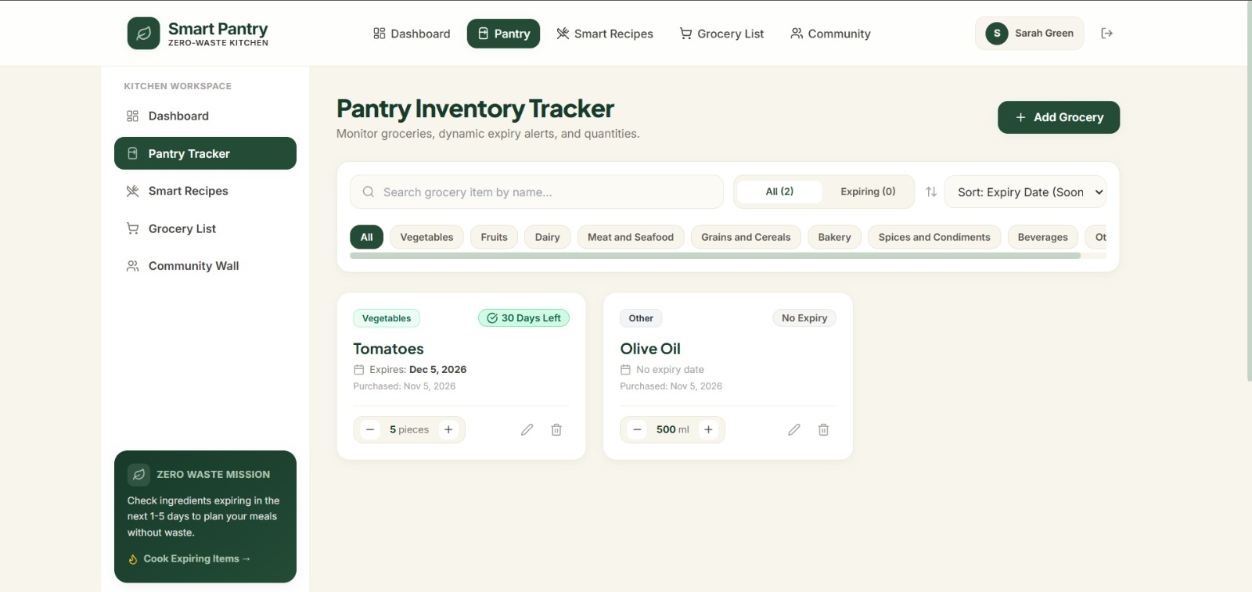
FEATURE WALKTHROUGH
SMART PANTRY • VIGNAN UNIVERSITY
Pantry Tracker
The inventory view makes it easier to see what is available and what needs attention.
Inventory controls
Add, edit, delete, search, filter and sort groceries.
Expiry indicators
Fresh, expiring soon and expired items are visually distinguished.
Quantity tracking
Each item stores an amount and unit, with controls to adjust stock.
Expiry logic: green = more than 5 days; yellow = 2–5 days; red = 1 day or expired.
08

Slide 9
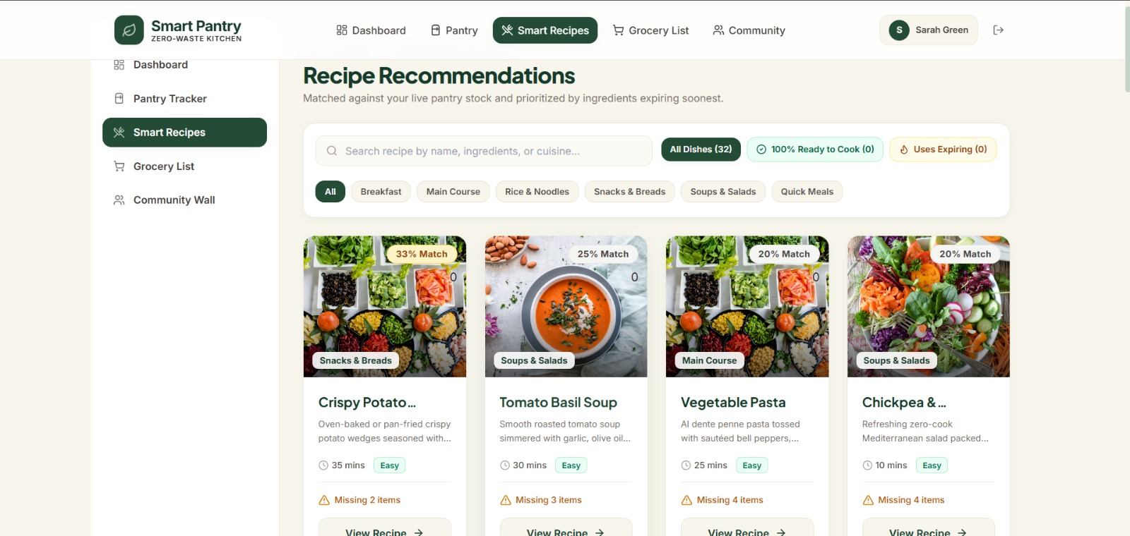
FEATURE WALKTHROUGH
SMART PANTRY • VIGNAN UNIVERSITY
Smart Recipe Matcher
Recipe suggestions are calculated from the user's actual pantry inventory.
Ingredient comparison
Available ingredients are compared with each recipe's requirements.
Match percentage
Available required ingredient types ÷ total required types × 100.
Priority ranking
Recipes using ingredients nearing expiry are prioritized.
The recipe catalogue is seeded with 32 recipes; recommendations do not require an external recipe API.
09

Slide 10
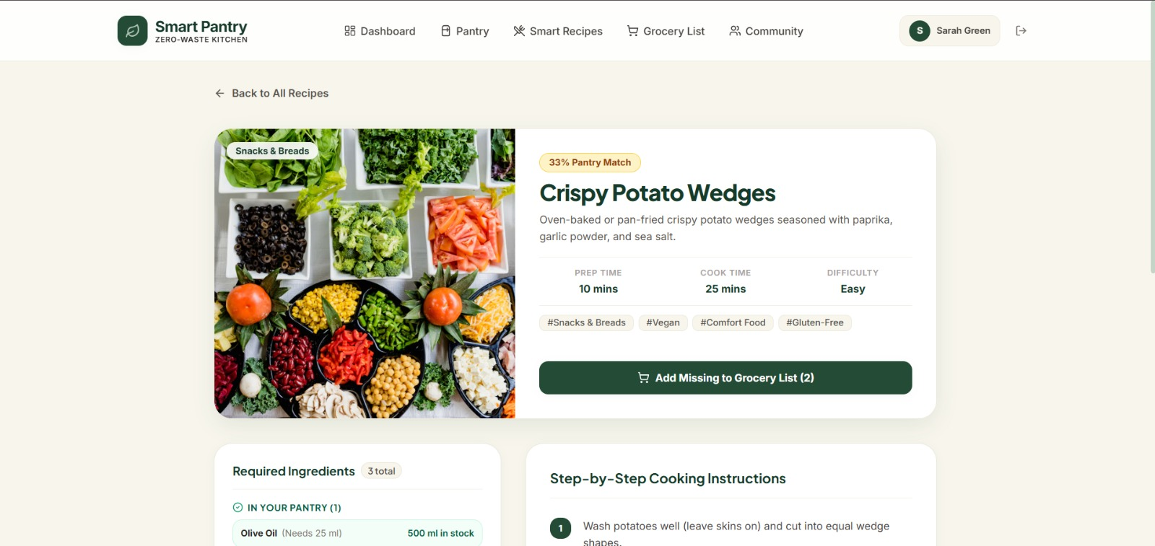
FEATURE WALKTHROUGH
SMART PANTRY • VIGNAN UNIVERSITY
From recommendation to cooking
Recipe details identify what is already available and what still needs to be purchased.
COOKING WORKFLOW
1. Open a suggested recipe.
2. Review required ingredients.
3. Add missing items to the grocery list.
4. Cook when stock is sufficient.
5. Deduct used quantities from pantry.
6. Record cooking history and eligible food saved.
Inventory updates should be validated on the server to avoid negative stock or repeated deductions.
10

Slide 11
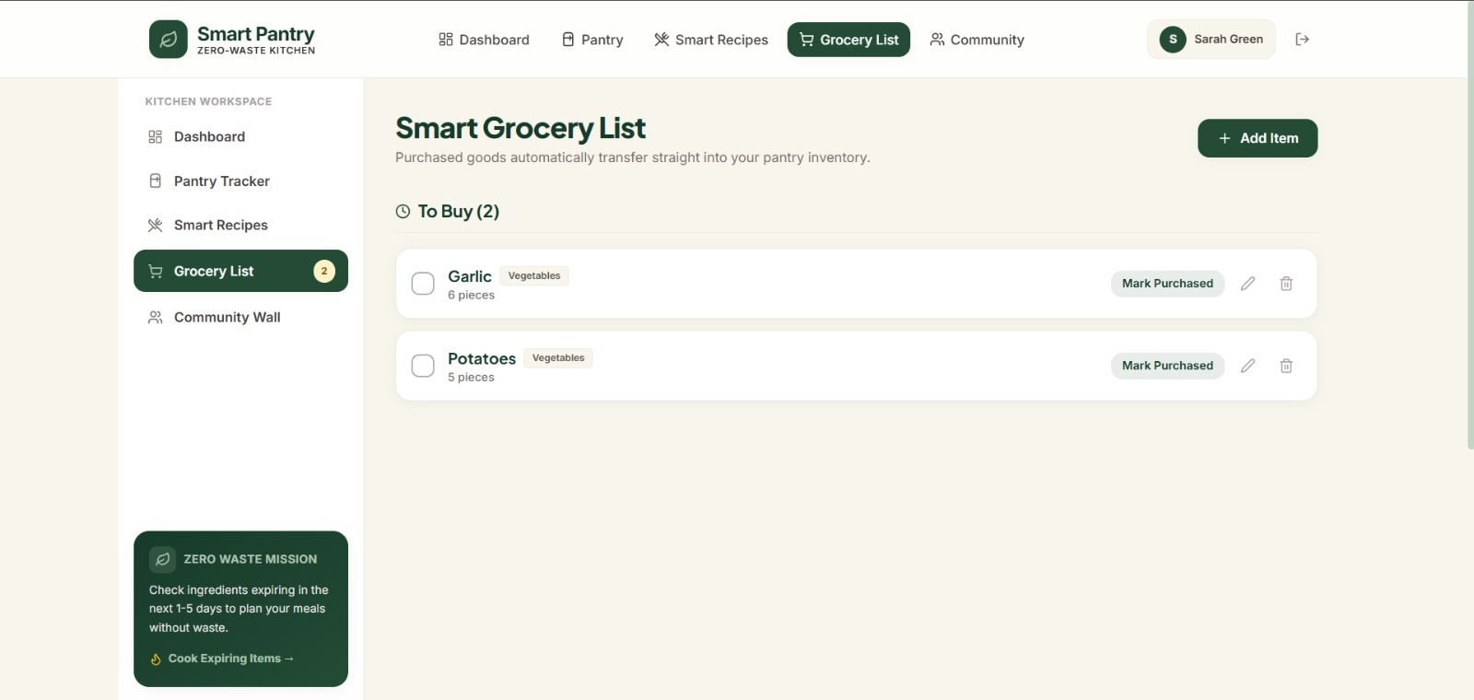
FEATURE WALKTHROUGH
SMART PANTRY • VIGNAN UNIVERSITY
Smart Grocery List
Missing recipe ingredients can become shopping tasks without re-entering them manually.
Automatic additions
Missing ingredients can be sent from a recipe to the grocery list.
Purchase tracking
Users can mark items as purchased and manage pending items.
Pantry transfer
Purchased quantities are added to existing or new pantry records.
The purchase flow should prevent duplicate transfers and allow an expiry date to be set.
11

Slide 12
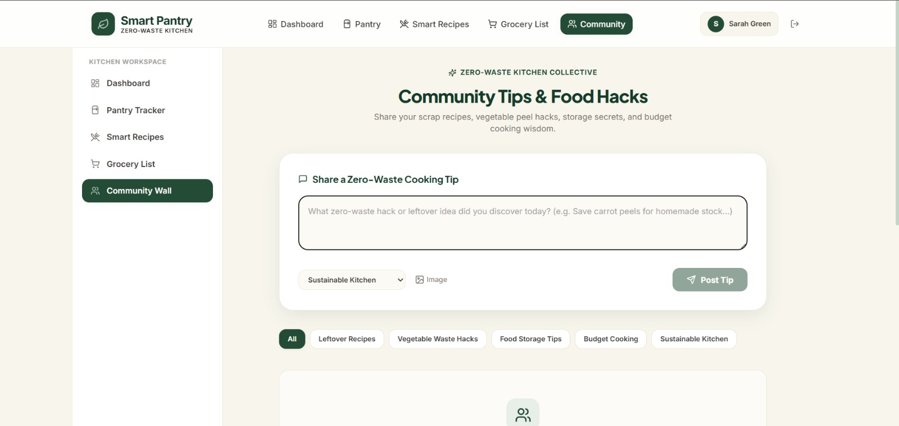
FEATURE WALKTHROUGH
SMART PANTRY • VIGNAN UNIVERSITY
Community Wall
A shared space for practical zero-waste cooking and food-storage ideas.
Share ideas
Authenticated users can publish tips and optional image links.
Explore categories
Posts can be organized by leftovers, storage, budget cooking and more.
Community actions
Users can like posts and manage their own content.
12

Slide 13
DEPLOYMENT & TESTING
SMART PANTRY • VIGNAN UNIVERSITY
Production deployment on Render
The deployed application uses a single web service connected to MongoDB Atlas.
SOURCE
HOSTING
DATA
ACCESS
GitHub repository
Render Web Service
MongoDB Atlas
Public HTTPS URL
DEPLOYMENT CONFIGURATION
VERIFICATION
• Root directory: repository root
• Build: npm run build
• Start: npm start
• Health check: /api/health
• Secrets supplied as Render environment variables
• Production frontend build completed
• API health endpoint checked
• Root and deep React routes served
• Unmatched API paths return JSON 404
• MongoDB Atlas connection established after credential correction
Live application
https://smart-pantry-79vj.onrender.com
13

Slide 14
CONCLUSION
A smarter pantry.
A more mindful kitchen.
PROJECT TAKEAWAYS
Know what is in the pantry.
Use ingredients before they expire.
Shop only for what is missing.
Share ideas that reduce waste.
Smart Pantry brings inventory tracking, recipe matching, grocery planning and community knowledge into one connected application.
THANK YOU
VIGNAN UNIVERSITY • P. Lakshya • I. Reshmitha SriHasini • V. Bhavya Sri

