Slide 1
Generative AI
LLM
FULL STACK AI COURSE
Generative AI,
LLM, LangChain,
RAG & AI Agents
LangChain
RAG
AI Agents
Agentic AI
From Basics to Agentic AI with Real-World Examples

Slide 2
SLIDE 01
What is Generative AI?
Definition
Real-World Examples
Generative AI is artificial intelligence that can create new content across multiple formats:
ChatGPT
Conversational AI by OpenAI
Gemini
Google's multimodal AI
📝 Text
🖼️ Images
Claude
Anthropic's AI assistant
💻 Code
GitHub Copilot
AI code completion
🎵 Audio
🎬 Video
Midjourney
AI image generation

Slide 3
SLIDE 02
Traditional AI vs Generative AI
Traditional AI
Generative AI
Classification
Content Generation
VS
Prediction
Text / Image Creation
Rule Based
Context Aware
Fixed Output
Dynamic Output

Slide 4
SLIDE 03
What is an LLM?
LLM = Large Language Model
How LLMs Work
Trained on massive amounts of text data to understand and generate human-like language at scale.
1
User Prompt
Input text from user
2
Tokenization
Text split into tokens
Popular LLMs
Transformer
Multi-head attention
3
GPT-4
Llama 3
Gemini
Prediction
Next token selection
4
OpenAI
Meta
Google
5
Response
Generated output text
Claude
Mistral
Anthropic
Mistral AI

Slide 5
SLIDE 04
Direct OpenAI API
Architecture
● ● ● example.py
from openai import OpenAI
client = OpenAI(api_key="KEY")
response = client.chat.completions.create(
model="gpt-3.5-turbo",
messages=[
{"role": "user",
"content": "Write email"}
]
)
print(response.choices[0]
.message.content)
Python Program
▼
OpenAI API
▼
LLM Response
Best For

Slide 6
SLIDE 05
What is LangChain?
LangChain is a framework for building AI-powered applications.
⚡ LangChain is NOT an LLM — It works WITH LLMs
Architecture
LangChain Simplifies
Python Program
Prompt Templates
Memory
↓
LangChain Framework
Chains
RAG
↓
OpenAI / Ollama / Gemini
Agents
Tool Calling
↓
LLM Response

Slide 7
SLIDE 06
Direct API vs LangChain
🔧 OpenAI API
= Engine
🚗 LangChain
= Car Framework
Feature
Direct OpenAI
LangChain
API Calling
Manual
Automatic ✓
Memory
Manual
Built-in ✓
RAG Support
Hard to implement
Easy ✓
AI Agents
Difficult
Easy ✓
Tool Calling
Manual
Built-in ✓

Slide 8
SLIDE 07
What is RAG?
RAG = Retrieval Augmented Generation
⚠ Problem with LLMs Alone
✓ RAG Solution
Hallucinate (make things up)
RAG retrieves real documents before generating a response — grounding the AI in facts.
No company / private data
Knowledge cutoff issues
RAG Architecture
User Question
→
Embedding
→
Vector DB
→
Similarity Search
→
Retrieve Context
→
LLM Answer

Slide 9
SLIDE 08
What is an AI Agent?
AI Agent = LLM + Tools + Memory + Reasoning + Decision Making
Agent Capabilities
🔧
Use Tools
🧠
Has Memory
📋
Plans Actions
APIs, databases, search
Persistent context
Multi-step execution
🌐
Web Access
📧
Send Email
⚙️
Execute Tasks
Real-time information
Trigger actions
Autonomous operation

Slide 10
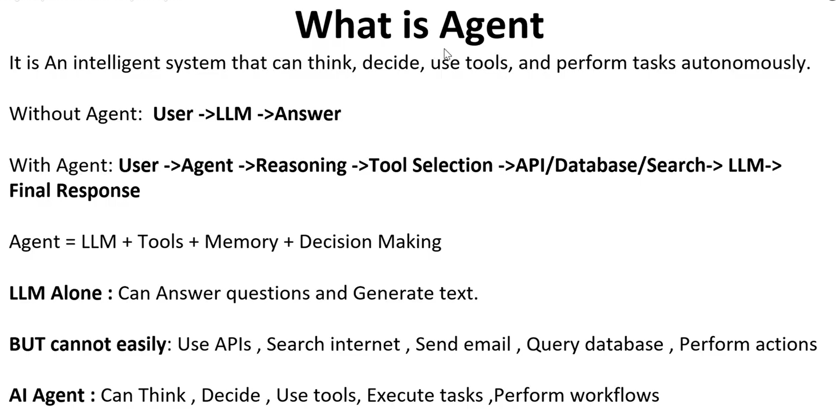

Slide 11
SLIDE 09
Agentic AI
Agentic AI = Autonomous multi-step AI system capable of planning, deciding & executing complex workflows
✈ Real-World: Travel Planner Agent
GenAI → Agentic Journey
1. Search available flights
1. Prompting
2. Check destination weather
2. LLM
3. Verify VISA requirements
3. Embeddings
4. RAG
4. Plan day-by-day itinerary
5. LangChain
5. Suggest & book hotels
6. Agents
6. Send confirmation email
7. Agentic AI
— without manual intervention —

Slide 12
FINAL SUMMARY
Summary
Generative AI
LLM
Creates new content — text, images, code, audio, video
Large Language Model — understands & generates human language
LangChain
RAG
AI orchestration framework — simplifies building AI apps
Retrieval + Generation — grounds AI in real documents
AI Agent
Agentic AI
LLM + Tools + Memory — performs real-world tasks autonomously
Autonomous multi-agent workflow system — no human intervention
Build with AI. Think with Agents. Scale with Agentic Systems.

