Slide 1
Python Weather App
Developed using CustomTkinter, Requests, and OpenWeatherMap API

Slide 2
Tools and Libraries Used
1. CustomTkinter – For modern and responsive GUI design
2. Requests – To fetch weather data from the OpenWeatherMap API
3. Pillow (PIL) – To handle and display weather icons dynamically
4. Time – To show the last updated time dynamically
5. OpenWeatherMap API – Provides real-time weather data based on city name

Slide 3
How It Works
1. User enters a city name in the input field.
2. The app sends a request to the OpenWeatherMap API using the Requests library.
3. The API returns JSON data containing temperature, humidity, wind speed, and weather conditions.
4. The data is extracted and displayed using CustomTkinter labels.
5. The Pillow library loads and resizes the weather icon dynamically.
6. The clock updates continuously using the Time library.

Slide 4
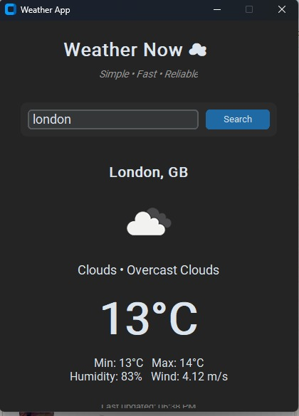
This screenshot shows the final design of the Python Weather App. Features: • Real-time weather updates • Simple and modern interface • Displays temperature, humidity, and wind speed • Auto-updating clock

Slide 5
Project Idea & Motivation
The main idea behind developing this Weather App was to create a lightweight, modern, and user-friendly desktop application that provides real-time weather updates for any city around the world.
Motivation:
• To explore GUI development using CustomTkinter
• To learn how to fetch and display API data in Python
• To make a clean and responsive weather interface similar to professional apps

Slide 6
Technical Architecture
The app is designed using a modular approach:
1. **Frontend Layer** – Built with CustomTkinter to handle GUI elements and user inputs.
2. **API Layer** – Communicates with the OpenWeatherMap API to fetch real-time weather data.
3. **Processing Layer** – Extracts required data such as temperature, humidity, and wind speed from JSON responses.
4. **Display Layer** – Updates UI dynamically and displays weather icons using the Pillow library.

Slide 7
Challenges Faced & Solutions
During development, a few challenges were faced:
• **Handling Invalid City Names** – Added error messages using messagebox.
• **Dynamic Weather Icons** – Used Pillow (PIL) to load and resize weather icons.
• **Real-Time Updates** – Integrated a clock using the Time library to refresh every second.
• **UI Responsiveness** – Tuned padding and font sizes for a cleaner layout.

Slide 8
Future Improvements
Planned future upgrades for the Weather App include:
• Adding a 7-day weather forecast feature.
• Including graphical charts for temperature trends.
• Supporting multiple languages.
• Adding location-based automatic weather detection.
• Improving dark/light mode customization.

Slide 9
Conclusion
The Python Weather App demonstrates how a simple idea can turn into a functional desktop application by combining creativity and programming logic.
Key Learnings:
• Working with APIs in Python
• Building modern GUI applications
• Handling real-time data efficiently
This project helped strengthen both programming and problem-solving skills.

