Slide 1
Hotel Bookings Analysis
End-to-End EDA & Business Strategy | 30,000 Transactions | Apr 2024 – Apr 2025

Slide 2
Executive KPIs
Total Bookings: 30,000
Confirmed: 21,672 (72.2%) | Cancelled: 6,070 (20.2%) | Failed: 2,258 (7.5%)
Average Lead Time: 30.4 days
Average Stay Length: 4.0 days
Average Booking Value: $25,081
Total Confirmed Revenue: $638.8M
Critical Finding: 5,468 bookings (18.2%) have no check-in dates
Of these, 92.3% are Cancelled — accounting for 83% of all cancellations

Slide 3
Channel Analysis

Slide 4
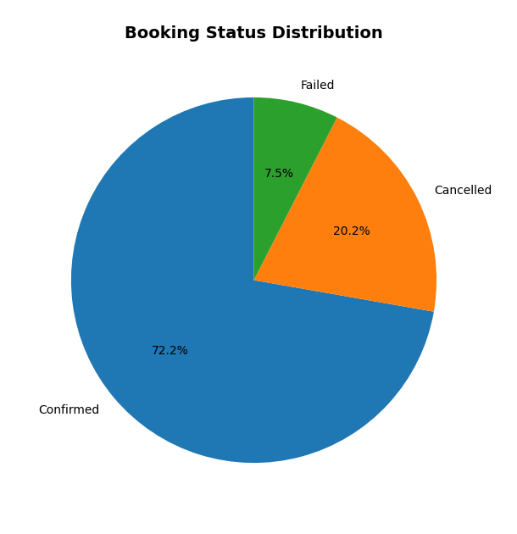
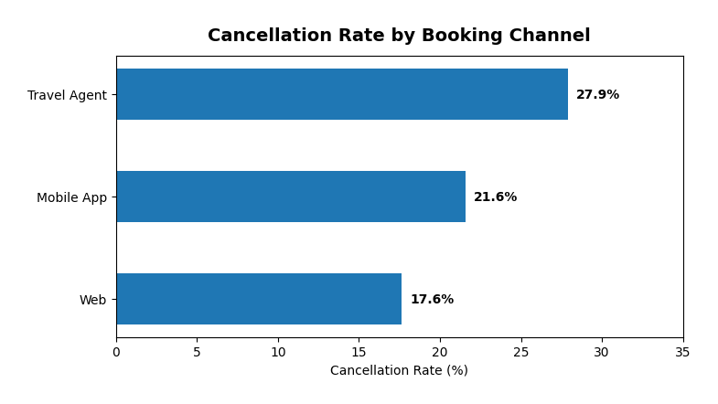
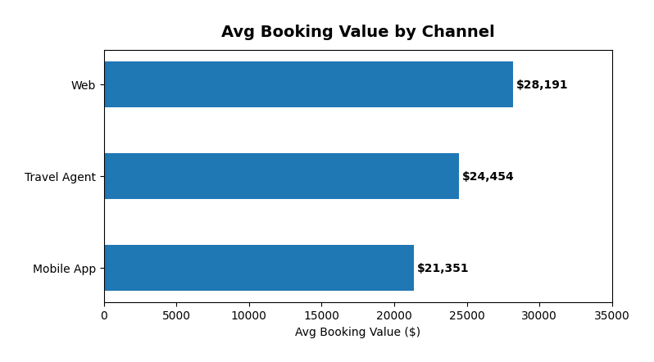
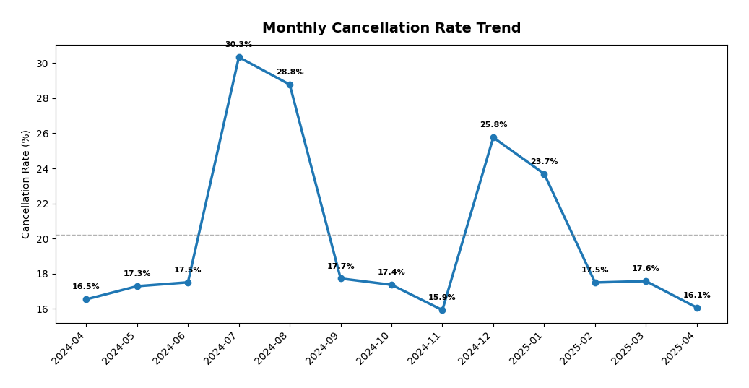
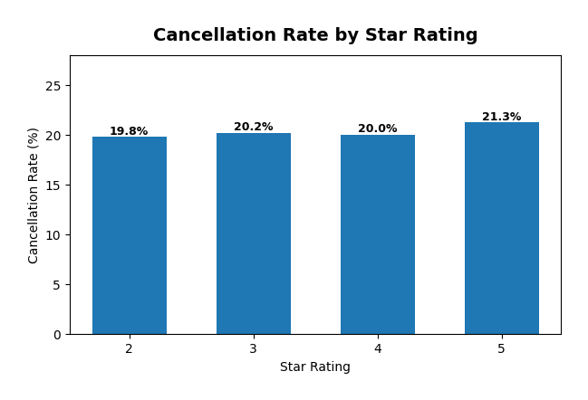
Executive Dashboard

Slide 5
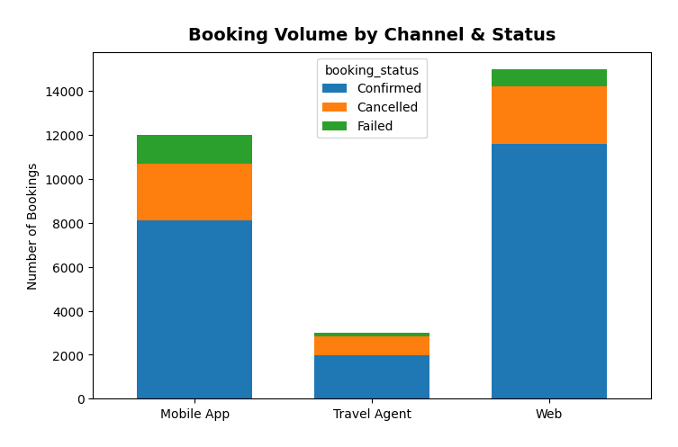
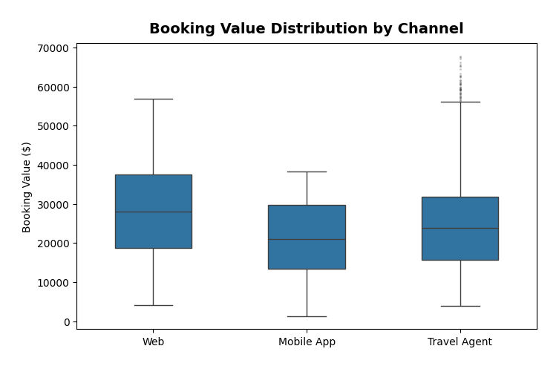
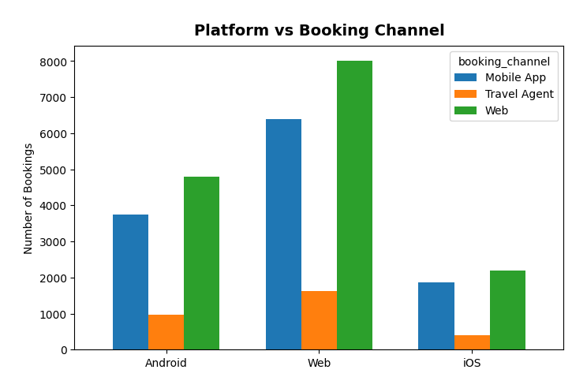
Booking Channel Deep-Dive

Slide 6
Channel Insights
Web Channel — Best Performer
50.0% of volume | 17.6% cancel rate | $28,191 avg value
Highest value, lowest cancellation — reward with loyalty programme
Mobile App — Price-Sensitive Segment
40.0% of volume | 21.6% cancel rate | $21,351 avg value
24% lower value than Web — upsell with App-exclusive room upgrades
Travel Agent — Cancellation Crisis
10.0% of volume | 27.9% cancel rate | $24,454 avg value
Likely speculative bulk bookings — require 20-30% non-refundable deposit

Slide 7
Room Type & Star Rating Analysis

Slide 8
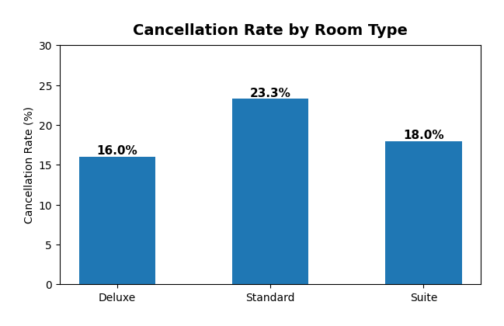
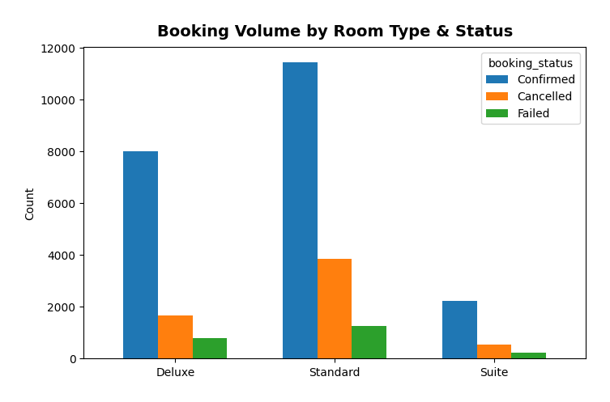
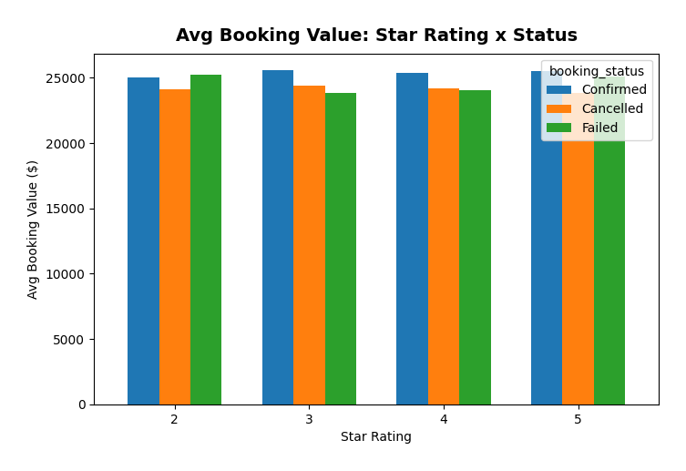
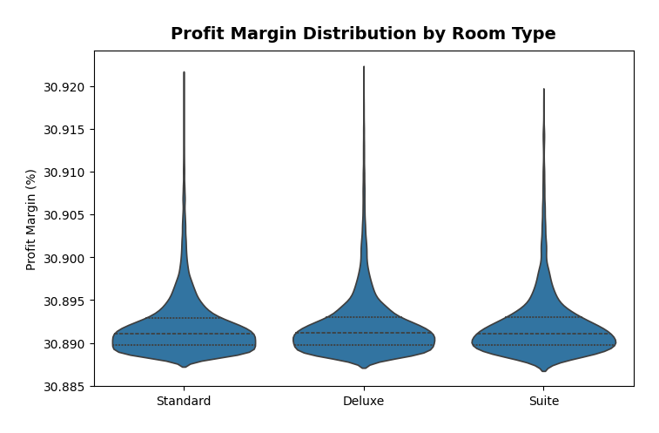
Room Type & Star Rating Analysis

Slide 9
Room Type Insights
Standard Rooms — Highest Cancellation (23.3%)
55.2% of all bookings but worst retention
Low-commitment choice — easy to book as placeholder, easy to cancel
Strategy: Offer 8-12% non-refundable discount to lock commitment
Deluxe Rooms — Best Retention (16.0%)
34.9% of bookings at similar price to Standard ($25K avg)
Premium choice signals committed travel plans
Strategy: Upsell Standard → Deluxe with small $50 credit incentive
Suite Rooms — Mid-Range (18.0%)
9.9% of bookings — niche segment, stable performance

Slide 10
Temporal Trends & Seasonality

Slide 11
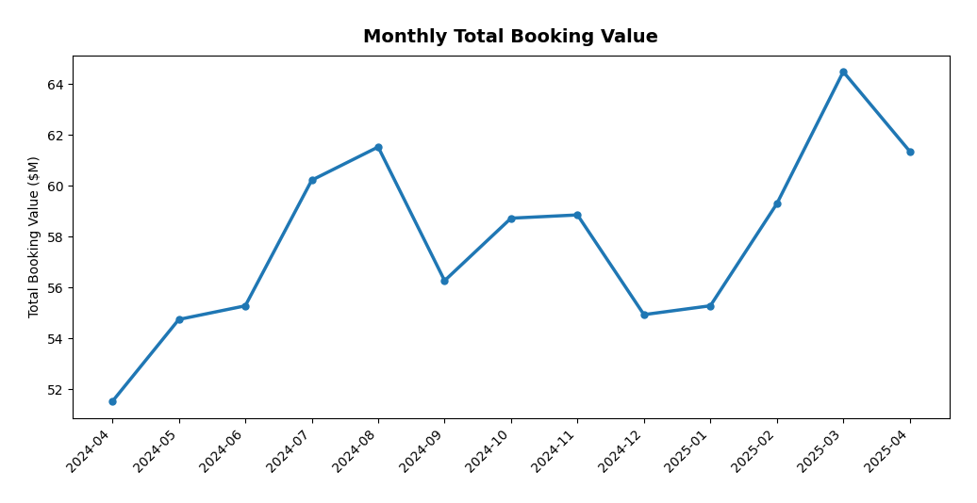
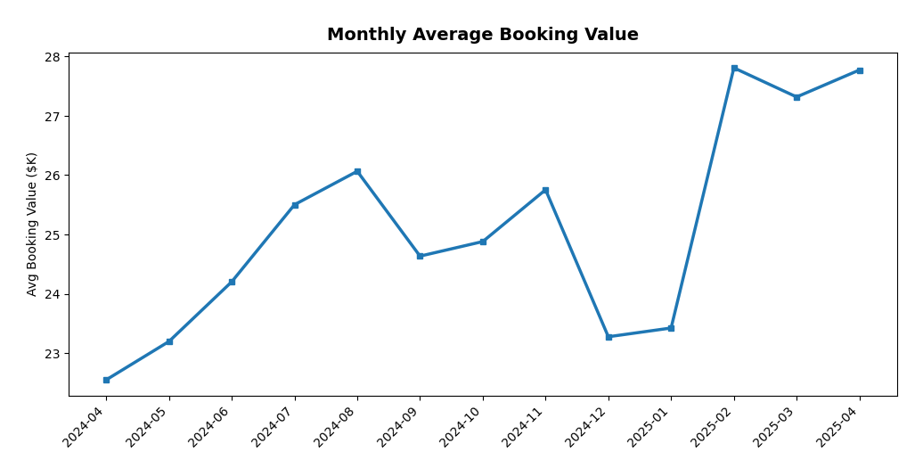
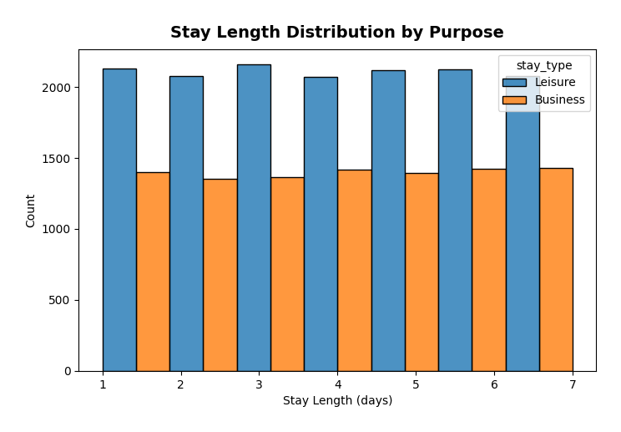
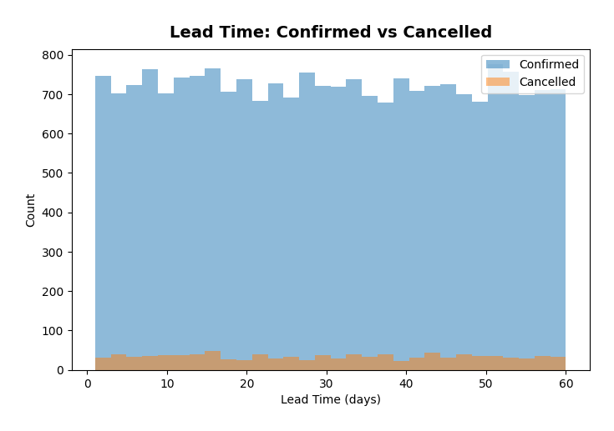
Temporal Trends & Seasonality

Slide 12
Seasonal Insights
Summer Peak (Jul-Aug): Cancellations spike to 28.8 – 30.3%
Peak vacation season creates over-booking behaviour
Strategy: Increase prices 10-15% + tighten cancellation policies
Holiday Bump (Dec-Jan): 23.7 – 25.8% cancellation
Year-end corporate budget cycles and holiday uncertainty
Booking Values Trending Up
Apr 2024: $22.5K → Apr 2025: $27.8K (+23% YoY growth)
Platform is moving upmarket or implementing dynamic pricing
Best Months (Lowest Cancellation)
November (15.9%) and April 2025 (16.1%) — push marketing spend here

Slide 13
Cancellation Deep Dive

Slide 14
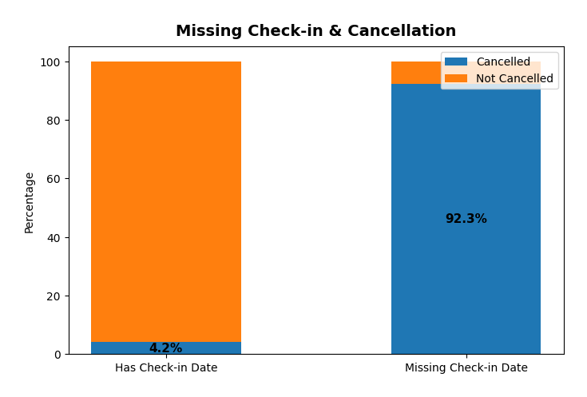
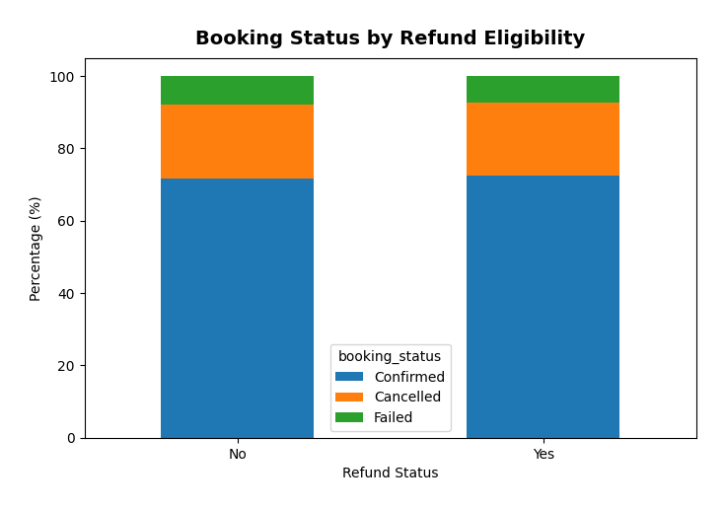
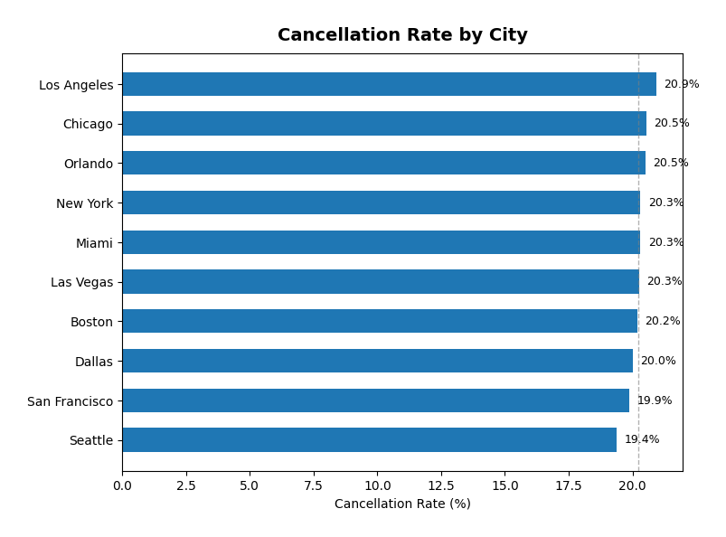
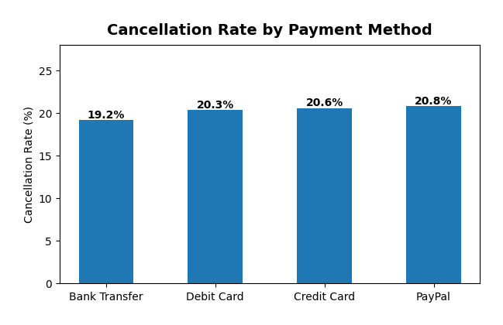
Cancellation Behaviour — Root Causes

Slide 15
Revenue & Profitability

Slide 16
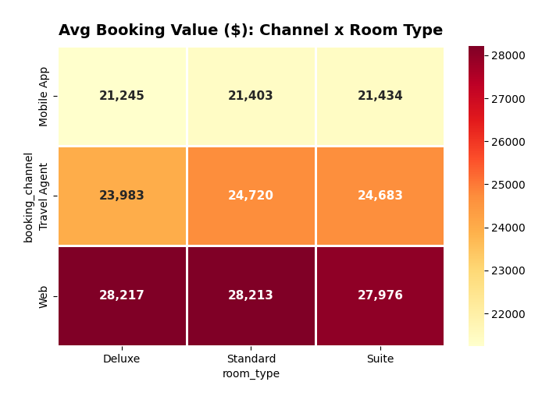
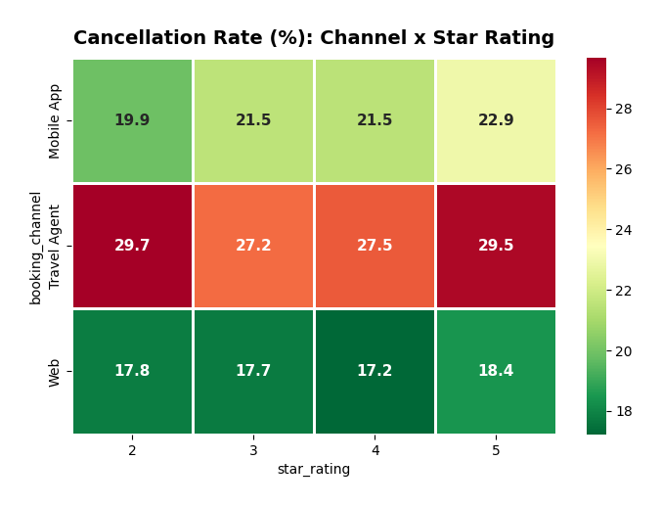
Revenue & Cancellation Heatmaps

Slide 17
Customer Behaviour & Promotions

Slide 18
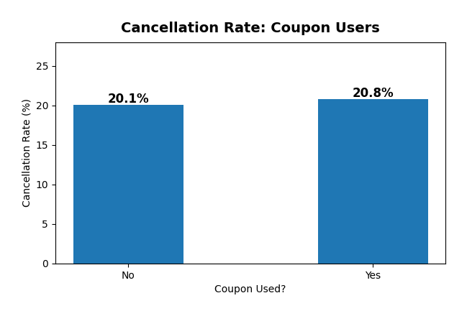
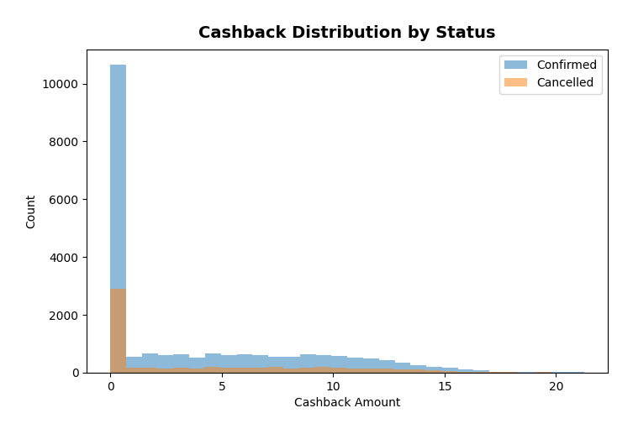
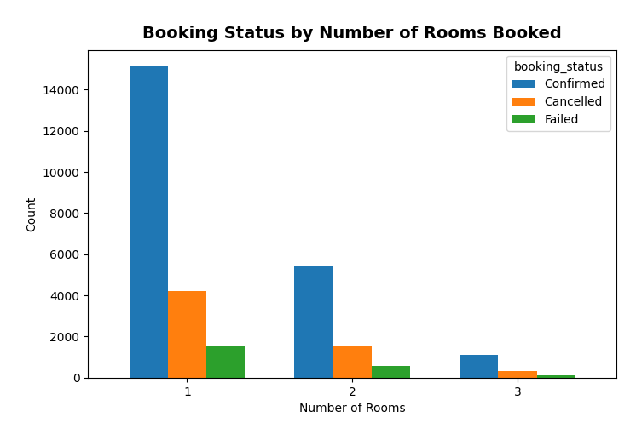
Customer Behaviour & Promotions Impact

Slide 19
City-Level Performance

Slide 20
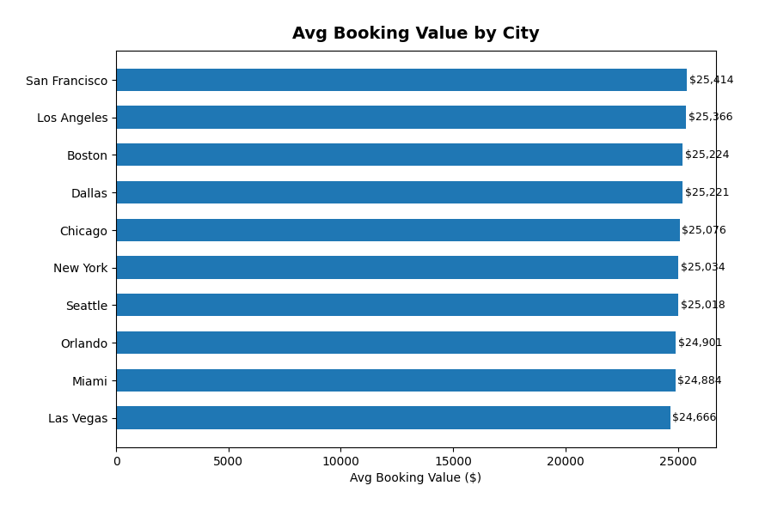
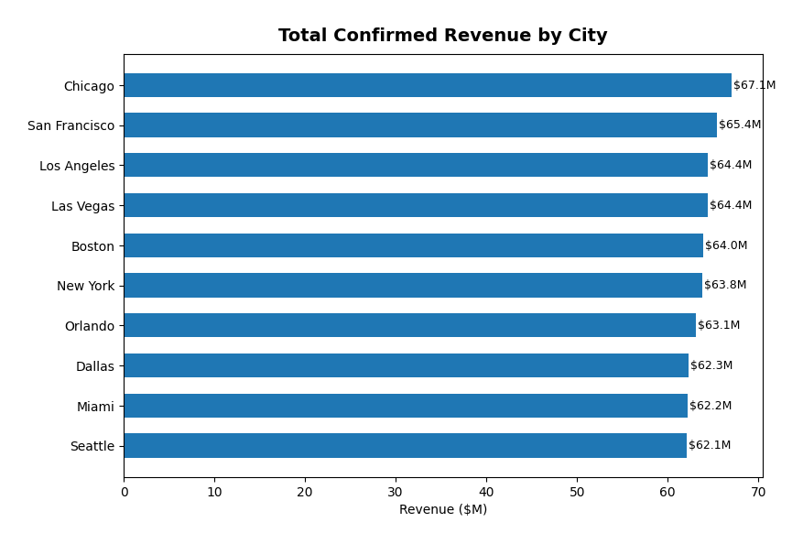
City-Level Performance Comparison

Slide 21
Strategic Recommendations
A. Reduce Cancellations (Target: 20.2% → ≤15%)
Non-refundable rate tiers for Standard rooms (8-12% discount)
Travel Agent deposit policy: 20-30% non-refundable
Progressive cancellation fees: Free 24hr → 10% → 25% → 50%
Automated confirmation nudges for bookings without check-in date > 7 days
B. Improve Profitability & Retention
Upsell Standard → Deluxe (7.3pp lower cancellation at similar prices)
Web-first loyalty programme for highest-value, lowest-cancel segment
Personalized re-booking flow: 5% discount instead of full refund
Corporate/repeat tiers: Bronze/Silver/Gold (avg 60 bookings per customer)
C. Pricing & Channel Optimization
Dynamic summer pricing: +10-15% in Jul-Aug with strict cancel policies
Off-peak promotion push: Nov & Feb-Apr (lowest cancel rates, highest ROI)
Mobile App value optimization: App-exclusive upgrades & bundles
City-targeted campaigns for LA (20.9%) and Chicago (20.5%)

Slide 22
Thank You
Hotel Bookings EDA — Data-Driven Strategy for Growth

