Slide 1
Hotel Bookings Portfolio Review
Standardizing Operations to Recapture $37M in Annual Revenue
CONFIDENTIAL
Analysis Period: April 2024 – April 2025 | 30,000 Transactions | 3 Channels · 3 Room Types · 15 Cities
Prepared for: Senior Leadership Team

Slide 2
Fixing Three Systemic Issues Can Reduce Cancellations from 20% to <15%, Recovering $37M
Executive Summary: The cancellation problem is concentrated, predictable, and solvable with five targeted interventions.
THE CORE FINDING
83% of all cancellations share a single trait: no check-in date was assigned at booking. This is not a demand problem—it is a process gap. Fixing this one data issue, combined with channel and pricing reforms, can recapture ~1,500 bookings and $37M annually.
DATA GAPS
83%
CHANNEL MIX
27.9%
SEASONAL SPIKES
30.3%
5,468 bookings lacked check-in dates. 92.3% of those cancelled. Accounts for 83% of total cancellations.
Travel Agents cancel 27.9% of bookings. Web cancels only 17.6% at 32% higher value. Agent model has zero financial consequence for cancelling.
Jul-Aug cancellation: 28.8–30.3%. Peak demand enables speculative multi-booking. Nov is the healthiest month at 15.9%.
PROJECTED IMPACT
Cancel rate: 20.2% → <15% | Recovered bookings: ~1,500/year | Revenue recaptured: ~$37M/year | Implementation: 60–90 days
Source: Hotel_bookings_final.csv, 30,000 transactions, Apr 2024–Apr 2025

Slide 3
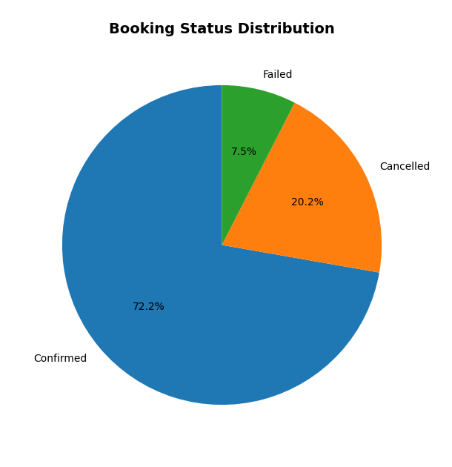
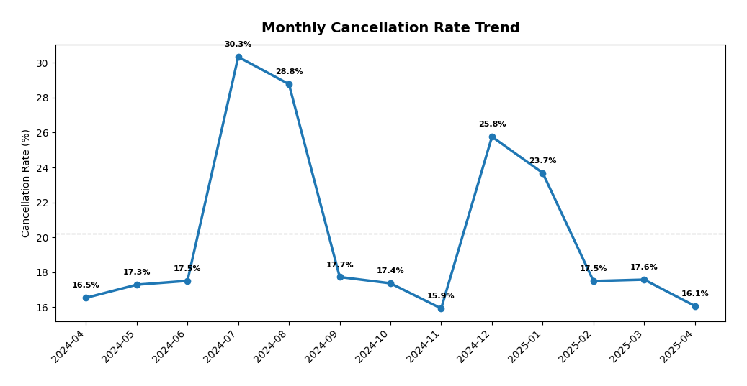
One in Five Bookings Is Lost Before the Guest Arrives, Representing $166M in Unrealized Revenue
The 20.2% cancellation rate is not uniformly distributed—it clusters around specific channels, room types, and data gaps.
30,000
21,672
6,070
2,258
$638.8M
Total Bookings
Confirmed (72.2%)
Cancelled (20.2%)
Failed (7.5%)
Confirmed Revenue
Source: Hotel_bookings_final.csv | N=30,000 | Unrealized revenue = cancelled booking values + failed booking values

Slide 4
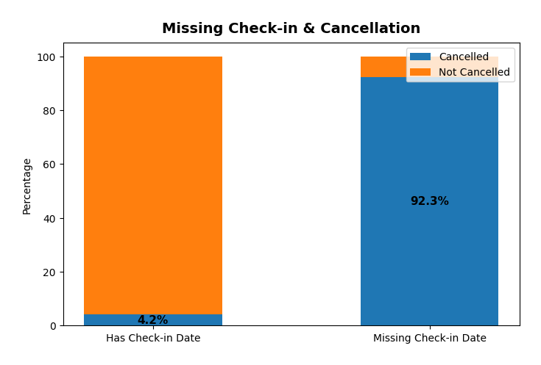
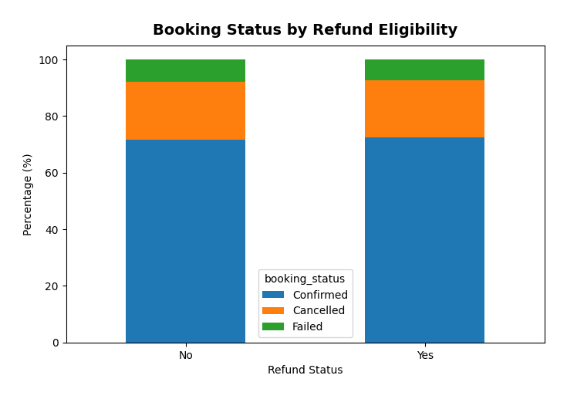
Standardizing Check-in Date Assignment at Booking Can Eliminate 83% of Cancellation Volume
The single largest driver of cancellations is a process gap, not a demand issue.
THE DATA GAP EFFECT
5,468 of 30,000 bookings (18.2%) have no check-in date assigned.
Of those 5,468 bookings without check-in dates:
• 5,045 were Cancelled (92.3%)
• 423 were Failed (7.7%)
• 0 were Confirmed (0.0%)
This means 83% of all 6,070 cancellations come from this single bucket.
Implication: A booking without a check-in date is effectively
already cancelled. The system just hasn’t registered it yet.
Recommendation: Auto-assign check-in dates at time of booking.
Force confirmation within 48 hours. Flag unconfirmed for follow-up.
Source: Hotel_bookings_final.csv | Missing check-in analysis on 5,468 records

Slide 5
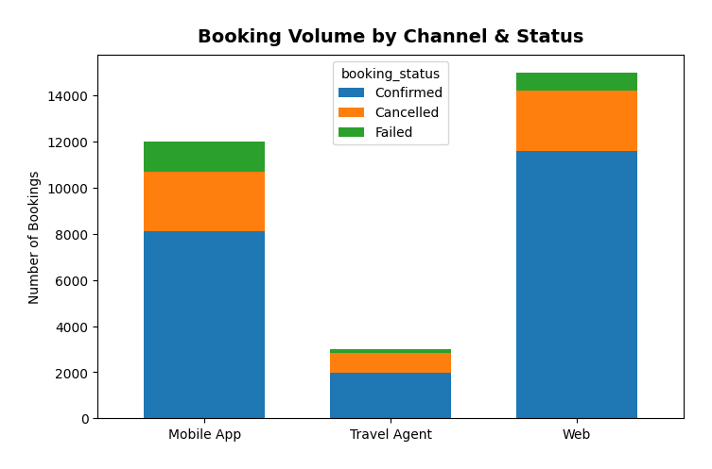
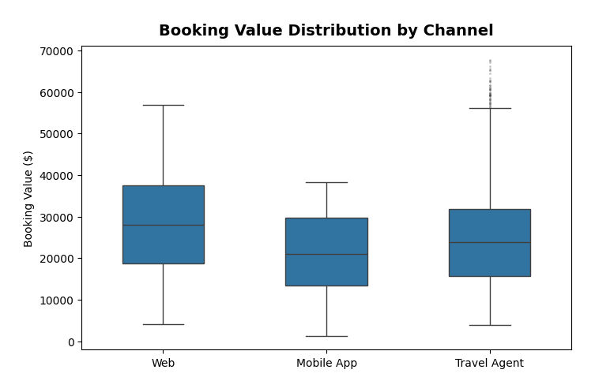
Web Direct Outperforms All Channels; Travel Agent Model Requires Structural Reform
Channel economics vary by 60% in cancellation rate and 32% in booking value—this is not a marginal difference.
WEB DIRECT
MOBILE APP
TRAVEL AGENT
17.6%
cancel rate
21.6%
cancel rate
27.9%
cancel rate
$28,191
avg value
$21,351
avg value
$24,454
avg value
50.0%
of volume
40.0%
of volume
10.0%
of volume
Self-selecting users who research before booking. Highest commitment, highest value. Lowest cancellation by 10pp vs Travel Agent.
Impulse-driven bookings on smaller screens. 24% lower value than Web. Not broken—under-monetized. Needs upsell flow.
Speculative bulk pre-bookings with zero deposit. No financial consequence for cancelling. Requires deposit enforcement immediately.
Source: Hotel_bookings_final.csv | Channel-level aggregation

Slide 6
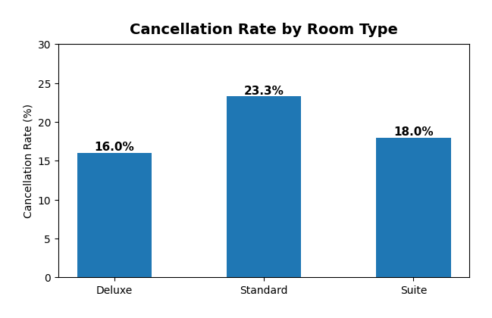
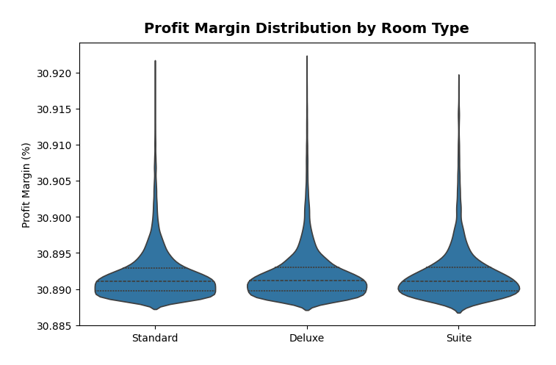
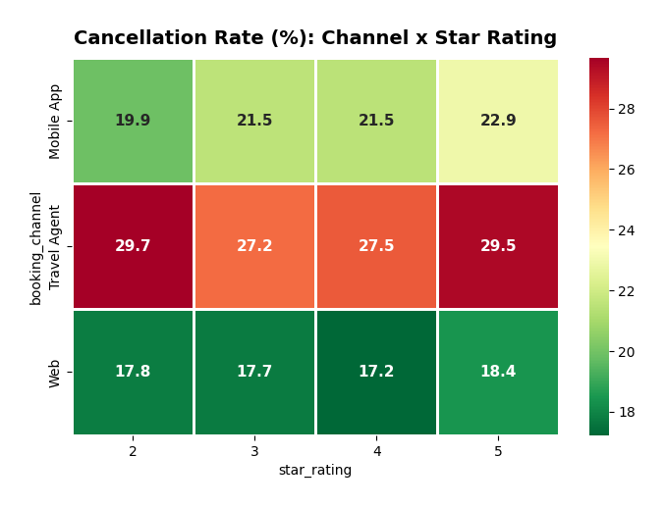
Standard Rooms Act as Placeholders; Summer Months Amplify Speculative Booking Behavior
Room type selection signals commitment level. Seasonality amplifies the underlying structural issues.
ROOM TYPE DYNAMICS
SEASONAL PATTERN
Standard: 55.2% of bookings | 23.3% cancel rate
Cheapest option, lowest commitment. Used as a “placeholder” booking.
Deluxe: 34.9% of bookings | 16.0% cancel rate
Similar avg price to Standard. People who choose Deluxe are committed.
Suite: 9.9% of bookings | 18.0% cancel rate
Niche premium segment. Stable and predictable.
Jul-Aug: 28.8–30.3% cancellation (1.5x average)
Peak demand enables speculative multi-hotel booking.
Nov: 15.9% — healthiest month. Strong conviction bookings.
Dec-Jan: 23.7–25.8% — holiday uncertainty and corporate cycles.
YoY Growth: Avg booking value up 23% ($22.5K → $27.8K)
Platform is moving upmarket. Pricing power is increasing.
Source: Hotel_bookings_final.csv | Room-type and monthly cohort analysis

Slide 7
Five Targeted Interventions Can Reduce Cancellations by 5pp and Recover $37M Annually
Each intervention addresses a specific, measurable root cause. Ordered by estimated impact.
#1
AUTO-ASSIGN CHECK-IN DATES
83% of cancels lack check-in dates. Auto-assign at booking, force 48hr confirmation.
~$20M
Eliminate the #1 cancellation predictor.
est. annual
#2
TRAVEL AGENT DEPOSIT POLICY
Require 20–30% non-refundable deposit. Agents cancel 28% because it costs them nothing.
~$8M
Introduce financial consequence for agent cancellations.
est. annual
#3
NON-REFUNDABLE RATE TIERS
8–12% discount for non-refundable Standard bookings. Filters out placeholder bookers.
~$5M
Lock commitment on Standard room bookings.
est. annual
#4
PROGRESSIVE CANCELLATION FEES
Free <24hrs → 10% (7d) → 25% (3d) → 50% (same-day). Industry-standard framework.
~$3M
Discourage late cancellations across all segments.
est. annual
#5
STANDARD → DELUXE UPSELL
$50 upgrade credit. Deluxe cancels at 16% vs Standard’s 23%. 7.3pp improvement per conversion.
~$1M
Shift volume toward lower-cancellation room type.
est. annual
TOTAL PROJECTED ANNUAL RECOVERY
~$37M
Source: Analysis team estimates based on cohort analysis of 30,000 transactions

Slide 8
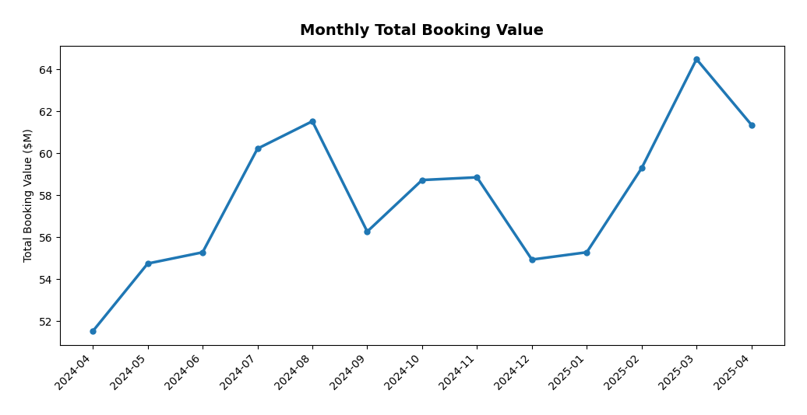
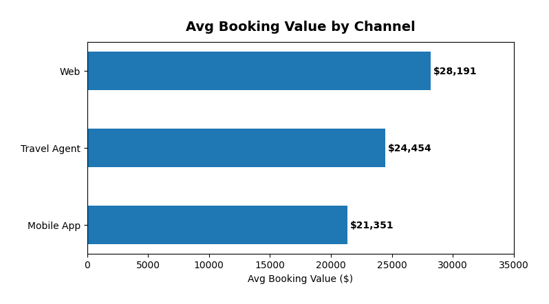
Optimizing Pricing Windows and Channel Mix Can Amplify Revenue Beyond Cancellation Recovery
Pricing power exists in peak months; promotional ROI is maximized in low-cancellation windows.
DYNAMIC PRICING
PROMOTIONS
CHANNEL STRATEGY
Summer (Jul-Aug)
Raise rates 10–15%.
High demand absorbs price increases.
Pair with strict cancel terms.
Off-Peak (Nov, Feb-Apr)
Invest promotional budget here.
Lowest cancel rates = best ROI.
Nov: 15.9% cancel, $25.7K avg.
Coupons are safe to use.
Coupon users cancel at the same
rate as non-users. No adverse effect.
Target Standard-room bookers
with Deluxe upgrade vouchers.
Shifts volume to lower-cancel tier.
Re-booking incentives
5% off alternative dates instead
of full refund on cancellations.
Double down on Web Direct.
Best unit economics across every metric.
Invest in SEO, direct booking incentives.
Reform Travel Agent Terms
Mandatory deposits.
Shorter booking windows.
Performance-based commission.
Mobile App: Upsell Engine
App-exclusive bundles, upgrades.
Close the $7K value gap vs Web.
499 repeat customers avg 60 bookings.
Source: Monthly cohort analysis, coupon usage cross-tabulation

Slide 9
The Bottom Line
The cancellation problem is not a demand problem.
It is a process gap, a channel incentive misalignment, and a pricing opportunity.
Three moves capture 80% of the value:
• Auto-assign check-in dates at booking (≈$20M)
• Require deposits on Travel Agent bookings (≈$8M)
• Non-refundable tiers for Standard rooms (≈$5M)
Combined projected impact: ~1,500 recovered bookings | ~$37M recaptured | Per year.
IMPLEMENTATION TIMELINE
Week 1–2: Check-in date auto-assignment (IT change) | Week 3–4: Agent deposit policy rollout | Week 5–8: Non-refundable tier launch | Week 8–12: Progressive fee structure + Deluxe upsell campaign
Hotel Bookings Portfolio Review | Confidential | Prepared for Senior Leadership

