Slide 1
Hotel Bookings Analysis
Project Report & Summary | 30,000 Booking Transactions | Apr 2024 - Apr 2025

Slide 2
Key Performance Indicators
Total Bookings: 30,000
Confirmed: 21,672 (72.2%) | Cancelled: 6,070 (20.2%) | Failed: 2,258 (7.5%)
Average Booking Value: $25,081
Total Confirmed Revenue: $638.8M
Average Lead Time: 30.4 days | Average Stay: 4.0 days
Critical Finding
5,468 bookings (18.2%) have no check-in date assigned
Of these, 92.3% are Cancelled -- accounting for 83% of all cancellations

Slide 3
Executive Dashboard

Slide 4
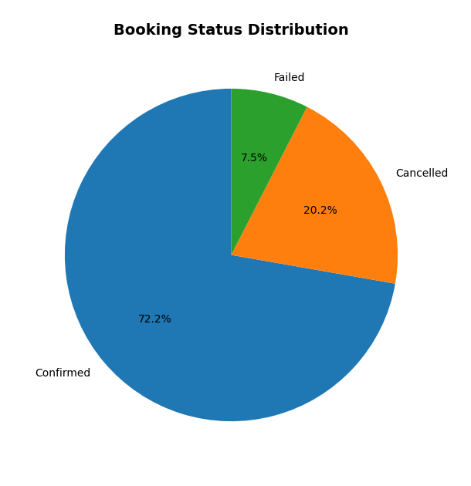
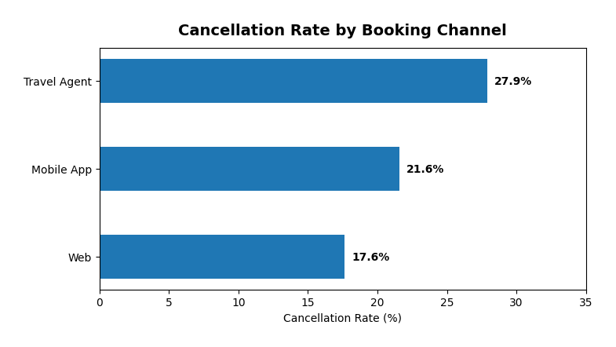
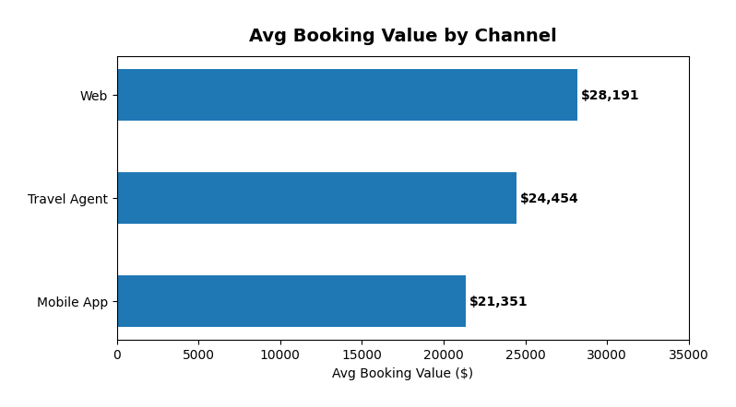
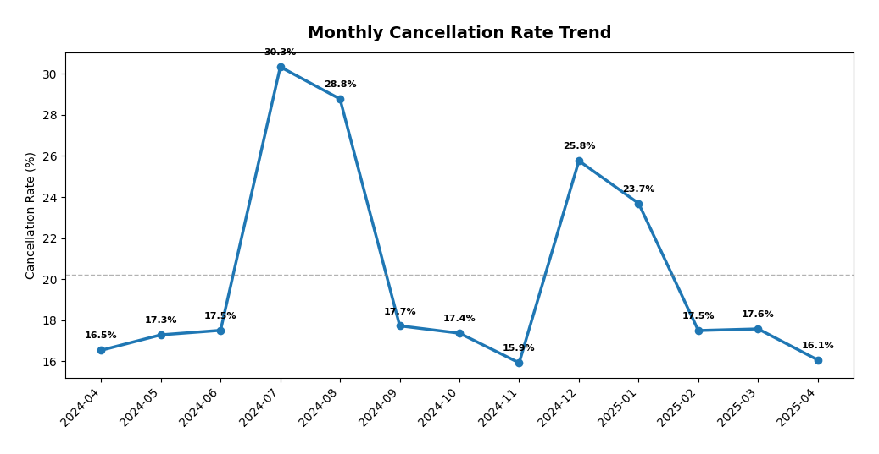
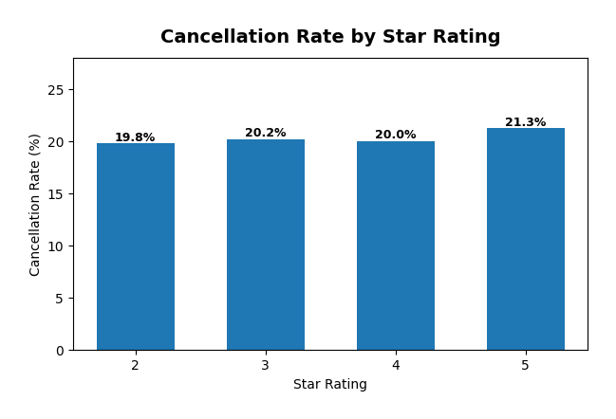
Booking Overview

Slide 5
Channel Analysis

Slide 6
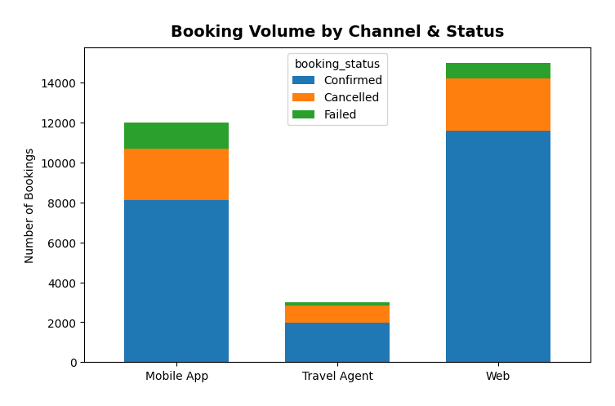
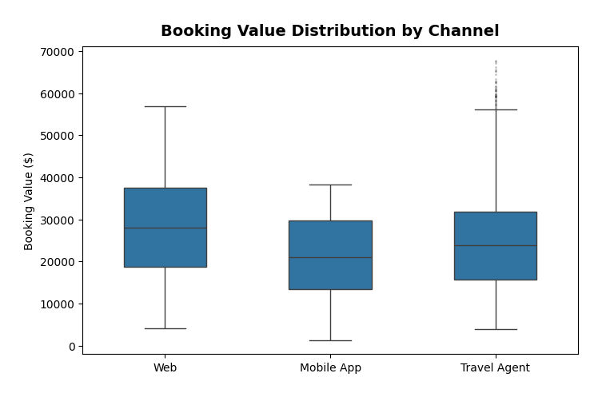
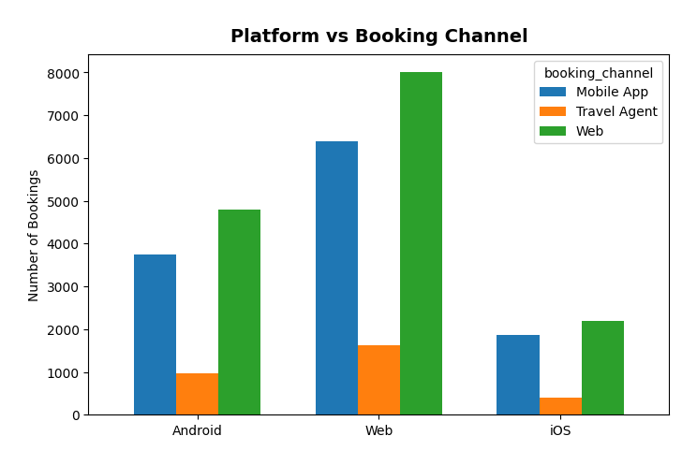
Booking Channel Deep-Dive

Slide 7
Channel Insights
Web -- Best Performer
50% of volume | 17.6% cancel rate | $28,191 avg value
Highest value per booking with lowest cancellation rate
Mobile App -- Price-Sensitive Segment
40% of volume | 21.6% cancel rate | $21,351 avg value
24% lower value than Web -- opportunity for App-exclusive upsells
Travel Agent -- Highest Risk
10% of volume | 27.9% cancel rate | $24,454 avg value
Likely speculative bulk pre-bookings; needs deposit enforcement

Slide 8
Room Type & Star Rating

Slide 9
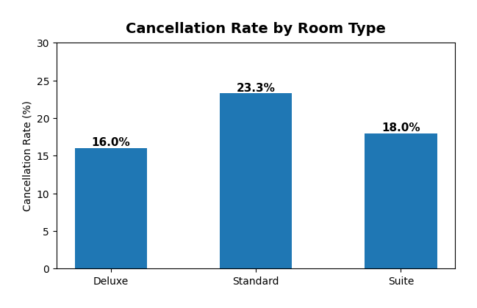
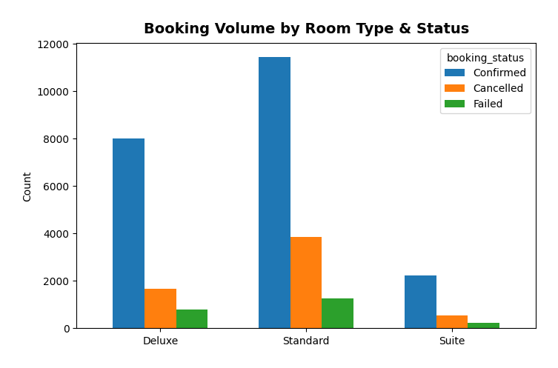
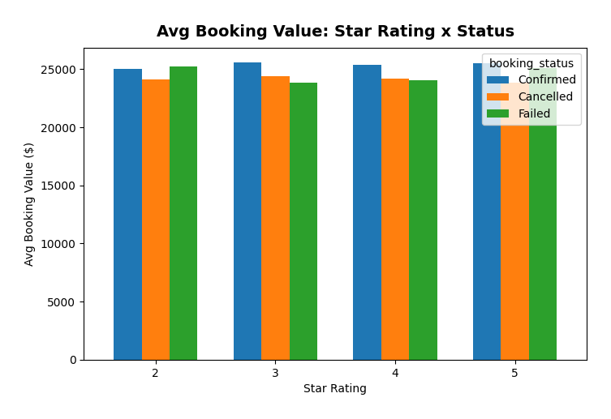
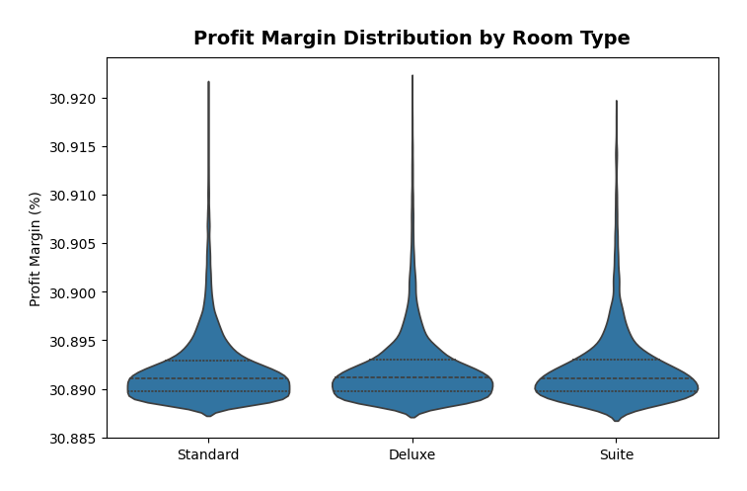
Room Type & Star Rating Analysis

Slide 10
Room Type Insights
Standard Rooms -- Highest Cancellation (23.3%)
55.2% of bookings but worst retention rate
Low-commitment choice; easy to book and cancel
Deluxe Rooms -- Best Retention (16.0%)
34.9% of bookings at similar avg price to Standard
Upselling Standard to Deluxe reduces cancel rate by 7.3 percentage points
Suite Rooms -- Stable at 18.0%
9.9% of bookings; niche premium segment

Slide 11
Temporal Trends & Seasonality

Slide 12
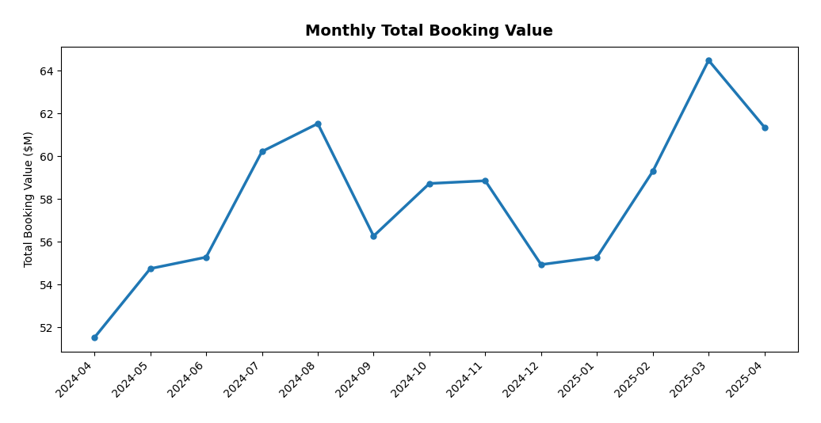
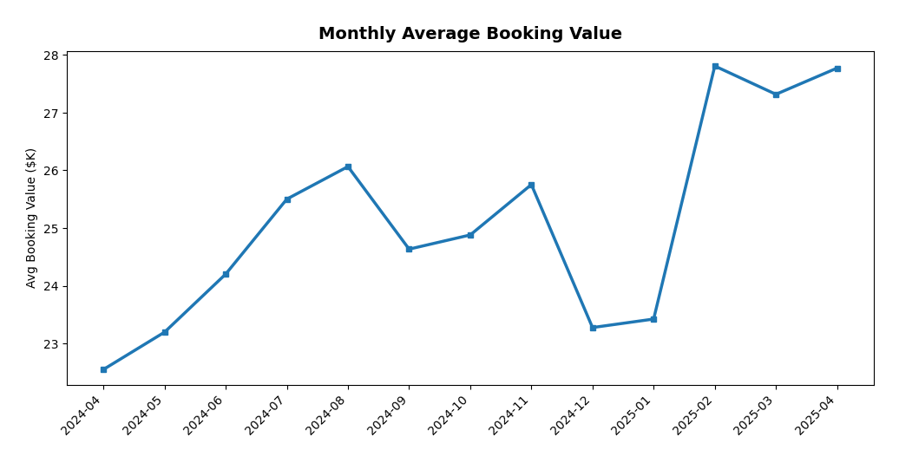
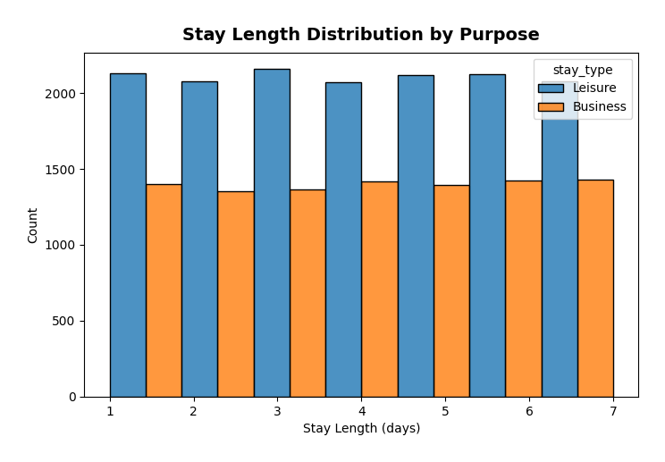
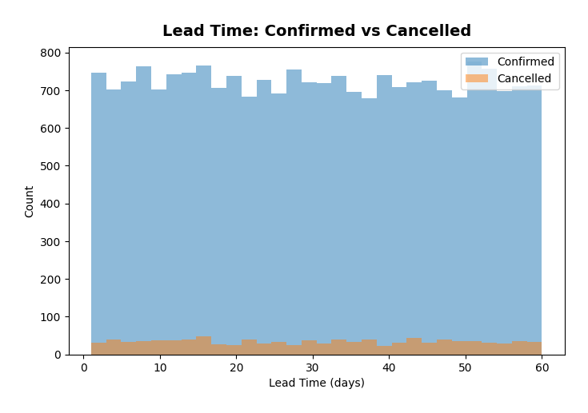
Temporal Analysis

Slide 13
Seasonal Insights
Summer Peak (Jul-Aug): Cancellations spike to 28.8 - 30.3%
Peak vacation season creates over-booking behaviour
Strategy: increase prices 10-15% with stricter cancel policies
Holiday Bump (Dec-Jan): 23.7 - 25.8% cancellation
Year-end uncertainty and corporate budget cycles
Booking Values Growing
Apr 2024: $22.5K avg --> Apr 2025: $27.8K avg (+23% YoY)
Platform moving upmarket or dynamic pricing taking effect
Best Months: November (15.9%) and April 2025 (16.1%)
Recommend concentrating marketing spend in these low-cancel windows

Slide 14
Cancellation Deep Dive

Slide 15
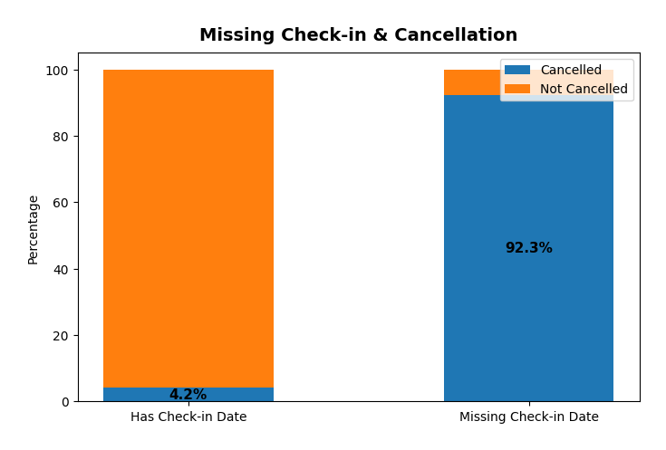
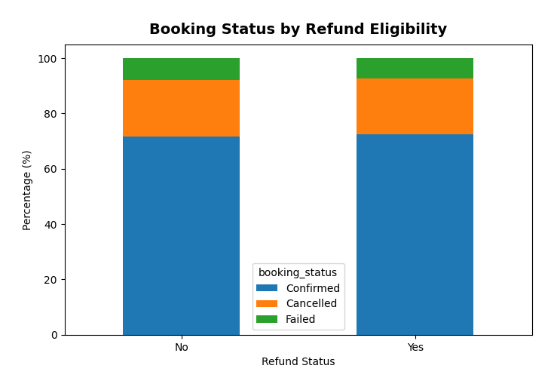
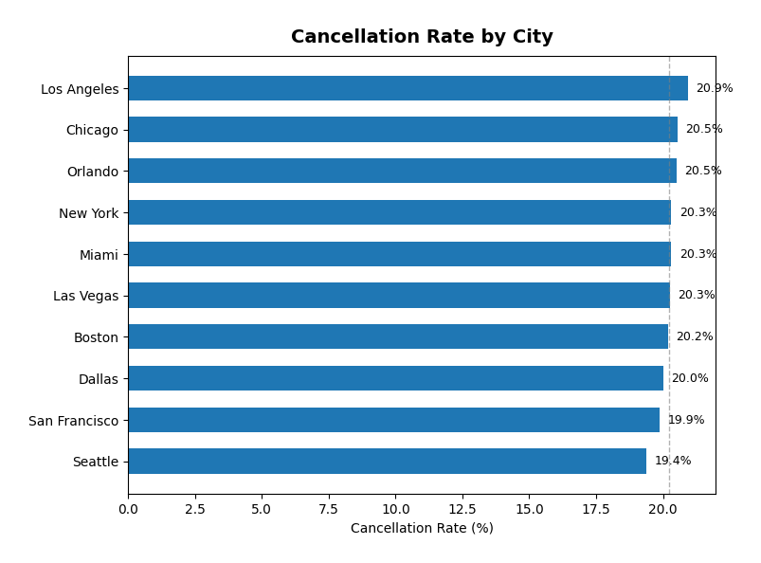
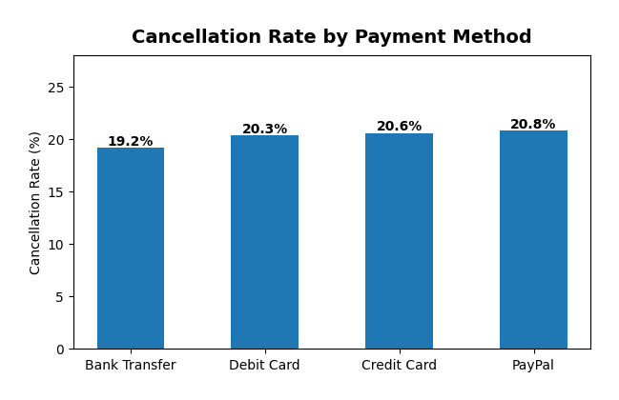
Cancellation Root Causes

Slide 16
Revenue & Profitability

Slide 17
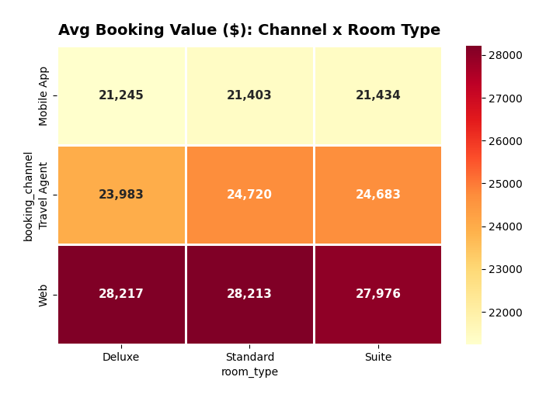
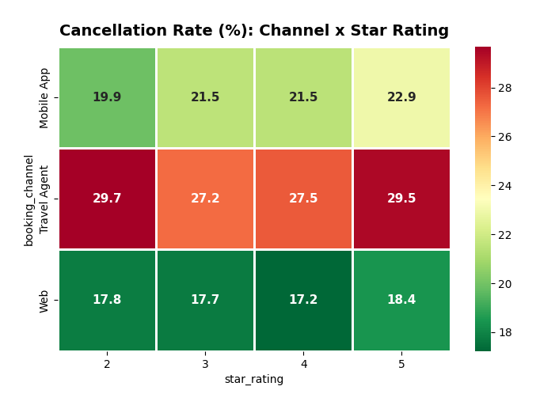
Revenue & Cancellation Heatmaps

Slide 18
Customer Behaviour & Promotions

Slide 19
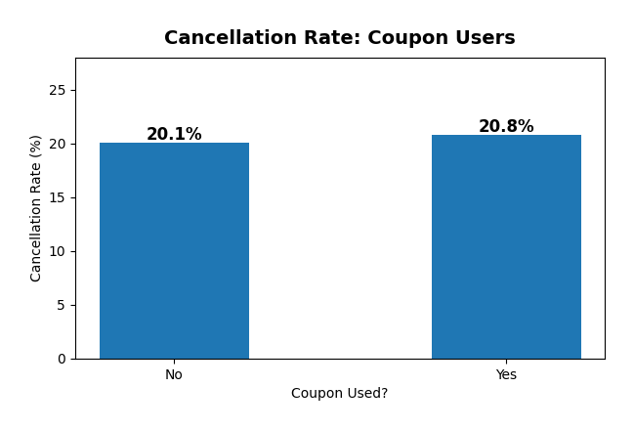
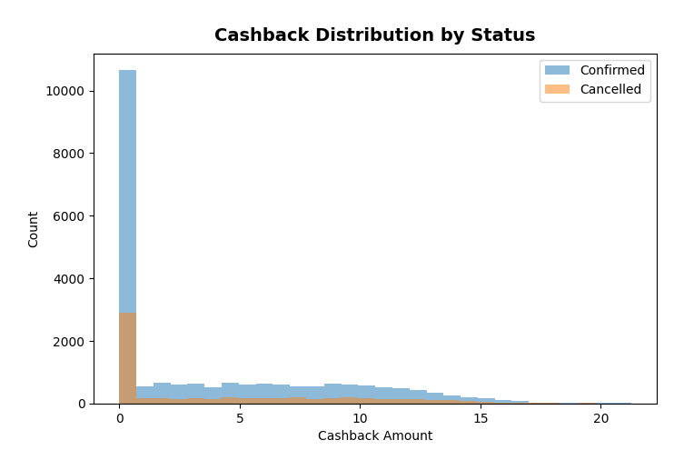
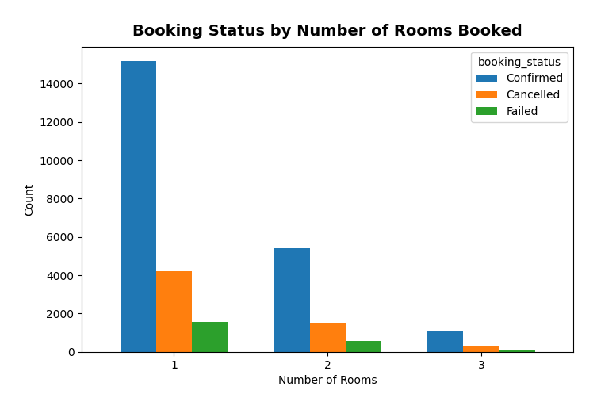
Customer & Promotions Impact

Slide 20
City-Level Performance

Slide 21
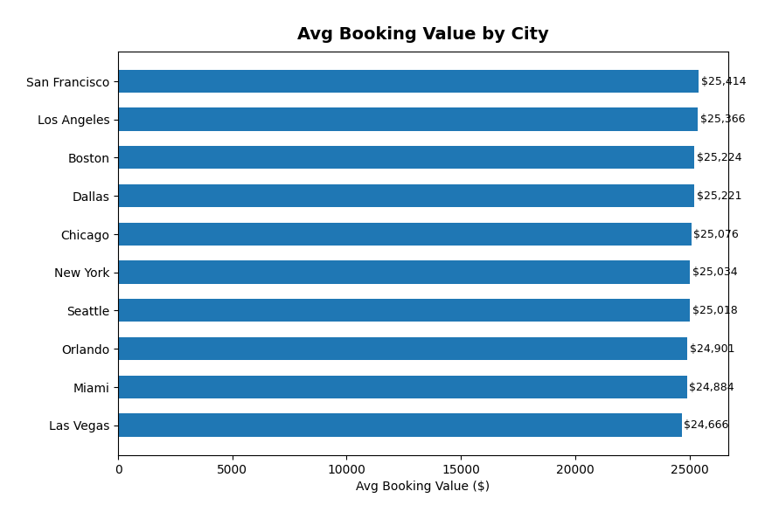
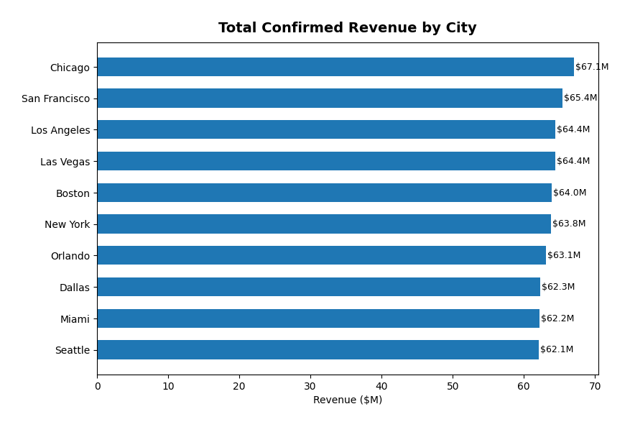
City Performance Comparison

Slide 22
Recommendations: Reduce Cancellations
Target: Reduce cancellation rate from 20.2% to under 15%
1. Non-refundable Rate Tiers
Offer Standard rooms at 8-12% discount for non-refundable bookings
2. Travel Agent Deposit Policy
Require 20-30% non-refundable deposit on agent bookings
3. Progressive Cancellation Fees
Free within 24hrs --> 10% (7 days) --> 25% (3 days) --> 50% (same day)
4. Check-in Confirmation Nudges
Auto-send reminders for bookings without check-in date after 7 days
5. Upsell Standard to Deluxe
Small $50 credit incentive; saves 7.3pp in cancellation rate

Slide 23
Recommendations: Growth & Optimization
Improve Profitability & Retention
1. Web-first Loyalty Programme
Reward highest-value, lowest-cancel segment with tiered rewards
2. Personalized Re-booking Flow
Offer 5% discount on alternative dates instead of full refund
3. Dynamic Summer Pricing
+10-15% in Jul-Aug with tighter cancellation policies
4. Off-peak Marketing Push
Nov & Feb-Apr have lowest cancel rates -- best ROI for promotions
5. Mobile App Value Optimization
App-exclusive room upgrades and bundles to close the $7K value gap vs Web
6. Corporate/Repeat Customer Tiers
499 unique customers averaging 60 bookings each -- loyalty tiers warranted

Slide 24
Thank You
Hotel Bookings Analysis -- Data-Driven Strategy for Growth

