Slide 1
Hotel Bookings
What the data tells us. Why guests cancel. What to do about it.
30,000 transactions | Apr 2024 – Apr 2025 | 3 channels · 3 room types · 15 cities

Slide 2
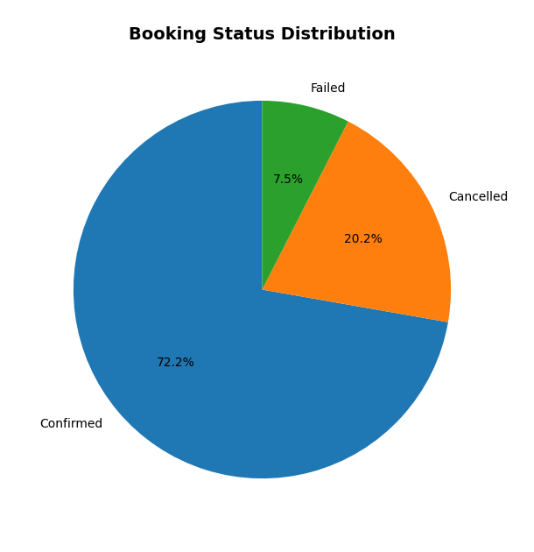
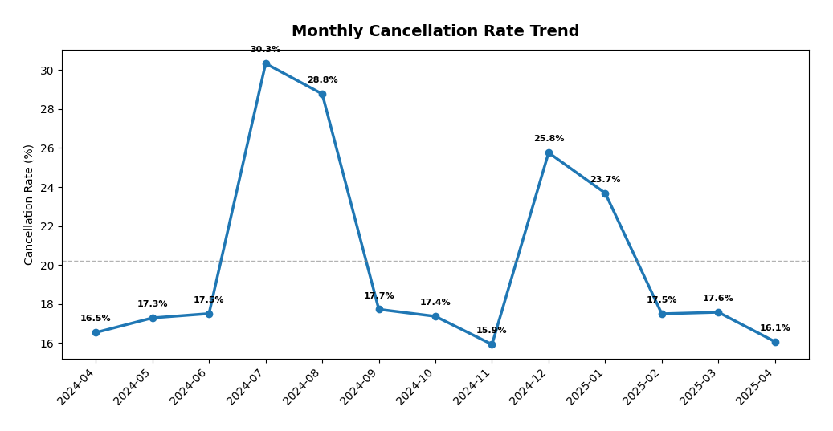
Three Things You Need to Know
01
02
03
One in Five Bookings Dies
Summer Is a Cancellation Machine
No Check-in Date = Almost Certain Cancel
20.2% of all bookings get cancelled.
That’s 6,070 lost bookings out of 30K.
Another 7.5% simply fail to complete.
Combined, you lose $166M in potential revenue.
Jul-Aug cancellation rate: 28.8–30.3%.
That’s nearly 1.5x the annual average.
Guests book multiple hotels, pick the cheapest,
then ghost the rest. Classic peak-season behavior.
5,468 bookings never got a check-in date.
92.3% of those were cancelled.
That’s 83% of ALL cancellations in one bucket.
Fix this one data gap, and you fix the majority.

Slide 3
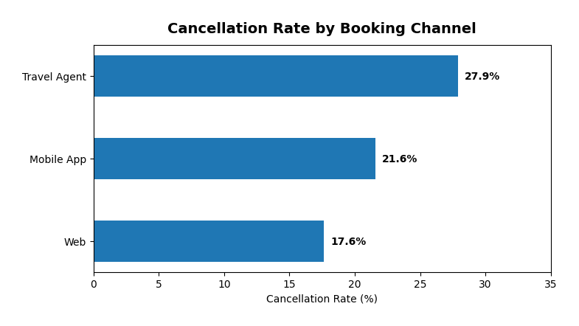
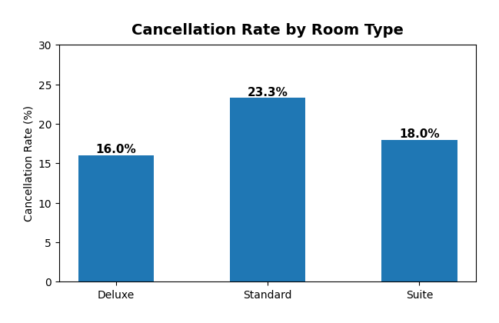
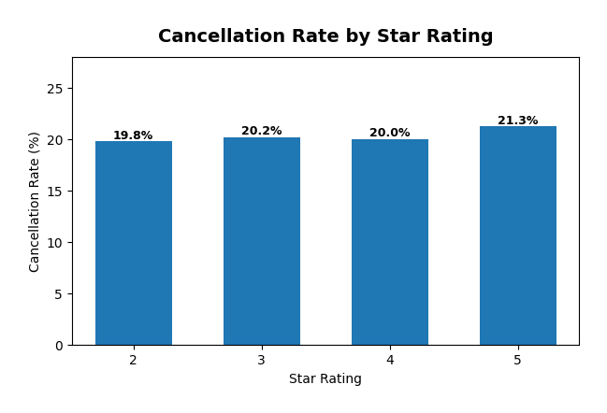
Not All Channels Are Created Equal
BY CHANNEL
BY ROOM TYPE
BY STAR RATING
Web is the golden channel.
$28,191 avg value • 17.6% cancel rate
50% of all bookings and the lowest cancellations.
Mobile App underperforms on value.
$21,351 avg — that’s 24% less than Web.
Travel Agents are the cancellation king.
27.9% cancel rate. Nearly 1 in 3 bookings lost.
Standard = highest volume, highest cancel.
55% of bookings but 23.3% cancellation.
It’s the “just-in-case” room. Low commitment.
Deluxe = best retention by far.
Only 16.0% cancel rate at similar prices.
People who pick Deluxe mean business.
Suite = stable niche (18.0% cancel).
Small volume but consistent.
Star rating barely moves the needle.
2-star: 19.8% • 3-star: 20.2%
4-star: 20.0% • 5-star: 21.3%
Cancel rates are essentially flat across stars.
The insight?
Cancellation isn’t about quality.
It’s about channel and commitment level.

Slide 4
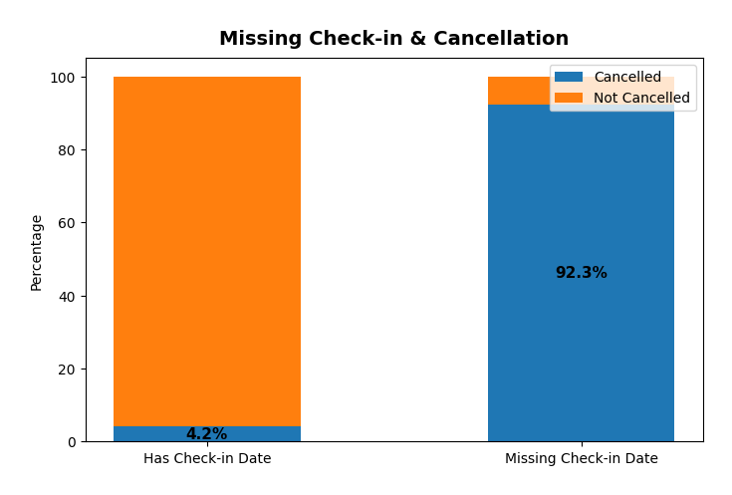
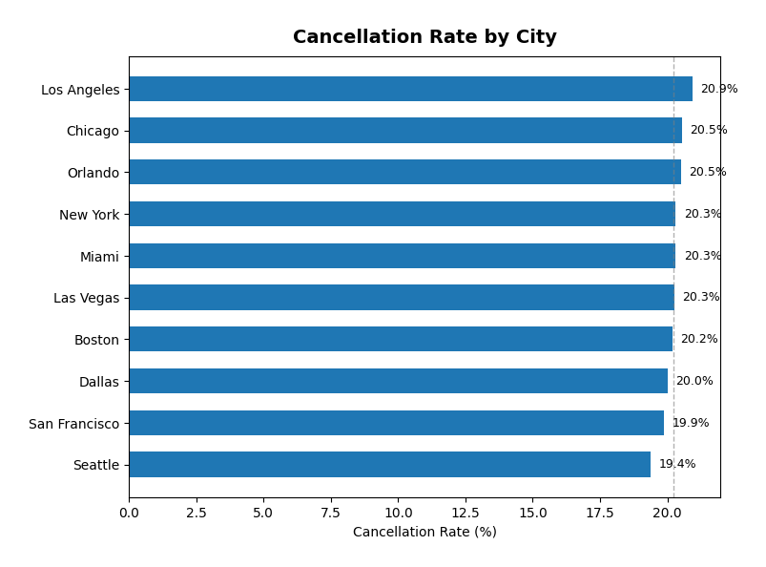
Why We’re Losing Bookings Before Day One
THE CANCELLATION ANATOMY
The missing check-in date is the single biggest red flag.
5,468 bookings had no check-in date. Of those, 92.3% cancelled.
This means 83% of all cancellations share one trait: no check-in assigned.
Travel Agents are booking speculatively.
They block rooms in bulk, then release what they can’t sell.
Result: 27.9% cancel rate vs 17.6% for Web direct.
Standard rooms are “placeholder” bookings.
Cheapest option, lowest commitment, easiest to abandon.
23.3% cancel rate — 7.3pp higher than Deluxe.
Summer over-booking is real.
Jul-Aug sees 30% cancellations. Travelers book 2–3 options,
then pick the winner. Your hotel might be the loser.
Coupon users and non-users cancel at the same rate.
Promotions aren’t causing cancellations — that’s good news.

Slide 5
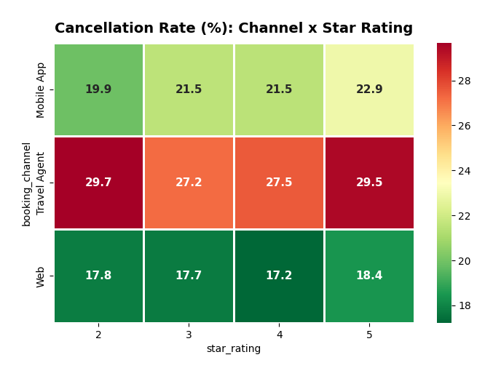
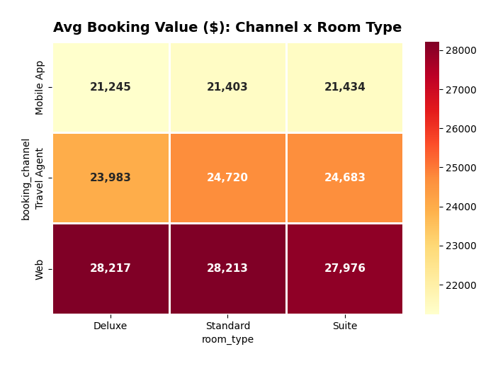
The ‘Why’ Behind the Numbers
WHY SOME CHANNELS WIN
Web users are self-selecting. They research, compare, decide.
That’s why they spend $28K avg and cancel least.
App users are impulse-driven. Smaller screens, quicker decisions.
Lower avg value ($21K) suggests price-hunting behavior.
Travel Agents batch-book with zero skin in the game.
No deposit = no consequence for cancelling. Simple as that.
THE SEASONAL STORY
Summer = high demand, high flakiness.
Booking values actually climb ($26K in Aug vs $22K in Apr).
But cancellation spikes to 30%. Demand creates over-booking.
Nov is the sweet spot: lowest cancel rate (15.9%), solid values ($25.7K).
Yearly trend shows avg values rising 23% YoY — platform growing.

Slide 6
How to Stop the Bleeding: 5 Moves to Cut Cancellations
01
Fix the Check-in Gap
Auto-assign check-in dates at booking. Send confirmation nudges after 48hrs. 83% of cancellations have this gap — closing it is the single highest-ROI fix.
02
Make Agents Put Skin in the Game
Require 20–30% non-refundable deposit on Travel Agent bookings. They cancel 28% of the time because there’s zero cost to doing so.
03
Launch Non-Refundable Rate Tiers
Offer Standard rooms at 8–12% discount for non-refundable bookings. People who pick this option are committed. They don’t cancel.
04
Progressive Cancellation Fees
Free cancel within 24hrs → 10% fee at 7 days → 25% at 3 days → 50% same-day. Gives flexibility early, but makes last-minute ditching expensive.
05
Upsell Standard → Deluxe
A $50 room-upgrade credit reduces cancellation by 7.3 percentage points. Deluxe guests cancel at 16% vs Standard’s 23%. The math writes itself.

Slide 7
How to Make More Money from the Guests You Keep
WEB-FIRST LOYALTY
PERSONALIZED RE-BOOKING
Web is 50% of volume with the best economics. Build a loyalty programme that rewards direct Web bookings. Tier it: Bronze/Silver/Gold. 499 unique customers averaging 60 bookings each — they deserve it.
When someone cancels, don’t just refund. Offer 5% off alternative dates. Turns a loss into a save. Even a 10% conversion rate on 6,070 cancellations = 607 recovered bookings.
MOBILE APP UPSELLS
REPEAT CUSTOMER PRICING
App users spend $7K less per booking than Web users. Close the gap with App-exclusive upgrades: room bundles, late checkout, breakfast add-ons. The user is already on their phone — make the upgrade feel effortless.
Every customer books an average of 60 times. Introduce volume-based pricing: 5% off after 10 bookings, 10% after 25. Lock in loyalty before a competitor does.

Slide 8
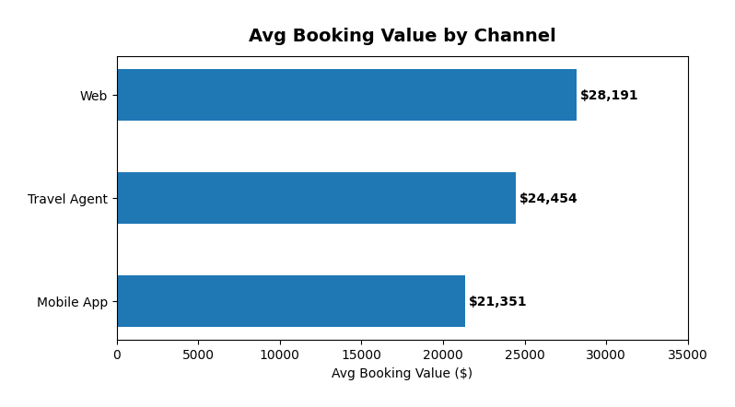
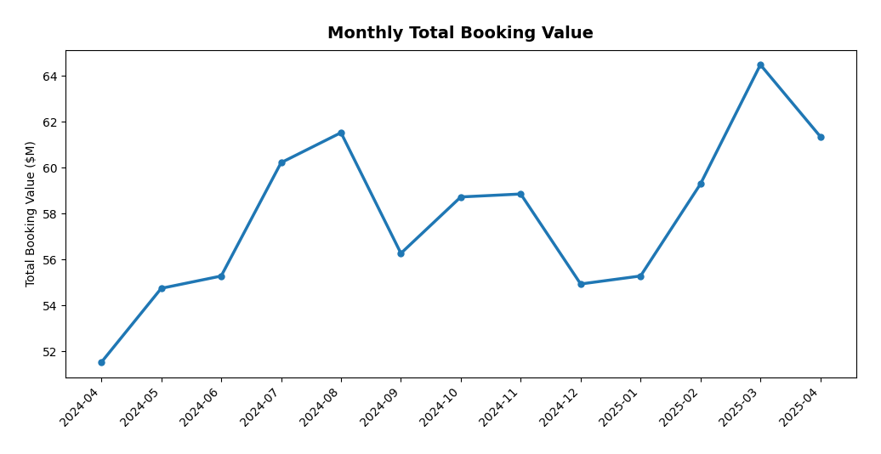
Where to Push: Pricing, Promos & Channel Playbook
PRICING
Summer (Jul-Aug): raise prices 10–15%.
Demand is high, cancel is high. Capture value from committed guests.
Pair with strict cancellation terms to filter out the flippers.
Off-peak (Nov, Feb-Apr): push promotions here.
Lowest cancel rates + best ROI on marketing spend.
PROMOTIONS
Coupons don’t increase cancellations — use them freely.
Coupon users cancel at the same rate as non-users.
Target Standard-room bookers with Deluxe upgrade vouchers.
CHANNEL STRATEGY
Double down on Web. It’s your best channel by every metric.
Renegotiate Travel Agent terms. Deposits, shorter booking windows.
Mobile App: not broken, just under-monetized. Fix with bundles.

Slide 9
The Bottom Line
You’re not losing guests because your hotels are bad.
You’re losing them because the system makes cancelling free and easy.
Fix the check-in data gap. Make agents pay deposits. Upsell to Deluxe.
Those three moves alone could cut cancellations from 20% to under 15%.
That’s ~1,500 recovered bookings. Roughly $37M in recaptured revenue.
Per year.
Hotel Bookings Analysis · 30,000 Transactions · Data-Driven Strategy

