Slide 1

TAMIL NADU ELECTION 2026 | ATLIQ MEDIA DECISION DESK
SLIDE 1/10
TAMIL NADU
ELECTION 2026
RECORD TURNOUT ≠ RECORD WAVE
Final Data Analysis | ECI Official Data | AtliQ Media Decision Desk
84.69%
FINAL VOTER TURNOUT | HIGHEST IN TAMIL NADU HISTORY
ATLIQ MEDIA | EVERY VOTE. EVERY STORY. | POWERED BY ECI DATA

Slide 2
TAMIL NADU ELECTION 2026 | ATLIQ MEDIA DECISION DESK
SLIDE 2/10
THE COMPLETE PICTURE
All key metrics at a glance | Tamil Nadu Assembly Election 2026
84.69%
FINAL TURNOUT
5.73 Cr
ELECTORATE 2026
4.83 Cr
VOTES POLLED
46 Lakh
NET SIR REDUCTION
ELECTORATE BREAKUP 2026
REAL INSIGHT: THE SIR EFFECT
MALE
FEMALE
3RD GENDER
56 LAKH
voters REMOVED from rolls
2.80 Crore
2.93 Crore
7,728
10 LAKH
new voters ADDED to rolls
83.57% turnout
85.76% turnout
60.49% turnout
Female voters: 51.13% of base | Female turnout LEADS male by 2.19%
46 LAKH
NET reduction in voter base
Key deciding factor in the 2026 result
+20 LAKH
actual vote count increase
Smaller base + same voters = higher % without a massive new swing
RECORD TURNOUT % IS DRIVEN BY A SMALLER BASE | NOT A MASSIVE NEW VOTER WAVE

Slide 3
TAMIL NADU ELECTION 2026 | ATLIQ MEDIA DECISION DESK
SLIDE 3/10
TURNOUT & VOTES COMPARISON
2021 vs 2026 | ECI Audited Official Data
2021
2026
ELECTION DATA
ELECTION DATA
6.29 CRORE
5.73 CRORE
Total Electorate (Voters)
Total Electorate (Voters)
4.63 CRORE
VS
4.83 CRORE
Votes Polled (Actual)
Votes Polled (Actual)
73.38%
84.69%
Turnout Percentage
Turnout Percentage
26.62%
15.31%
Voters Who Did Not Vote
Voters Who Did Not Vote
WHAT CHANGED?
Electorate: 56 Lakh REDUCTION | Votes Polled: +20 Lakh | Turnout %: +11.31% | Net story: Same voters, smaller base
MORE PEOPLE CAME OUT TO VOTE | BUT NET INCREASE IS ONLY 20 LAKH VOTES

Slide 4
TAMIL NADU ELECTION 2026 | ATLIQ MEDIA DECISION DESK
SLIDE 4/10
VOTER BASE & SIR IMPACT
Breaking Down the Numbers | ECI Special Intensive Revision
1 SIR EFFECT
2 ELECTORATE BREAKUP
3 WHAT DOES IT MEAN?
Special Intensive Revision
2026 ECI Audited Data
The Base Change Effect
56 LAKH
Voters Removed from List
10 LAKH
New Voters Added to List
MALE
x Voter base shrank by 46 Lakh
2.80 Crore
x Turnout jumped +11.31%
83.57% turnout
FEMALE
x Actual votes up only 20 Lakh
2.93 Crore
x High % = smaller denominator
85.76% turnout
46 LAKH NET
Reduction in Voter List
6.29 Cr (2021) → 5.73 Cr (2026)
3RD GENDER
7,728
REALITY CHECK
Higher turnout % is mainly because of a smaller voter base, not a massive new voter wave.
60.49% turnout
Female voters: 51.13% of base
Female turnout LEADS by 2.19% — Decisive Factor
VOTER LIST REDUCED | TURNOUT % UP | REAL VOTE GAIN ONLY 20 LAKH

Slide 5
TAMIL NADU ELECTION 2026 | ATLIQ MEDIA DECISION DESK
SLIDE 5/10
WAVE vs REALITY
What the Numbers Really Tell Us | Perception vs Ground Truth
WHAT IT LOOKS LIKE (ON PAPER)
WHAT IT REALLY IS (ON GROUND)
o Statewide Turnout: 84.69% (Highest Ever)
o Actual Vote Increase: ONLY 20 LAKH
o Percentage Jump: +11.31% Statewide
o Voter Base Shrank: 56 LAKH via SIR
o Social Media: "Massive Wave" Narrative
VS
o Same voters active, not a mass new swing
o Alliance Perception: Total Dravidian Wipeout
o Localized, fierce constituency-level battles
o Debutant TVK: Landslide Mandate
o High participation, no runaway majority
PERCEPTION: TSUNAMI / BIG SWING
REALITY: HIGH PARTICIPATION, CLOSE CONTEST
Widespread media & social consensus
ECI data confirms measured shift, not a tsunami
KEY TAKEAWAY:
Percentage increase does not equal a statewide wave. The real vote count proves a highly competitive, close fight.
HIGH TURNOUT: YES | HUGE SWING: NO | RECORD TURNOUT ≠ RECORD WAVE

Slide 6
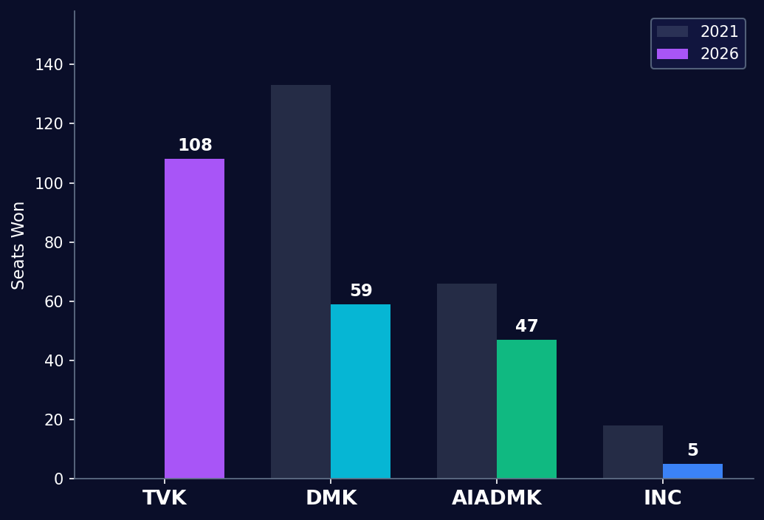
TAMIL NADU ELECTION 2026 | ATLIQ MEDIA DECISION DESK
SLIDE 6/10
ASSEMBLY SEAT DISTRIBUTION
Shattering the Dravidian Duopoly | 234 Total Seats
TVK
108 Seats
Debutant tops table. Largest single formation. 2021: 0 seats.
DMK
59 Seats
Collapsed from 133 (2021). Lost 74 seats in one election.
AIADMK
47 Seats
Slipped to third. Down from 66 seats in 2021.
INC
5 Seats
Severe decline from 18 seats. National partner marginalised.
TRI-POLAR ERA BEGINS | NO SINGLE MAJORITY | TVK LARGEST SINGLE FORMATION

Slide 7
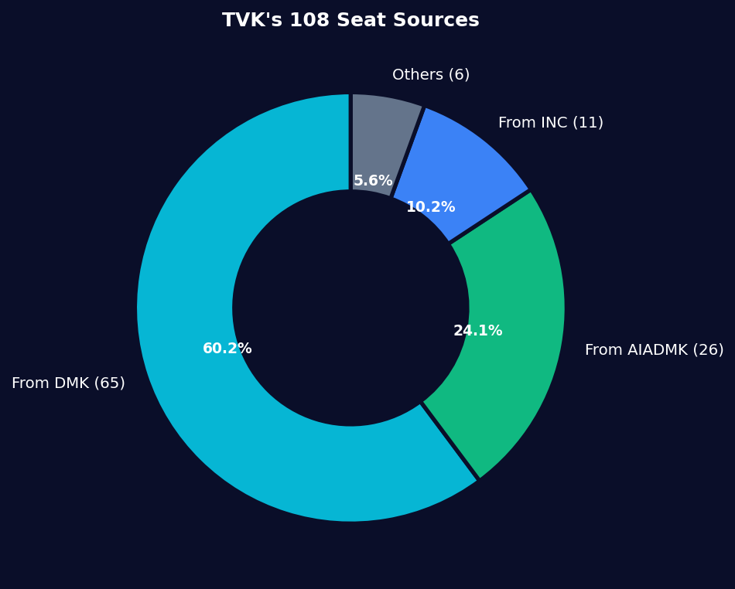
TAMIL NADU ELECTION 2026 | ATLIQ MEDIA DECISION DESK
SLIDE 7/10
VOLATILITY INDEX & VOTER FLOW
Where did TVK's 108 seats come from? | Statewide churn analysis
69.7%
STATEWIDE VOLATILITY INDEX
163 of 234 constituencies changed hands
65
Seats gained from DMK
26
Seats gained from AIADMK
11
Seats gained from INC
6
Seats from all others
DMK donated 60.2% of TVK's total seat count
Biggest single mandate transfer in Tamil Nadu history
163 FLIPS | 69.7% VOLATILITY | HIGHEST EVER SEAT CHURN IN TAMIL NADU

Slide 8
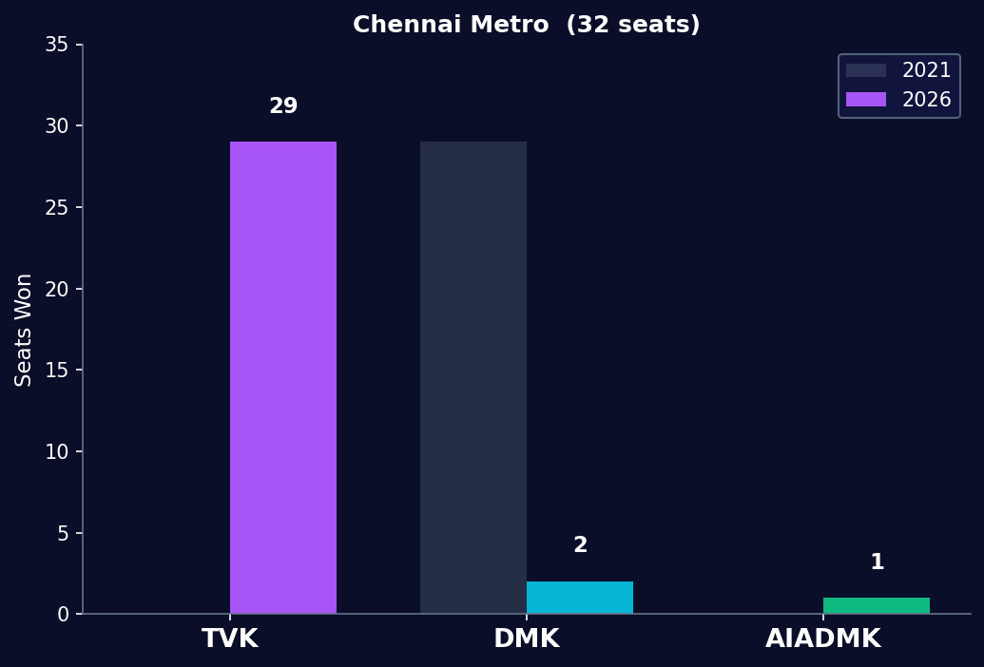
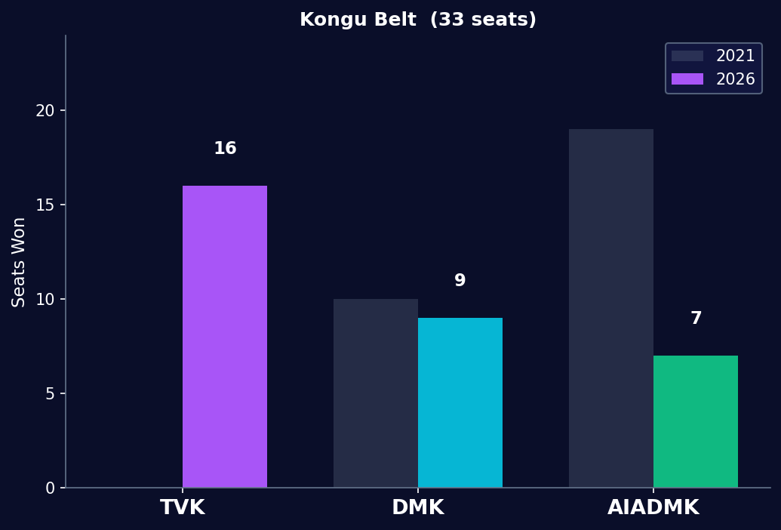
TAMIL NADU ELECTION 2026 | ATLIQ MEDIA DECISION DESK
SLIDE 8/10
REGIONAL STRONGHOLD REVERSALS
Chennai Metro Swept | Kongu Bastion Collapsed
TVK swept 29/32 Chennai seats | DMK 2021 stronghold zeroed out
AIADMK Kongu bastion: 19 → 7 | TVK wins 16 of 33
URBAN CORE SWEPT + RURAL STRONGHOLD CRACKED = TVK'S WINNING FORMULA

Slide 9
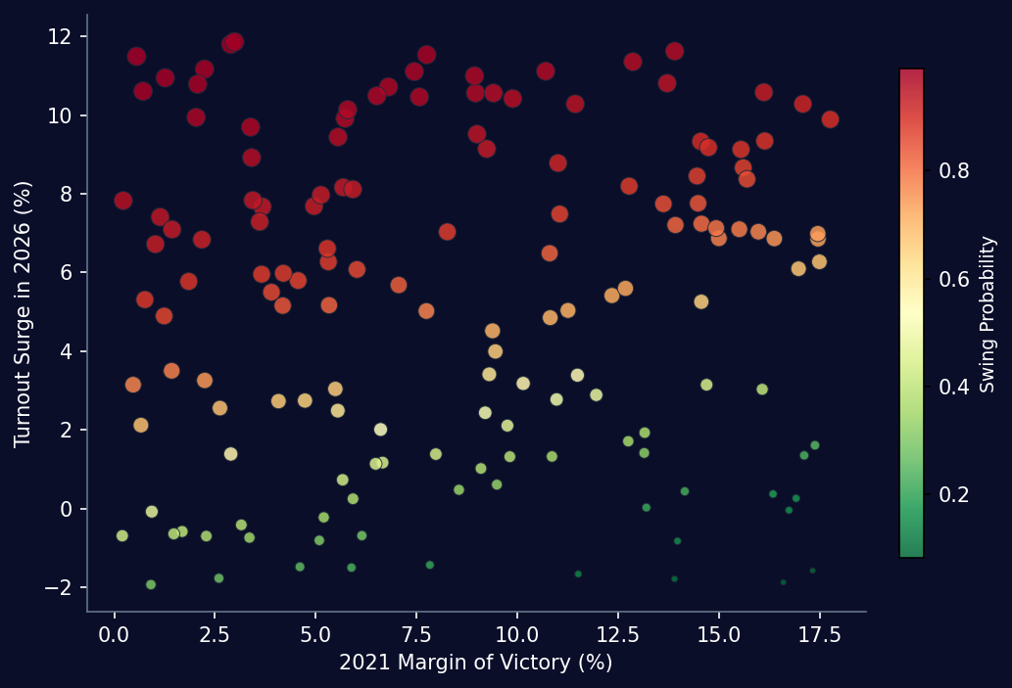
TAMIL NADU ELECTION 2026 | ATLIQ MEDIA DECISION DESK
SLIDE 9/10
SWING SEAT PREDICTOR
Micro-Level Predictive Analytics | AtliQ Media Decision Model
70.94%
MODEL CLASSIFICATION ACCURACY
Supervised classifier on ECI data
KEY MODEL FINDINGS
o Turnout surge: strongest predictor of a flip
o High 2021 margins resisted seat change
o Low margin + high surge = near-certain flip
o Model called TVK plurality before 6 PM
o Signals visible from 60% vote count stage
TURNOUT SURGE IS THE SINGLE STRONGEST PREDICTOR OF SEAT FLIPS

Slide 10
TAMIL NADU ELECTION 2026 | ATLIQ MEDIA DECISION DESK
SLIDE 10/10
FINAL VERDICT | THE BOTTOM LINE
1-Hour Broadcast Show Flow | AtliQ Media Production Plan
1-HOUR BROADCAST SHOW FLOW
FINAL VERDICT
Act 1
Record Turnout ≠ Record Wave
More people came out to vote, but the
net increase is only 20 Lakh actual votes.
Voter list reduction (SIR) artificially
inflated the turnout percentage.
Contest remained highly close & competitive
with no sweeping statewide tsunami wave.
The Shock (0-15 min)
Statewide shifts, TVK incursion, ECI base stats and the 20 Lakh reveal
Act 2
The Strongholds (15-35 min)
Regional spotlights, Chennai Metro sweep and Kongu bastion collapse
Act 3
The Churn (35-50 min)
Volatility index, direct seat flips, AtliQ predictor model live reveal
EVERY VOTE COUNTS
Act 4
DEMOCRACY WINS
Integrity (50-60 min)
DATA TELLS THE TRUTH
Turnout arithmetic, methodology disclosure, panel grounded in data
ATLIQ MEDIA | FACT-BASED ELECTION COVERAGE | POWERED BY ECI DATA

