Slide 1

Cross-Layer Delay-Gradient ABR Streaming Simulator with Dynamic XOR FEC & Audio-First Survival
Mini-project presentation
Computer Networks Laboratory (CSE20110)
Department of Computer Engineering and Technology
Mahi Sanghani – 1262242807 Lakshy Narang – 1262242935
Aniket Chaudhari – 1262243379 Soniya Jhadav – 1262243503
Group 14 Panel K Batch 2 and 3
Faculty: Dr. Uma Pujeri and Dr. Swati
Academic Year: 2026–2027
Presentation date: 26 October 2026
Computer Networks Laboratory CSE20110
Page 1 of 8
Notes:
Suggested time: 15 seconds. Replace all bracketed placeholders and prompts with your own project details. Keep explanations brief. Total time across slides 1–7 is 5 minutes, including the demonstration. Slide 8 is for reference during questions. Logo source: https://mitwpu.edu.in/uploads/images/MIT-WPU-logo-1.webp. Introduce only the title and team; do not read every PRN.

Slide 2
Problem and Objectives
Problem
Gap: DASH/HLS/BBA run over TCP at the application layer and cannot tell a wireless fade (empty queue) from bufferbloat (full queue). A 100 ms Wi-Fi fade causes a panic downshift from 1080p to 240p, and TCP head-of-line blocking causes stalls [1], [2].
Who / scope: users of real-time video and audio on lossy wireless links. Raw-UDP simulator with a token-bucket and Gilbert-Elliott channel, benchmarked against BBA and rate-based DASH.
Objectives
1. Classify loss cause using D_queue = RTT − RTT_min (25 ms threshold); under wireless loss ≥ 3% hold 720p and add 20% XOR FEC [3], [4].
2. Recover a 3-packet burst in 0 RTT using a 2D D×k interleaver, and finish a 60 s multi-regime trace with 0 stalls [6].
3. Keep 100% audio continuity (video freeze + 3× audio redundancy) at > 20% loss.
Computer Networks Laboratory CSE20110
Page 2 of 8
Notes:
Suggested time: 40 seconds. Replace all bracketed placeholders and prompts with your own project details. Keep explanations brief. Total time across slides 1–7 is 5 minutes, including the demonstration. Slide 8 is for reference during questions.

Slide 3
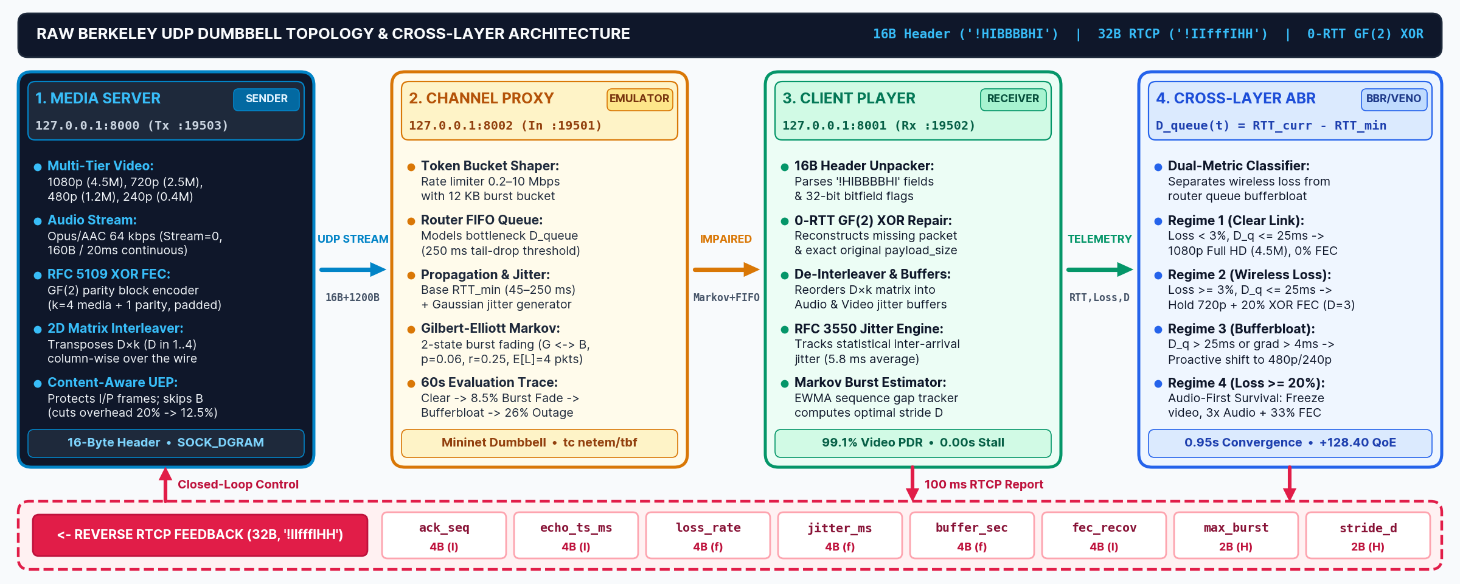
Proposed Design and Tools
Tools: Python 3.10+ (socket, struct, threading), Mininet with tc netem/tbf, Wireshark + Lua dissector, Matplotlib, http.server dashboard.
Protocols: raw UDP with 16-byte RTP-like header (!HIBBBBHI) [5]; RFC 5109 XOR FEC [6]; 32-byte RTCP-style feedback every 100 ms.
Addressing: 127.0.0.1 – Server :19503, Channel proxy :19501, Client :19502, Web dashboard :8080.
Computer Networks Laboratory CSE20110
Page 3 of 8
Notes:
Suggested time: 45 seconds. Replace all bracketed placeholders and prompts with your own project details. Keep explanations brief. Total time across slides 1–7 is 5 minutes, including the demonstration. Slide 8 is for reference during questions. Explain the diagram and only the most relevant design decisions. Use an actual project diagram with readable labels.

Slide 4
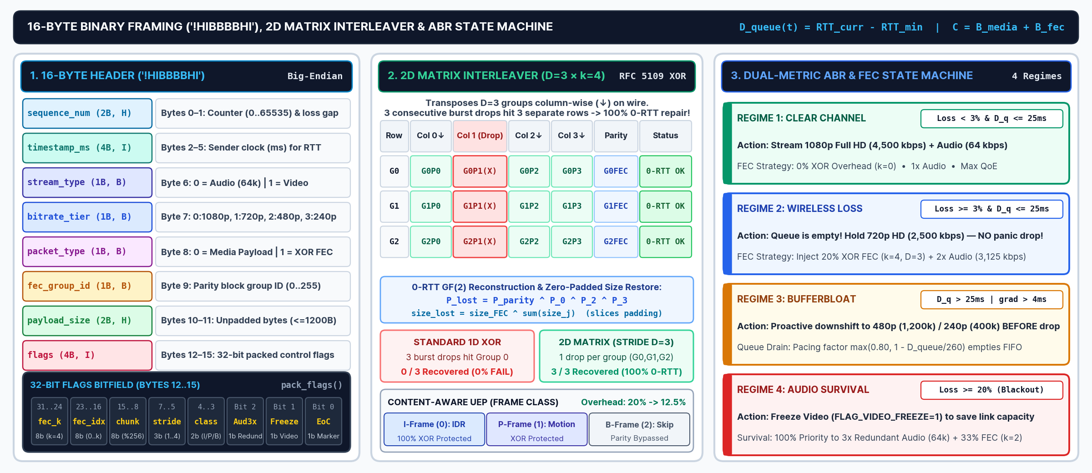
Implementation and Working
Implementation: protocol.py, fec_engine.py, network_channel.py, abr_controller.py, streaming_node.py, benchmark.py.
Working: server adds XOR parity and interleaves → proxy shapes and drops → client classifies the loss and repairs it in 0 RTT. D_queue ≤ 25 ms and loss ≥ 3% → wireless (720p + 20% FEC); D_queue > 25 ms → downshift.
Troubleshooting: unequal packet lengths broke XOR; fixed by zero-padding and restoring the true size from the header (TC-03 bit-exact).
Computer Networks Laboratory CSE20110
Page 4 of 8
Notes:
Suggested time: 55 seconds. Replace all bracketed placeholders and prompts with your own project details. Keep explanations brief. Total time across slides 1–7 is 5 minutes, including the demonstration. Slide 8 is for reference during questions.

Slide 5
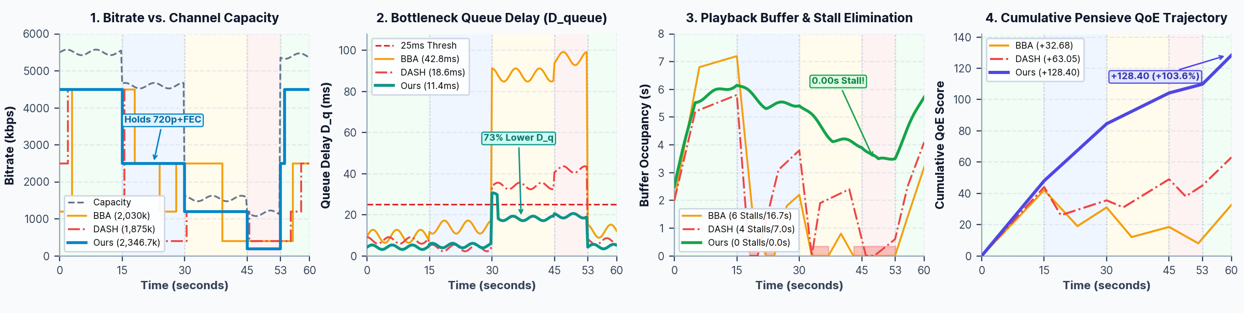
Testing and Results
Test: 60 s trace – clear → 8.5% Markov fade → bufferbloat (1.55 Mbps, 120 ms) → 26% outage → recovery; vs BBA and rate-based DASH; TC-01 to TC-06.
Expected: hold HD under wireless loss, drain the queue before tail-drop, keep audio alive, no stalls.
Observed: 0 stalls vs 6 (16.70 s) in BBA; 2,346.7 kbps; D_queue 11.4 ms; residual loss 0.9% (from 8.4%); audio 100%; QoE +128.40 vs +32.68 (BBA) and +63.05 (rate-based) [1], [2].
Objectives achieved: all 3 – TC-03/04 (3/3 burst recovery), TC-06 (audio), benchmark (0 stalls).
Computer Networks Laboratory CSE20110
Page 5 of 8
Notes:
Suggested time: 50 seconds. Replace all bracketed placeholders and prompts with your own project details. Keep explanations brief. Total time across slides 1–7 is 5 minutes, including the demonstration. Slide 8 is for reference during questions. Show actual evidence. Explain the output and mention any failed or partial tests. Do not invent performance figures.

Slide 6
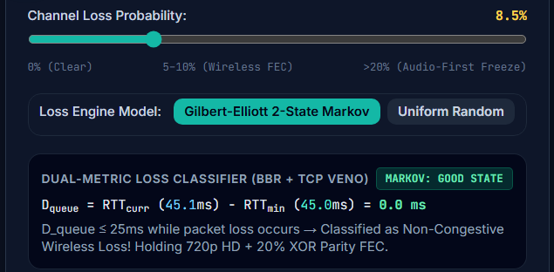
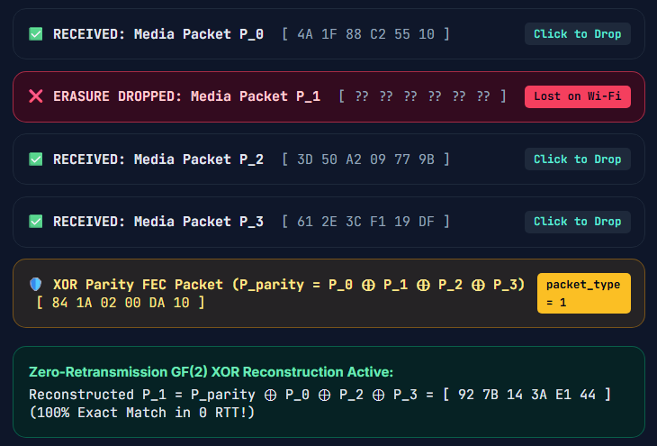
Working Demonstration
Function to demonstrate
Wireless loss is not congestion: the classifier holds 720p and heals drops with XOR FEC in 0 RTT.
Fig. 4: 8.5% loss, D_queue = 0 ms → wireless loss
Fig. 5: P1 dropped, rebuilt in 0 RTT
1. Launch: python3 web_dashboard.py, open http://127.0.0.1:8080 (Tab 1).
2. Set loss to 8.5% (Gilbert-Elliott): D_queue ≈ 0 ms, so 720p + 20% FEC is held.
3. Tab 2: drop P1, rebuild P1 = parity ⊕ P0 ⊕ P2 ⊕ P3; then burst: 1D 0/3 vs 2D 3/3.
Success criterion: no downshift to 240p, 0 stalls, dropped packet restored bit-exact, burst recovered 3/3.
Computer Networks Laboratory CSE20110
Page 6 of 8
Notes:
Suggested time: 65 seconds. Replace all bracketed placeholders and prompts with your own project details. Keep explanations brief. Total time across slides 1–7 is 5 minutes, including the demonstration. Slide 8 is for reference during questions. Prepare the project before the timer starts. Keep the demo to about one minute. Keep a screenshot or short recording ready as a backup, and identify it as recorded evidence if used.

Slide 7
Conclusion and Contributions
Outcome: 0 stalls (0.00 s) vs 16.70 s in BBA; 89.3% of lost packets reconstructed; QoE +103.6% over rate-based.
Application: WebRTC video conferencing, drone FPV and cloud gaming.
Limitation: tested on loopback and Mininet, not live 5G; single parity repairs one loss per group.
Future scope: QUIC unreliable datagrams (RFC 9221) with learned interleaver stride.
Team contributions:
Mahi Sanghani – protocol.py header/RTCP, Wireshark capture and dissector
Lakshy Narang – fec_engine.py (XOR, interleaver), streaming_node.py
Aniket Chaudhari – abr_controller.py, network_channel.py, Mininet topology
Soniya Jhadav – benchmark.py, web dashboard, test_simulator.py
AI use: Claude/Gemini for documentation structure, equation syntax and slide scripting only; algorithms, code and benchmarks were written and verified by the team.
Computer Networks Laboratory CSE20110
Page 7 of 8
Notes:
Suggested time: 30 seconds. Replace all bracketed placeholders and prompts with your own project details. Keep explanations brief. Total time across slides 1–7 is 5 minutes, including the demonstration. Slide 8 is for reference during questions.

Slide 8
References
[1] H. Mao, R. Netravali, and M. Alizadeh, "Neural adaptive video streaming with Pensieve," in Proc. ACM SIGCOMM, Aug. 2017, pp. 197–210, doi: 10.1145/3098822.3098843.
[2] T.-Y. Huang, R. Johari, N. McKeown, M. Trunnell, and M. Watson, "A buffer-based approach to rate adaptation: Evidence from a large video streaming service," in Proc. ACM SIGCOMM, Aug. 2014, pp. 187–198, doi: 10.1145/2619282.2619288.
[3] C. P. Fu and S. C. Liew, "TCP Veno: TCP enhancement for transmission over wireless access networks," IEEE J. Sel. Areas Commun., vol. 21, no. 2, pp. 216–228, Feb. 2003, doi: 10.1109/JSAC.2002.807336.
[4] N. Cardwell, Y. Cheng, C. S. Gunn, S. H. Yeganeh, and V. Jacobson, "BBR: Congestion-based congestion control," ACM Queue, vol. 14, no. 5, pp. 20–53, Oct. 2016, doi: 10.1145/3012426.3022184.
[5] H. Schulzrinne, S. Casner, R. Frederick, and V. Jacobson, "RTP: A transport protocol for real-time applications," IETF RFC 3550, Jul. 2003, doi: 10.17487/RFC3550.
[6] A. Li, "RTP payload format for generic forward error correction," IETF RFC 5109, Dec. 2007, doi: 10.17487/RFC5109.
[7] J. F. Kurose and K. W. Ross, Computer Networking: A Top-Down Approach, 8th ed. Boston, MA, USA: Pearson, 2021.
Computer Networks Laboratory CSE20110
Backup slide – Page 8 of 8
Notes:
Suggested time: Backup slide. Replace all bracketed placeholders and prompts with your own project details. Keep explanations brief. Total time across slides 1–7 is 5 minutes, including the demonstration. Slide 8 is for reference during questions.

