Slide 1
Georgia Restaurants
An Analysis

Slide 2
Introduction
While traveling in the southern states of the US in general, and in the state of Georgia in specific, it is usually not easy to find the right kind of restaurants to one’s need and taste.
This capstone project will focus on the state of Georgia in USA, analyzing the various categories of restaurants and food options available for travelers and localities in different towns and cities.

Slide 3
Problem Statements
What categories of restaurants are popular in different parts of the state?
Are vegan/vegetarian options available in the state? Where are they located?
Where can one find a cafe or quick bite?
Are there specialty southern restaurants in the state? Where are they located?
Which towns do not have dine-in restaurants? (potentially not traveler friendly to stop for dine-ins)

Slide 4
Data Sources
List of all towns and cities in Georgia, USA Source: https://en.wikipedia.org/wiki/List_of_municipalities_in_Georgia_(U.S._state)
Geolocation (latitude and longitude) of each town and city - Using Geocoder Nominatim OSM API Package: geocoder Nominatim
Restaurants and food venues - From Foursquare crowdsource data, using ‘Venues’ endpoint Endpoint: Foursquare venue explore endpoint https://api.foursquare.com/v2/venues/explore

Slide 5
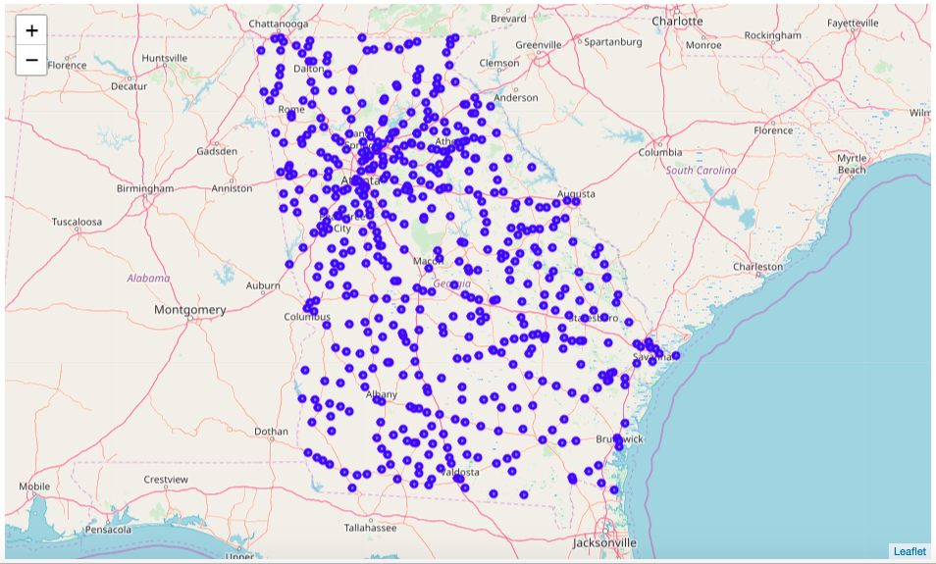
Data Analysis
visualize all the towns/cities in the state of Georgia

Slide 6
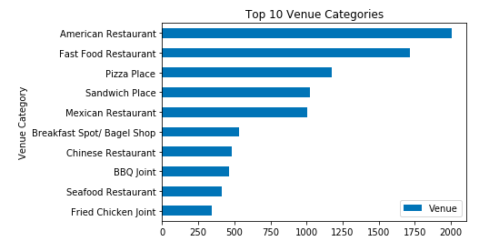
Top 10 Categories

Slide 7
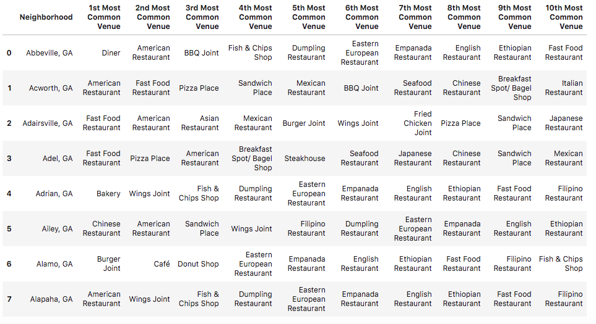
Feature set Selection

Slide 8
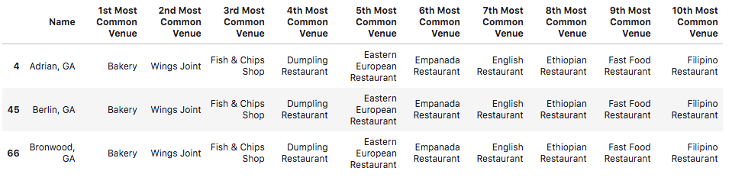
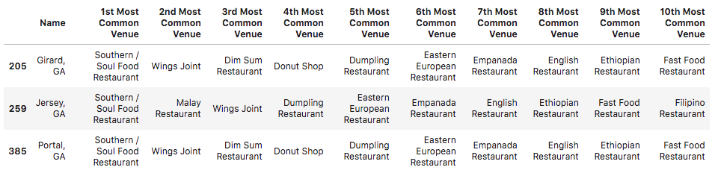
Methodology
K-means clustering for unsupervised dataset
Total clusters = 10
Cluster 6
Cluster 10

Slide 9
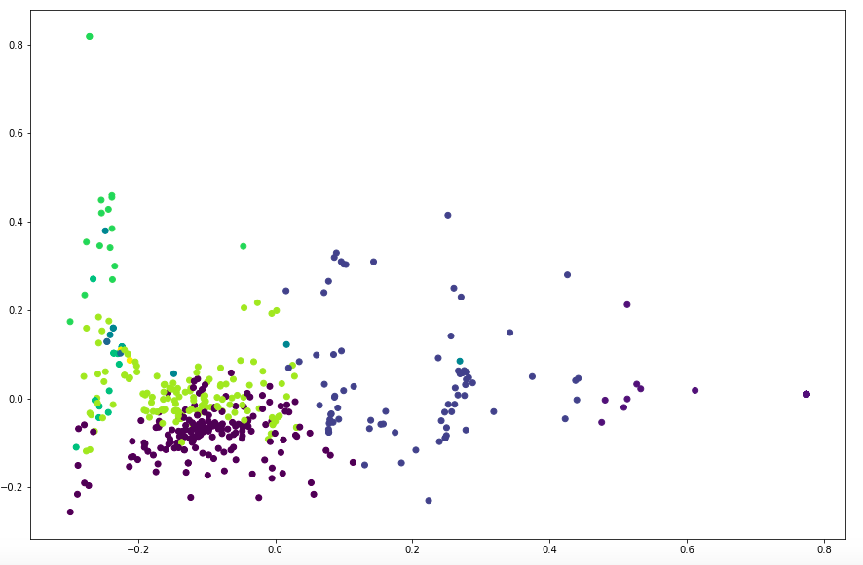
Result Analysis
2D scatter plot of the 10 clusters

Slide 10
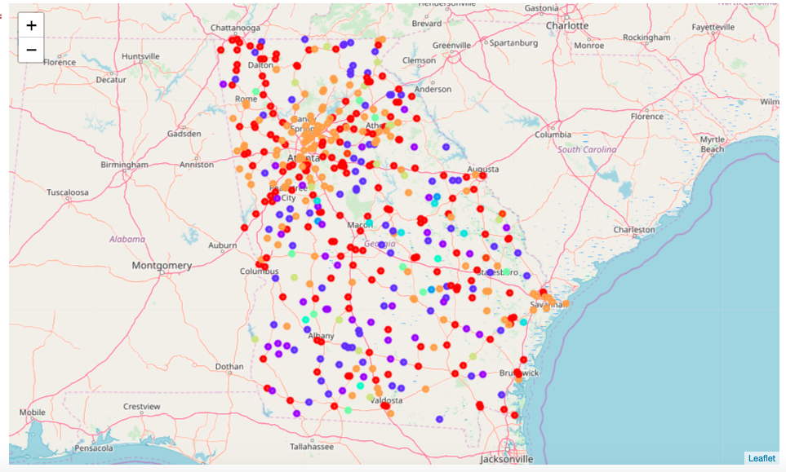
Visualize clusters

Slide 11
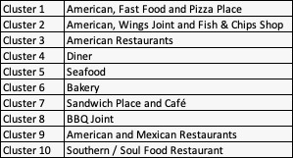
Problem statement 1
The most popular restaurant categories include American, fast food and Pizza place. They are distributed in clusters 1,2,3, and 9.

Slide 12
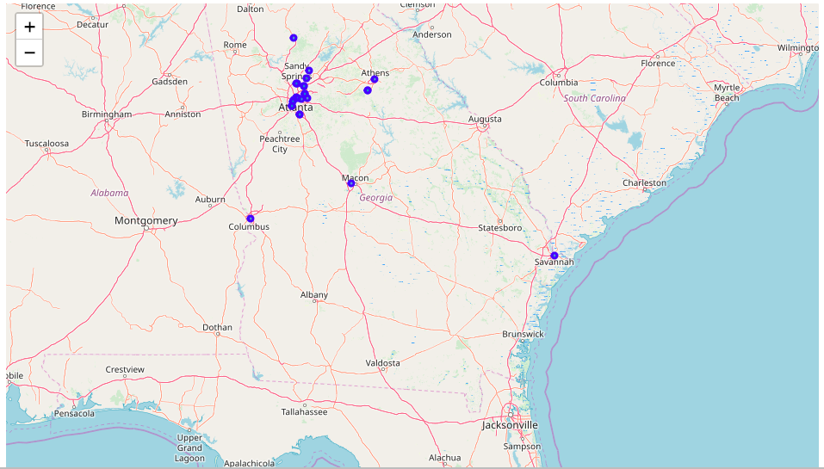
Problem statement 2
Total of only 31 vegetarian/vegan restaurants out of 13118 venues, Georgia is not a vegan friendly state
Options are centered around a few cities including Atlanta, Macon, Athens, Savanah, and Columbus.

Slide 13

Problem statement 3
Cafe and Sandwich/Quick bite belongs to cluster 7 and are distributed thinly around the entire state

Slide 14
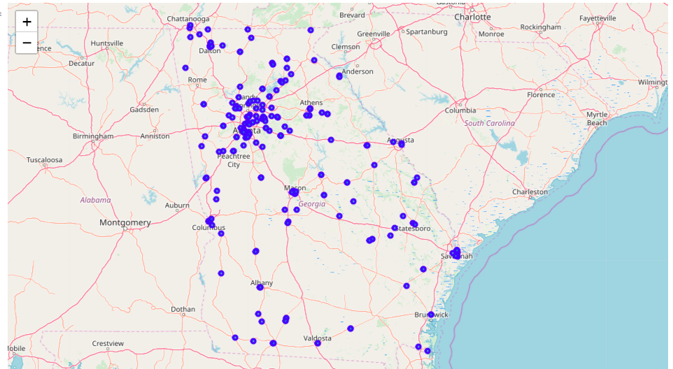
Problem statement 4
231 restaurants classified as Southern, Georgia is a typical southern state with many American and southern restaurants well distributed across the entire state.

Slide 15
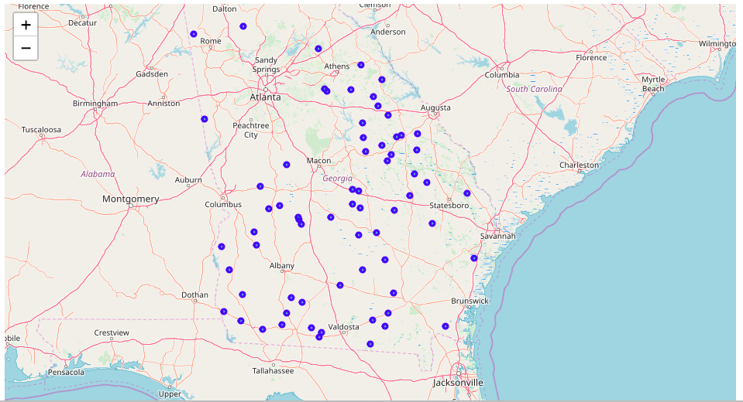
Problem statement 5
68 towns/cities where no restaurants checked-in Perhaps, these are cities to avoid for dine-in plans.

