Slide 1

Project Title - Seasonal Agriculture Performance Analysis
Lakshya Tomar
Meerut Institute of Engineering and Technology
AICTE STU ID : STU6799c50c509cd1738130700

Slide 2

PROBLEM STATEMENT
Agricultural activities are influenced by seasonal variations in environmental conditions, farming practices, resource availability and market conditions.
As a result, agricultural performance may differ from one season to another.
However, raw agricultural data does not clearly explain how agricultural performance changes across seasons or what patterns can be observed in different seasonal conditions.
The problem is to analyze the given agricultural dataset and investigate seasonal differences in agricultural performance by identifying meaningful patterns, trends, relationships and variations within the available data.

Slide 3
Project Description
->The project uses a farm-level dataset of 4,000 records across 28 different attributes- covering crops, locations, environmental factors(rainfall, temperature, humidity), farming practices and resource usage – to uncover seasonalpatterns and relationship through statistical and visual analysis in python.
->A Data analytics project studying how agriculture performance (yield, profit, water, efficiency) varies across seasons.

Slide 4

WHO ARE THE END USERS?
->Farmers and agriculture planners – to decide crop and season selection based on data-backed insights.
->Agriculture policy makers/government bodies- for resources allocation and seasonal planning.
->Agri-tech companies and researchers- for further predictive modelling.

Slide 5

Technology Used
  Language: python.
  Libraries: Pandas, NumPy.
  Visualization: Matplotlib, Seaborn.
  Environment: google collab.
  Techniques: Missing value treatment(median), outlier detection(IQR method).

Slide 6
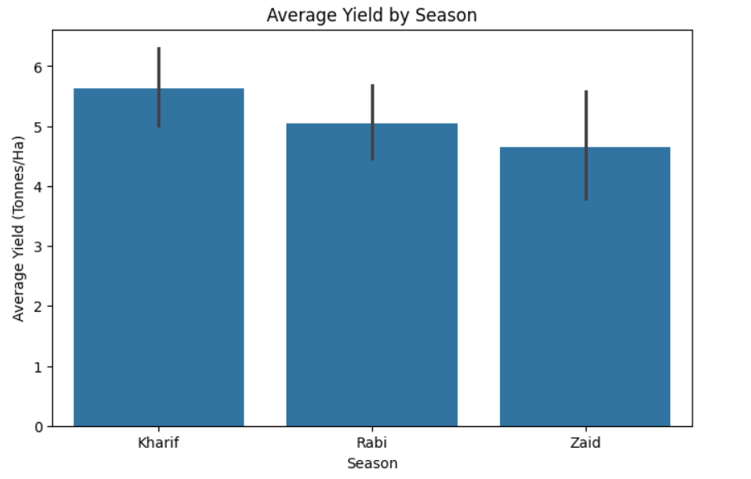
RESULTS
How much Yield produce in avg Season.

Slide 7
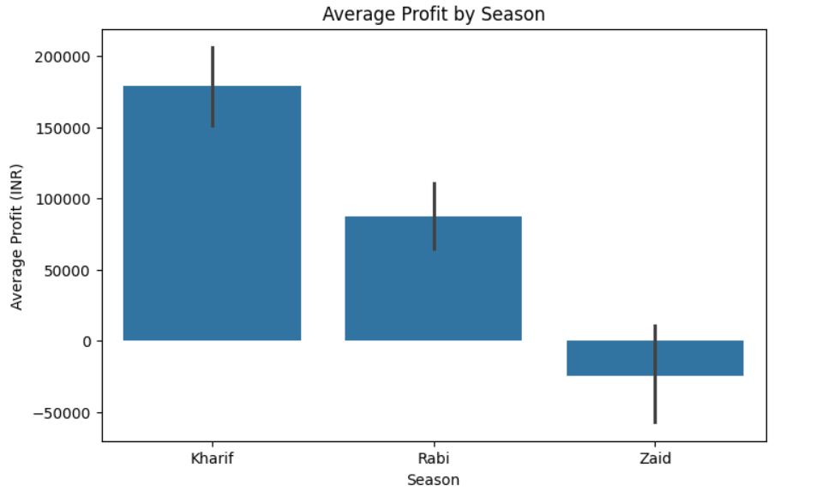
RESULTS
Profit generate by Season

Slide 8
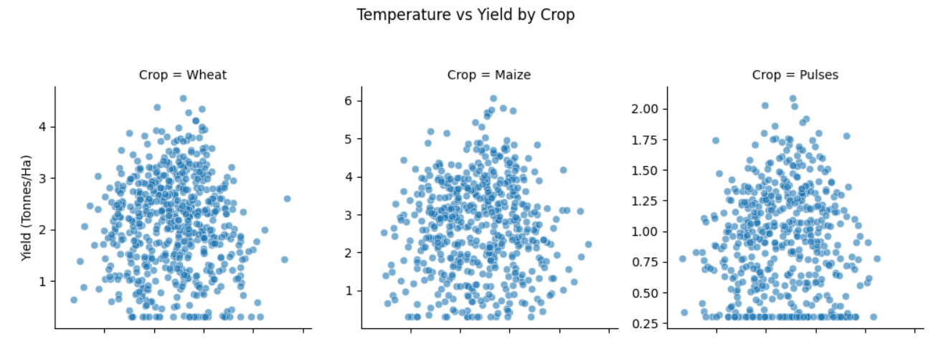
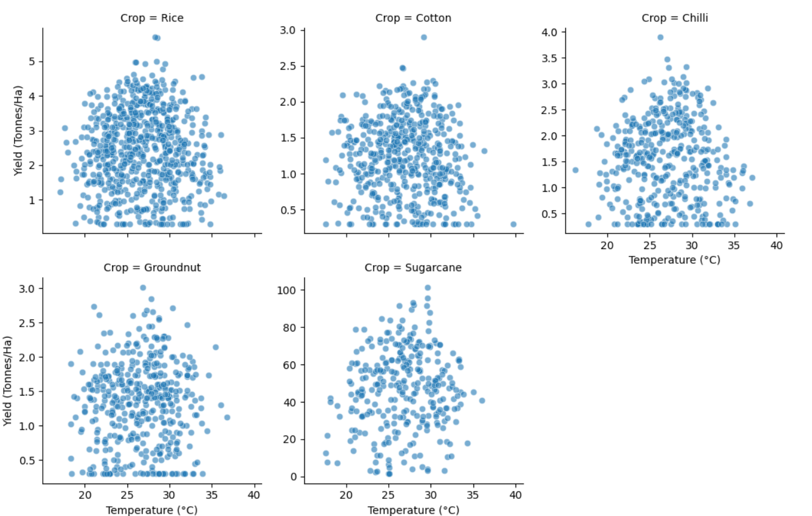
RESULTS
Temp vs Yield

Slide 9
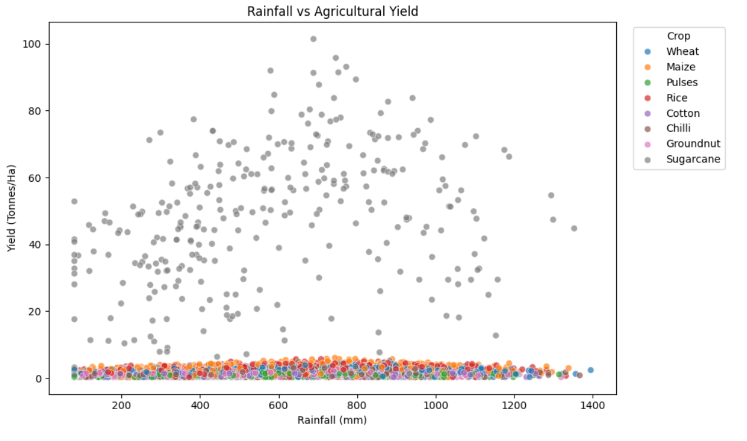
RESULTS
Rainfall vs Agriculture Yield

Slide 10
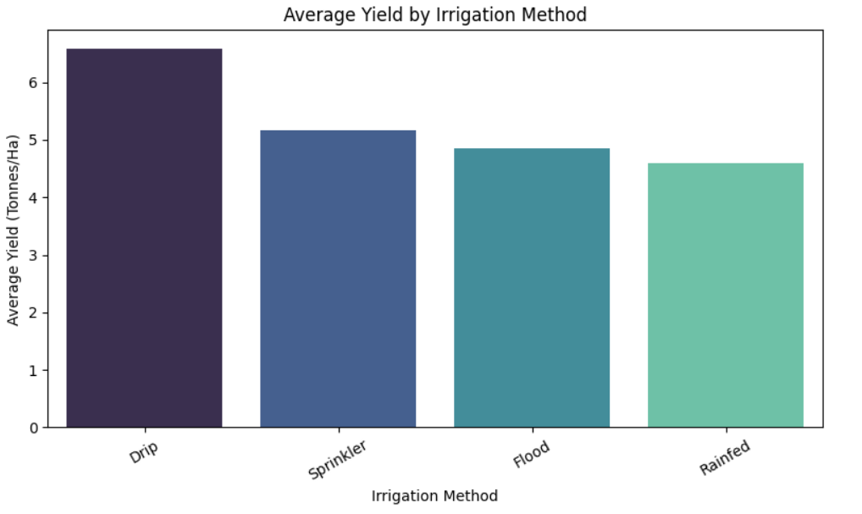
RESULTS
Irrigation Method

Slide 11
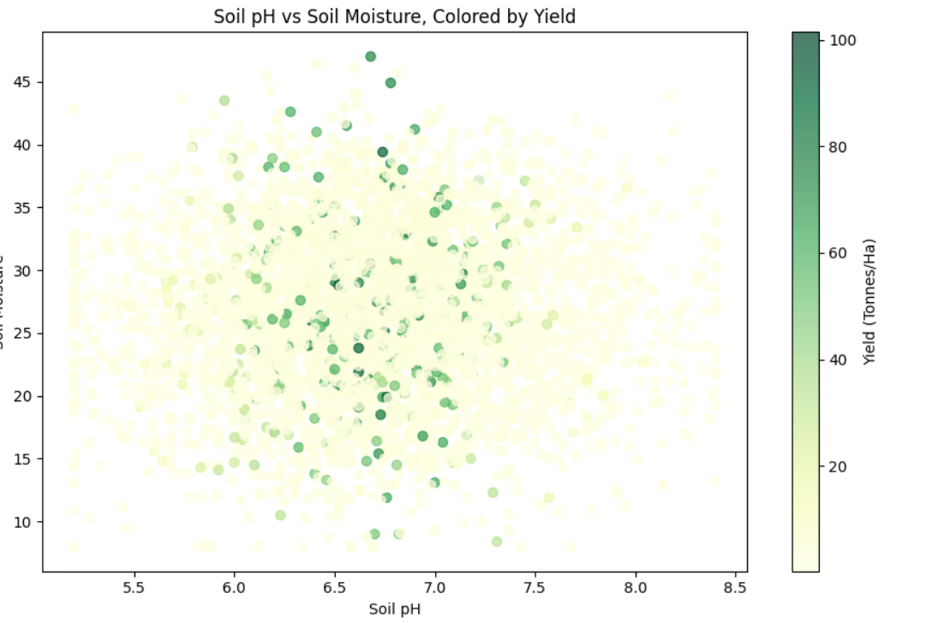
RESULTS
Soil pH vs Soil Moisture

Slide 12
Future scope
Build predictive ML models to forecast yield and profit.
Add soil type, fertilizer type, and market price data for deeper analysis.
Extend dataset across multiple years for long-term trend forecasting.
Create an interactive dashboard (Power BI/Streamlit) for farmers to use directly.
Integrate live weather API data for real-time seasonal recommendations.

Slide 13
GitHub Link
https://github.com/laksya-tomar/Seasonal_Agriculture_Performance_Analysis.git

Slide 14
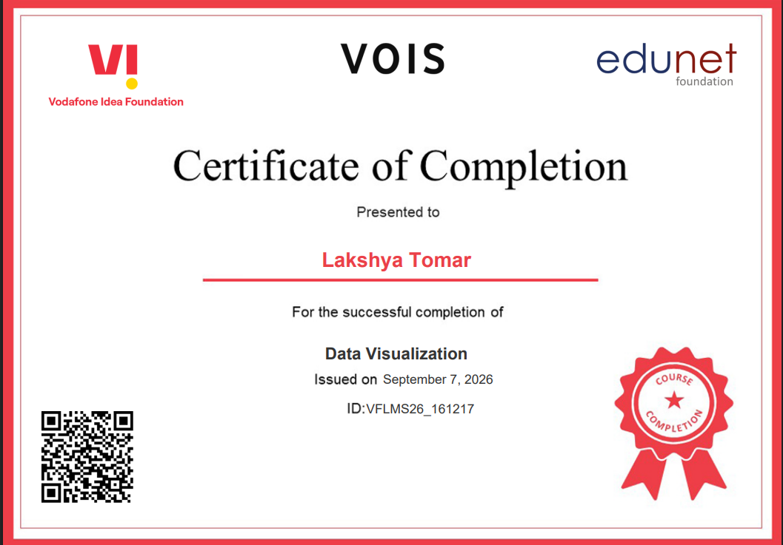
VOIS Course completion certificate -
Course name- Data Visualization

Slide 15
Thank you
.
.

