Slide 1
The Battle of Neighborhoods
Presented by Lakshmikanth S

Slide 2
Introduction to Business Problem
Lakshmikanth, a friend of mine is interested in starting a VR Park in USA. We defined best locality on the basis of
Population density
Per capita
Population in each location
Venues in each locality

Slide 3
Data
List of all the cities in United States with population density and coordinates: https://en.wikipedia.org/wiki/List_of_United_States_cities_by_population
List of all the cities in United States with Per Capita Income : https://en.wikipedia.org/wiki/List_of_United_States_counties_by_per_capita_income
Four Square API : https://foursquare.com

Slide 4
Methodology
In order to do the analysis and suggest the best location, following are the steps we have to follow :
-The Wikipedia page (https://en.wikipedia.org/wiki/List_of_United_States_cities_by_population) was scraped using the BeautifulSoup library to build a pandas dataframe listing the cities, states, coordinates, area and population density. The dataframe was cleaned and processed appropriately.
-The Wikipedia page (https://en.wikipedia.org/wiki/List_of_United_States_counties_by_per_capita_income) was scraped using the BeautifulSoup library to build a pandas dataframe listing the cities, states and percapita income. The dataframe was cleaned and processed appropriately.
-The Foursquare API is then used to get the venues in each city of United States

Slide 5
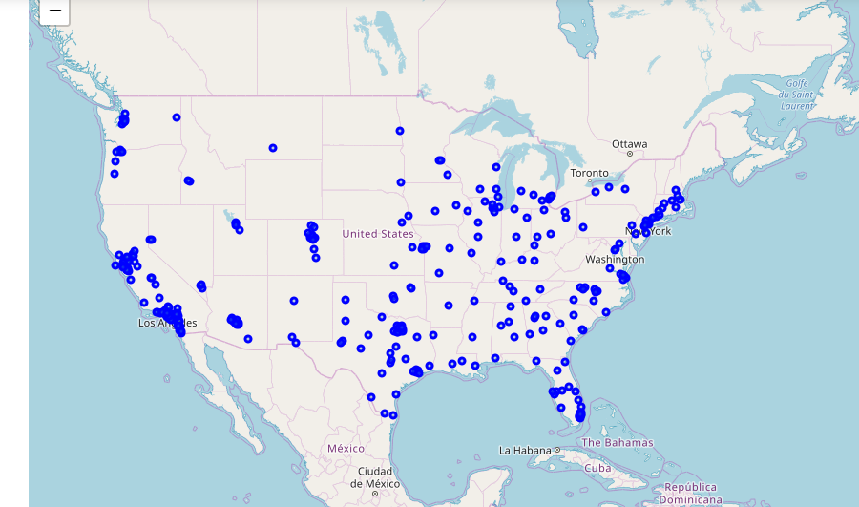
Plot of all cities in USA

Slide 6
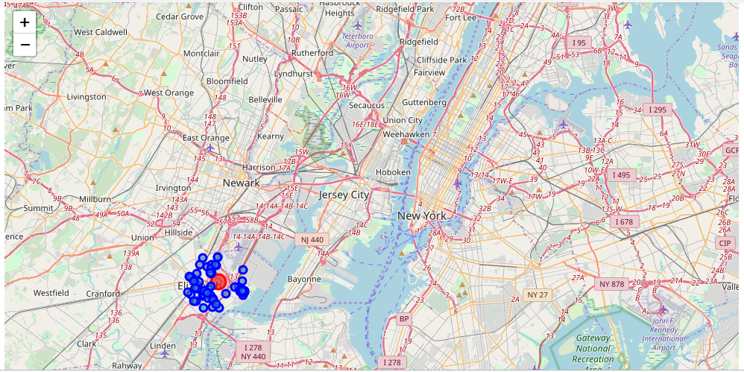
Map of venues in Elizabeth
Based on constraints we have chosen, we found that Elizabeth would be better place to start

Slide 7
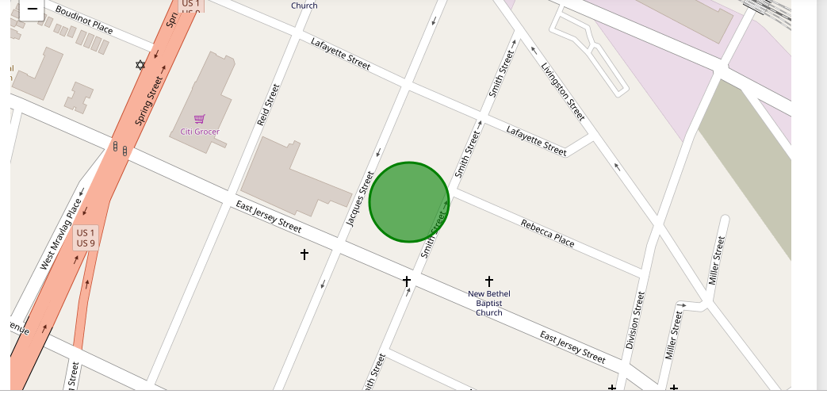
Result
The green circle shows the best place to start the VR park. Its between the East Jersey Street and Lafayette street

Slide 8
Thank You

