Slide 1
school_shootings
Lakuntara pallahidu (3311811015)
Dwi cahya purnama aji (3311811042)
Edward akbar _3311811043)

Slide 2

#####################################################
# Analysis of school shootings from 1990 to present #
#####################################################
#load packages
library(ggplot2)
library(scales)
library(maps)
library(tm)
library(plyr)

Slide 3
#import data
df2 <- read.csv("E:/data/school_shootings.csv", header=FALSE, stringsAsFactors=FALSE)

Slide 4
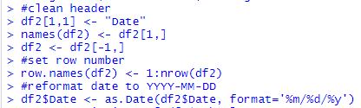
#clean header
df2[1,1] <- "Date"
names(df2) <- df2[1,]
df2 <- df2[-1,]
#set row number
row.names(df2) <- 1:nrow(df2)
#reformat date to YYYY-MM-DD
df2$Date <- as.Date(df2$Date, format='%m/%d/%y')

Slide 5
# 1. Descriptives of df2$school
df2$School <- as.factor(df2$School)
levels(df2$School)
levels(df2$School)[match("-", levels(df2$School))] <- NA
levels(df2$School)[match("", levels(df2$School))] <- NA
df2$School <- factor(df2$School, levels = c("ES", "MS", "HS", "C"))
levels(df2$School)[levels(df2$School) == "ES"] <- "Elementary"
levels(df2$School)[levels(df2$School) == "MS"] <- "Middle"
levels(df2$School)[levels(df2$School) == "HS"] <- "High"
levels(df2$School)[levels(df2$School) == "C"] <- "College"
table(df2$School)
par(mar=c(5,5,5,3))
plot(df2$School, main = "Type of school where shooting occured", ylim=c(0,500), ylab="Incidences")

Slide 6
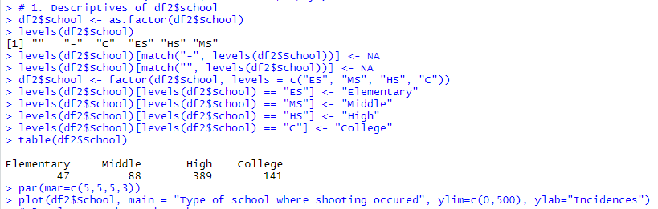

Slide 7
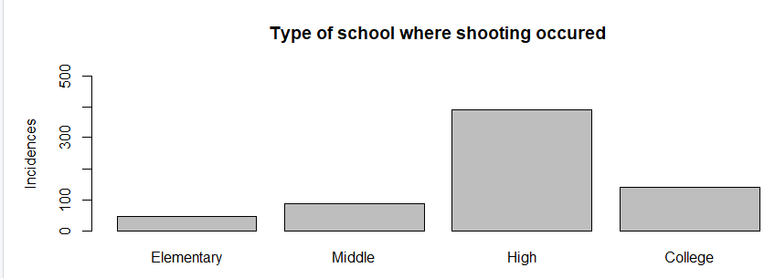

Slide 8
# 2. Plot Date by Number_shot
df2$Fatalities <- as.numeric(df2$Fatalities)
df2$Wounded <- as.numeric(df2$Wounded)
df2$Number_shot <- rowSums(df2[,c("Fatalities", "Wounded")], na.rm = TRUE)
p2 <- ggplot(data = df2, aes(Date, Number_shot)) + geom_line() +ylim(0,60)
p2 + theme(axis.text.x = element_text(angle = 90, hjust = 1)) +
scale_x_date(labels = date_format("%Y"), breaks='1 years') +
ggtitle("Time series: Number shot") +
theme(plot.title = element_text(hjust = 0.5)) + ylab("Number shot")
hist(df2$Number_shot,
main = "Histogram: Number of people shot",
xlab = "Number shot",
xlim = c(0,60),
ylim = c(0,350),
las = 1,
breaks = 80)
table(df2$Number_shot)

Slide 9
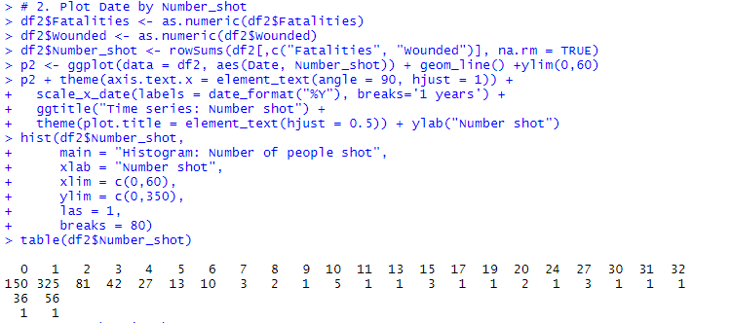

Slide 10
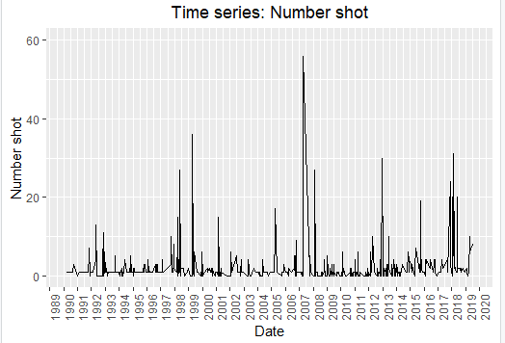

Slide 11
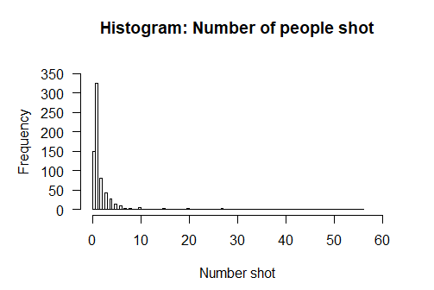

Slide 12
# 3. Map shooting by state
df3 <- ddply(df2, .(State), function(df2) c(Count=nrow(df2)))
df3$region <- tolower(df3$State)
states <- map_data("state")
map.df <- merge(states,df3, by="region", all.x=T)
map.df <- map.df[order(map.df$order),]
ggplot(map.df, aes(x=long,y=lat,group=group))+
geom_polygon(aes(fill=Count))+
geom_path()+
scale_fill_gradientn(colours=rev(heat.colors(10)),na.value="grey90")+
coord_map()+ggtitle("Shooting occurances by state")+theme(plot.title = element_text(hjust = 0.5))

Slide 13
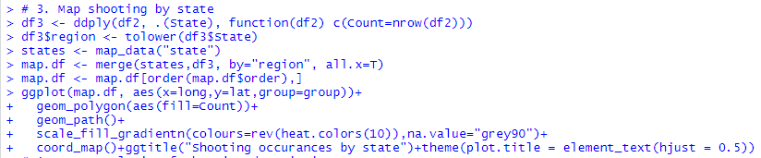

Slide 14
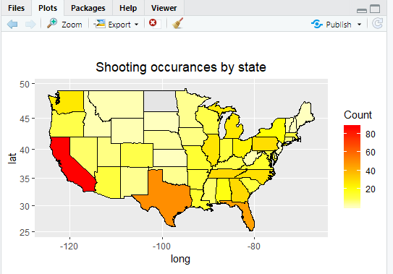

Slide 15
# 4. Text analysis of shooting description
text_desc <- paste(df2$Desc, collapse = " ")
corpus_desc <- Corpus(VectorSource(text_desc))
dtm_desc <- TermDocumentMatrix(corpus_desc)
m_desc <- as.matrix(dtm_desc)
v_desc <- sort(rowSums(m_desc),decreasing=TRUE)
d_desc <- data.frame(word = names(v_desc),freq=v_desc)
row.names(d_desc) <- 1:nrow(d_desc)
d_desc <- d_desc[-c(10,19,31), ]
head(d_desc, 15)
par(mar=c(5,5,5,5))
barplot(d_desc[1:15,]$freq, las = 2, names.arg = d_desc[1:15,]$word,
col ="gray", main ="Most common words in shooting description",
ylab = "Word frequencies", ylim=c(0,400))
df_desc_1 <- df2[grep("arrested",df2$Desc),] #examine events associated arrested

Slide 16
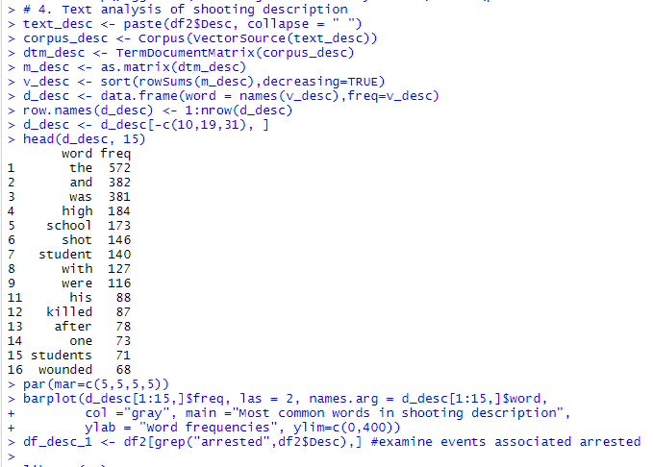

Slide 17
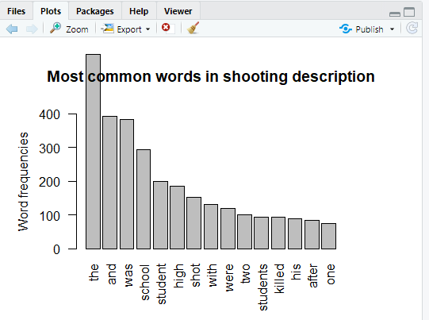

Slide 18
DATA SET
https://www.kaggle.com/ecodan/school-shootings-us-1990present
GITHUB
https://github.com/lakuntarapallahidu/DATA-MINING-TB
Minggu 9 Teori Klasifikasi
https://learning-if.polibatam.ac.id/mod/resource/view.php?id=4766

Slide 19
referensi
https://rpubs.com/yeonjoannechung/341416
Minggu 9 Teori Klasifikasi
https://learning-if.polibatam.ac.id/mod/resource/view.php?id=4766

