Slide 1
AI356 · High Performance Computing
Parallel Louvain
Community Detection
A high-performance implementation using C · MPI · OpenMP
Dhruv Jindal U23AI083
Lakshit Vedant U23AI015
Yash Joshi U23AI119
B.Tech AI · 3rd Year

Slide 2
Agenda
01
02
03
Problem Statement
Louvain Algorithm
Parallelization Strategy
Why community detection matters
How it works, modularity optimization
MPI + OpenMP hybrid approach
04
05
06
Implementation
Datasets & Results
Conclusion
C, CSR graph format, code structure
Facebook, Email, Twitter benchmarks
Takeaways and future scope

Slide 3
01 · Problem Statement
What is Community Detection?
4,039
265K
Real-world networks (social, biological, infrastructure) naturally cluster into communities.
Community detection identifies groups of densely connected nodes — revealing hidden structure.
Applications: fraud detection, recommendation systems, protein interaction analysis, network segmentation.
Challenge: algorithms must scale to millions of nodes in reasonable time.
Facebook nodes
Email network nodes
81K
4.7×
Twitter nodes
Speedup achieved

Slide 4
02 · The Louvain Algorithm
1
Initialize
Modularity Q
Each node begins in its own community. N communities for N nodes.
Q = Σ [ Aᵢⱼ − kᵢkⱼ/2m ] δ(cᵢ,cⱼ)
2
Local Optimization
For each node, compute modularity gain ΔQ from moving to a neighbor's community.
Aᵢⱼ Adjacency matrix weight
kᵢ, kⱼ Degree of nodes i and j
3
Best Move
Move node to the community with the maximum positive ΔQ gain.
2m Total edge weight (×2)
δ(cᵢ,cⱼ) 1 if same community, else 0
4
Repeat
Iterate over all nodes until no beneficial moves remain (convergence).

Slide 5
03 · Parallelization Strategy
MPI · Inter-process
OpenMP · Intra-process threading
Distributes the graph across multiple processes via domain decomposition
Each process handles a contiguous chunk of nodes
MPI_Allgatherv syncs community assignments across processes
MPI_Allreduce checks global convergence condition
Compiled with mpicc + -O3 optimization
#pragma omp parallel for — threads work local node chunk in parallel
Dynamic scheduling (chunk=64) balances uneven node degrees
#pragma omp atomic — safe updates to shared community weights
Reduction clauses for improvement flags and shift counts
Threads share CSR graph in-memory for cache efficiency

Slide 6
04 · Implementation
Project Structure
Graph Storage: CSR Format
src/main.c
num_nodes — total vertices
num_edges — total edges
row_ptr[] — CSR row offsets (size: N+1)
col_idx[] — edge targets + weights
node_weights[] — weighted degree per node
total_weight — sum of all edge weights
Entry point — serial & parallel dispatch
src/graph.c / .h
CSR graph loader (SNAP edge-list format)
src/louvain_serial.c
Baseline serial Louvain implementation
src/louvain_parallel.c
MPI + OpenMP parallel implementation
scripts/benchmark.py
Automated compile → run → plot pipeline
scripts/visualize.py
Community cluster & histogram visualizer
Cache-efficient traversal — ideal for large sparse graphs

Slide 7
05 · Datasets
Real-world social network graphs from Stanford SNAP
Dataset
Nodes
Edges
Description
Facebook
4,039
88,234
Social circles from Facebook ego networks
Email
265,214
420,045
EU research institution email communication network
Twitter
81,306
1,768,149
Twitter follower graph (largest — best speedup)
Pipeline:
fetch_data.py → normalize.py → ./louvain → visualize.py → benchmark_results.png
Source: Stanford SNAP · snap.stanford.edu/data

Slide 8
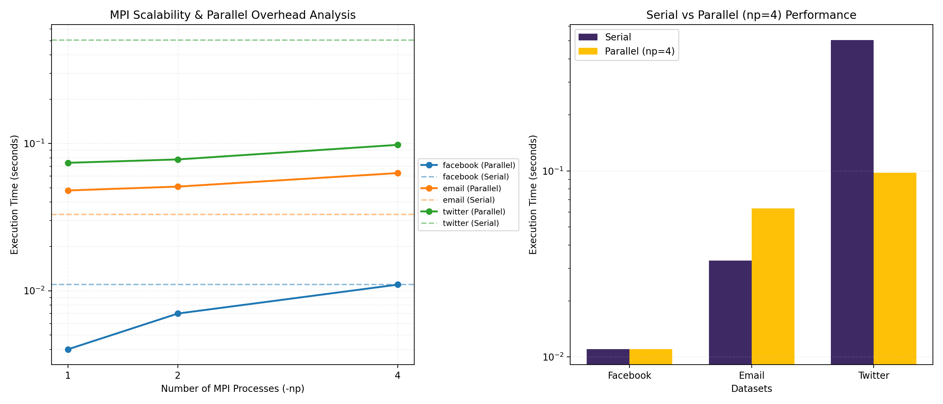
05 · Benchmark Results
Facebook ~1.2×
Twitter ~4.7×
Email ~0.6×
Small graph — MPI overhead limits gain
Large graph — computation dominates
Irregular structure — overhead penalty

Slide 9
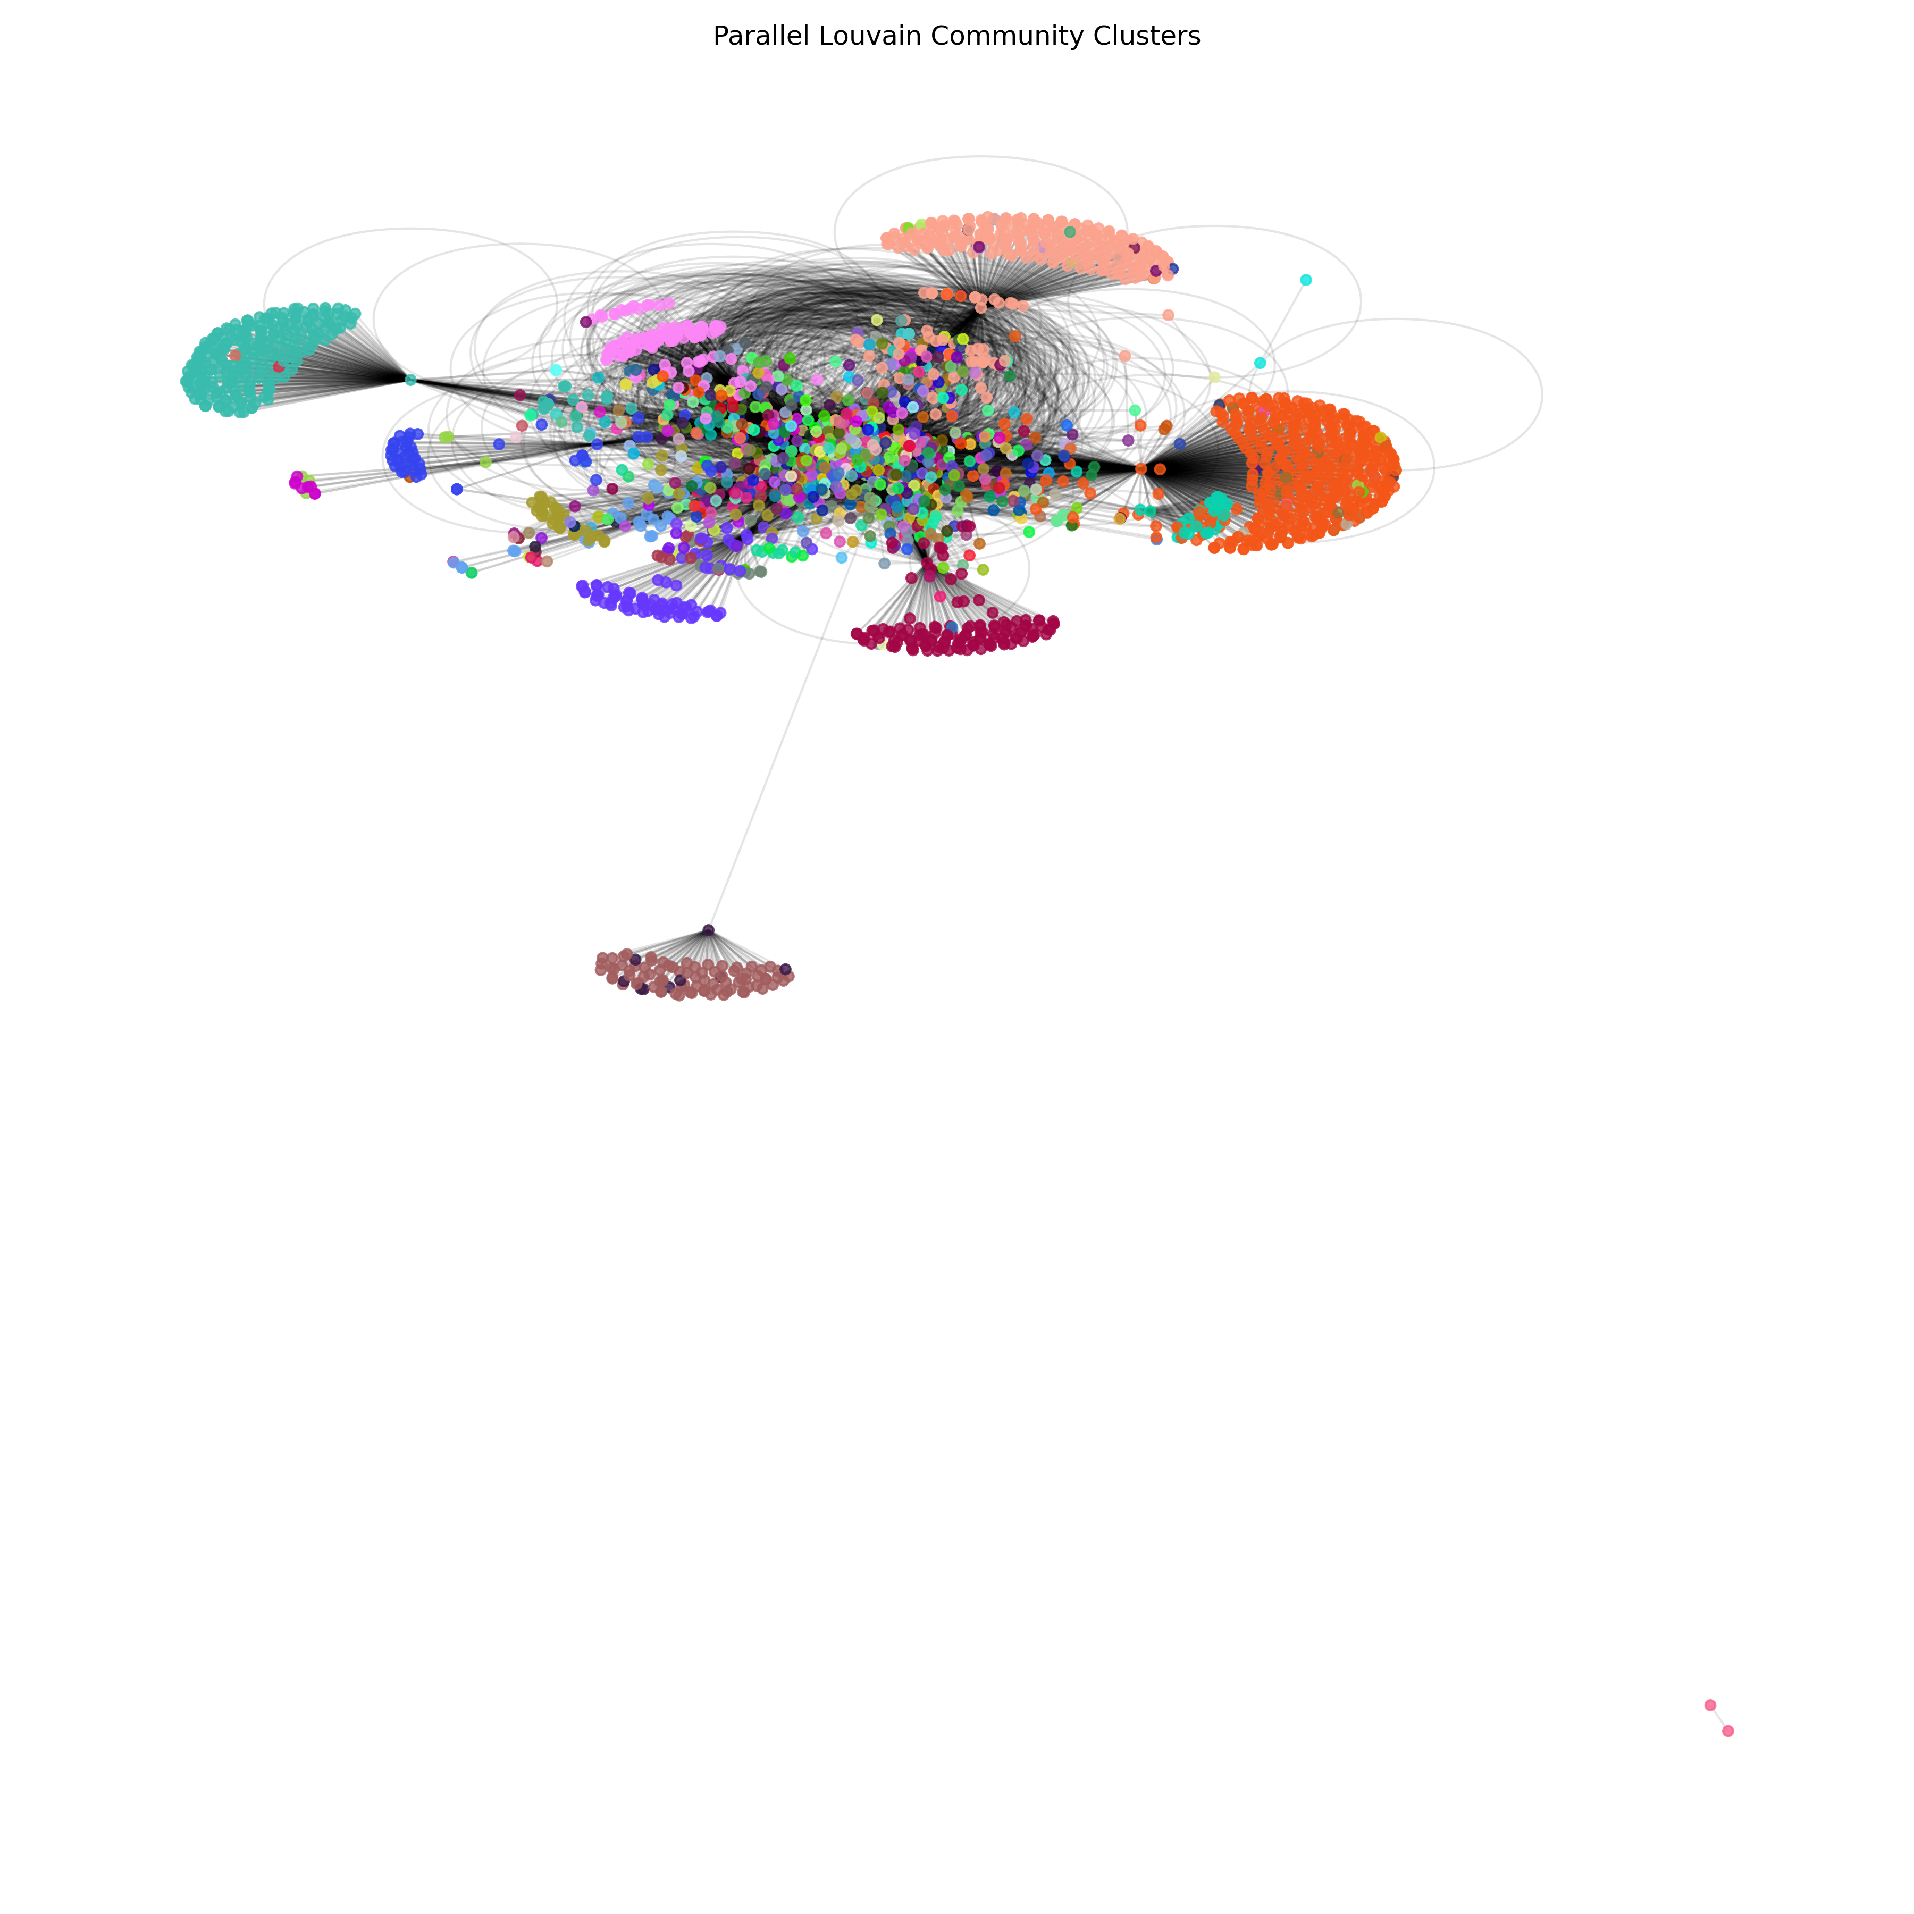
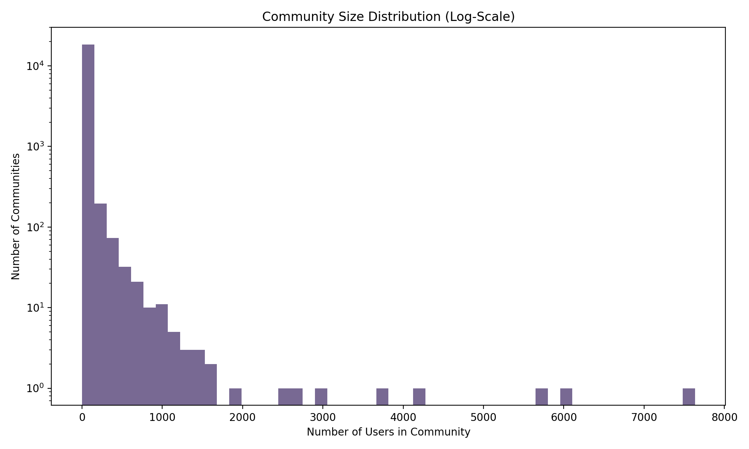
05 · Community Visualization
Key Observations
Louvain found many small communities and a few large dense clusters
Community size follows a power-law distribution
High modularity (0.83) indicates strong community structure

Slide 10
06 · Conclusion
Key Takeaways
Future Scope
✓
Implemented Louvain in C — a clean, efficient serial baseline.
GPU acceleration with CUDA for massive speedup
Multi-level hierarchical Louvain (phase 2 aggregation)
Dynamic graph support — streaming community updates
Distributed memory on HPC clusters (multi-node MPI)
Weighted edge support for richer datasets
✓
Hybrid MPI + OpenMP parallelism achieves up to 4.7× speedup on large graphs.
✓
CSR format ensures cache-friendly memory access for sparse graph traversal.
✓
Modularity score of 0.83 confirms high-quality community partitioning.
✓
Communication overhead limits gains on small graphs — well-understood trade-off.

Slide 11
Thank You
Questions & Discussion
Dhruv Jindal
Lakshit Vedant
Yash Joshi
U23AI083
U23AI015
U23AI119
AI356 · High Performance Computing | B.Tech AI · 3rd Year
Built with C · MPI · OpenMP · Python

