Slide 1

Binary Visualization
Features Implemented:
Read in any file type
Create graph of frequency of adjacent pairs of bytes
Display graph using OpenGL in one hard-coded color scheme
Features
Planned:
Pretty graphical user interface!
Change color schemes on command
Save your favorite graphs with a single button click

Slide 2
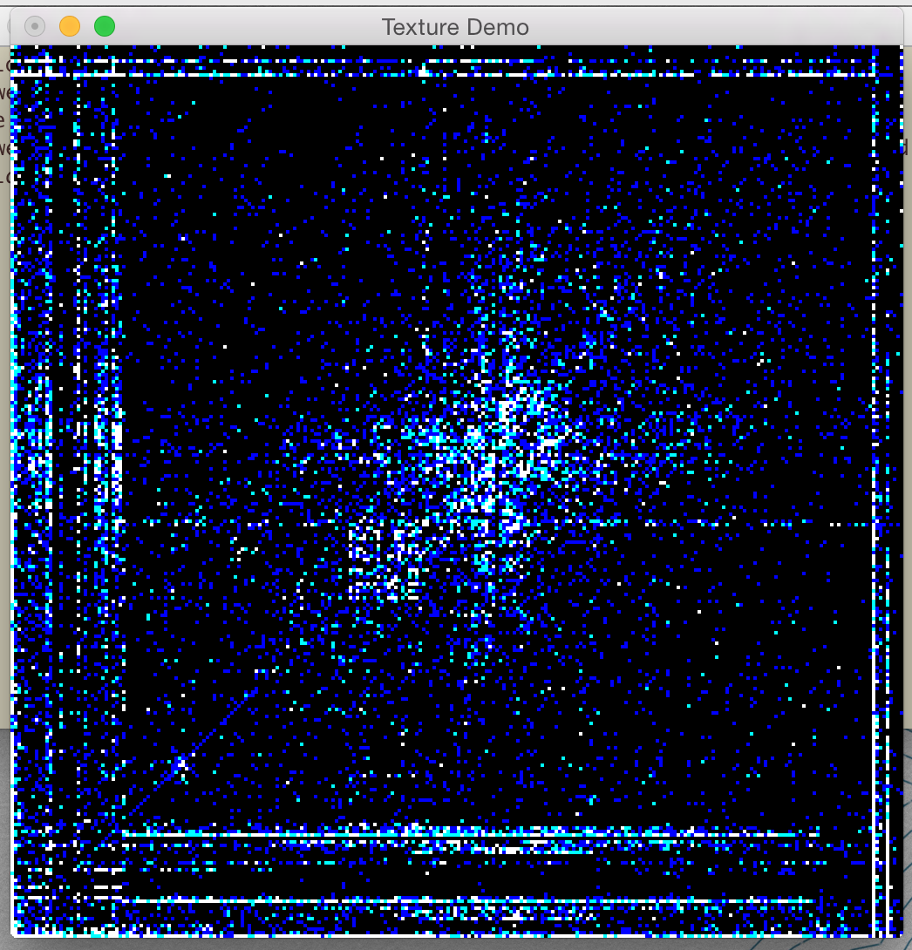
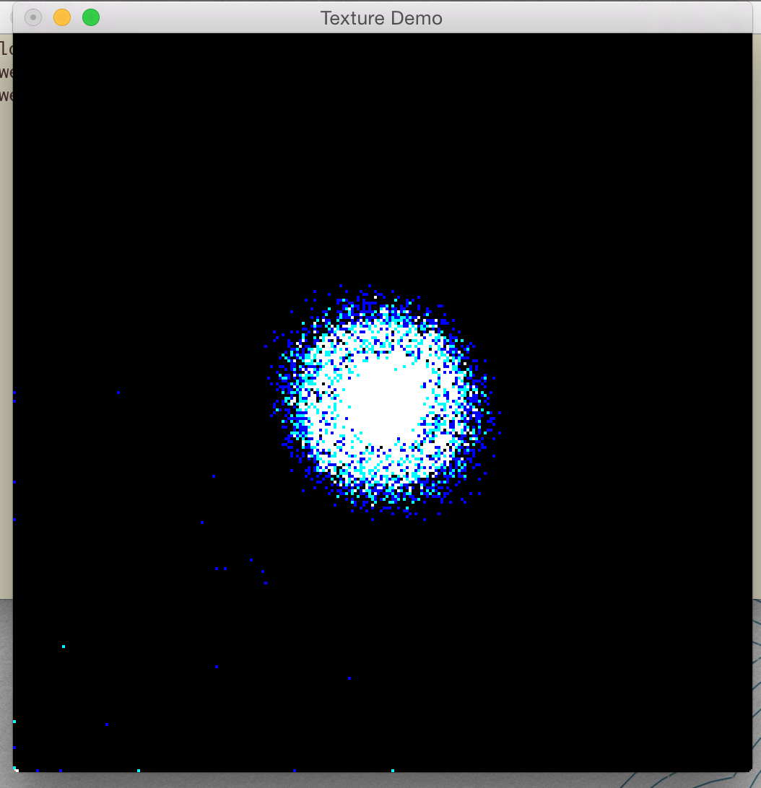
Example Graphs
OTF file
WAV file

Slide 3
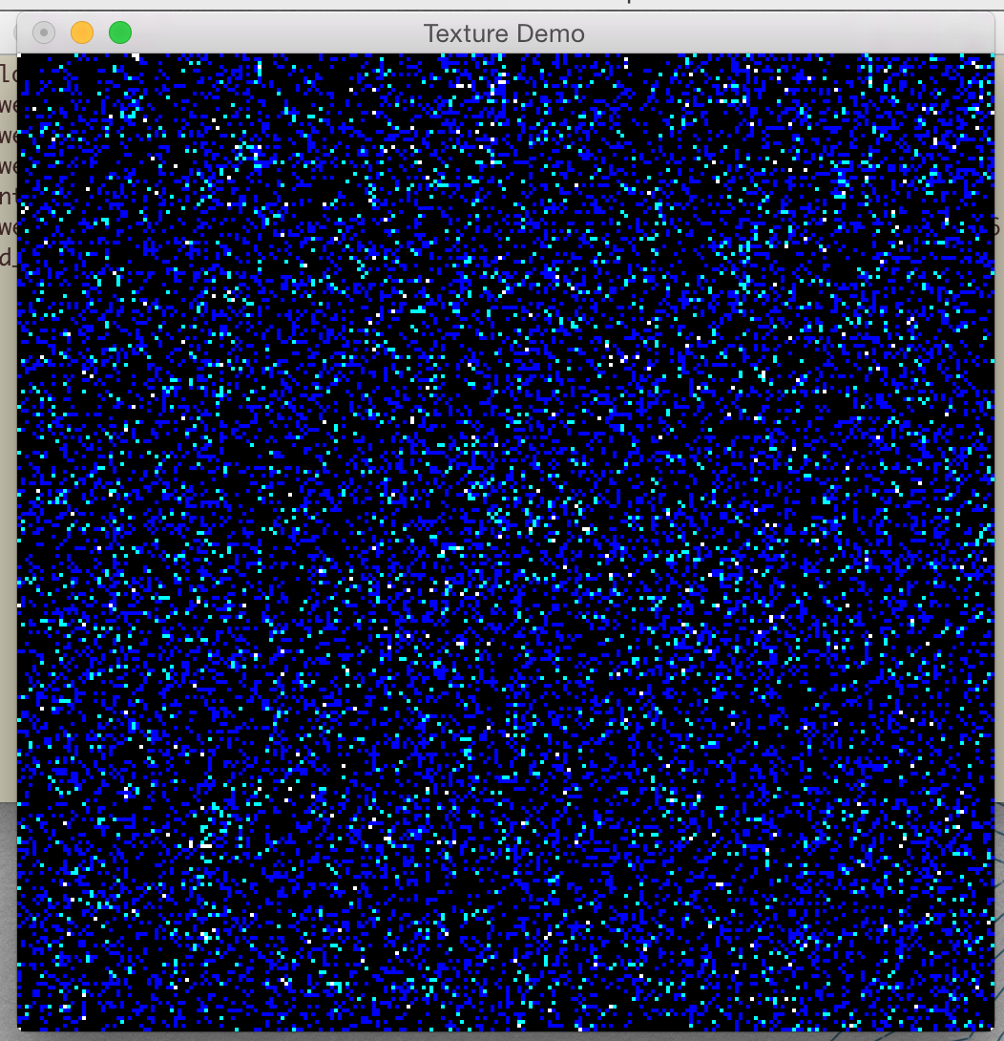
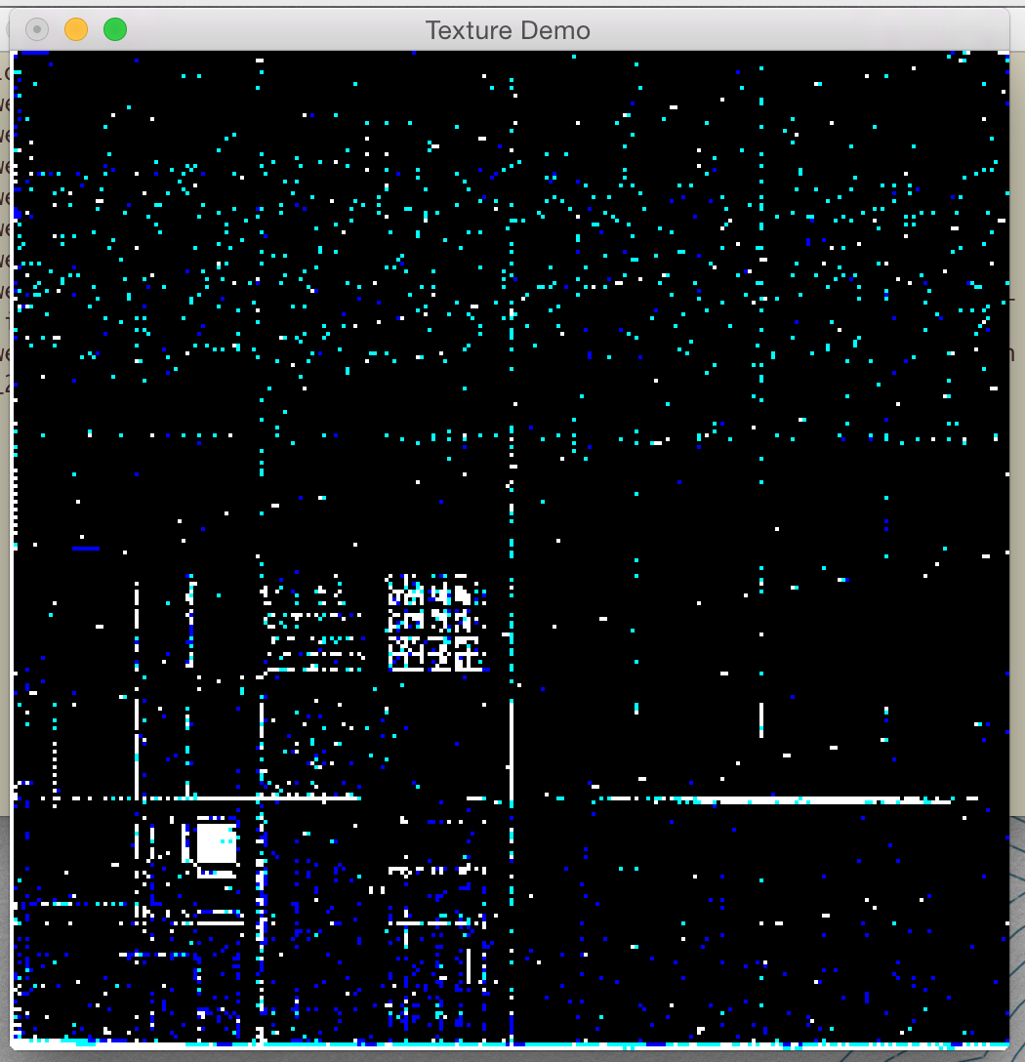
Example Graphs
PNG file
XLS file

