Slide 1
BLOOD DONOR
FINDER SYSTEM
Connecting Blood Donors with People in Need
Web-Based Application
Name: LALAM PADMINI
Roll No: 24VV1A1236

Slide 2
Problem Statement
• Finding a suitable blood donor during an emergency can be difficult and time-consuming.
• Traditional methods often depend on phone calls, personal contacts and social media.
• Manual donor and request management makes it difficult to track availability and responses.
• A centralized system is needed to connect blood seekers, donors and administrators efficiently.

Slide 3
Objectives
• Provide a centralized platform for blood donor registration.
• Allow users to search available donors by blood group and location.
• Enable users to create and track blood requests.
• Allow donors to accept or decline pending requests.
• Provide administrators with centralized control over users, donors, requests and inventory.
• Reduce the time required to find suitable blood donors.

Slide 4
Proposed System
• The application connects people who need blood with registered donors through a web-based platform.
• Users can register, log in, create donor profiles and submit blood requests.
• Other users can view pending requests from other users and respond to them.
• Requesters can view donor responses and track the status of their requests.
• Administrators can manage users, donors, requests, responses and blood inventory.

Slide 5
User Module
• User registration and login
• Session-based authentication and logout
• User profile management
• Add donor information including blood group, age, gender and city
• Search available donors using blood group and city
• Create blood requests
• View and track personal requests
• View donor responses

Slide 6
Donor & Request Management
• Donor profiles store blood group, age, gender, city, availability and last donation date.
• Users can view pending requests created by other users.
• Request ID and donor ID are handled automatically during donor responses.
• Donors can accept or decline a pending request.
• Accepted responses update the request status to APPROVED.
• Declined responses are stored while the request remains available for other donors.

Slide 7
Technology Stack
• Frontend: JSP, HTML, CSS and JavaScript
• Backend: Java Servlets
• Database: MySQL
• Application Server: Apache Tomcat
• Database Connectivity: JDBC
• Development Environment: Eclipse
• Database Management: MySQL Workbench

Slide 8
System Workflow
• Register / Login
• Create Request
• View Pending Requests
• Enter the system
• Submit blood requirement
• See other users' requests
• Admin Management
• Track Status
• Donor Response
• Manage system data
• Requester sees progress
• Accept or decline
• End-to-end coordination between requesters, donors and administrators.

Slide 9
Database Design
• users – stores registered user information
• donors – stores donor profiles and availability
• requests – stores blood requirements and request status
• donor_responses – stores donor responses to requests
• admin – stores administrator login information
• blood_inventory – stores available blood units
• Foreign keys maintain relationships between users, donors, requests and donor responses.
• The relational schema is designed using normalization principles up to 3NF.

Slide 10
Admin Module
• Separate admin login and session management
• Admin dashboard with system statistics
• Manage registered users
• Manage registered blood donors
• Manage blood requests
• View donor responses
• Add and update blood inventory units
• Monitor overall system activity.

Slide 11
Blood Inventory
• Maintain available units for each blood group.
• Admin can add a blood group when it is not already present.
• Admin can update the available units for an existing blood group.
• Inventory records store the last updated timestamp.
• Low-stock conditions can be highlighted for faster monitoring.

Slide 12
Advantages
• Centralized blood donor and request management
• Faster donor discovery
• Reduced manual communication
• Clear request and response tracking
• Automatic handling of donor and request identifiers
• Admin control over the complete system
• Organized blood inventory management
• User-friendly web interface

Slide 13
Future Enhancements
• Emergency blood request prioritization
• In-app and email/SMS notifications
• Nearby donor search using maps and location services
• OTP-based authentication
• Advanced admin analytics and reports
• Blood bank integration
• Mobile application support
• Donor eligibility and donation reminders

Slide 14
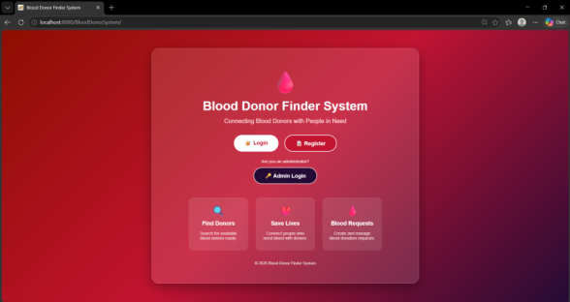
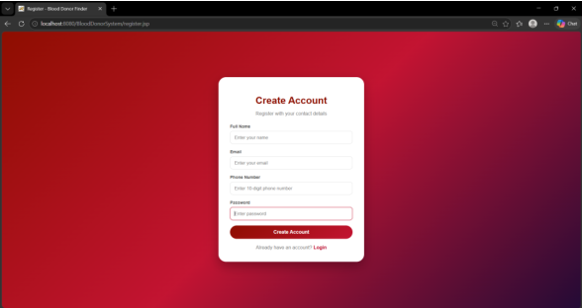
Application Entry & Registration
Welcome Page
Register Page
BLOOD DONOR FINDER SYSTEM • PROJECT OUTPUTS

Slide 15
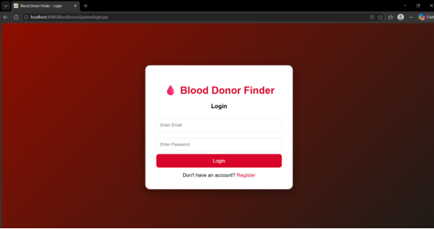
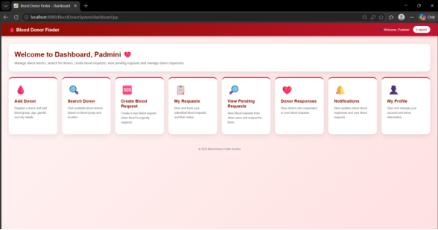
User Authentication
Login Page
User Dashboard
BLOOD DONOR FINDER SYSTEM • PROJECT OUTPUTS

Slide 16
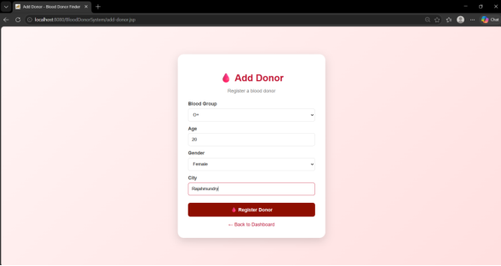
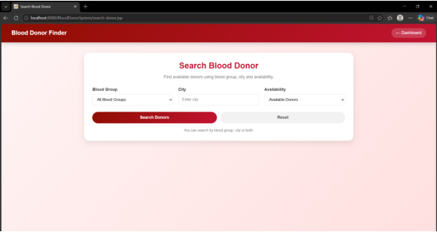
Donor Registration & Search
Add Blood Donor
Search Blood Donor
BLOOD DONOR FINDER SYSTEM • PROJECT OUTPUTS

Slide 17
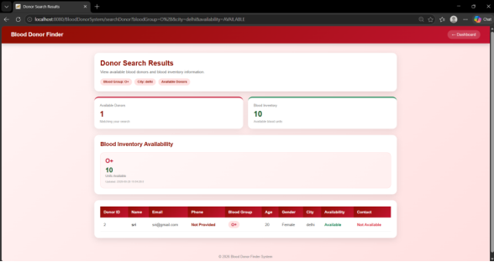
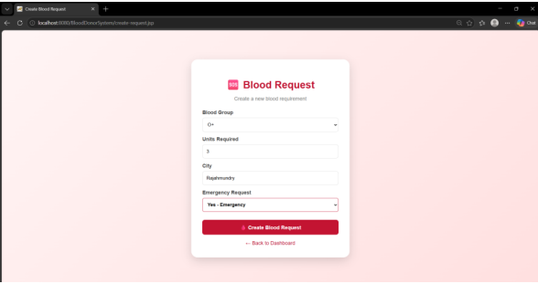
Donor Search & Request Creation
Donor Search Results
Create Blood Request
BLOOD DONOR FINDER SYSTEM • PROJECT OUTPUTS

Slide 18
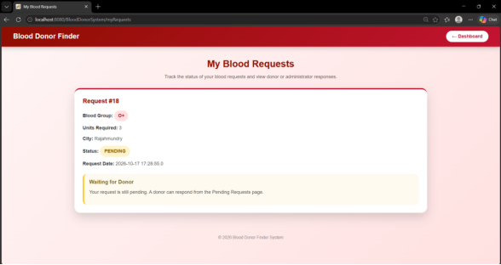
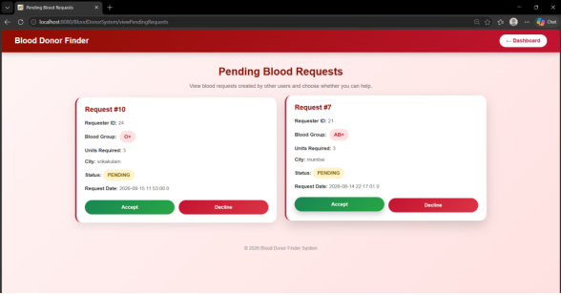
Request Tracking
My Blood Requests
Pending Blood Requests
BLOOD DONOR FINDER SYSTEM • PROJECT OUTPUTS

Slide 19
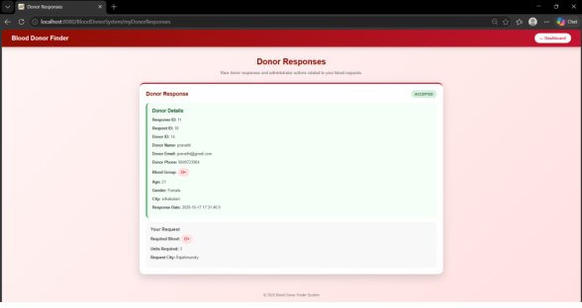
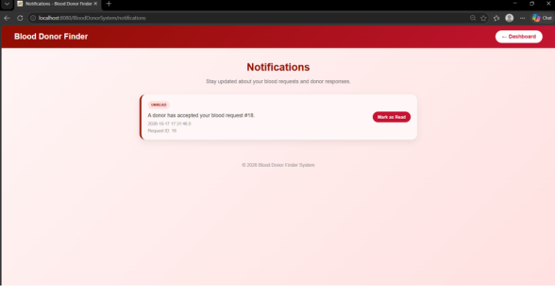
Responses & Notifications
Donor Responses
Notifications
BLOOD DONOR FINDER SYSTEM • PROJECT OUTPUTS

Slide 20
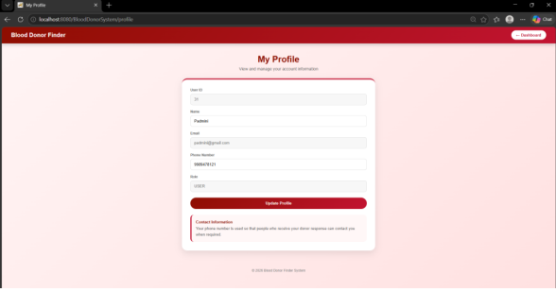
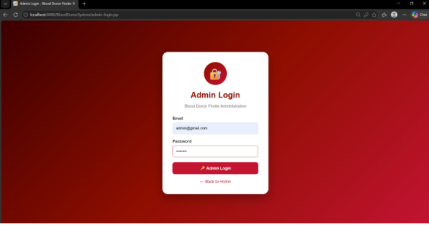
Profile & Administrator Access
User Profile
Admin Login
BLOOD DONOR FINDER SYSTEM • PROJECT OUTPUTS

Slide 21
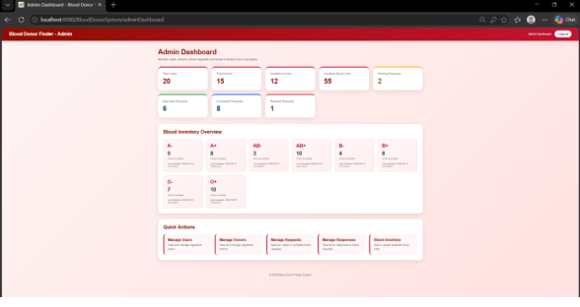
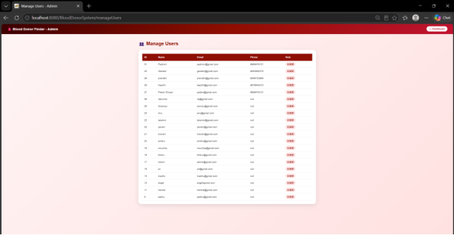
Administrator Dashboard & Users
Admin Dashboard
Admin Manage Users
BLOOD DONOR FINDER SYSTEM • PROJECT OUTPUTS

Slide 22
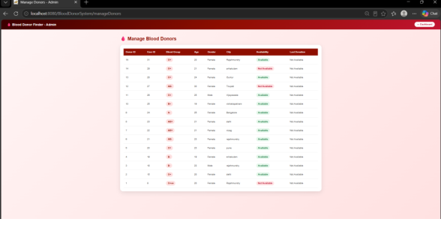
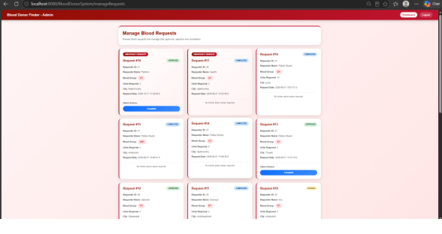
Donor & Request Administration
Admin Manage Donors
Admin Manage Requests
BLOOD DONOR FINDER SYSTEM • PROJECT OUTPUTS

Slide 23
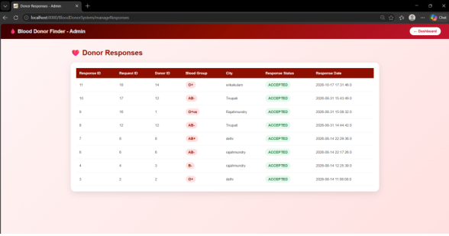
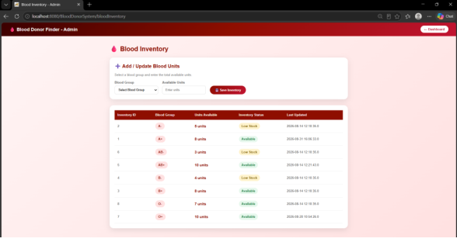
Response Management & Blood Inventory
Admin Manage Responses
Admin Blood Inventory
BLOOD DONOR FINDER SYSTEM • PROJECT OUTPUTS

Slide 24
Conclusion
• The Blood Donor Finder System provides a centralized platform for connecting blood donors with people in need.
• It supports donor registration, donor search, blood requests, responses and request status tracking.
• The admin module improves monitoring of users, donors, requests, responses and blood inventory.
• The system provides a strong foundation for a scalable blood donation support platform.

Slide 25
THANK YOU
Blood Donor Finder System
Connecting donors, requests and lifesaving support through one platform.

