Slide 1

SEMESTER PROJECT - FINAL PRESENTATION
COORDINATION AND CONTROL OF A GROUP OF GROUND ROBOTS
COORDINATION AND CONTROL OF A GROUP OF GROUND ROBOTS

Slide 2
Motivation
What ?
Create a practical testing environment :
Flexible
Modulable
Easy to use / Easy to setup
Why ?
No existing open-source projects with JetBots and multi-agent control
Enable real life conditions testing
How ?
ROS2
Jetbots
Optitrack
Notes:
Red issues are the main ones especially challenging because no similar projects
Architecture is highlighted because it directly depends on the various issues faces and solutions found

Slide 3
Background
ROS2
Robotic Operating System
Set of software libraries and tools for building robot applications
Real-time control
Added support for multi-robot system
Jetbot
Open-source ground robots
NVIDIA Jetson Nano
GPU
Camera

Slide 4
Challenges
ROS2
Network connection
Architecture
Real time position tracking
Flexibility
Easy to use / to setup
Jetbots
OS configuration
Control
Task Assignment [TA]
System compatibility
Notes:
Red issues are the main ones especially challenging because no similar projects
Architecture is highlighted because it directly depends on the various issues faces and solutions found

Slide 5
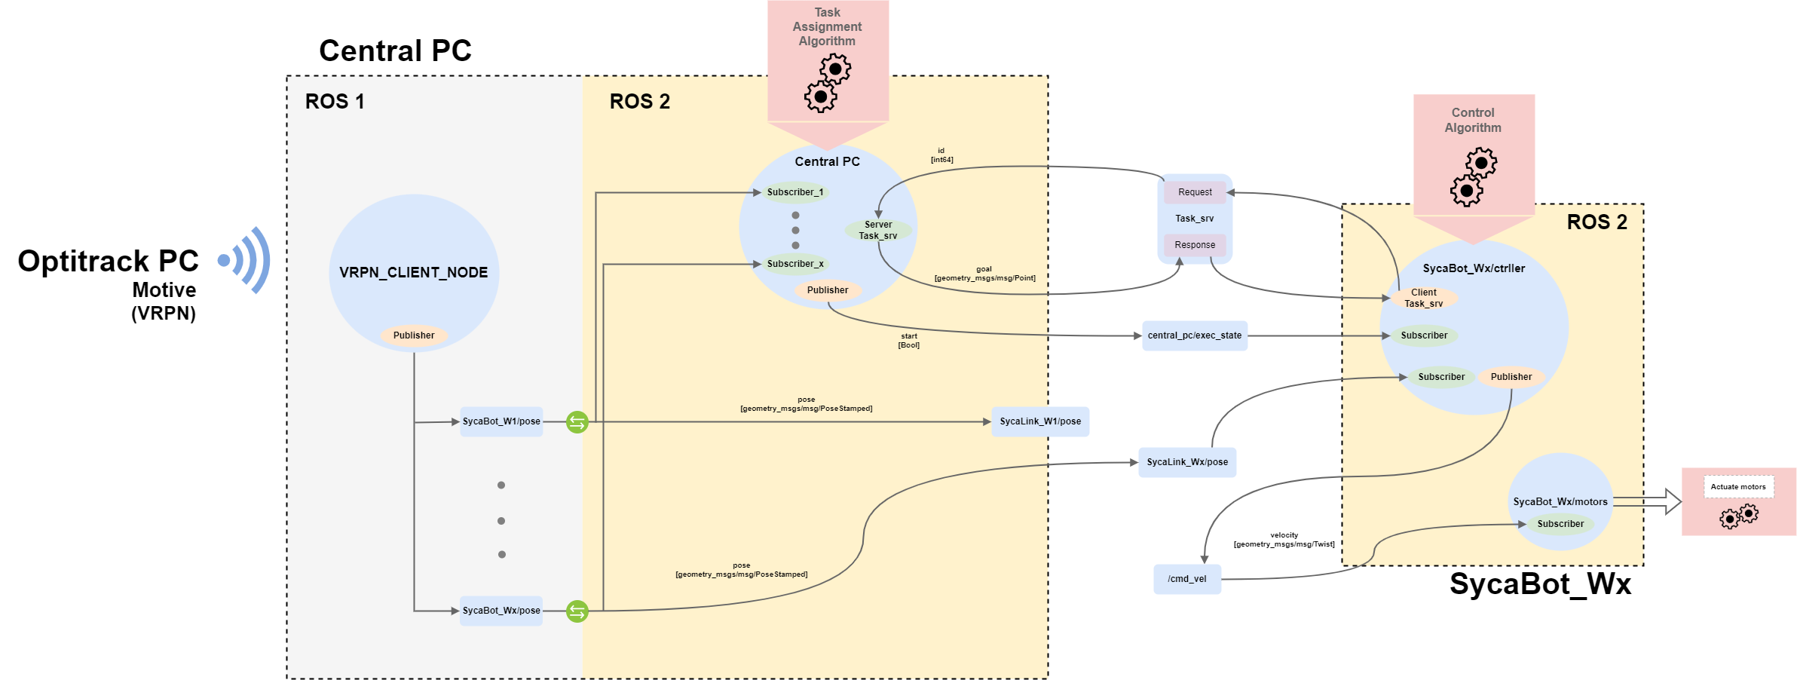
General architecture
Wireless Communication
Notes:
ROS2 is made of node (blue circle)
To communicate :
Topics
Services
Communication flow

Slide 6
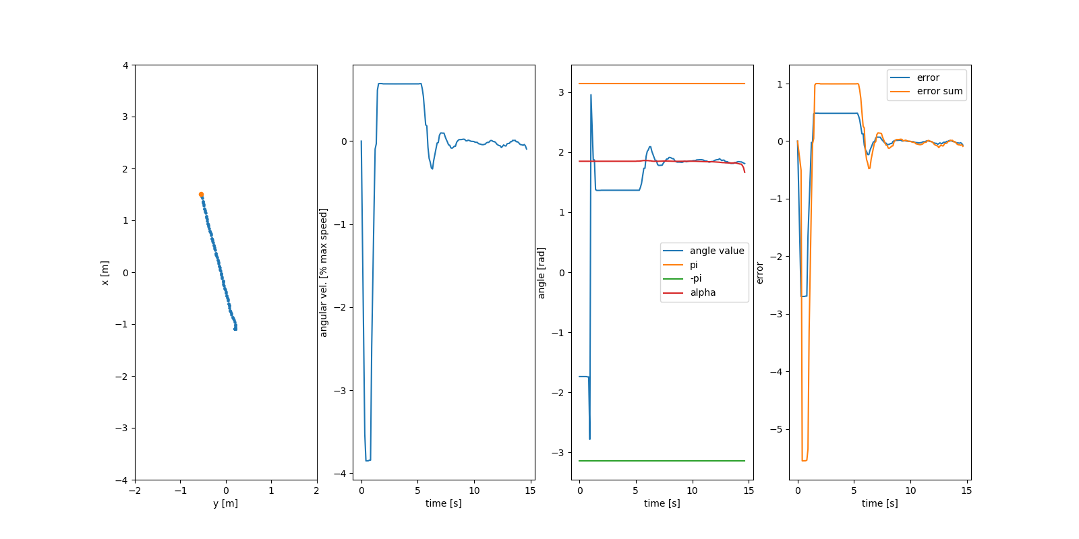
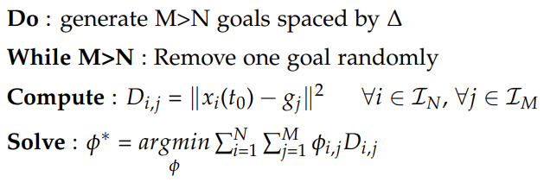
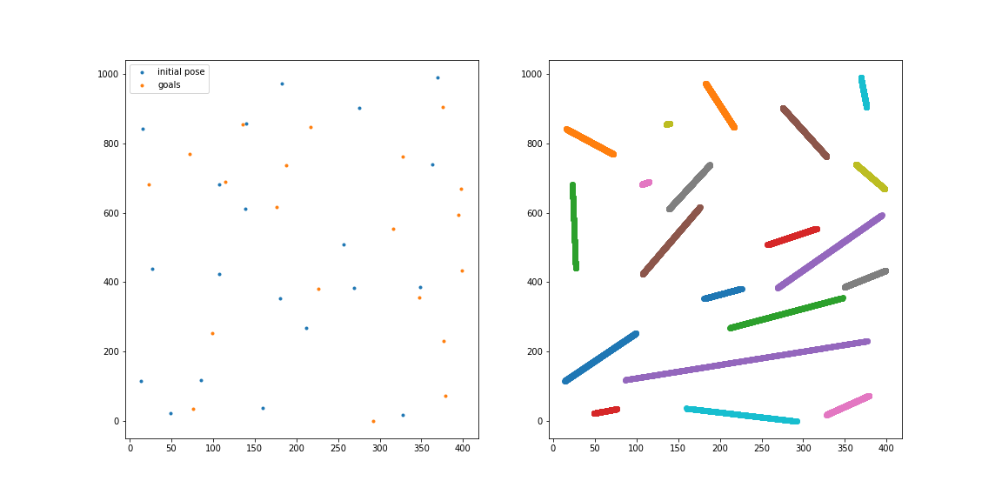
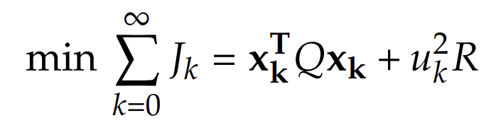
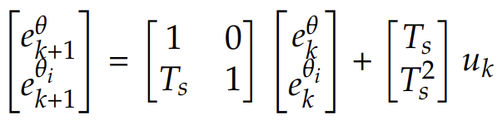
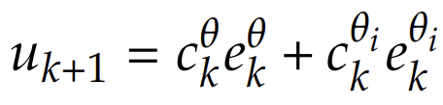

TA & Control
C-CAPT with N robots and M goals & LQR
C-CAPT with N robots and M goals
Discrete LQR
Initial poses and goal locations
TA with N=20 and $\text{Δ}=2√2R$
Matthew Turpin, Nathan Michael, and Vijay Kumar. “Capt: Concurrent assignment and planning of trajectories for multiple robots”
Notes:
If delta = 2sqrt(2)R then no collisions.

Slide 7

Demonstration

Slide 8
Open issues – Future work
Open Issues
Wireless communication
Docker
Future work
MPC
Safe learning
Cameras
Performance analysis

Slide 9
Thank you for your attention

