Slide 1


“POLITEHNICA” University of Timisoara Faculty of Automation and Computers Department of Computer and Software Engineering
Metabolic Network Activity Modeling
Supervisor: Lect. Dr. Eng. Versavia ANCUSA
Author: Eng.Larisa MOCU

Slide 2
Complex Networks
Set of items or objects, usually called nodes or vertices, which are connected through edges
Complex networks are the skeleton of complex systems in the real-world
Known as networks with non-trivial topology and dynamics

Slide 3
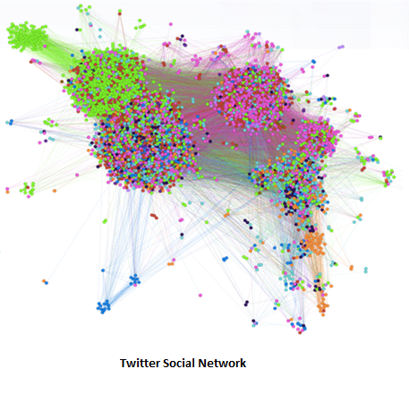
Complex Networks
Networks are all around us!

Slide 4
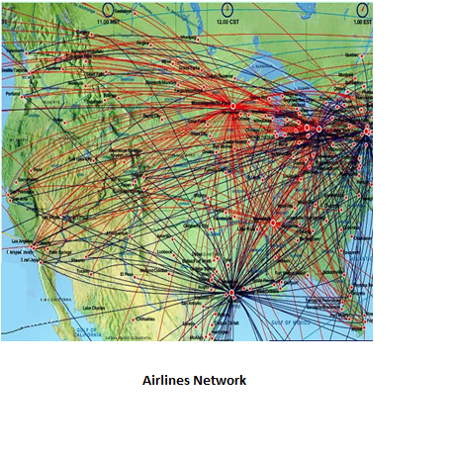
Complex Networks

Slide 5
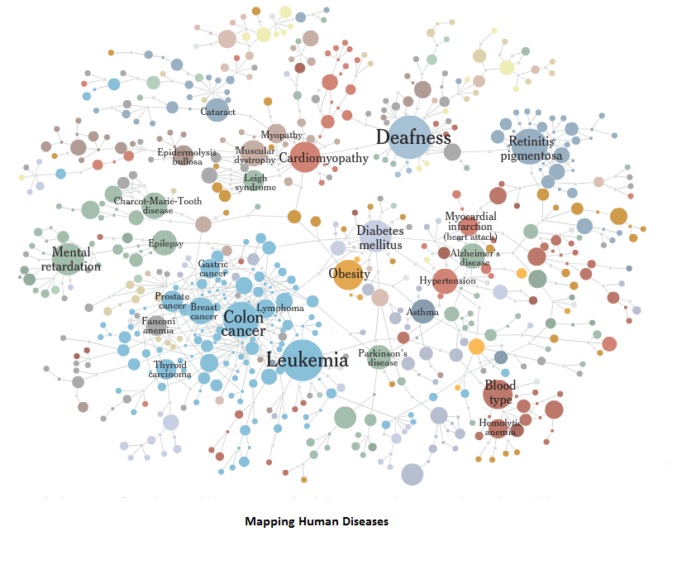
Introduction – Complex Networks

Slide 6
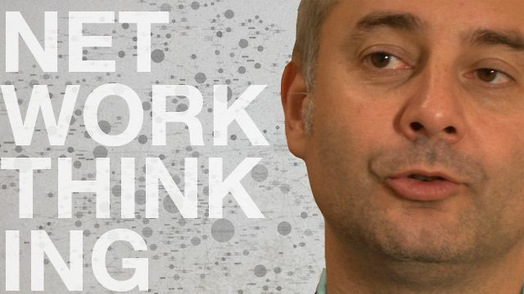
Complex Networks

Slide 7
Introduction – Complex Networks
Albert – Laszlo Barabasi - best known for his work in the research of network theory
He introduced the concept of “scale-free” networks
Contributions in network medicine/biology – the concept of “diseasome”

Slide 8
Complex Networks
Properties
- Betweeness Centrality
- Closeness Centrality
- Average Path Length
- Average Clustering Coefficient
- Average Degree
- Modularity
- Graph Density

Slide 9
Metabolic Networks – Previous Models
Medical (bio-chemistry)
A very simplified one presented on the right
Widely used
No clear quantitative/qualitative data
An assiduous research area
Albert Barabasi
Massive simulation
Facilitates analysis & correlations
Used & validated by specialists
Uses known interaction for genes
Static
Does not mention regulation direction
Only 10% genes are studied untill now
Paul Smolen
Similarities to computer processes
Dynamic
Does not include re-triggers
Does not extrapolate the network
No correlations
Gene up-regulated in ADN
Copy gene in ARN in reverse
siRNA
mRNA
Other RNA
Select amino acids’ code
Filter “junk”
Always 4 codes
Each code has 3 segments
Create protein from selected amino acids
Concatenate amino-acids
Protein folds
Protein becomes stable
Release in the bloodstream
When protein concentration ok, down-regulate gene
Up-regulate and/or down-regulate other genes/proteins

Slide 10
(Quasi) Similar Processes
Gene up-regulated in ADN
Copy gene in ARN in reverse
Select amino acids’ code
Create protein from selected amino acids
When protein concentration ok, down-regulate gene
Message to transmit
Copy message to buffer + code
Decode message from bus
Transmit message on bus
When message received ok, clear message from queue

Slide 11


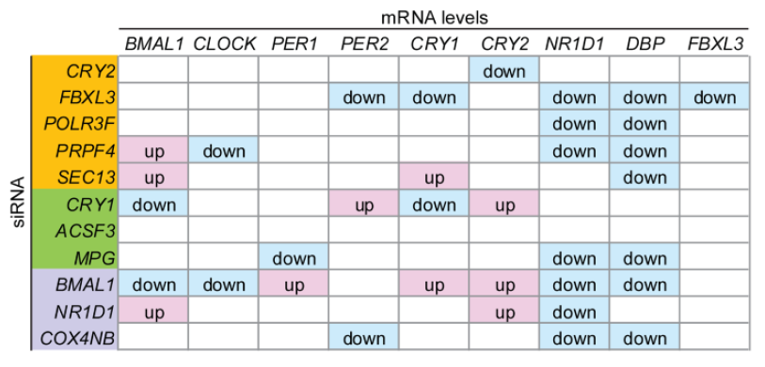
Medical data issues
Problem: Proteins and genes are mixed
Solution: genes are proteins, so treat them all the same
Ok by doctors
Problem: siRNA ≠ mRNA
Solution: siRNA activates, so take siRNA into account as initiator and mRNA as a result else treat them both the same
[1] Fig. 1

Slide 12
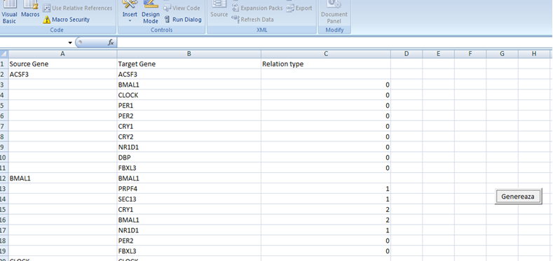
Modeling clock gene network – database processing

Slide 13
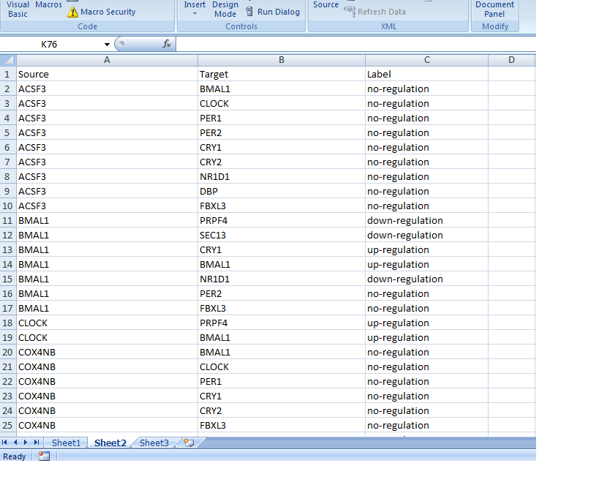
Modeling clock gene network – database processing

Slide 14
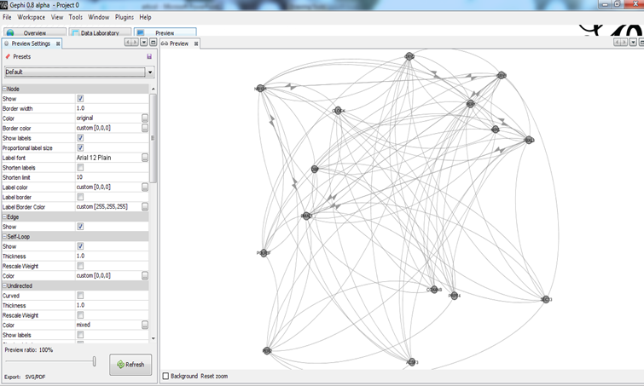
Modeling clock gene network – Gephi simulation

Slide 15
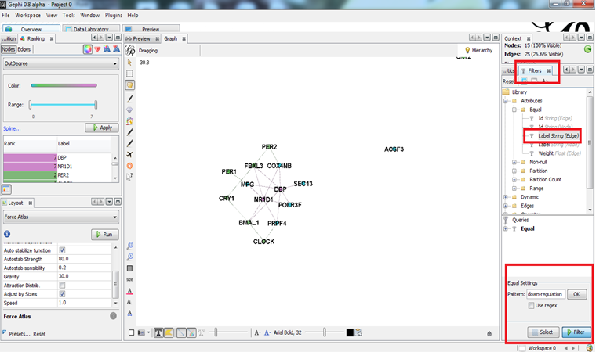
Modeling clock gene network – Gephi simulation

Slide 16
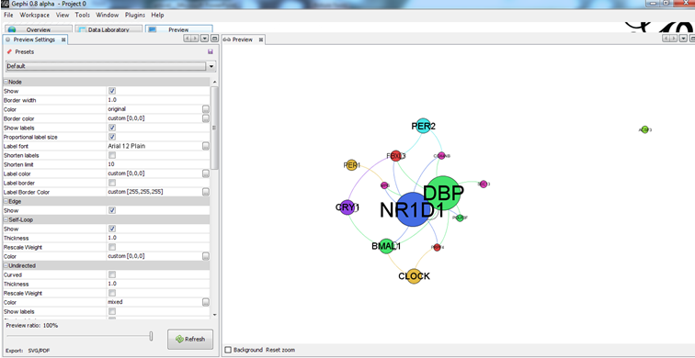
Modeling clock gene network – Gephi simulation

Slide 17
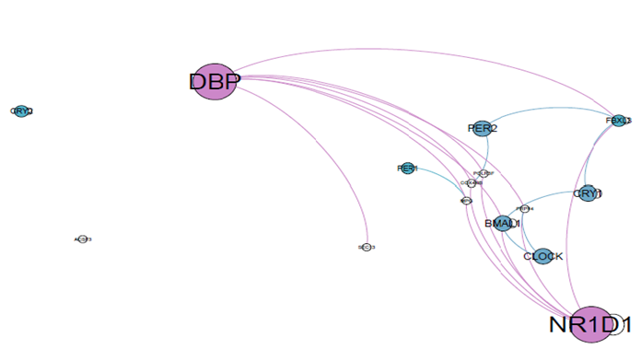
Modeling clock gene network – Gephi simulation results
Most down-regulated genes

Slide 18
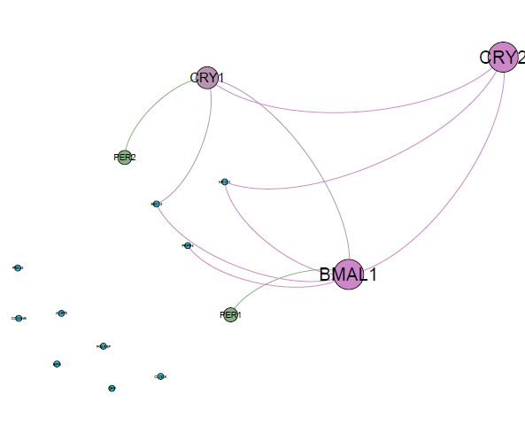
Modeling clock gene network – Gephi simulation results
Most up-regulated genes

Slide 19
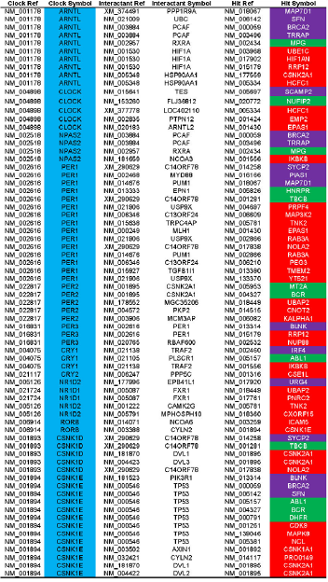
Modeling metabolic networks – protein interaction network analysis
[1] Fig. 2

Slide 20
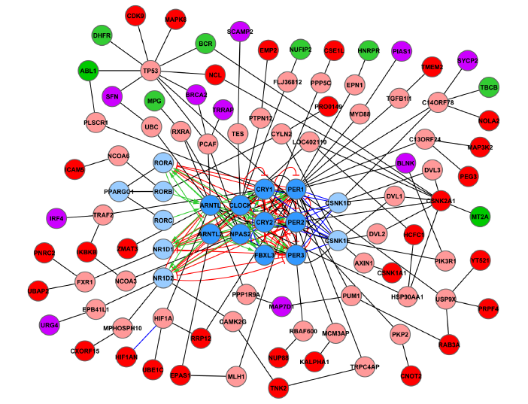
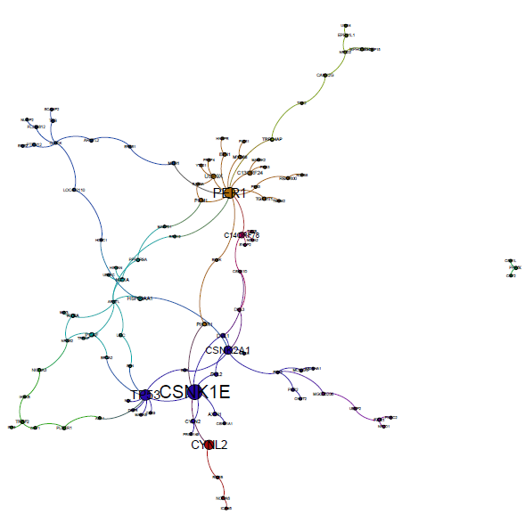
Modeling metabolic networks – protein interaction network analysis

Slide 21
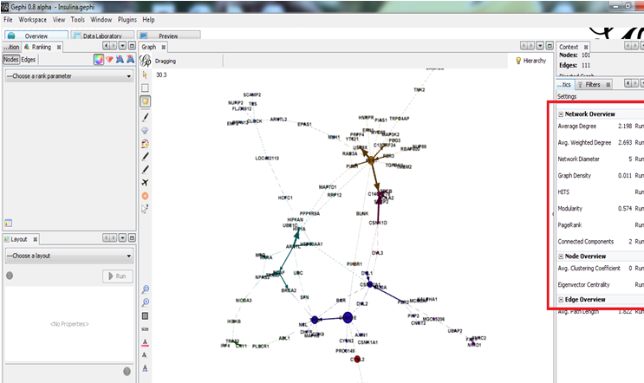
Modeling metabolic networks – protein interaction network analysis using gephi

Slide 22
Conclusions

Slide 23
References
[1], [2] - Eric E. Zhang, Andrew C. Liu, Tsuyoshi Hirota, Loren J. Miraglia, Genevieve Welch, Pagkapol Y. Pongsawakul, Xianzhong Liu, Ann Atwood, Jon W. Huss, Jeff Janes, Andrew I. Su, John B. Hogenesch, Steve A. Kay, A Genome-Wide RNAi Screen for Modifiers of the Circadian Clock in Human Cells

