Slide 1

A Project Report On “CREDIT DECISION MAKING SYSTEM” Presented by
LALATENDU NAYAK (1901060145)
DINESH KUMAR GOUDA (1901060323)
KAUSTUV PATRA (1901060103)
.
Under the guidance of
Prof. Murali kr. Senapaty
DEPARTMENT OF COMPUTER SCIENCE & ENGINEERING
GIET UNIVERSITY, GUNUPUR-765022
2023

Slide 2

Table of content
Objective
Problem statement
Process
Software Requirements
Dataset description
Target variable
Models applied
Experimental results

Slide 3
Objective to create the model
The objective of the problem is to pick “whether the customer is able to pay the debt or not”.
The main objective of this project is to predict whether assigning the loan to particular person will be safe or not.
In this model we will predict the loan data by using some machine learning classification algorithms.
so we will build a model that will help them identify the potential customers who have a higher probability of purchasing the loan.

Slide 4
Problem statement
Bank has majority customers who are borrowers / depositers with varying deposit amount.
Bank has a quite small number of borrowers or asset customers.
So in order to increase the customers base the bank is interested to giving loan to customers .
So we have to predict whether the customer will be able to get the loan or not based on previous data.

Slide 5
Process
Data collection
Analysis of data
Data Pre-processing
Model training
Model testing
Deployment

Slide 6
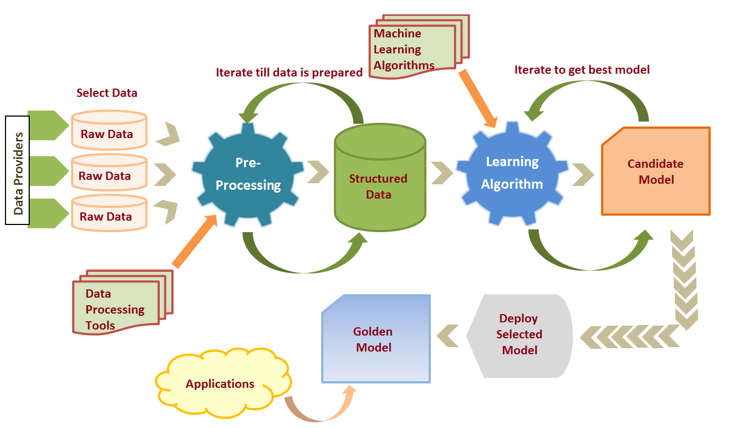
Process

Slide 7
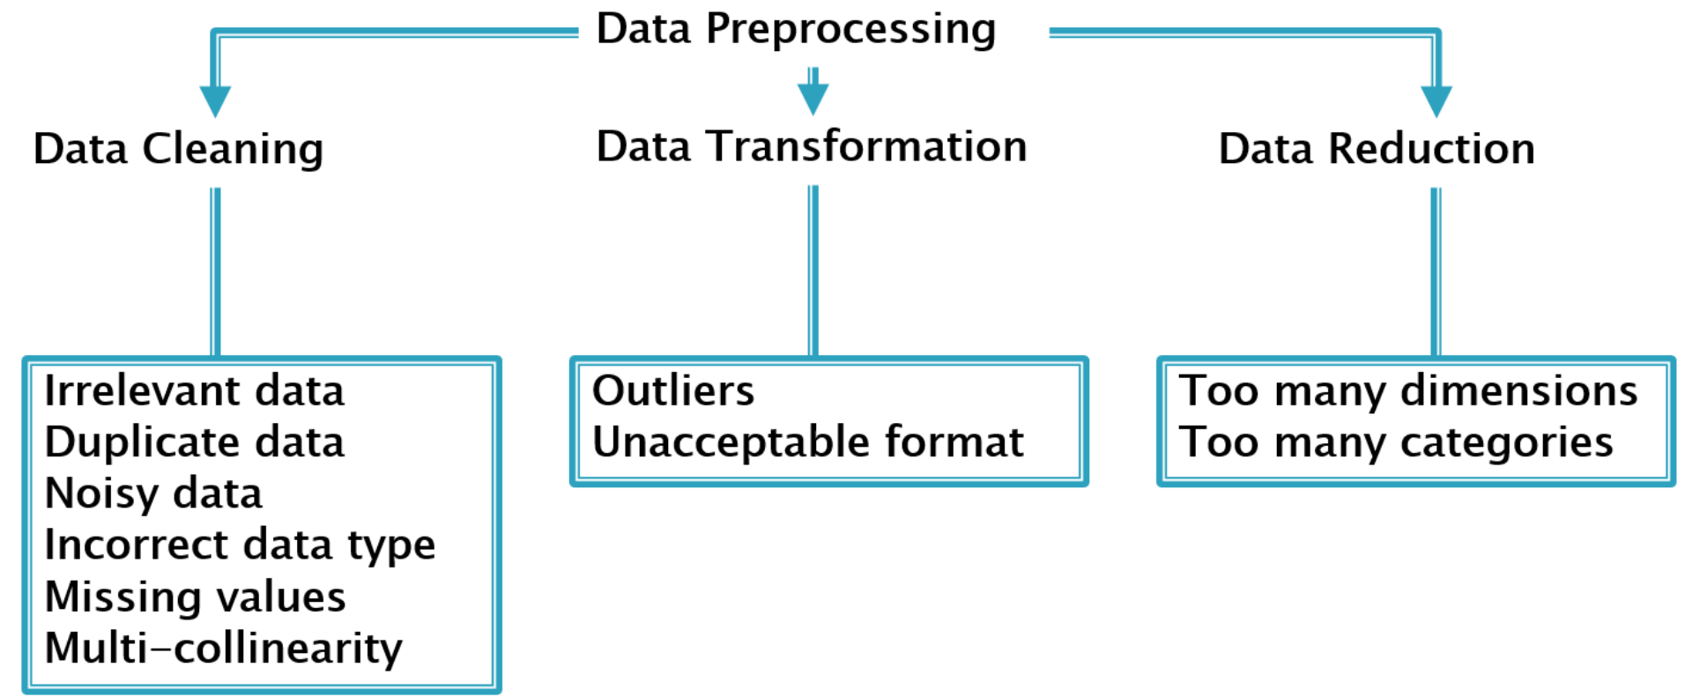
Data Preprocessing
Data pre-processing is a process of preparing the raw data and making it suitable for a machine learning model. It is the first and crucial step while creating a machine learning model.
GIET UNIVERSITTY, GUNUPUR

Slide 8
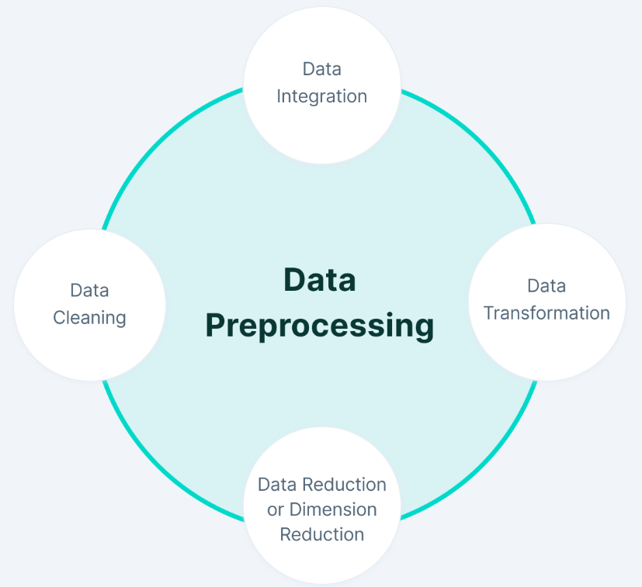
Data Preprocessing
Handling missing data
Encoding categorical data
Removing noisy data
GIET UNIVERSITTY, GUNUPUR

Slide 9
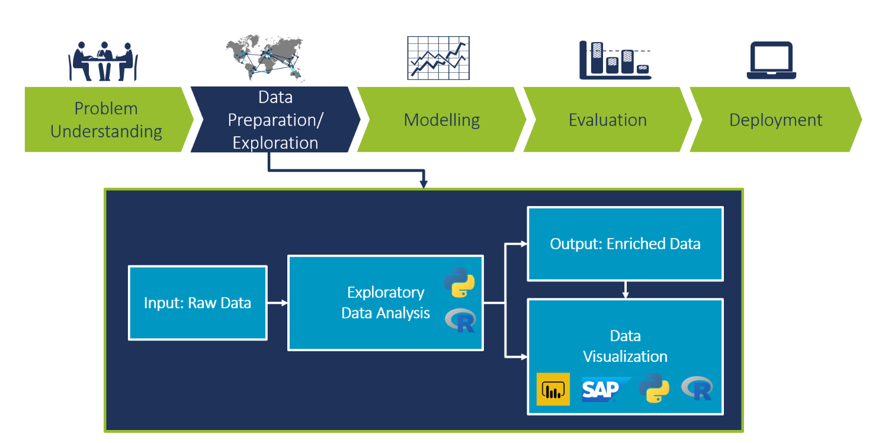
Exploratory Data Analysis
Exploratory data analysis is an approach of analyzing data sets to summarize their main characteristics.
It is the critical process of performing initial investigations on data so as to discover patterns and draw the graphical representation.
GIET UNIVERSITTY, GUNUPUR

Slide 10
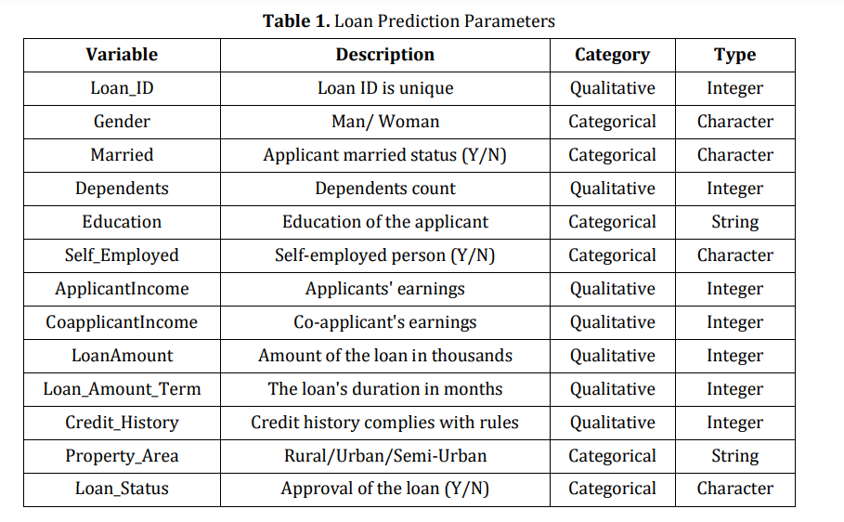
Data descriptions
GIET UNIVERSITTY, GUNUPUR

Slide 11
Models applied
SVM
Logistic regression
Decision Tree
Naive Baye’s Classifier

Slide 12

SVM
Support Vector Machine or SVM is a Supervised machine Learning algorithm, which is used for Classification as well as Regression problems.
primarily, it is used for Classification problems in Machine Learning.
GIET UNIVERSITTY, GUNUPUR

Slide 13
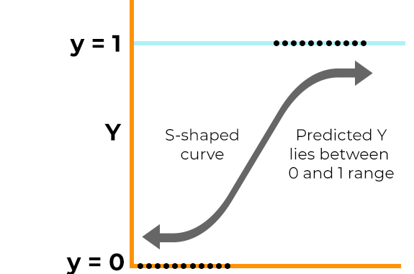
Logistic Regression
Logistic regression is a supervised learning classification algorithm used to predict the probability of a target variable.

Slide 14
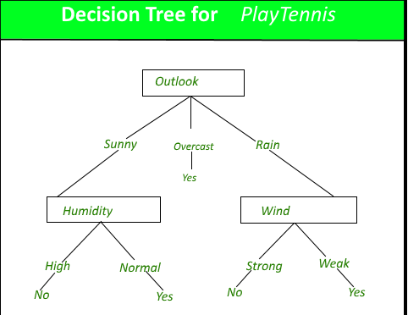
Decision Tree
A Decision tree is a flowchart-like tree structure, where each internal node denotes a test on an attribute, each branch represents an outcome of the test, and each leaf node holds a class label.

Slide 15
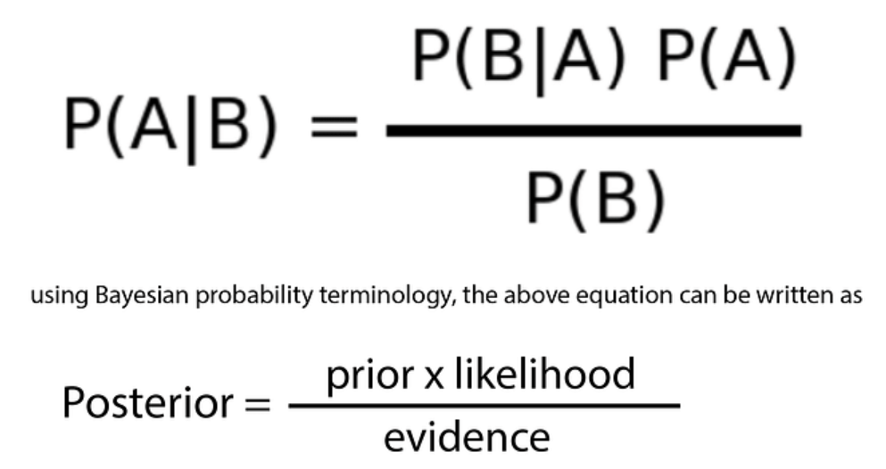
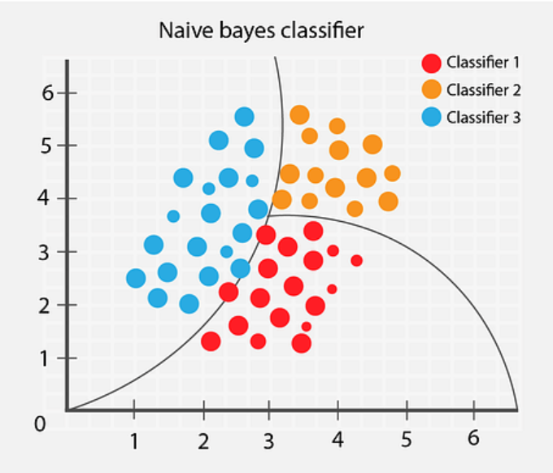
Naïve Bayes Classifier Algorithm
Naïve Bayes Classifier is one of the simple and most effective Classification algorithms which helps in building the fast machine learning models that can make quick predictions.
It is a probabilistic classifier, which means it predicts on the basis of the probability of an object.
GIET UNIVERSITTY, GUNUPUR

Slide 16
Experimental Result
MODEL | TRAINING ACCURACY | TEST ACCURACY
SVM | 0.79 | 0.77
Logistic Regression | 0.81 | 0.79
Decession tree | 1.0 | 0.67
Naive Baye’s Classifier | 0.80 | 0.79

Slide 17
Software requirements
Jupyter notebook
Python
Numpy
Pandas
Seaborn
Matplotlib

Slide 18



